Slide 1


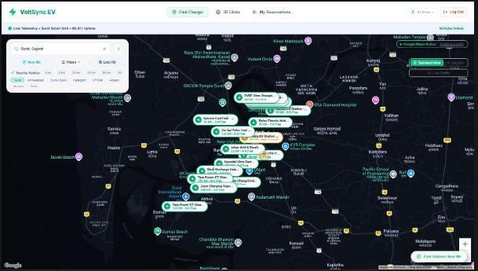
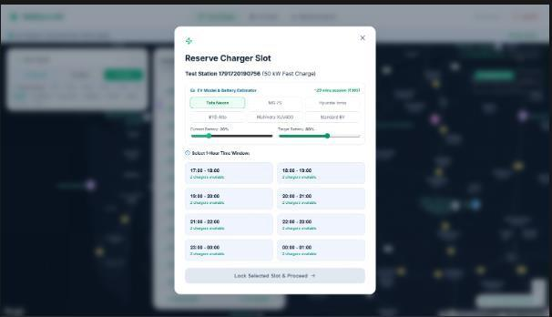
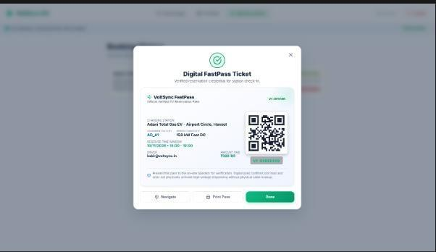
VoltSync: EV Charging Station Finder
& Booking System
Sabalpara Kabir Hasmukhbhai | Enrollment No. 23SE02CS092
Company Mentor: Mr. Brijesh Dhanani • Institute Mentor: Ms. Khushbu Chauhan
P P Savani University, School of Engineering | B.Tech Computer Science & Engineering, Semester 7
Internship Organisation: Roshni WebSolutions | 08 June – 03 October 2026
Introduction
Results and discussion
EV drivers may reach a charging station only to find that compatible chargers are occupied or unavailable.
Interactive station map and availability markers
VoltSync combines map-based station discovery, time-slot booking and operator controls to reduce uncertainty and prevent conflicting reservations.
Objectives
Find stations by connector, power, price and location.
Reserve an available slot with a five-minute lock.
Estimate charging time and energy cost.
Recommend a nearby free station when a hub is full.
Provide QR check-in and operator controls.
Methodology
Figure 2. Map-based station finder (project report screenshot).
1. Station discovery
Map 16 seeded hubs in Surat using a Leaflet-based interface.
2. Search and estimation
Filter stations and estimate charging time and energy cost.
3. Safe reservation
Acquire a temporary atomic lock for five minutes.
Figure 3. Slot selection and reservation lock.
Figure 4. Digital FastPass QR ticket.
4. Smart rerouting
Recommend nearby free stations using Haversine distance.
16
5 min
25 / 25
5. Check-in and operations
charging hubs
temporary slot lock
regression tests passed*
Generate FastPass QR; operators manage stations and charger status.
Atomic locks and a unique partial index protect active reservations from double-booking.
System architecture
Reported deployment: Vercel frontend, Render API and MongoDB Atlas database.
Decoupled client-server application with a stateless REST API and cloud database.
*Test totals and project metrics are reproduced from the supplied final report.
Driver / Operator
React 18 + Vite
Express REST API
MongoDB Atlas
The report describes Leaflet.js mapping and MongoDB geospatial / compound unique partial indexes for location queries and booking integrity.
Testing and validation
Figure 1. VoltSync application architecture.
Testing area
Tests
Passed
Failed
Booking integrity and fallback
Functional
8
8
0
Integration
6
6
0
Reservation lifecycle
System
4
4
0
Performance
4
4
0
Select
slot
Atomic lock
(5 minutes)
Payment
confirmation
FastPass
QR ticket
User acceptance
3
3
0
Total: 25 reported tests; all passed in the final project report.
If the lock expires or another booking has it, the slot is released or the API returns a conflict.
Conclusion
When a station is full, VoltSync can recommend the nearest operational alternative using Haversine distance.
VoltSync brings station discovery, slot booking, charging estimates, QR check-in and operator controls into one responsive web application.
Technology and security
The final report states that the app was deployed to cloud hosting and validated with automated regression and additional tests.
TECHNOLOGY STACK
SECURITY CONTROLS
Limitations and future work
Frontend: React 18, Vite
Backend: Node.js, Express.js
Database: MongoDB Atlas
Maps: Leaflet.js
Hosting: Vercel, Render, Atlas
• bcryptjs salted password hashing
• JWT authentication
• Driver / Operator RBAC
• IDOR protection on reservations
• NoSQL query sanitization
LIMITATIONS
FUTURE WORK
• Simulated payments only.
• No physical charger integration.
• No native mobile app.
• Live payment integration.
• Charger telemetry / OCPP.
• Real-time updates and alerts.
• Expanded user testing.
Deployment
PRODUCTION HOSTING
DOCUMENTED SCOPE
References
Frontend: Vercel
Backend API: Render
Database: MongoDB Atlas
Responsive web application; simulated payment; no physical charging hardware integration.
1. VoltSync – EV Charging Station Finder & Booking System, Final Project Report, P P Savani University, October 2026.
2. Internship / UDP / Training Reporting 2, 3 and 4, supplied project documents.
P P Savani University • School of Engineering | Internship period: 08 June – 03 October 2026
*Metrics and implementation details are presented as reported in the submitted documents; not independently re-tested.

