Slide 2
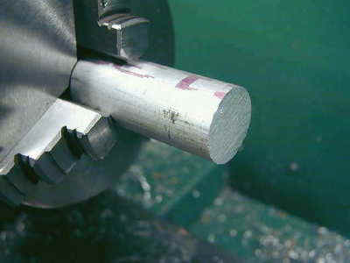
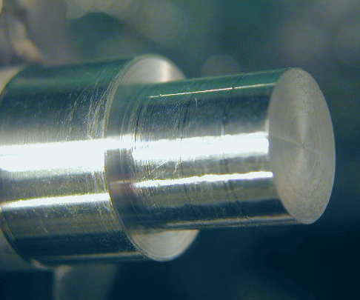
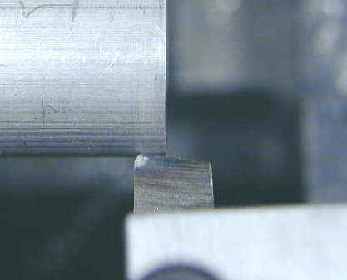
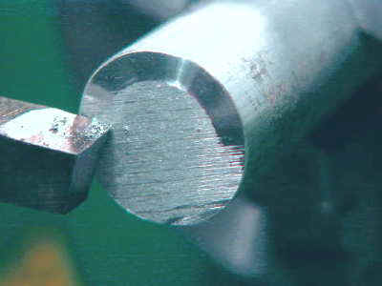
Lathe Operations

Slide 3
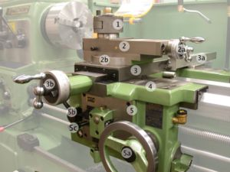
Lathe Operations

Slide 4
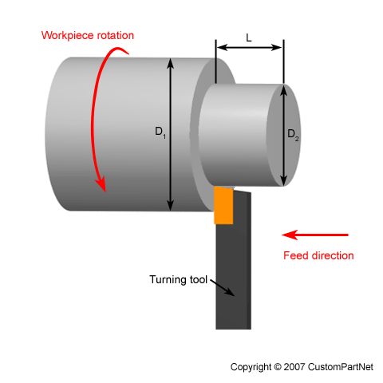
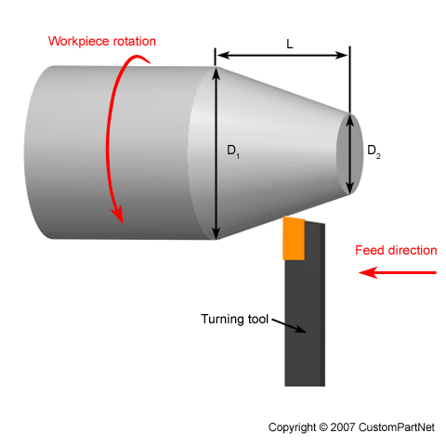
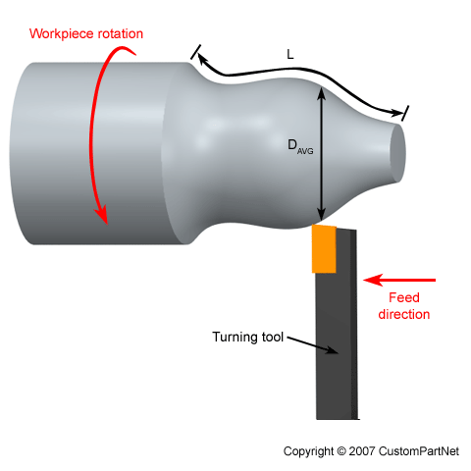
Lathe Operations

Slide 5
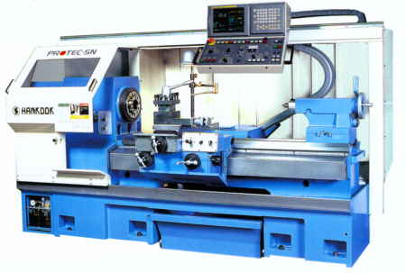
CNC Lathe

Slide 6
CNC Machines & Programming
CNC stands for “Computer Numerically Controlled”.
In using CNC machines one has to prepare a computer program to manufacture the part.
In operating CNC machines you need more of mental skills than physical skills.
All of you have to do an exercise on
    CNC Lathe (Demo)
    CNC Milling (Individual Exercise)

Slide 7
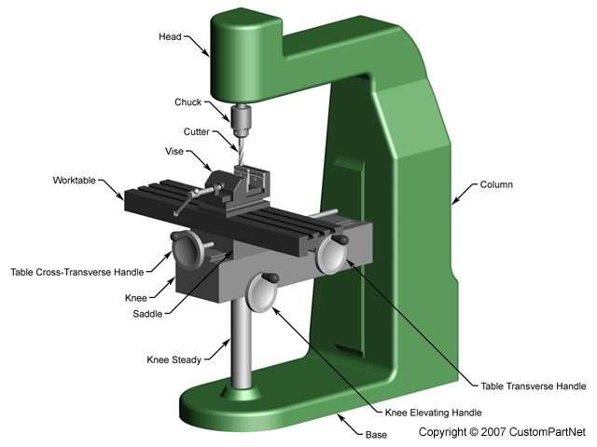
Milling Machine
Demo

Slide 8
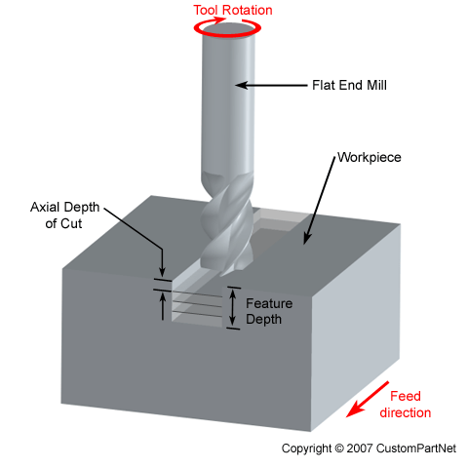
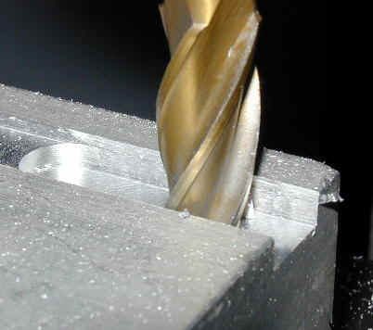
Milling Process

Slide 9
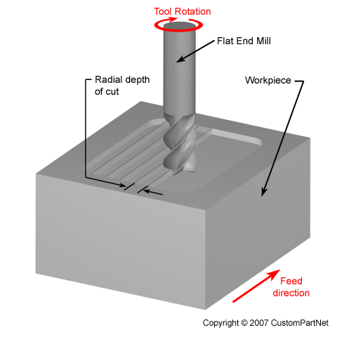
Milling Process

Slide 10
Exercise

Slide 11


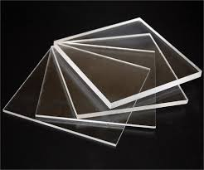
40 mm
50 mm
6 mm

Slide 12
CNC Programming
Motion Statements
G00 Linear Movement (rapid)
G01 Linear Movement (feed)
G02 Circular Movement (cw feed)
G03 Circular Movement (ccw feed)

Slide 13
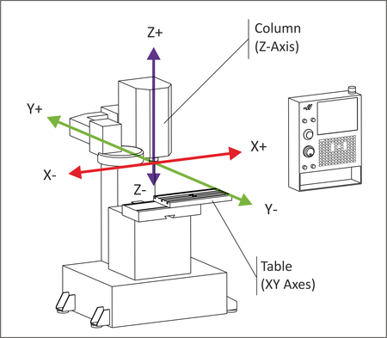
Milling Machine Axes

Slide 14
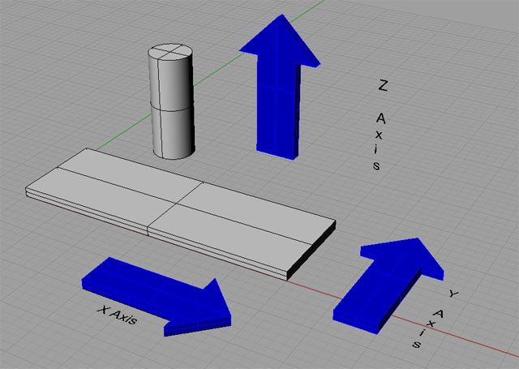
Milling Machine Axes

Slide 15
CNC Programming
G00 Linear Movement (rapid)
Y
55
60
10
24
(0, 0)
X
G00 X55 Y60

Slide 16
CNC Programming
G02 Circular Movement (Clockwise)
Y
G02
X34 Y0
I0 J-24
G02 X34 Y0 CR24
10
24
(0, 0)
X

Slide 17
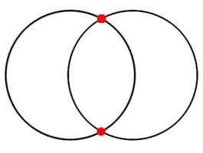
CNC Programming
G02/G03 Circular Movement

Slide 18
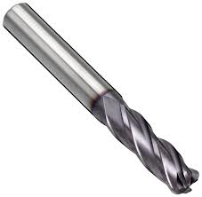
Tool Diameter = 6 mm

Slide 21
5

Slide 22
5

Slide 24
y
x
z
x

Slide 26
G01 Z-8

Slide 27
G01 Z+3

Slide 28
G00 X 10 Y -10

Slide 29
G01 Z-3

Slide 30
G01 Y -30

Slide 31
G01 X 32

Slide 32
G02 X 62 Y-30 I15 J0
G02 X 62 Y-30 CR 15

Slide 33
CNC Programming

Slide 34
5
40 mm
30
20
50 mm
5
11

