Slide 1
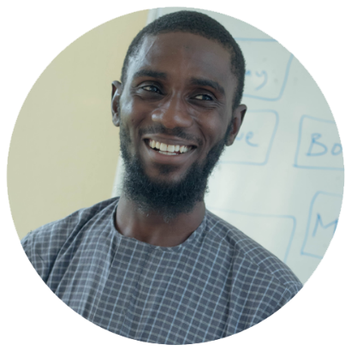
Learn Web Design with Easy
by
Kabir Yusuf Bashir
C.T.O Team Piccolo
www.teampiccolo.com

Slide 2
Let’s start with
How does the Internet works
How does the website works

Slide 3
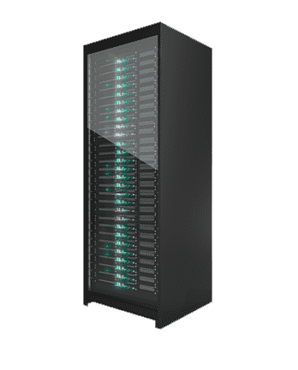

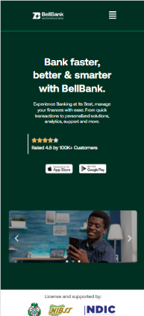
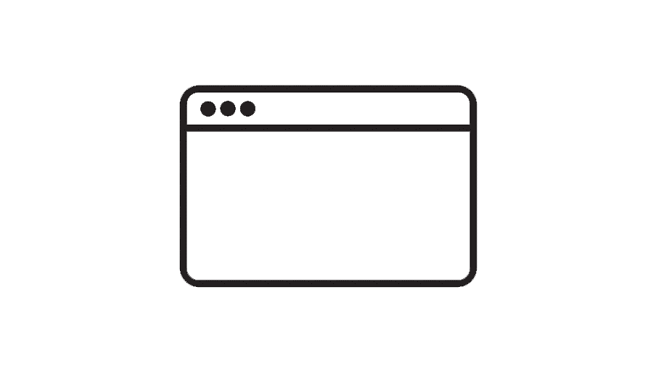


How does the Internet Works
104.21.35.168
www.bellmfb.com
104.21.35.168
ISP
104.21.35.168

Slide 4






How does the Website Works
Website

Slide 5



Tools to Use

Slide 6
L.C.T Model
Learn
Teach
Code

Slide 7
Meet-Ups
Articles, Blogs, Documentation, etc.
Learn
Watching videos
Bootcamps
Join Community

Slide 8
Start a Side Project
Contribute to an open source project
Join a Start-Up or Start a Start-Up
Code
Be Discipline & Consistent
Take a break once a while

Slide 9
Be a Mentor
Start Creating Contents like videos, articles, etc.
Teach
Help the Community
Organize Meetup
And be Patient

Slide 10
Thank you for your time!

