Slide 1
Agents/communication
Simulations/scenarios
Pure C++
objects
Pure OTcl
objects
C++/OTcl split objects
C++
OTcl
ns2

Slide 2
3rd party Java code
Java.lang
Java.net
Java.io
Re-implements java.net and other classes and invokes the JNI for Protolib compatibility.
NS-2
events
AgentJ
Abstracts NS-2 socket and timer implementations.
Protolib
Live Network
NS-2 simulated
network

Slide 3
agentj <command> <args>
attach-agentj <class>
AgentJObject.java
simulation.tcl
extends
YourClass.java
public String command(String command, String args[]) {
if (command.equals(“go”)) …
}
TCL
Java

Slide 4
C++ NS2 Agent
AgentJVirtualMachine
JNI
ns2AgentPtr
AgentjVirtualMachine
Attach-agent
Java Ns-2 Agent
ns2AgentPtr
JNI
NS2 Agent
NS2 Agent
NativeImp
Protolib
Protolib
Protolib
NS2 Comms

Slide 5
AgentjVirtualMachine.cpp
AgentJVirtualMachine
Agentj.cpp
AgentJObject
YourClass
extends
script.tcl
YourClass
YourClass
C++/TCL
Java

Slide 6
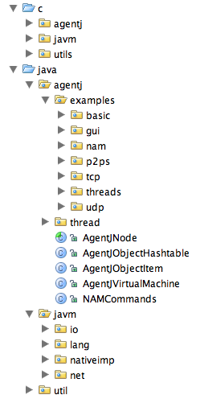
C source code for Agentj
JVM creator and AgentJ C++ agent implemetation
Native implementation of java.net and timers
Java source code for Agentj
Demonstrations - Java agent implementations
AgentJ implementation for synchronizing threads
Java Agent implementation - users subclass this
Java Virtual Machine - Entry Point for creating
Java agents and registering ids and pointers
Access to NAM GUI - set color, highlight, etc
Java re-implementation
Java and native bindings for all sockets and timers

