Slide 1
Online Word Guessing Game
Presented and Created by Group 1
Notes:
Someone introduces the presentation (maybe bia since she is the first to introduce us)

Slide 2





Our team
Beatriz
Glaser
Zoe Yook
Rafal
Ciechanski
Kabir Bissessar
Jaime Montero
Notes:
Everyone introduces themselves pt.1

Slide 3




Our team
Deepanker
Kanjarla
Mimi Määttä
Harvey Lim
Elizabeth Witney
Notes:
Everyone introduces themselves pt.2

Slide 4
Table of contents
01
02
03
04
The Process
Overview
Obstacles & Outcomes
Demo
Notes:
Someone goes over the table of contents (maybe liz since she is the last to introduce herself)

Slide 5
01
The Process
Notes:
Kabir:

Slide 6
The Process
01
02
03
Learning
Applying
Finalizing
Agile/Scrum + Sprint
Research
Sim Cards
Break down
Start to build/create
Research expanded
Debugging
Setting up the server
Running everything
Notes:
Kabir:
First go over how the project process could be broken into three components, first being that we had to learn/teach ourselves how to use Agile/scrum and sprint planning. Also, due to how this was a new topic for many of us we had to research on the background of the project, such as which language would we need, how to work with linux, how does connection between devices work, etc. Additionally we learned how to write a sim card. The new applied what we learned and started to break down what needed to be done and started to build/create a game that runs through a serve. This process could be described in a sort of two steps forward 1 step back as we would start working towards something which would then lead to more questions and research but eventually we finished. At the end of our process was finalizing everything which consisted of debugging and adding personal touches

Slide 7
02
Overview
Notes:
Deepanker:

Slide 8
General description
Product: Word Guessing Game
Features:
User has 5 guesses per day
Randomly given word of the day
Word is taken from English language
Game is played via a server through mobile devices if the sim card is connected to the server
Notes:
Deepanker: Our project is called The Word Guessing Game, it is an online web-based word game, where the user has five guesses to guess the word of the day. The word of the day is randomly selected from a list that consists of random five letter words from the English language. The game is run by and can be played via mobile devices if the sim card is connected to the server.

Slide 9
Meeting the Requirements
Game can connect and be played with multiple devices at a time
The game in on a mobile server
Implemented through utilising python 3.7
The game is accessible through the browser
Notes:
Deepanker: The following are the requirements that we managed to satisfy when making our product:
Game can connect and be played with multiple devices at a time
The game runs on a mobile server
The game is implemented through utilising python 3.7
The game is accessible through the browser

Slide 10
03
Demo
Notes:
Everyone

Slide 11
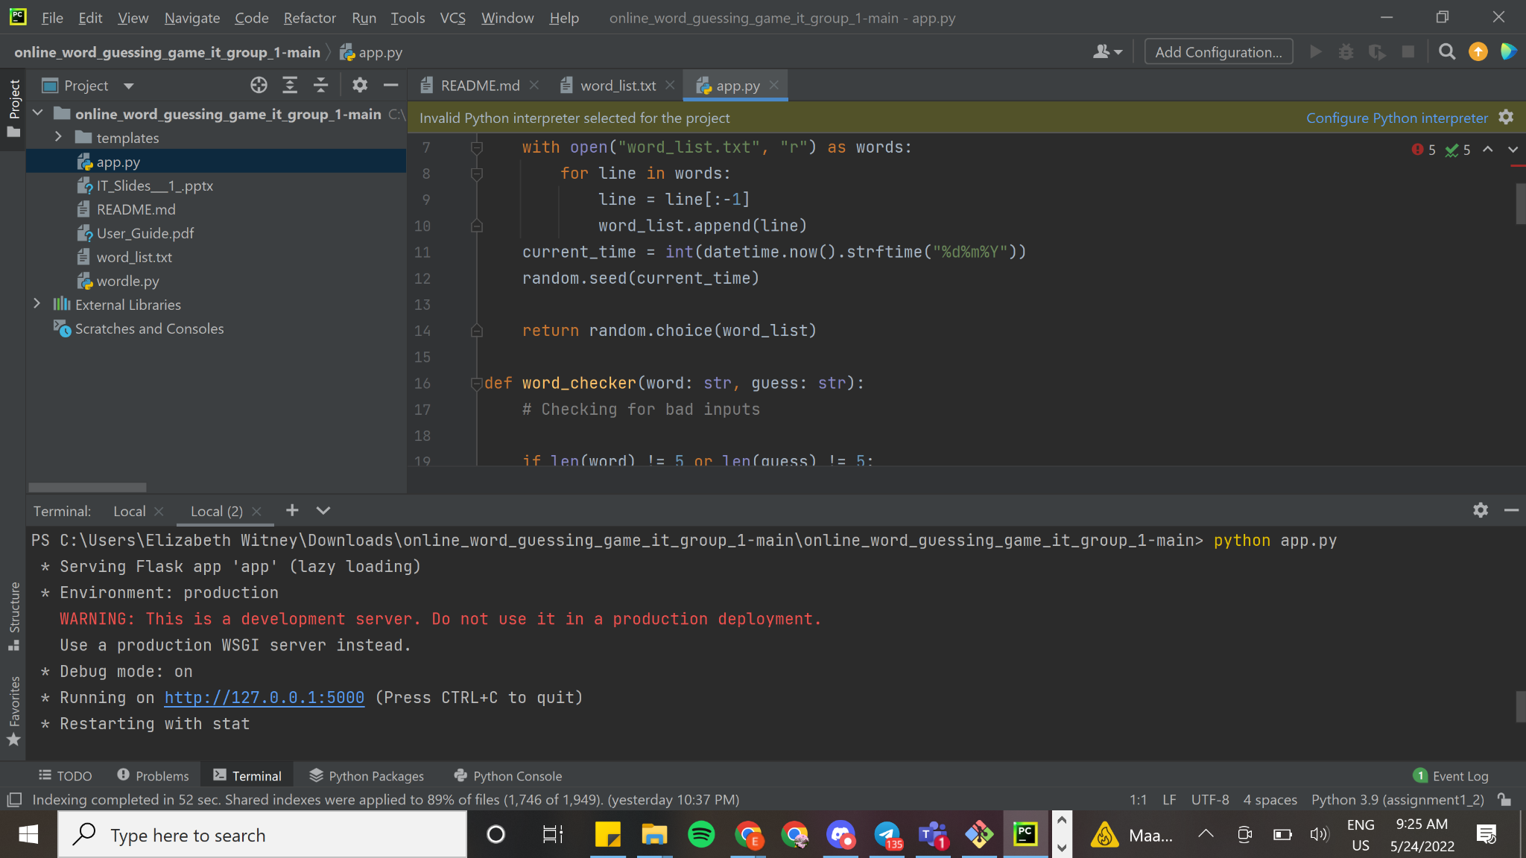
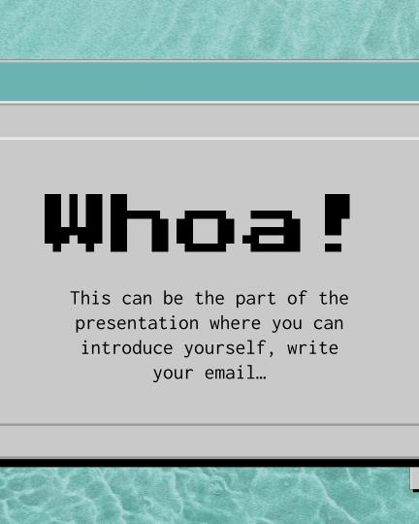
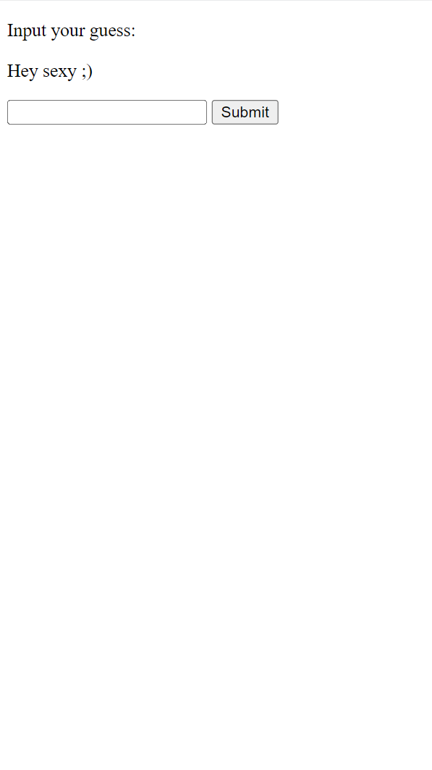
Notes:
We will do demo
++ i would like to put some photo replacements to represent what our computer looks like and what the users phone screen looks like

Slide 12
04
Obstacles & Outcomes
Notes:
Liz:

Slide 13
Obstacles We Faced
Meeting Personal Deadlines
Teamwork & Communication
Technical Complications
Notes:
Liz:
Meeting personal deadlines
Due to this being new it was hard to tell how long things would take
It was difficult to know exactly what would need to be done which complicated the tasks, making it hard to predict the amount of time things would take, hence tasks passing over to the next day/week
Team communication
Due to being new to Agile/scrum and sprint planning, it was hard to work out who would do what and what things overlapped and if more people needed to do more things than others. This lead to people doing their own thing and takes away from efficiency of work
Technical Complications
Due to many of us being novices to this particular field/subject, there were obstacles in the technical field that needed immense research or trial & error to overcome. This proved tedious and time consuming but was a part of the learning process.

Slide 14
Positive Outcomes
Teamwork & Communication
Interpersonal Skills
Technical Integration
Notes:
Liz:
Team work & communication
As the project went on and we as a team became more familiar we started to work beter together and communicate better, making our work more efficient
Interpersonal skills
As time went on it became easier to tell how long certain tasks would take, making us able to better meet our deadlines and do as was stated in the sprint planning
Technical Integration
Applying and practicing using multiple languages into one project instead of doing all work in one language. Also including sim cards ad servers taught us how to integrate different forms of technology in an efficient way to propel and advance our work.

Slide 15
Thank You!

