Slide 1
Lecture request (original brief)
Remove before recording
TOPIC
CT Angiography of the Chest, Abdomen and Pelvis and CT Angiography of the Upper and Lower Extremity Runoff: Review of Basic Interpretation, Pearls, and Common Pitfalls and Traps to Avoid
결과물
위 주제의 강의 PPT를 pptx 파일로 만들고, 온라인에서 바로 볼 수 있도록 준비한다.
대상·근거
혈관 전문의와 다른 분야 영상의학 전문의 대상. 학술지 수준의 신뢰할 수 있는 자료를 바탕으로, 논문과 교재를 참고한 근거 있는 내용으로 구성한다.
시각 자료
필요한 사진은 직접 만들어 채운다. 도표·표·수치는 다이어그램이나 표로 시각화한다.
난이도
초보 의사도 한눈에, 직관적으로 이해할 수 있게 한다.
형식
인터넷 강의로 녹화·배포할 예정이므로 설명은 말로 덧붙인다. 슬라이드 글은 간소하고 명료하고 짧게, 글·그림·사진·도표·다이어그램을 함께 쓴다.
Notes:
Original request for this lecture, kept for review. Remove this slide before recording.

Slide 2
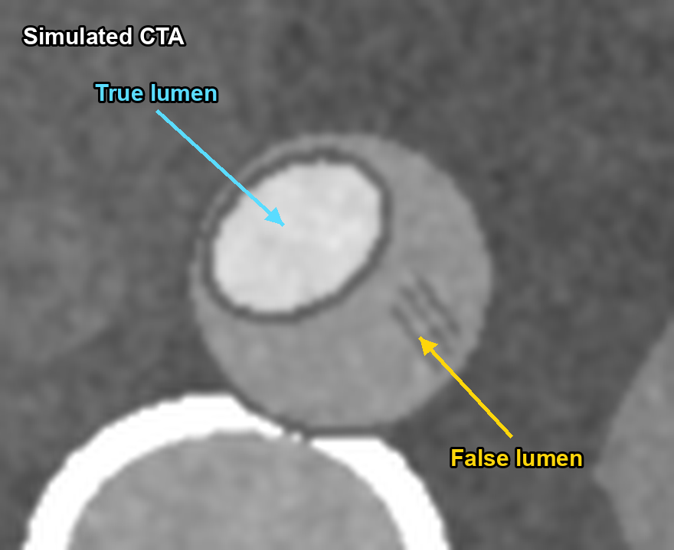
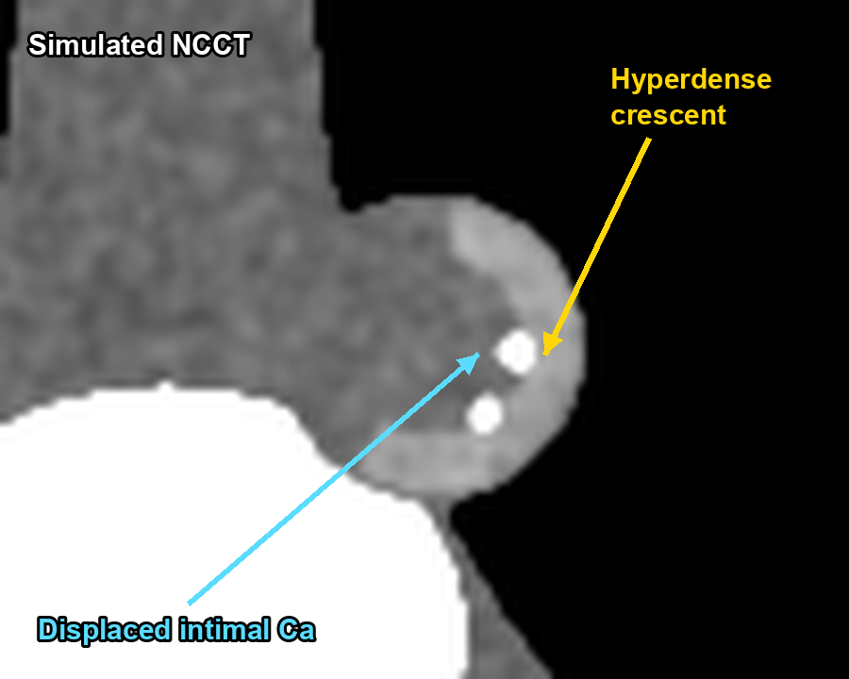
CT Angiography of the Chest, Abdomen & Pelvis and Extremity Runoff
Basic interpretation · Pearls · Pitfalls & traps to avoid
All CT images in this deck are simulated for teaching
Radiology Lecture Series | For residents, fellows & general radiologists
Notes:
Welcome. Today we cover CT angiography of the chest, abdomen and pelvis, and upper- and lower-extremity runoff CTA. We have three goals: a basic reading workflow, practical pearls you can use tomorrow, and the traps that most often mislead junior readers. All CT images in this deck are simulated for teaching, with realistic HU values; please supplement them with real cases from your own PACS.

Slide 3
Roadmap: four questions for every CTA
1
2
3
4
Was it acquired right?
Am I reading it right?
Chest · Abdomen · Pelvis
Extremity runoff
Bolus timing, coverage, phases
Windows, MPR / CPR / MIP / VR
Aorta, EVAR, bleeding, visceral
Lower & upper limb, variants
✓ PEARL
= practical tip to adopt
! PITFALL
= trap that produces a wrong report
Notes:
Ask four questions, in order, every time you open a CTA. First, was it acquired correctly? If the bolus timing is wrong, no amount of reading skill will save the report. Second, am I reading it correctly? These are the window and reformat traps. Parts three and four cover the anatomy. Throughout the deck, a green PEARL marks a tip to adopt, and an amber PITFALL marks a trap that leads to a wrong report.

Slide 4
Why CTA? High accuracy — with known blind spots
Lumen + wall + surroundings
One acquisition shows plaque, thrombus, hematoma and the cause outside the vessel
Fast, available, 3D
Pre-procedural roadmap for surgery and intervention
Blind spots
Dense calcification, small stents, slow / late flow — accuracy falls below the knee
Met R et al. JAMA 2009;301:415–24 · García-Blázquez V et al. Eur Radiol 2013;23:1181–90
Notes:
Why CTA? In meta-analysis, CTA detects a stenosis of 50 percent or more in peripheral arterial disease with a sensitivity of 95 percent and a specificity of 96 percent. For acute GI bleeding, sensitivity is 85 percent and specificity 92 percent, which is good enough for a first-line test. But accuracy drops with dense calcification below the knee, small stents and slow flow. Much of this lecture is about those blind spots.

Slide 5
Part 1 — Acquisition
If the bolus is wrong, the report will be wrong
Notes:
Part one: acquisition. Readers need to know the protocol to explain why the images look the way they do.

Slide 6
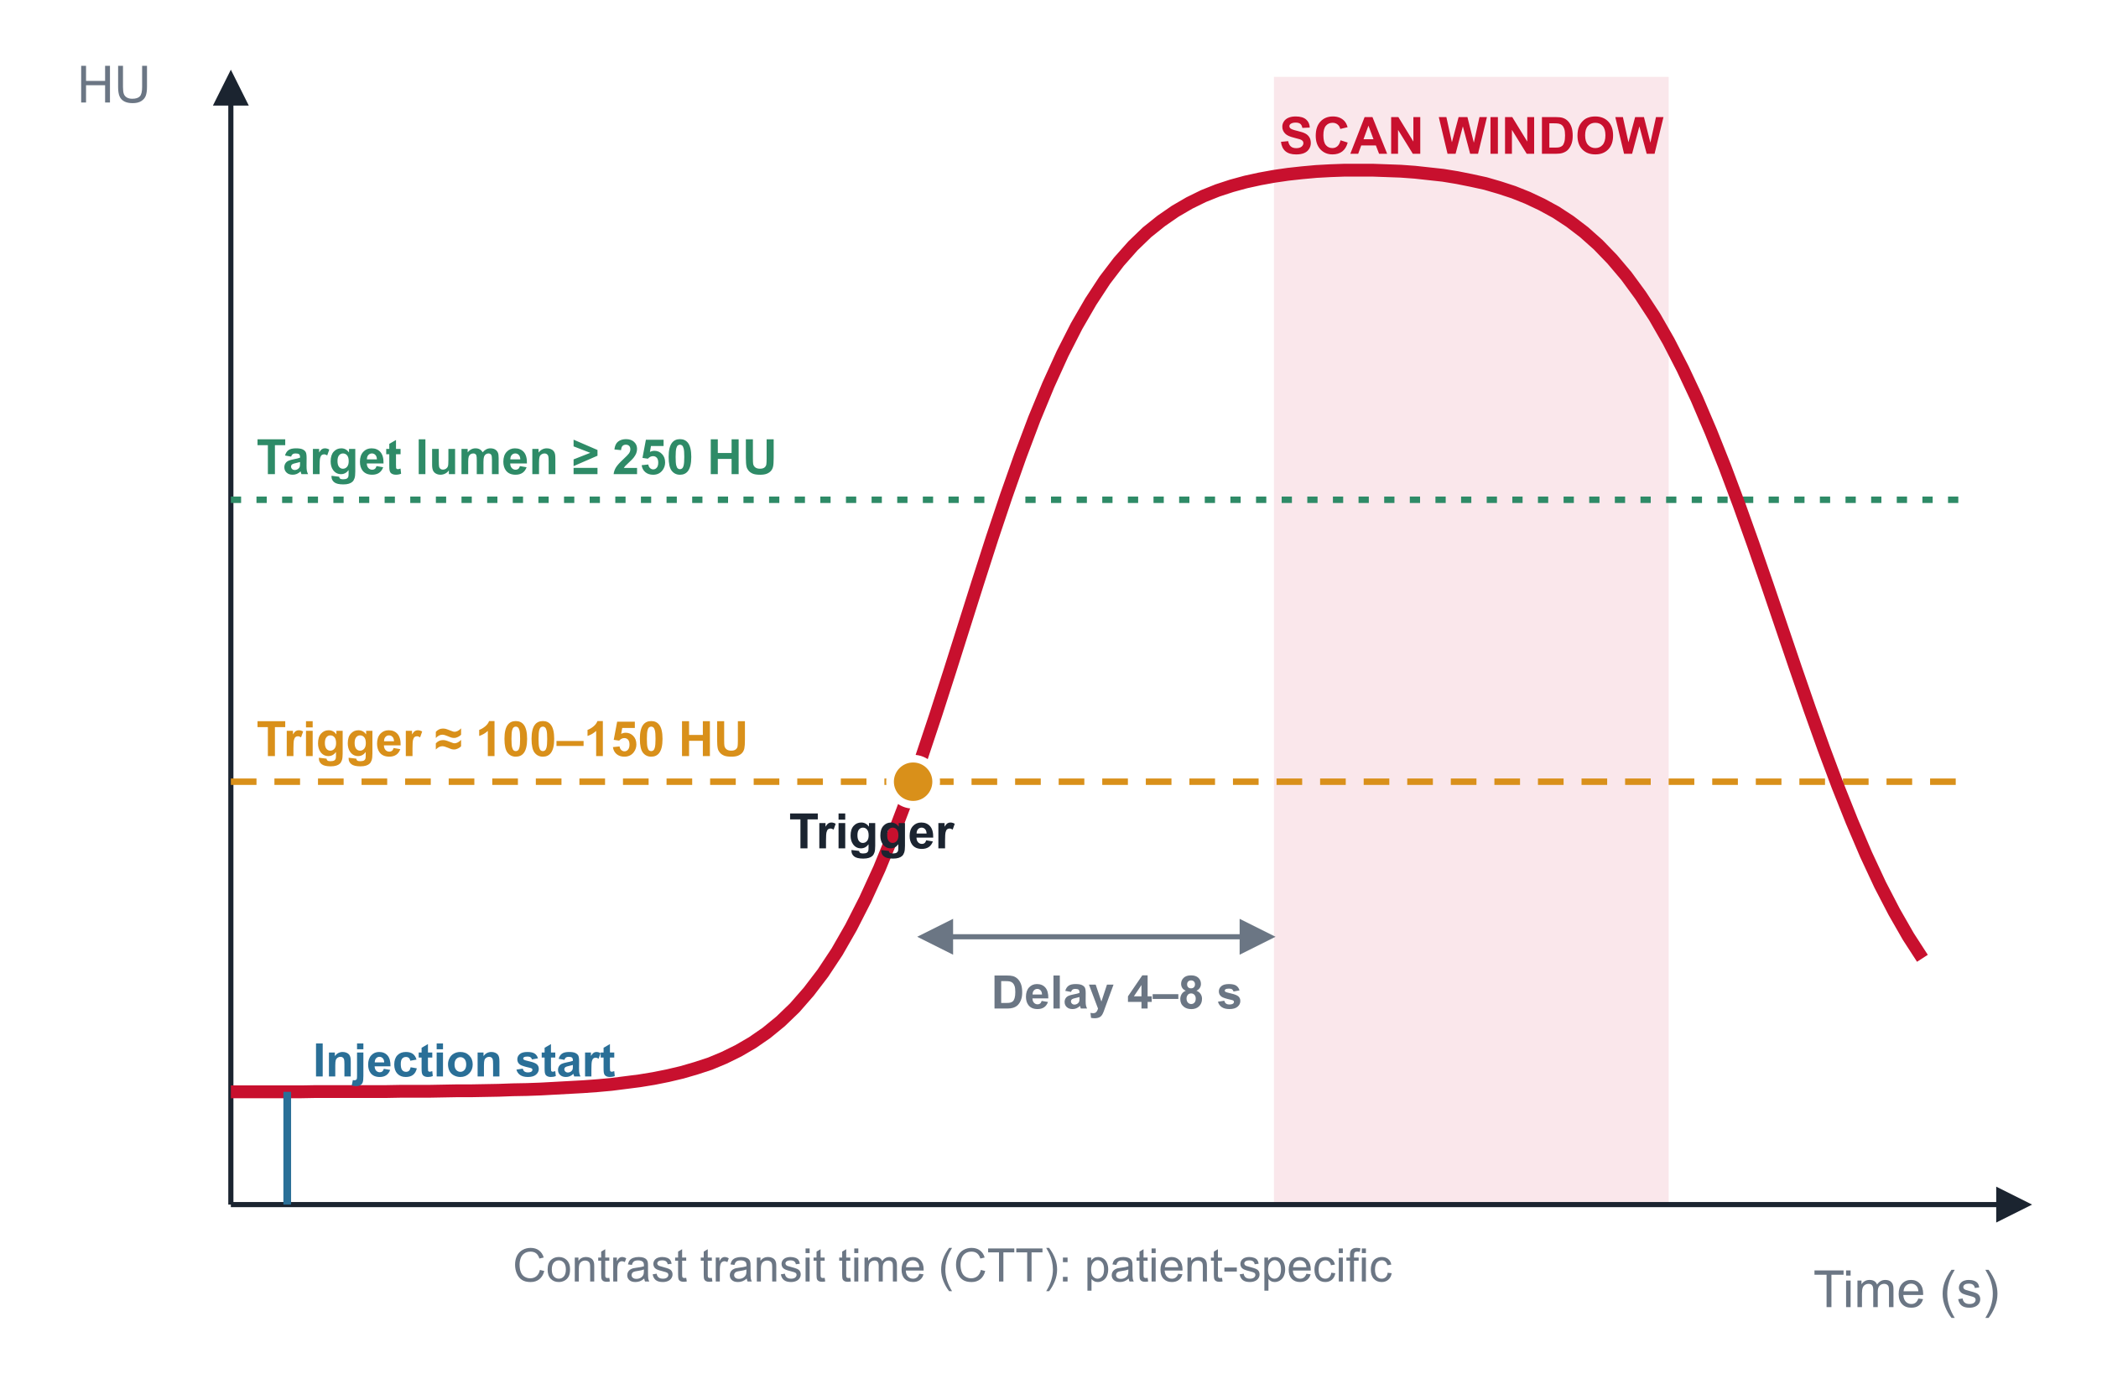
Timing is everything: bolus tracking
1
ROI in the target vessel
Aorta C/A/P: asc. or desc. aorta · Runoff: abdominal aorta · Upper limb: arch
2
Trigger ≈ 100–150 HU
Then a short diagnostic delay (≈ 4–8 s) for breath-hold and table travel
3
Saline chaser 30–50 mL
Pushes the tail of the bolus, reduces venous streak, saves contrast
✓ PEARL
Aim for ≥ 250 HU in the target lumen
Fleischmann D et al. J Vasc Interv Radiol 2006;17:3–26 · ACR–NASCI–SIR–SPR Practice Parameter for Body CTA
Notes:
Contrast transit time varies from patient to patient. It is longer with low cardiac output or a large aneurysm. That is why we use bolus tracking instead of a fixed delay. Place the ROI in the target vessel; when it reaches 100 to 150 HU, scan after a 4 to 8 second delay. The target is at least 250 HU in the lumen. A saline chaser saves contrast and reduces venous streak artifact.

Slide 7
Protocol at a glance
Parameter | Aorta: C/A/P | Lower-extremity runoff | Upper extremity
Coverage | Thoracic inlet → femoral heads | Diaphragm / renal level → toes | Aortic arch → fingertips
Phases | NCCT (AAS, post-EVAR) + arterial ± delayed | Arterial; delayed knee→feet on demand | Arterial ± delayed hand
Trigger ROI | Ascending or descending aorta | Abdominal aorta | Aortic arch
Special | ECG gating for root / ascending aorta | Fixed scan time (~40 s); injection ≈ scan time | Inject contralateral arm (or foot)
Main trap | Pulsation & venous streak | Outrunning the bolus | Streak, vasospasm, positional TOS
All: ≤ 1 mm reconstructions, iso-osmolar or low-osmolar contrast, high iodine delivery rate
Fleischmann D et al. JVIR 2006 · Hellinger JC et al. Radiol Clin North Am 2010;48:397–421 · ACR–NASCI–SIR–SPR Practice Parameter for Body CTA
Notes:
Here are the three protocols on one slide. Aortic CTA must include a non-contrast scan for acute aortic syndrome and post-EVAR follow-up, and the aortic root and ascending aorta need ECG gating. The key to lower-extremity runoff is a fixed scan time of about 40 seconds, with the injection duration matched to the scan time. For the upper limb, inject the contralateral arm. The bottom row lists the main trap for each protocol; we will go through them one by one.

Slide 8
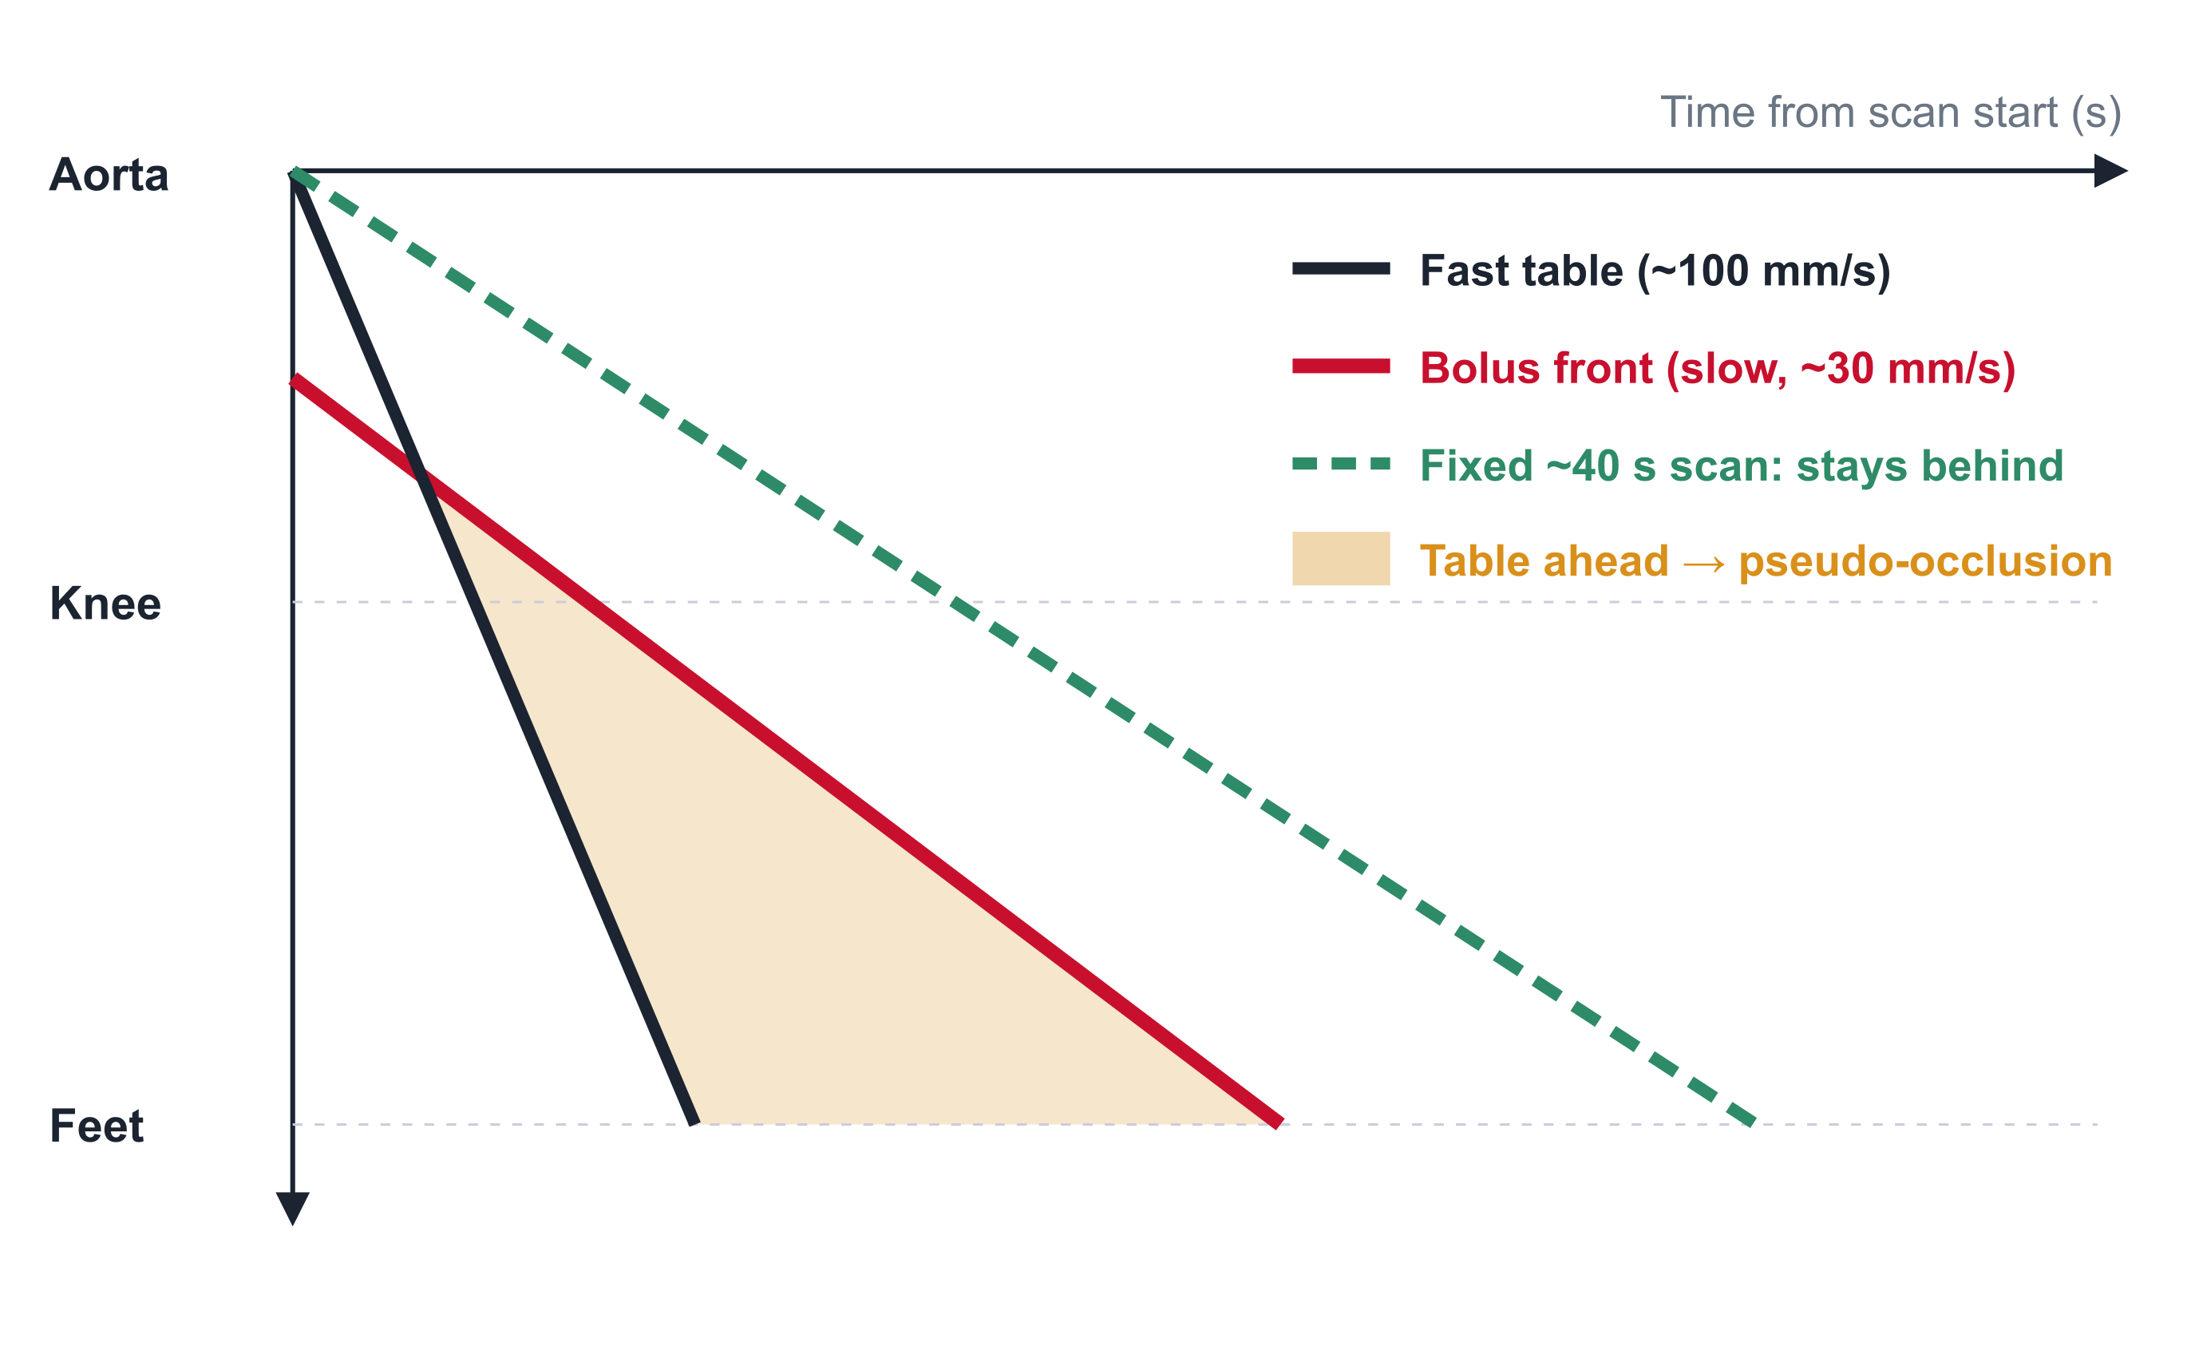
Don't outrun the bolus
! PITFALL
Modern scanners can cover aorta-to-toes in a few seconds — faster than the contrast travels in diseased limbs
Result: tibial arteries look 'occluded' while the artery is simply not yet opacified
✓ PEARL
Slow the table: fixed scan time ≈ 40 s
Always be ready for a second pass, knee → feet
Asymmetric distal filling = suspect timing first
Fleischmann D, Rubin GD. Radiology 2005;236:1076–82 · Fleischmann D et al. JVIR 2006;17:3–26
Notes:
This is the best-known runoff pitfall. Modern scanners cover aorta to toes in a few seconds, but contrast travels much more slowly in diseased legs. If the table outruns the bolus, the tibial arteries look occluded. The fix is to fix the scan time at about 40 seconds, which slows the table, and to add a delayed knee-to-feet acquisition right away if distal filling is poor. When you see asymmetric or simultaneous distal loss of opacification, suspect timing first.

Slide 9
More iodine signal, less contrast — and kidney safety
80–100 kVp
40–50 keV
33.2 keV
IV contrast & kidney (ACR–NKF 2020)
eGFR ≥ 30
Low tube voltage raises iodine attenuation
Virtual monoenergetic images (dual-energy) rescue weak bolus
Iodine K-edge: why lower energy = brighter lumen
Risk of CI-AKI negligible → do not withhold
eGFR < 30 (not on dialysis)
! PITFALL
Prophylactic IV saline indicated unless contraindicated
Low keV also amplifies noise and calcium blooming — read stenosis on standard / higher-keV images too
Acute kidney injury
Manage as eGFR < 30; weigh benefit of the scan
Withholding a needed CTA in acute aortic syndrome or bleeding is usually the bigger risk
Albrecht MH et al. Radiology 2019;293:260–71 · Davenport MS et al. Radiology 2020;294:660–8 (ACR–NKF consensus)
Notes:
The iodine K-edge is 33.2 keV. Lowering tube voltage to 80 to 100 kVp, or using 40 to 50 keV virtual monoenergetic images from dual-energy CT, makes vessels brighter. This lets you reduce contrast dose or rescue a slightly mistimed study. But noise and calcium blooming also increase, so confirm stenosis grading on standard images. For kidney safety, the 2020 ACR-NKF consensus says there is no reason to withhold contrast at an eGFR of 30 or more; below 30, in patients not on dialysis, consider prophylactic IV saline. In acute aortic syndrome or active bleeding, delaying the CTA is usually the bigger risk.

Slide 10
Part 2 — Reading toolkit
Windows, reformats and the traps they create
Notes:
Part two: the reading toolkit. Depending on how you look at the same data set, a stenosis can appear or disappear.

Slide 11
A reproducible reading workflow
Axial source
Double-oblique MPR
CPR + cross-sections
MIP / VR
Always first & last
Measure diameters
Grade stenosis
Overview & communication
Window preset | Width / Level (HU) | Use
Standard CTA | 600–800 / 150–250 | Lumen, flap, extravasation
Calcified vessel / stent | ≈ 1500 / 300–400 | Reduce blooming, in-stent lumen
Non-contrast | ≈ 250–350 / 40–50 | Intramural hematoma, hyperdense material
✓ PEARL
Adjust the window to the lumen you see: rule of thumb W ≈ 2–3 × lumen HU, L ≈ ½ lumen HU
! PITFALL
Never grade a stenosis on MIP or VR alone
Fleischmann D et al. JVIR 2006;17:3–26
Notes:
Use a fixed reading order. Start with the axial source images, measure diameters on double-oblique MPR, grade stenoses on CPR and cross-sections, and use MIP and VR for overview and communication with clinicians. Finish on the source images again. Adjust the window to the lumen rather than using a fixed preset: as a rule of thumb, the width is two to three times the lumen HU and the level about half. For calcium and stents, widen the window to around 1500.

Slide 12
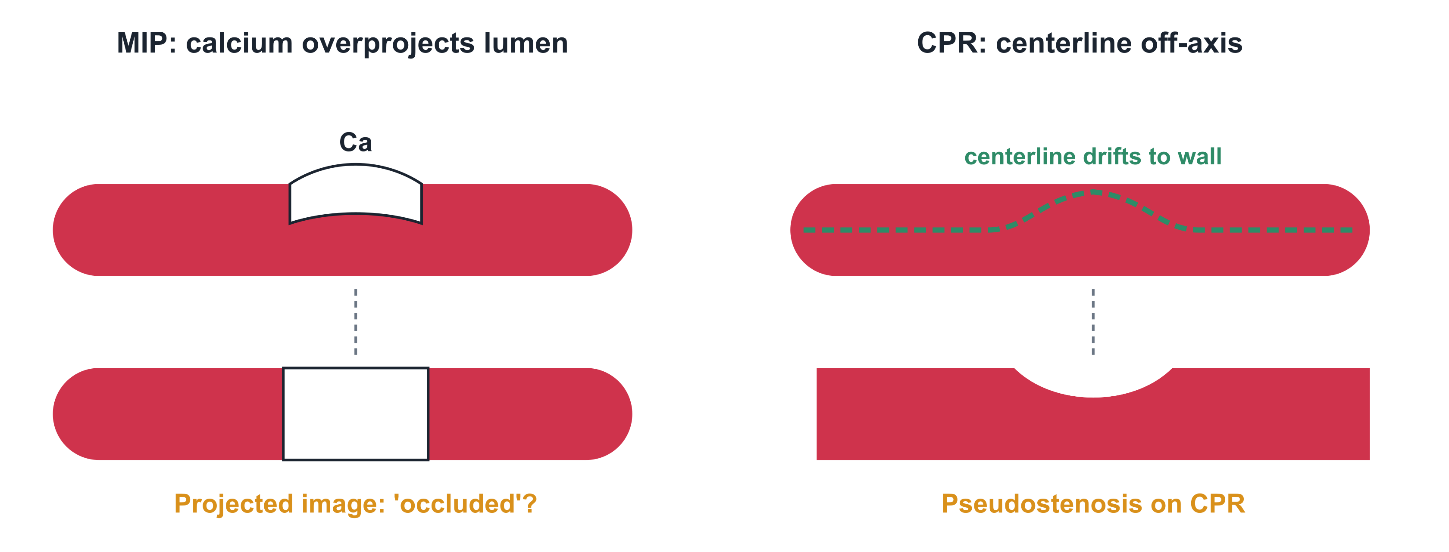
Reformat traps: MIP hides, CPR invents
MIP
CPR
VR
Brightest voxel wins → calcium and stents overproject the lumen
Off-center centerline → pseudostenosis or missed lesion; rotate 360°
Threshold-dependent → small vessels vanish, stenoses exaggerate
Fleischmann D et al. JVIR 2006;17:3–26
Notes:
These are the reformat traps. MIP projects the brightest voxel, so calcium or stents overproject the lumen and mimic occlusion. On CPR, a centerline that drifts to the wall creates a pseudostenosis or hides a real lesion, so always rotate the CPR through 360 degrees and match it with cross-sections. VR is threshold-dependent: small vessels vanish and stenoses look worse. Confirm every finding on the source images.

Slide 13

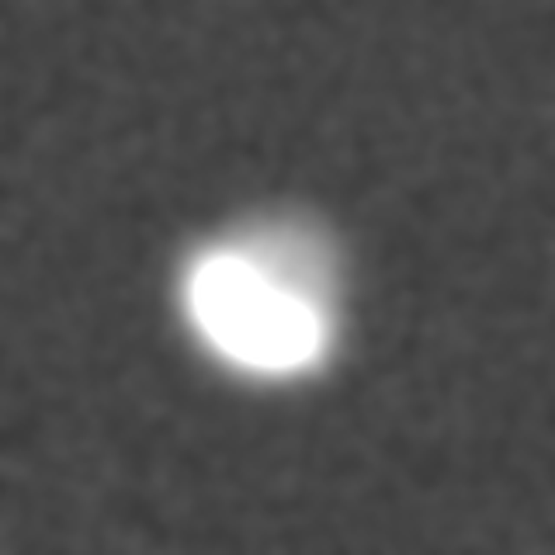
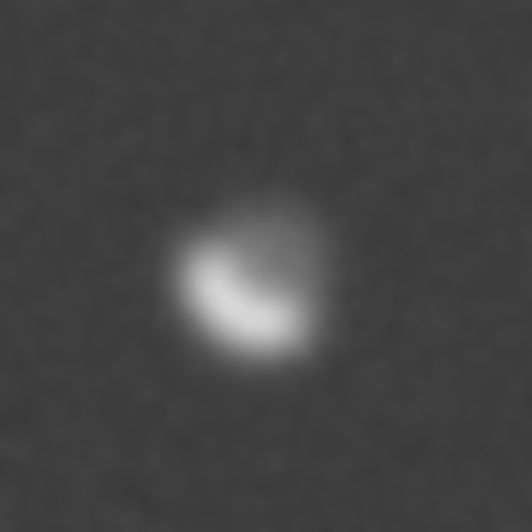
Calcium blooming: the window changes the stenosis
! PITFALL
Partial volume spreads dense calcium → overestimation of stenosis, worst in tibial arteries
✓ PEARL
Widen the window (W ≥ 1500)
Thin slices, sharper kernel
Dual-energy calcium removal (verify!)
If still unclear: call it 'non-diagnostic', suggest DSA / duplex
True anatomy (schematic)
W 700 / L 200: looks occluded
W 1600 / L 450: lumen visible
Simulated tibial artery with eccentric calcified plaque, same data, two windows
Met R et al. JAMA 2009;301:415–24 · Fleischmann D et al. JVIR 2006;17:3–26
Notes:
This simulation shows the same data at two windows. With the narrow window in the middle, partial-volume spread of calcium covers the lumen and it looks occluded. Widen the window to 1500 or more, on the right, and the lumen is visible. This is the most common cause of stenosis overestimation, especially in the tibial arteries. Use thin slices, a sharper kernel and dual-energy calcium removal. If it is still unclear, don't force a grade: call the segment non-diagnostic and suggest DSA or duplex ultrasound.

Slide 14
Part 3 — Chest · Abdomen · Pelvis
Aorta, EVAR, bleeding and visceral arteries
Notes:
Part three: chest, abdomen and pelvis CTA. We start with measuring the aorta.

Slide 15
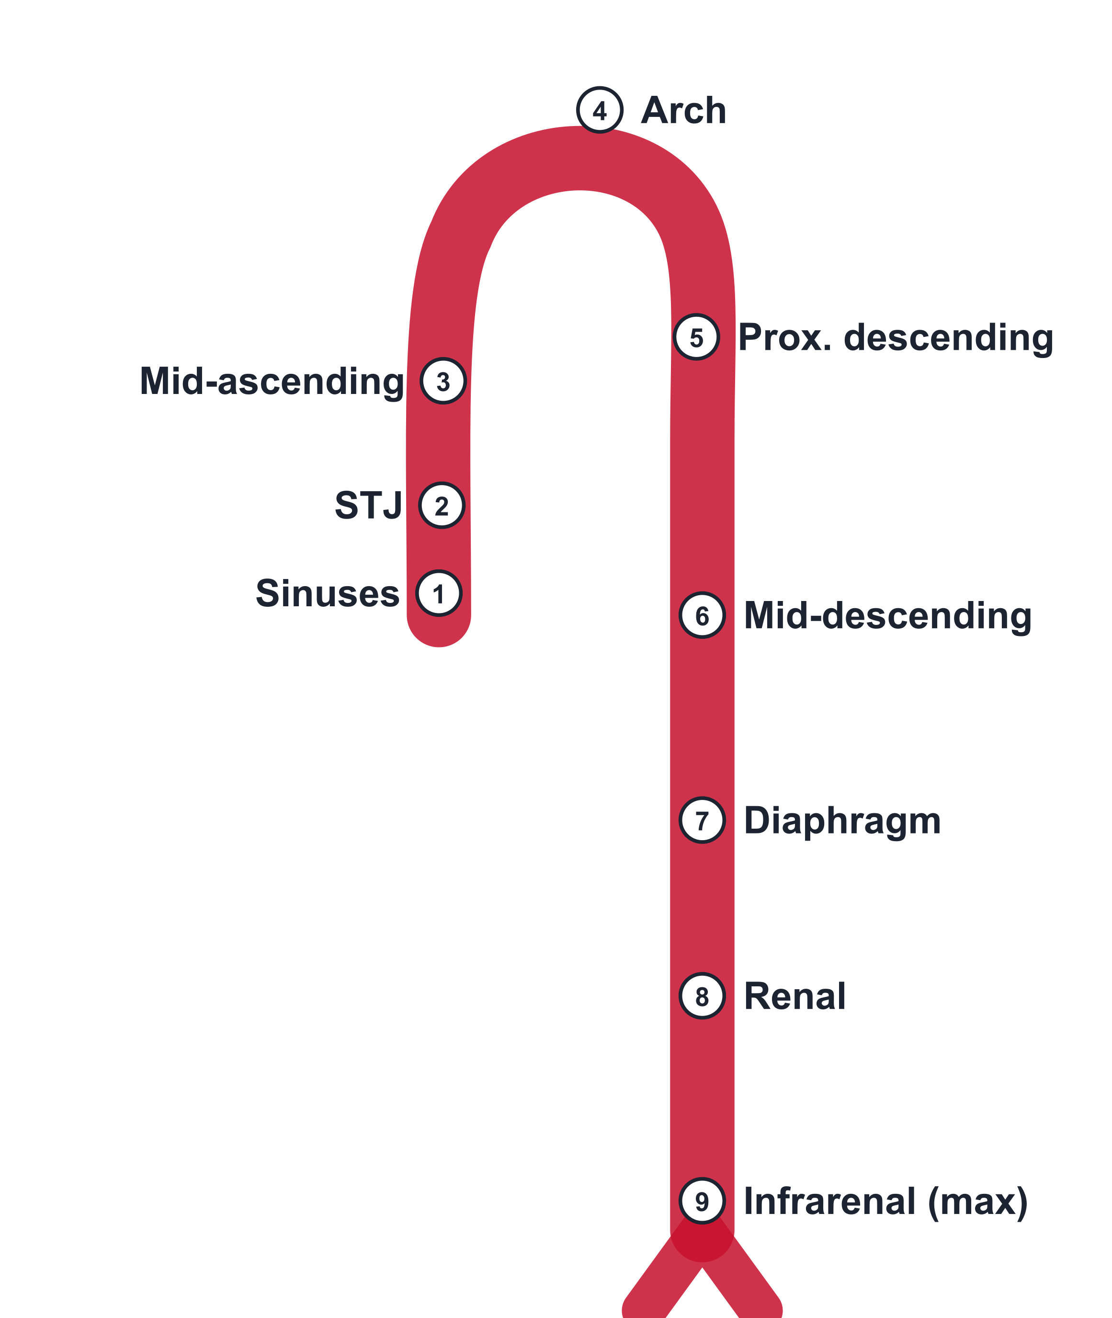
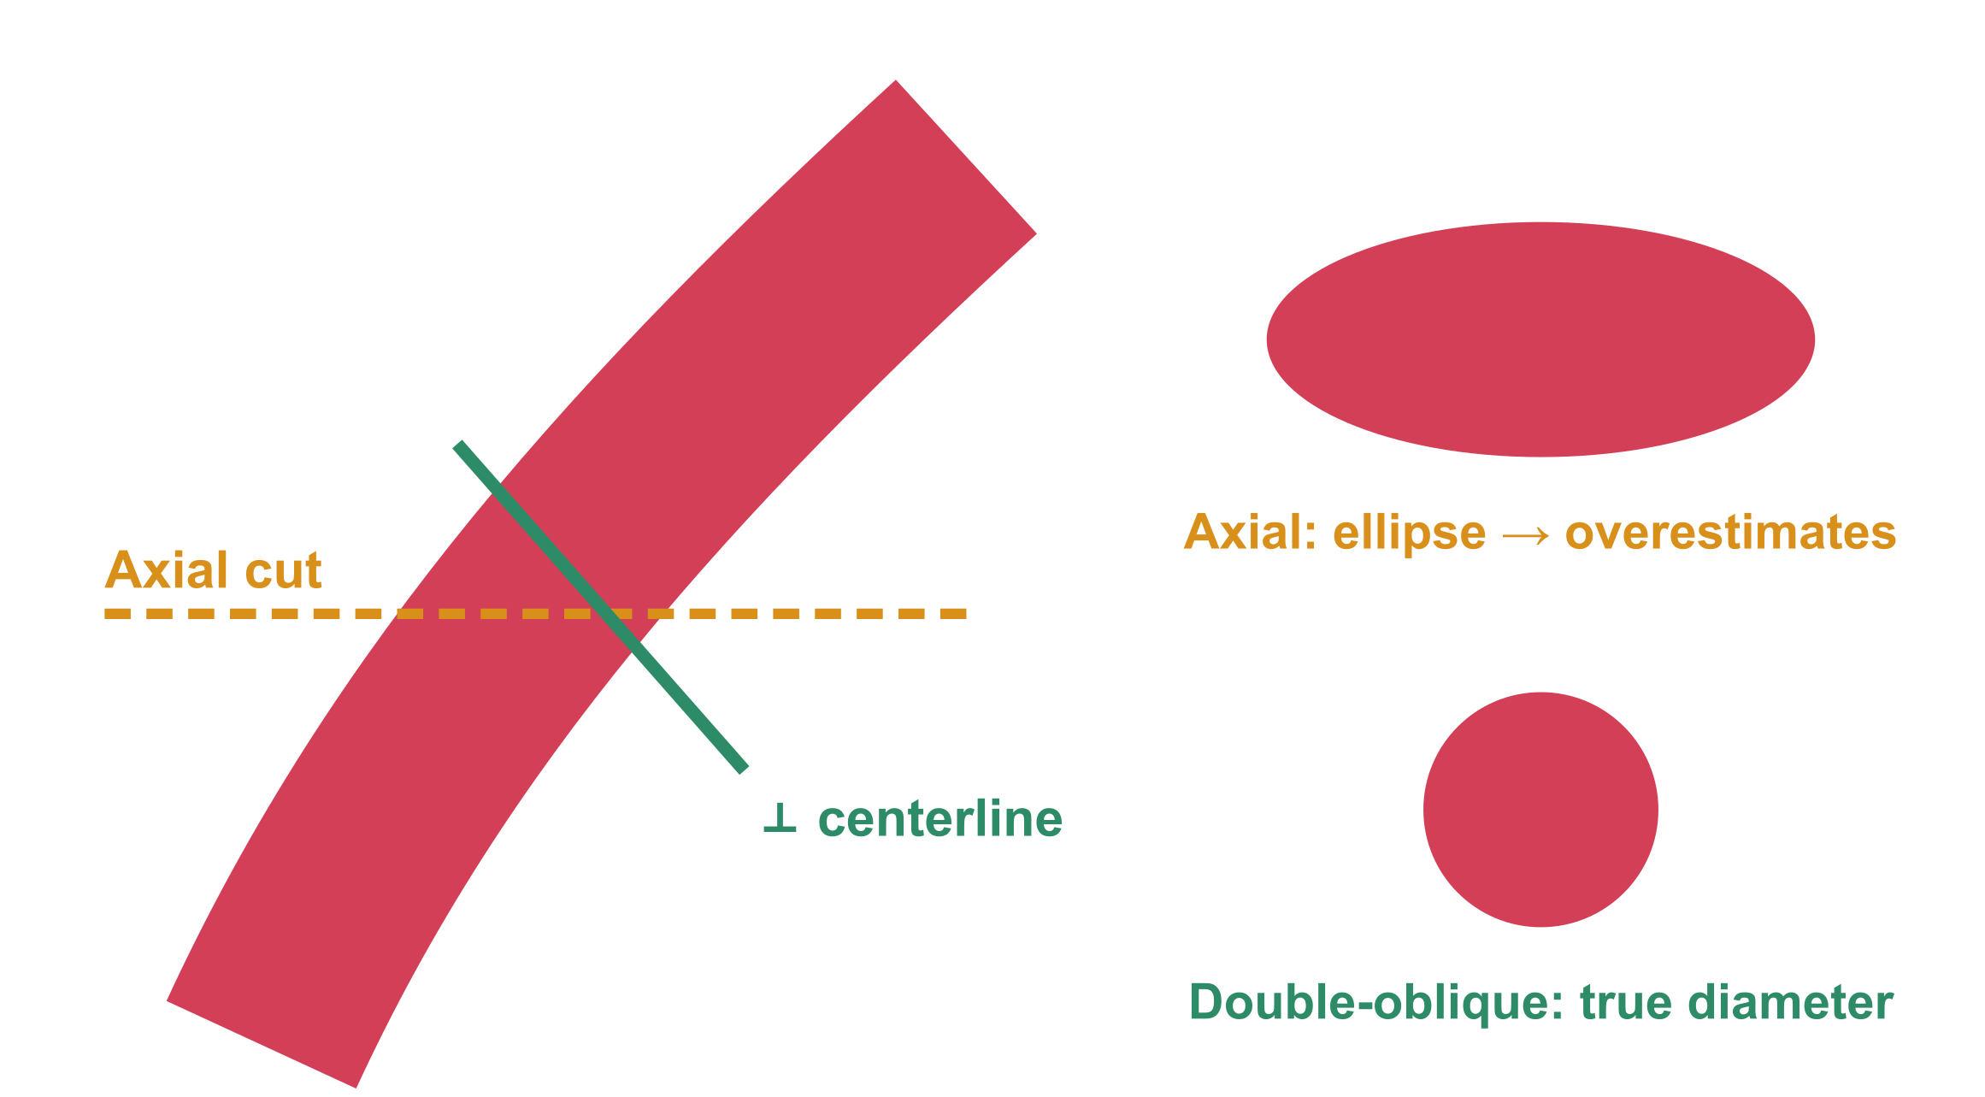
Measure the aorta the same way, every time
Perpendicular to the centerline (double-oblique), not axial
AAA: outer wall → outer wall at maximum diameter (SVS)
Report location of the maximum + the method used
Compare with the earliest available study, not just the last
Isselbacher EM et al. 2022 ACC/AHA Aortic Disease Guideline, Circulation 2022;146:e334–482 · Chaikof EL et al. J Vasc Surg 2018;67:2–77
Notes:
Aortic diameters are only comparable if you measure the same way every time. Measuring a tortuous aorta on axial images gives an ellipse and overestimates the diameter. Measure on a double-oblique plane perpendicular to the centerline; for abdominal aortic aneurysm, the SVS recommends the maximum outer-wall-to-outer-wall diameter. Report the location and the method, and compare with the oldest available study, not just the most recent one. Slow growth is easy to miss if you only compare with the last scan.

Slide 16
AAA: diameter drives the next step
≥ 5.5 cm
5.0–5.4 cm
Refer for repair (men)
4.0–4.9 cm
Re-image in 6 months; women: consider repair
3.0–3.9 cm
Re-image in 12 months
Re-image in 3 years
✓ PEARL
Also report: rapid growth (≥ 1 cm/yr), symptoms, iliac aneurysm, neck anatomy for EVAR
! PITFALL
Mixing inner- and outer-wall methods between studies can fake 2–5 mm 'growth'
Chaikof EL et al. SVS AAA guidelines, J Vasc Surg 2018;67:2–77
Notes:
For AAA, diameter drives the next step. Under the 2018 SVS guidelines, re-image 3.0 to 3.9 centimeter aneurysms in 3 years, 4.0 to 4.9 in 12 months, and 5.0 to 5.4 in 6 months. Repair is considered at 5.5 centimeters or more in men, and from 5.0 to 5.4 in women. Also report rapid growth of 1 centimeter or more per year, symptoms, iliac aneurysms and neck anatomy for EVAR. And remember: switching measurement methods can create a few millimeters of fake growth.

Slide 17
Acute aortic syndrome: three entities, one workup
Schematic
Aortic dissection
Intramural hematoma
Penetrating ulcer (PAU)
Intimal flap · two lumens
Crescentic wall thickening · no flap · hyperdense on NCCT
Contrast outpouching beyond the intima in an atherosclerotic aorta
Workup: NCCT → ECG-gated arterial CTA (thoracic inlet → femoral heads) → ± delayed phase
Isselbacher EM et al. 2022 ACC/AHA Aortic Disease Guideline, Circulation 2022;146:e334–482
Notes:
Acute aortic syndrome has three entities. Aortic dissection shows an intimal flap and two lumens. Intramural hematoma shows crescentic wall thickening without a flap and is hyperdense on non-contrast CT. A penetrating atherosclerotic ulcer is contrast outpouching beyond the intima in an atherosclerotic aorta. On contrast images alone, an intramural hematoma is easily mistaken for thrombus, so non-contrast CT is essential. The sequence is non-contrast, ECG-gated arterial phase, and a delayed phase when needed.

Slide 18
True lumen or false lumen?
Feature | True lumen | False lumen
Size | Smaller, compressed | Usually larger
Beak sign (acute angle) | — | Present
Cobwebs (medial strands) | — | Present
Enhancement | Earlier, brighter | Delayed, may be lower
Continuity | With non-dissected aorta | Ends blindly
Thrombus | Rare | Common
Simulated image
✓ PEARL
Beak sign + larger area are the most reliable signs
LePage MA et al. AJR 2001;177:207–11
Notes:
Distinguishing the true and false lumen matters for treatment planning, especially which lumen the stent-graft goes into and how organs are perfused. The false lumen is usually larger, shows the beak sign, an acute angle where the flap meets the outer wall, and may contain cobwebs. It enhances later and often contains thrombus. The true lumen is continuous with the non-dissected aorta. In the LePage study, the beak sign and a larger cross-sectional area were the most reliable signs.

Slide 19
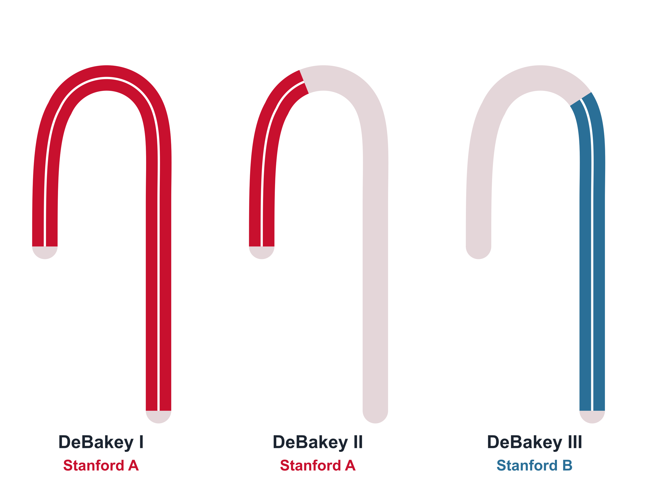
Classify — then report what changes management
Report checklist
✓
Entry tear location & extent (proximal → distal)
✓
Branch vessels: from TL or FL? static vs dynamic obstruction
✓
End-organ perfusion: bowel, kidneys, limbs
✓
Rupture signs: periaortic / mediastinal blood, hemopericardium
✓
Maximal aortic & false-lumen diameters
✓
Coronary / aortic valve involvement (gated study)
Stanford A — involves ascending aorta → emergency surgery
Stanford B — spares ascending → medical / TEVAR if complicated
Isselbacher EM et al. Circulation 2022;146:e334–482
Notes:
Classification drives management. If the ascending aorta is involved, it is Stanford type A, an emergency for surgery. If not, it is type B, treated medically, with TEVAR if complicated. DeBakey types I and II are Stanford A; type III is Stanford B. Include the checklist on the right in every report. In particular, whether branch vessels arise from the true or false lumen, and whether the obstruction is static or dynamic, changes the interventional approach.

Slide 20
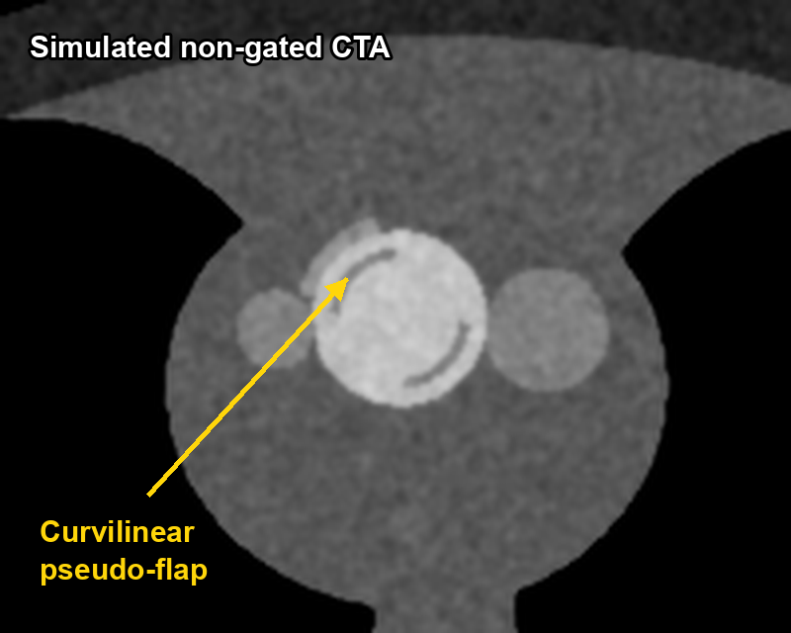
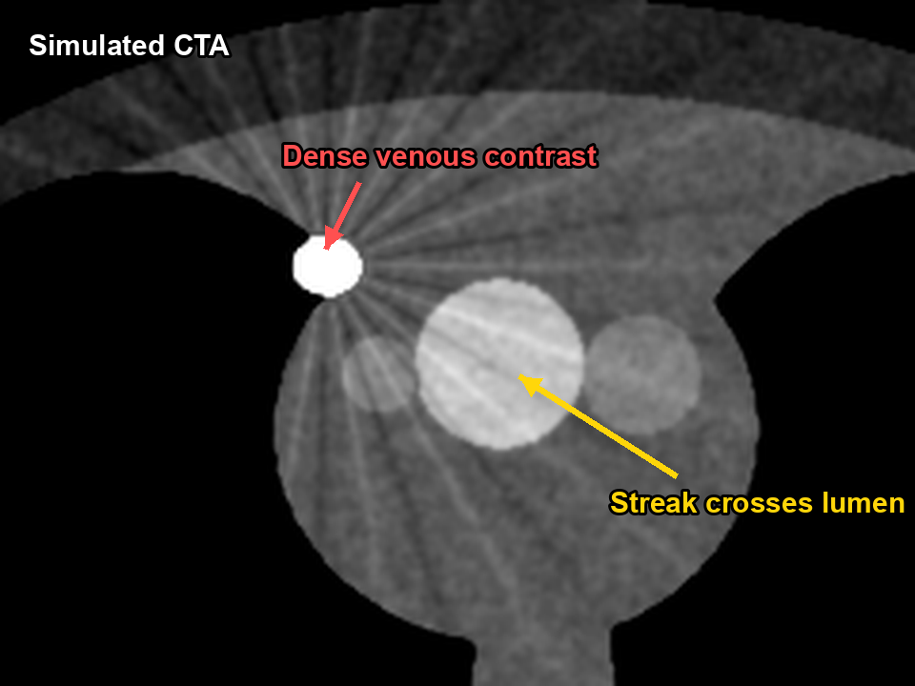
Dissection mimics: don't call a flap that isn't there
! PITFALL
Other mimics
Superior pericardial recess hugging the ascending aorta
Left brachiocephalic vein / SVC
Mural thrombus (next slide)
Atelectasis or pleural thickening next to the descending aorta
Pulsation artifact (non-gated)
Streak from dense venous contrast
Fix: ECG gating; flap absent on other planes
Fix: saline chaser, right-arm injection, check lung window
Real flaps persist across planes and phases; artifacts don't
Batra P et al. RadioGraphics 2000;20:309–20 · Simulated images
Notes:
Calling a flap that isn't there can send a patient to emergency surgery. On non-gated CT, pulsation of the ascending aorta creates curvilinear pseudo-flaps, typically at the left-anterior and right-posterior walls. ECG gating fixes this; if the 'flap' does not continue on other planes, it is artifact. Dense contrast in the SVC or left brachiocephalic vein creates streaks across the arch, which a saline chaser and right-arm injection reduce. A real flap is seen consistently across planes and phases.

Slide 21
IMH or mural thrombus? Look at the calcium
Intramural hematoma
Mural thrombus
Smooth crescent, follows the wall
Intimal Ca displaced inward (luminal side)
Hyperdense on NCCT (≈ 60–70 HU)
Often non-dilated aorta, acute pain
Irregular luminal surface
Ca stays at the outer wall, thrombus inside it
Not hyperdense on NCCT
Usually in an aneurysmal aorta
Simulated NCCT, narrow window
✓ PEARL
No NCCT = IMH easily missed
Isselbacher EM et al. Circulation 2022 · Batra P et al. RadioGraphics 2000;20:309–20
Notes:
The key to telling intramural hematoma from mural thrombus is the position of the calcium. Intramural hematoma is blood in the media, beneath the intima, so intimal calcification is displaced inward toward the lumen. Thrombus sits on top of the intima, so the calcium stays at the outer wall. Intramural hematoma is also a hyperdense crescent of about 60 to 70 HU on non-contrast CT, whereas thrombus has an irregular luminal surface and is usually found within an aneurysm. Without a non-contrast scan, intramural hematoma is easily missed.

Slide 22
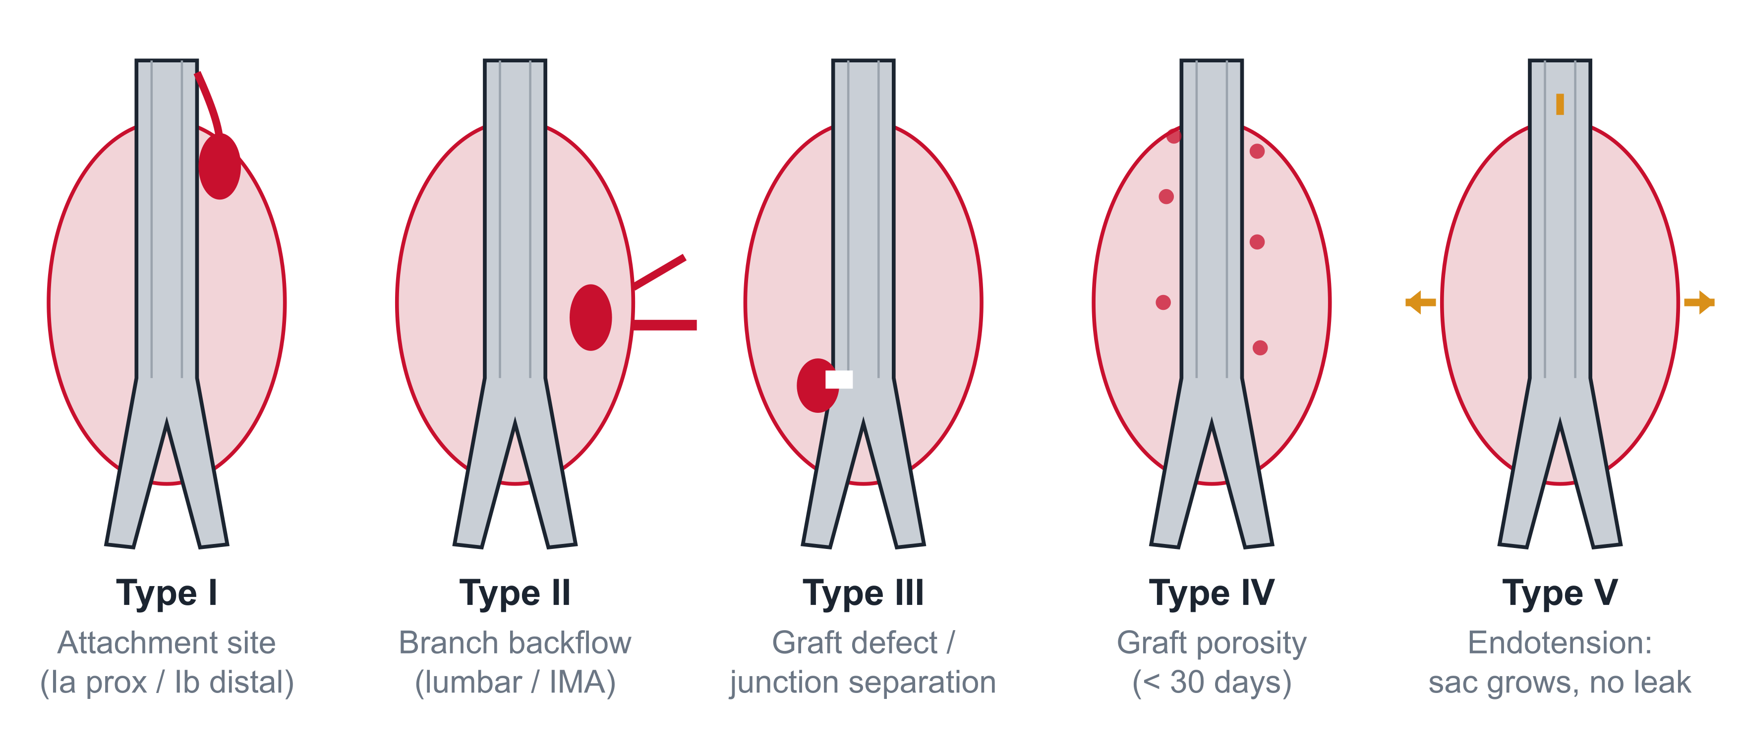
After EVAR: classify the endoleak
✓ PEARL
Triphasic protocol
NCCT (calcium, glue, coils) + arterial + delayed — delayed phase catches slow type II leaks
! PITFALL
Always measure the sac
Type I & III: high pressure → treat promptly
Type II: most common; treat if sac grows
Type IV: transient, early porosity
Type V: growth without visible leak
A growing sac with 'no leak' is still a failing repair (type V or occult leak)
Stavropoulos SW, Charagundla SR. Radiology 2007;243:641–55 · Chaikof EL et al. J Vasc Surg 2018;67:2–77
Notes:
The core of post-EVAR follow-up is endoleak classification. Type I is at the attachment site; type II is retrograde flow from lumbar arteries or the IMA; type III is a graft defect or junctional separation; type IV is early graft porosity; and type V is sac enlargement without a visible leak. Types I and III are high-pressure leaks treated promptly; type II, the most common, is treated when the sac grows. Non-contrast images separate calcium and embolic material, and the delayed phase catches slow type II leaks. And measure the sac every time.

Slide 23
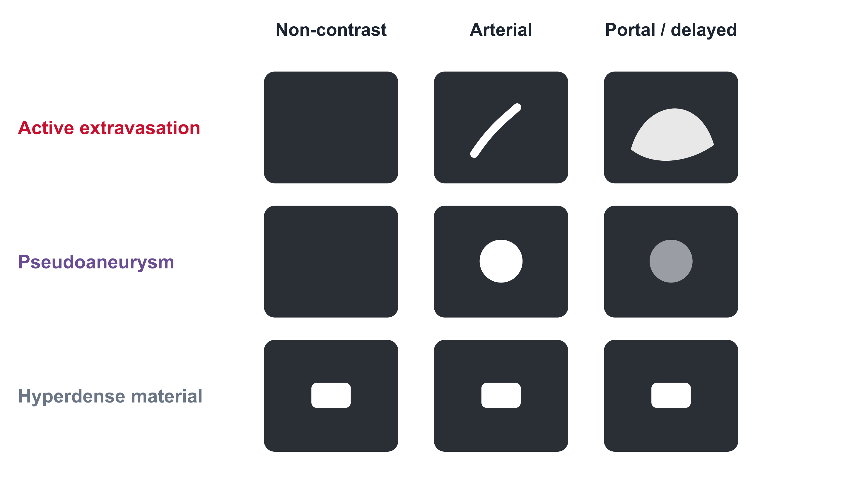
Bleeding: what changes between phases
✓ PEARL
Extravasation grows & changes shape on delay; pseudoaneurysm keeps its shape and follows the blood pool
García-Blázquez V et al. Eur Radiol 2013;23:1181–90 · Kuhle WG, Sheiman RG. Radiology 2003;228:743–52 (animal model)
Notes:
Reading bleeding studies is about what changes between phases. Active extravasation is absent on non-contrast images, appears as a jet in the arterial phase, and grows and changes shape on the delayed phase. A pseudoaneurysm is round in the arterial phase, keeps its shape on delay, and washes out with the blood pool. Anything already bright on non-contrast images is hyperdense material such as medication, retained contrast or clips, which is why the non-contrast scan is essential. In an animal model, CTA detected bleeding rates of about 0.3 mL per minute: more sensitive than catheter angiography, less sensitive than RBC scintigraphy.

Slide 24
Visceral arteries: three quick pearls
1
2
3
Median arcuate ligament
SMA occlusion: embolus vs thrombus
Renal fibromuscular dysplasia
Hook-shaped focal narrowing of the proximal celiac axis, worse in expiration
Embolus: abrupt cutoff a few cm beyond origin, proximal branches spared. Thrombus: at the origin, on plaque, collaterals
'String of beads' in mid-to-distal renal artery; young women
✓ PEARL
✓ PEARL
✓ PEARL
Scan in deep inspiration; compression alone ≠ syndrome
Look for bowel wall, pneumatosis, portal venous gas
Thin-slab MIP + CPR; atherosclerosis is ostial
Horton KM, Talamini MA, Fishman EK. RadioGraphics 2005;25:1177–82
Notes:
Three visceral pearls. First, median arcuate ligament compression is a hook-shaped narrowing of the proximal celiac axis that worsens in expiration, so scan in deep inspiration, and don't call compression alone a syndrome. Second, an SMA embolus cuts off abruptly a few centimeters beyond the origin with proximal branches spared, while thrombosis occurs at the origin on plaque, with collaterals. Always look at the bowel wall. Third, fibromuscular dysplasia gives a string-of-beads appearance in the mid-to-distal renal artery, whereas atherosclerosis is ostial.

Slide 25
Part 4 — Extremity runoff
Lower limb, upper limb and the variants that matter
Notes:
Part four: extremity runoff CTA.

Slide 26
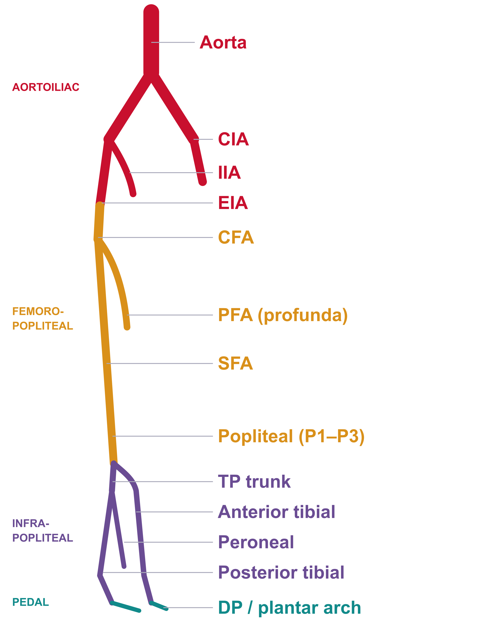
Lower limb: report by territory
What the vascular team needs
Inflow
Aortoiliac disease, CFA quality (access & endarterectomy)
Outflow
Femoropopliteal lesions: length, occlusion, reconstitution
Runoff
Number of patent tibial vessels to the ankle / foot
Target
Best distal target for bypass; pedal arch
✓ PEARL
GLASS staging uses femoropopliteal + infrapopliteal grades
Conte MS et al. Global Vascular Guidelines on CLTI. J Vasc Surg 2019;69:3S–125S
Notes:
Report lower-limb runoff by territory: aortoiliac, femoropopliteal, infrapopliteal and pedal. The vascular team needs four things: inflow, meaning the iliac and common femoral arteries; outflow, meaning femoropopliteal lesion length, occlusion and level of reconstitution; runoff, the number of patent tibial vessels to the ankle; and the best distal target for bypass. In chronic limb-threatening ischemia, the Global Vascular Guidelines' GLASS staging uses femoropopliteal and infrapopliteal grades, so structuring your report this way helps.

Slide 27
Grade simply, report consistently
Normal
< 50%
50–99%
Occlusion
Segment | Right | Left | Length / notes
Common & external iliac | Normal | 50–99% | L EIA 2 cm, calcified
CFA / profunda | < 50% | Normal | CFA plaque: access caution
SFA / popliteal | Occlusion | < 50% | R SFA 12 cm, reconstitutes above knee
AT / PT / peroneal | AT, PT patent | Peroneal only | Non-diagnostic L PT (Ca)
Pedal | DP patent | Plantar arch
✓ PEARL
Example report grid — state 'non-diagnostic' segments explicitly instead of guessing
Fleischmann D et al. JVIR 2006;17:3–26 · Conte MS et al. J Vasc Surg 2019
Notes:
Keep grading simple: normal, less than 50 percent, 50 to 99 percent, and occlusion. Consistency matters more than precision. Use a table, side by side, by segment, with lesion length, calcification and reconstitution level. As in this example, calling a heavily calcified segment non-diagnostic is far safer than guessing stenosis or occlusion.

Slide 28
Runoff pitfalls: six traps
!
Pseudo-occlusion
!
Asymmetric filling
!
Venous contamination
Table outran the bolus → check symmetry, add delayed pass
Proximal disease delays one leg; 'occlusion' may be late flow
Cellulitis, ulcer, AV fistula or late scan: veins mimic arteries
!
Calcium & stents
!
Collaterals
!
Position & motion
Blooming overestimates stenosis; widen window
Large geniculate collaterals mistaken for a patent popliteal
Knee flexion, foot motion; entrapment needs stress views
Fleischmann D et al. JVIR 2006;17:3–26
Notes:
Six runoff traps. Pseudo-occlusion because the table outran the bolus. Asymmetric filling, where proximal disease delays one leg. Venous contamination from cellulitis, ulcers, AV fistulas or a late scan, where veins mimic arteries. Blooming from calcium and stents. Large geniculate collaterals mistaken for a patent popliteal artery. And positioning and motion: popliteal entrapment requires provocative views such as plantar flexion.

Slide 29
Not everything is atherosclerosis
Entity | Typical patient | CTA clue
Popliteal artery aneurysm | Older men | Look at the other knee and the aorta — often bilateral / associated AAA
Popliteal entrapment | Young, athletic | Medial deviation of popliteal artery; compression on plantar-flexion
Cystic adventitial disease | Young–middle-aged men | Smooth extrinsic narrowing by a non-enhancing cyst
Acute embolism | AF, recent MI | Abrupt meniscus cutoff, no collaterals, otherwise normal arteries
Persistent sciatic artery | Rare variant | Continuation of internal iliac along the thigh; aneurysm-prone
✓ PEARL
Young patient + claudication + clean arteries elsewhere → think non-atherosclerotic
Fleischmann D et al. JVIR 2006;17:3–26
Notes:
Not everything is atherosclerosis. Popliteal aneurysms are often bilateral and associated with AAA, so always check the other knee and the aorta. In a young athlete with claudication, think of popliteal entrapment; a smooth extrinsic narrowing suggests cystic adventitial disease. An abrupt cutoff without collaterals in otherwise normal arteries means embolism. And know the rare persistent sciatic artery, a continuation of the internal iliac artery along the back of the thigh.

Slide 30
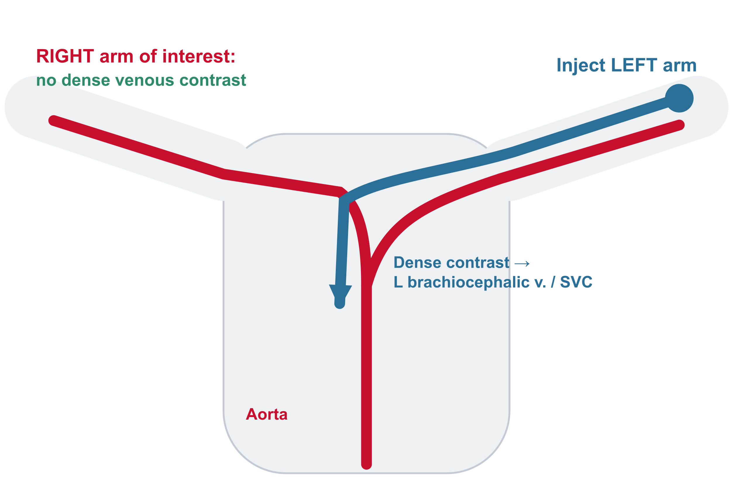
Upper limb: inject away from the side of interest
1
Contralateral injection
Avoids dense venous streak over the subclavian / axillary artery; foot vein if bilateral
2
Arm position
Arm of interest raised (or at side) and immobilised; hand palm-up and warm
3
Thoracic outlet
Scan in abduction AND neutral — compression may appear only with the manoeuvre
Hellinger JC, Epelman M, Rubin GD. Radiol Clin North Am 2010;48:397–421
Notes:
For upper-limb CTA, inject on the side opposite the one of interest. An ipsilateral injection puts dense contrast in the subclavian and axillary veins, right next to the artery, causing streak. If both sides are needed, use a foot vein. Immobilize the arm of interest and keep the hand warm. For thoracic outlet syndrome, scan in both abduction and neutral position; compression may appear only with the manoeuvre.

Slide 31
Upper limb: pitfalls and pearls
! PITFALL
Vasospasm
! PITFALL
Positional compression
Cold hands narrow digital arteries → mimics occlusive disease. Warm the hand; repeat if needed
Mild narrowing in abduction is common in healthy people — correlate with symptoms
✓ PEARL
Hypothenar hammer
✓ PEARL
Arch variants
Ulnar artery aneurysm / occlusion at the hook of the hamate after repetitive palm trauma
Aberrant right subclavian (≈ 0.5–2%), common brachiocephalic–left carotid origin
Hellinger JC et al. Radiol Clin North Am 2010;48:397–421
Notes:
Upper-limb pitfalls and pearls. Cold hands cause digital artery vasospasm that mimics occlusive disease, so warm the hand and repeat if needed. Mild narrowing in abduction is common in healthy people, so correlate with symptoms. An ulnar artery aneurysm or occlusion near the hook of the hamate after repetitive palm trauma is hypothenar hammer syndrome. And an aberrant right subclavian artery is seen in roughly 0.5 to 2 percent of people.

Slide 32
Variants that change the procedure
Variant | Approx. prevalence | Why it matters
Accessory renal arteries | ≈ 25–30% | EVAR coverage, donor nephrectomy, renal infarct after stent-graft
Aberrant right subclavian artery | ≈ 0.5–2% | Dysphagia lusoria, TEVAR planning, right radial access
Retro- / circumaortic left renal vein | A few % | Injury during aortic surgery or EVAR
High origin of the radial artery | ≈ 10–15% | Arterial access, flap and fistula surgery
Persistent sciatic artery | < 0.1% | Aneurysm, thromboembolism; SFA often hypoplastic
✓ PEARL
Name the variant in the impression when a procedure is planned
Prevalence figures are approximate ranges reported in anatomical and imaging series
Notes:
These variants change procedures. Accessory renal arteries are present in roughly a quarter of patients and matter for EVAR coverage and donor nephrectomy. An aberrant right subclavian artery affects TEVAR planning and right radial access. A retroaortic or circumaortic left renal vein risks injury during surgery. A high origin of the radial artery matters for access and flap surgery, and a persistent sciatic artery for aneurysm and embolism. When a procedure is planned, name the variant in the impression. Prevalence figures vary between series, so they are shown as approximate ranges.

Slide 33
Take-home messages
Check the bolus before the vessel: ≥ 250 HU, symmetric distal filling
Axial source images first and last; MIP / VR never grade stenosis
1
2
Widen the window for calcium and stents; say 'non-diagnostic' when needed
NCCT is mandatory for IMH, bleeding and post-EVAR
3
4
Flaps persist across planes and phases — artifacts don't
Report what changes management: entry tear, branches, runoff, variants
5
6
Notes:
To summarize. Check the bolus before the vessel. Start and finish on the axial source images, and never grade stenosis on MIP or VR. Widen the window for calcium and stents, and say non-diagnostic when you cannot see. Non-contrast CT is mandatory for intramural hematoma, bleeding and post-EVAR follow-up. Real flaps persist across planes and phases. And finally, report what changes management. Thank you.

Slide 34
References
1. Fleischmann D, Hallett RL, Rubin GD. CT angiography of peripheral arterial disease. J Vasc Interv Radiol. 2006;17:3–26.
2. Fleischmann D, Rubin GD. Quantification of intravenously administered contrast medium transit through the peripheral arteries: implications for CT angiography. Radiology. 2005;236:1076–82.
3. Met R, Bipat S, Legemate DA, Reekers JA, Koelemay MJ. Diagnostic performance of CT angiography in peripheral arterial disease: systematic review and meta-analysis. JAMA. 2009;301:415–24.
4. Isselbacher EM, Preventza O, Hamilton Black J 3rd, et al. 2022 ACC/AHA guideline for the diagnosis and management of aortic disease. Circulation. 2022;146:e334–e482.
5. Chaikof EL, Dalman RL, Eskandari MK, et al. The Society for Vascular Surgery practice guidelines on the care of patients with an abdominal aortic aneurysm. J Vasc Surg. 2018;67:2–77.
6. LePage MA, Quint LE, Sonnad SS, Deeb GM, Williams DM. Aortic dissection: CT features that distinguish true lumen from false lumen. AJR. 2001;177:207–11.
7. Batra P, Bigoni B, Manning J, et al. Pitfalls in the diagnosis of thoracic aortic dissection at CT angiography. RadioGraphics. 2000;20:309–20.
8. Stavropoulos SW, Charagundla SR. Imaging techniques for detection and management of endoleaks after endovascular aortic aneurysm repair. Radiology. 2007;243:641–55.
9. García-Blázquez V, Vicente-Bártulos A, Olavarria-Delgado A, et al. Accuracy of CT angiography in the diagnosis of acute gastrointestinal bleeding: systematic review and meta-analysis. Eur Radiol. 2013;23:1181–90.
10. Kuhle WG, Sheiman RG. Detection of active colonic hemorrhage with use of helical CT: findings in a swine model. Radiology. 2003;228:743–52.
11. Horton KM, Talamini MA, Fishman EK. Median arcuate ligament syndrome: evaluation with CT angiography. RadioGraphics. 2005;25:1177–82.
12. Conte MS, Bradbury AW, Kolh P, et al. Global vascular guidelines on the management of chronic limb-threatening ischemia. J Vasc Surg. 2019;69:3S–125S.
13. Hellinger JC, Epelman M, Rubin GD. Upper extremity computed tomographic angiography: state of the art technique and applications in 2010. Radiol Clin North Am. 2010;48:397–421.
14. Albrecht MH, Vogl TJ, Martin SS, et al. Review of clinical applications for virtual monoenergetic dual-energy CT. Radiology. 2019;293:260–71.
15. Davenport MS, Perazella MA, Yee J, et al. Use of intravenous iodinated contrast media in patients with kidney disease: consensus statements from the ACR and NKF. Radiology. 2020;294:660–8.
16. ACR–NASCI–SIR–SPR Practice Parameter for the Performance and Interpretation of Body Computed Tomography Angiography (CTA). American College of Radiology (current revision).
Notes:
These are the references. All figures and recommendations in the slides are based on these sources. Adapt protocol values to your own scanner and contrast agent.

