Slide 1
Markdown to Presentation
DigitalizeIT GmbH

Slide 2
Introduction
Goal Convert md (Markdown) files to a presentation.
By using pandoc.
Pandoc is a very powerful tool and can convert almost any document format to another document format.
For all options run pandc --help or checkout Pandoc User’s Guide

Slide 3
Setup
On Debian/Ubuntu based distributions install following software
sudo apt-get install pandoc sudo apt-get install texlive-latex-base
If there should be missing software search in google for it.

Slide 4
Basic
To simply convert an md file run:
pandoc README.md -t beamer -o presentation.pdf

Slide 5
Advanced
To generate a more beautiful presentation add metadata.
This can be done in the md file itself with a yaml block at the beginning
--- title: - Mardown to Presentation author: - DigitalizeIT GmbH theme: - Copenhagen ---
pandoc README.md -t beamer -o presentation.pdf
List with all themes

Slide 6
Using a template file
Modify the md with specific pandoc metadata is not always what you want. We can put all these metadata to a template file. E.g. template.yaml.
pandoc README.md -t beamer -o presentation.pdf \ --metadata-file=template.yaml

Slide 7
Code block highlighting
There are several code highlighting styles available:
pandoc --list-highlight-styles
An example by using the zenbrun style
pandoc README.md -t beamer -o presentation.pdf \ --metadata-file=template.yaml \ --highlight-style=zenburn

Slide 8
Generate other document types
There are almost 50 output formats available. To list them:
pandoc --list-output-formats
Be aware that every generator has it’s own options. For example the theme option in the template.yaml is only available in the beamer generator.

Slide 9
Generate a PDF document
pandoc README.md -t latex -o presentation.pdf \ --metadata-file=template.yaml \ --highlight-style=zenburn -V geometry:a4paper

Slide 10
Generate HTML
pandoc README.md -t html5 -o presentation.html \ --metadata-file=template.yaml \ --highlight-style=zenburn
If you analyze the generated HTML code all HTML tags have specific class attributes. So it’s straight forward to generate a custom css.

Slide 11
Generate Microsoft Office documents
Unfortunately docx and pptx have no templates available.
Generate a PowerPoint
pandoc README.md -t pptx -o presentation.pptx \ --metadata-file=template.yaml \ --highlight-style=zenburn
Generate a word document
pandoc README.md -t docx -o presentation.docx \ --metadata-file=template.yaml \ --highlight-style=zenburn

Slide 12
Conclusion
Cons
Pandoc is in my opinion not a replacement for professional PowerPoint presentation or word documents.
Pro
Pandoc is a powerful tool to generate documents based out of Markdown files. Especial to document a software project. It can be easily integrated into a CI/CD pipeline and the documentation will be released at the same time as the software.
Hints
If you want to transform the Markdown be aware of it when writing. Especial the code snippets will not have a word wrap in the most cases. When generating a presentation (e.g. beamer). Be aware of the size of each slide…

Slide 13
Results Document
Preview of the generated document

Slide 14
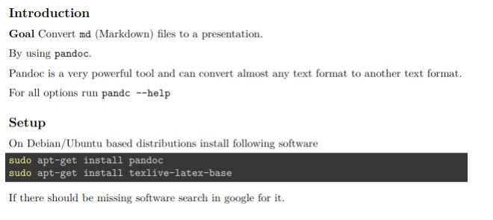
generated document

Slide 15
Results Presentation
Preview of the generated presentation

Slide 16
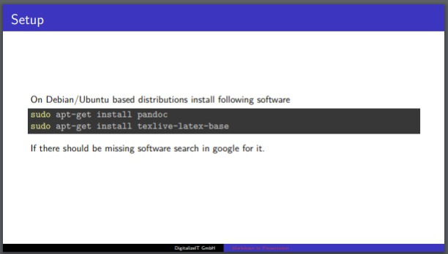
generated presentation

