Slide 1
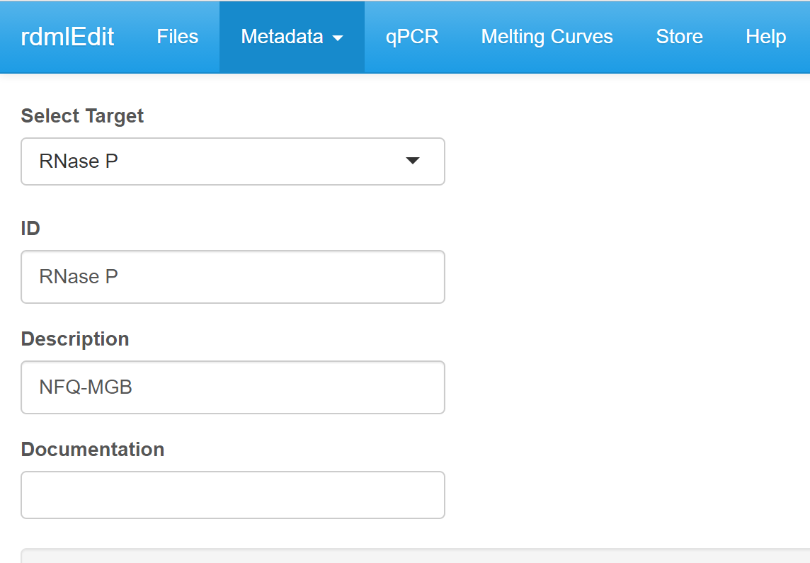
Tabs with menus to load, edit
and view the data.
Drop down menu for selection of
experiment specific settings
Input filed for character or
numeric values

