Slide 1
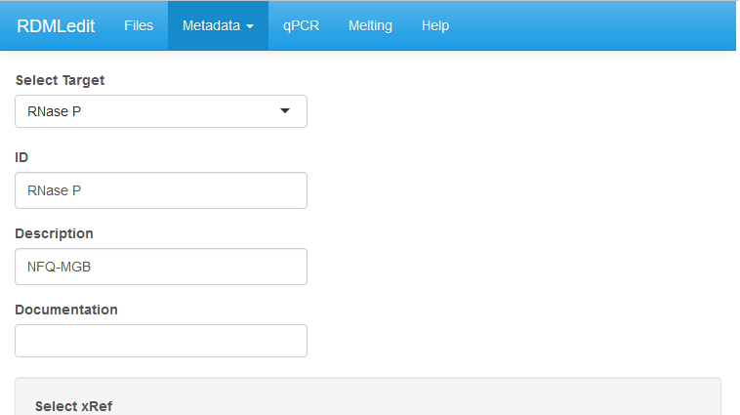
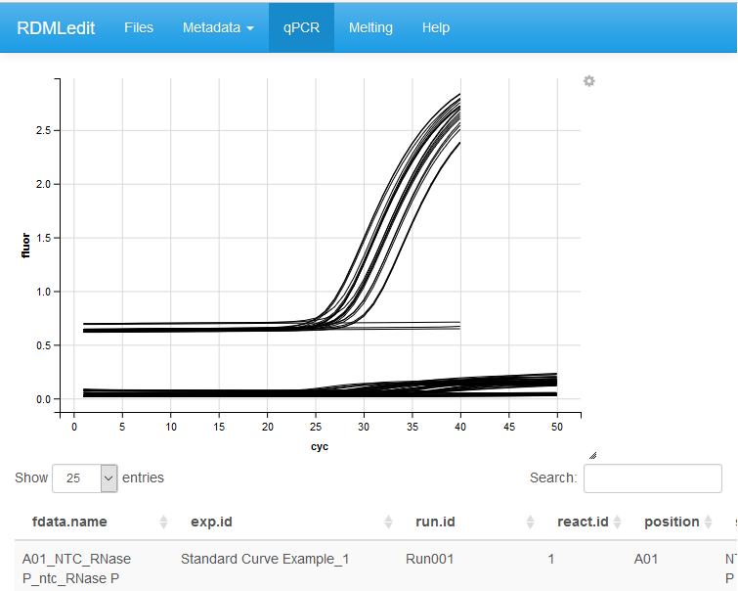
A
Tabs with menus to load, edit
and view the data.
Drop down menu for selection of
experiment specific settings
Input filed for character or
numeric values
B
Raw amplification curves of two merged data sets from
different experiments
Interactive table with filter, sort and search functionality

