Slide 1
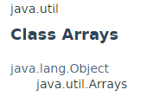
Arrays
Arrays class contains various methods for manipulating arrays (such as sorting and searching). This class also contains a static factory that allows arrays to be viewed as lists.
The methods in this class all throw a NullPointerException, if the specified array reference is null.

Slide 2
Observable
https://docs.oracle.com/javase/8/docs/api/index.html?java/util/Arrays.html

