Slide 1
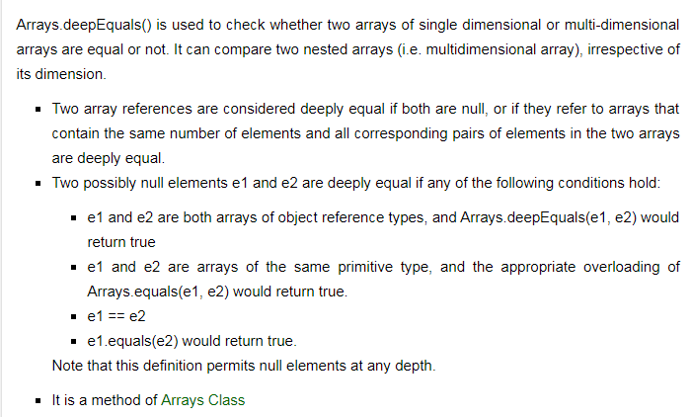
Java.util.Arrays.deepEquals() in Java

