Slide 1
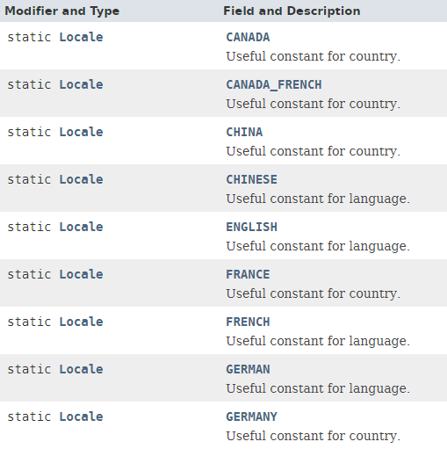
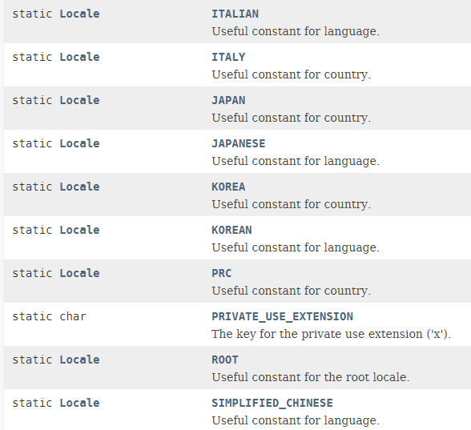
Locale

Slide 2
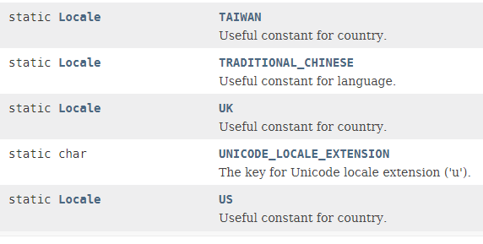
Locale

Slide 3
TimerTask
https://docs.oracle.com/javase/8/docs/api/index.html?java/util/Locale.html

