Slide 1
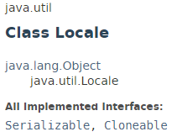
Locale
The java.util.Locale class object represents a specific geographical, political, or cultural region. This object can be used to get the locale specific information such as country name, language, variant etc.

Slide 2
TimerTask
https://docs.oracle.com/javase/8/docs/api/index.html?java/util/Locale.html

