Slide 1
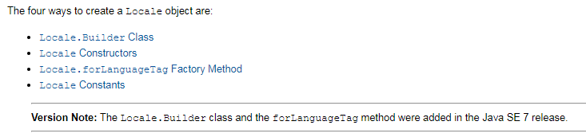
Locale
There are several ways to create a Locale object. Regardless of the technique used, creation can be as simple as specifying the language code. However, you can further distinguish the locale by setting the region (also referred to as "country") and variant codes.

Slide 2
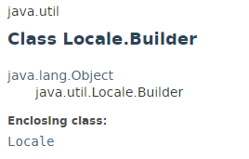
Locale
LocaleBuilder Class
The Locale.Builder utility class can be used to construct a Locale object that conforms to the IETF BCP 47 syntax. For example, to specify the French language and the country of Canada, you could invoke the Locale.Builder constructor and then chain the setter methods as follows:
Locale aLocale = new Locale.Builder().setLanguage("fr").setRegion("CA").build();
The next example creates Locale objects for the English language in the United States and Great Britain:
Locale bLocale = new Locale.Builder().setLanguage("en").setRegion("US").build();
Locale cLocale = new Locale.Builder().setLanguage("en").setRegion("GB").build();
The final example creates a Locale object for the Russian language:
Locale dLocale = new Locale.Builder().setLanguage("ru").setScript("Cyrl").build();

Slide 3
Locale
Locale Constructors
There are three constructors available in the Locale class for creating a Locale object:
Locale(String language)
Locale(String language, String country)
Locale(String language, String country, String variant)
The following examples create Locale objects for the French language in Canada, the English language in the U.S. and Great Britain, and the Russian language.
aLocale = new Locale("fr", "CA");
bLocale = new Locale("en", "US");
cLocale = new Locale("en", "GB");
dLocale = new Locale("ru");
It is not possible to set a script code on a Locale object in a release earlier than JDK 7.

Slide 4
Locale
forLanguageTag Factory Method
If you have a language tag string that conforms to the IETF BCP 47 standard, you can use the forLanguageTag(String) factory method, which was introduced in the Java SE 7 release. For example:
Locale aLocale = Locale.forLanguageTag("en-US"); Locale bLocale = Locale.forLanguageTag("en-US");

Slide 5
Locale
Locale Constants
For your convenience the Locale class provides constants for some languages and countries. For example:
cLocale = Locale.JAPAN; dLocale = Locale.CANADA_FRENCH;
When you specify a language constant, the region portion of the Locale is undefined. The next three statements create equivalent Locale objects:
j1Locale = Locale.JAPANESE;
j2Locale = new Locale.Builder().setLanguage("ja").build();
j3Locale = new Locale("ja");
The Locale objects created by the following three statements are also equivalent:
j4Locale = Locale.JAPAN;
j5Locale = new Locale.Builder().setLanguage("ja").setRegion("JP").build();
j6Locale = new Locale("ja", "JP");

Slide 6
TimerTask
https://docs.oracle.com/javase/8/docs/api/index.html?java/util/Locale.html
https://docs.oracle.com/javase/8/docs/api/java/util/Locale.Builder.html

