Slide 1
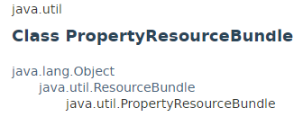
PropertyResourceBundle
PropertyResourceBundle is a concrete subclass of ResourceBundle that manages resources for a locale using a set of static strings from a property file.

Slide 2
TimerTask
https://docs.oracle.com/javase/8/docs/api/index.html?java/util/PropertyResourceBundle.html

