Slide 1
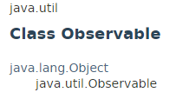
Observable
Observable class represents an observable object, or "data" in the model-view paradigm.
Observable can be subclassed to represent an object that the application wants to have observed.

Slide 2
Observable
Observer 2
update()
Notify the change
Notify the change
Observable
Notify the change
Observer 1
Observer 3
update()
notifyObservers()
update()
An observable object can have one or more observers.
An observer may be any object that implements interface Observer.
After an observable instance changes, an application calling the Observable's notifyObservers method causes all of its observers to be notified of the change by a call to their update method.

Slide 3
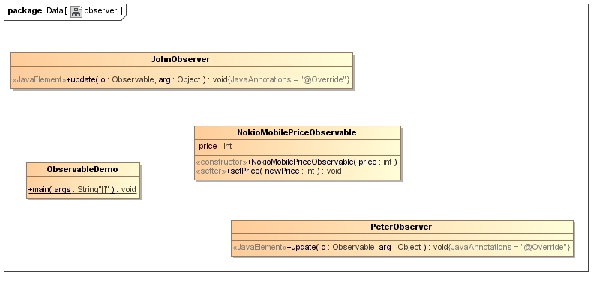


Observable
Notify the price change
Notify the price change

Slide 4
Observable
https://docs.oracle.com/javase/8/docs/api/index.html?java/util/Observable.html

