Slide 1
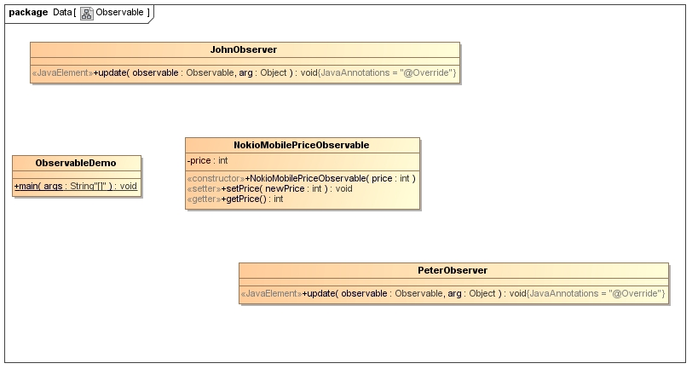


Observable
Notify the price change
Notify the price change

