Slide 1
Télesphore Evariste Larba KABORÉ | DATA 205 | Spring 2026 | CRN: 3206 | Montgomery College
From Service Coverage to
Mortality Reduction
PLAN
1
Introduction
2
Data
3
Methods & Tools
4
Data Preparation
Predictive and Spatial Analysis of Maternal Health in Malawi
5
Descriptive Statistics
6
Equity Analysis
Télesphore Evariste Larba KABORÉ
DATA 205 Capstone Project · CRN 3206 · Montgomery College · Spring 2026
7
Predictive Analysis
8
Spatial Analysis
9
Dashboard & Results
10
Conclusions
DATA 205 · Spring 2026 · Télesphore Evariste Larba KABORÉ · Montgomery College
Notes:
"Good evening. My name is Télesphore Kaboré, and today I want to take you on a data journey through one of the most pressing public health challenges in sub-Saharan Africa : why women in Malawi are still dying from causes we know how to prevent."
"This capstone project combines predictive modeling, equity analysis, and spatial mapping to go beyond simple national averages and ask: who is being left behind, where, and why?"
"To answer that, I'll walk you through ten sections. We'll start with the context that motivated this work, then move through the data sources and methods I used, before diving into the results : descriptive trends, equity breakdowns, predictive models, and district-level maps. We'll close with the dashboard I built for policymakers and the recommendations that follow from the analysis."
"Let's start with why Malawi, and why now."

Slide 2
INTRODUCTION
Context & Motivation
Why Maternal Health in Malawi?
Core Research Questions
Malawi has made progress reducing maternal mortality — but national averages hide critical gaps across districts, wealth groups, and education levels.
This project builds on doctoral work in maternal health service uptake, aiming to go beyond simple coverage rates using:
Survey-weighted descriptive analysis (DHS 2015–16 & 2024)
Equity analysis by wealth, education & residence
Predictive modeling (logistic regression)
District-level spatial mapping
Power BI dashboard for policymakers
1
How did ANC4+, SBA, and PNC coverage change between 2015 and 2024?
2
How do indicators vary by wealth, education, and urban/rural residence?
3
Which factors predict non-utilization of maternal health services?
4
Which districts improved or declined in maternal health coverage?
5
How can dashboard storytelling support planning and decision-making?
Notes:
"Malawi has made real progress on maternal mortality over the past decade , but national numbers mask deep inequalities across districts, wealth groups, and education levels. That gap between the headline and the reality is what motivated this project."
"Building on my doctoral research in maternal health service uptake, I designed a multi-method analysis, combining survey-weighted statistics, equity breakdowns, predictive modeling, spatial mapping, and a Power BI dashboard, to move beyond what aggregate coverage rates can tell us."
"That led me to five concrete questions, which together form the backbone of everything you'll see today, from how coverage shifted between 2015 and 2024, to which districts are falling behind, to whether data storytelling can actually support planning decisions."

Slide 3
DATA
Data Sources & Preparation
Malawi DHS 2015–16
Malawi DHS 2024
World Bank WDI
Nationally representative household survey · Individual recode files · Survey weights applied (÷1,000,000) · Key indicators: ANC4+, SBA, PNC · District, wealth quintile, education, residence
Most recent survey for trend comparison · Variables harmonized across years · District names cleaned & standardized · Spatial join with GADM administrative boundaries
National-level maternal mortality context · Broader development trend indicators · Used for executive summary framing in dashboard
Three binary outcomes created: ANC4+ (≥4 antenatal visits) SBA (skilled birth attendance) PNC (postnatal care received)
Notes:
"The analysis draws on three data sources. The backbone is the Malawi Demographic and Health Survey, two rounds: the 2015–16 survey as my baseline, and the 2024 survey as the most recent snapshot. Both are nationally representative household surveys, and I applied the DHS survey weights throughout to ensure my estimates reflect the actual population."
"One important step was harmonizing variables across the two rounds, district names, wealth quintiles, and outcome definitions, so the comparison is apples to apples. I also joined the district-level summaries to GADM administrative boundaries to enable the spatial mapping you'll see later."
"From these surveys I constructed three binary outcomes that run through the entire analysis: ANC4+, whether a woman attended at least four antenatal visits; SBA, whether a skilled provider was present at delivery; and PNC, whether she received postnatal care. Everything from the descriptive trends to the predictive models is built around these three indicators."
"Now let me walk you through the tools and methods I used to analyze them."

Slide 4
METHODS & TOOLS
Analytical Approach
Multi-method pipeline: descriptive | equity | predictive | spatial | dashboard
R / RStudio
Python / scikit-learn
Survey-weighted statistics, equity analysis, spatial mapping (sf, ggplot2, geodata), Quarto reporting
Logistic regression modeling, class balancing, ROC-AUC evaluation, confusion matrices
Power BI
GADM + sf
Interactive dashboard: executive page, spatial page, indicator comparison : decision-support storytelling
District boundary harmonization, spatial joins, choropleth maps for 2015, 2024 & change analysis
Notes:
"This project follows a five-stage analytical pipeline — descriptive, equity, predictive, spatial, and dashboard — each requiring a different tool."
"R was my primary environment for everything statistical: survey-weighted estimates, equity breakdowns by wealth and education, and the choropleth maps built with the sf and ggplot2 packages. For the predictive modeling I moved to Python and scikit-learn, where I ran logistic regression models and addressed class imbalance using balanced weighting. The spatial boundary work relied on GADM shapefiles joined to the DHS district summaries. And the final data product is a three-page Power BI dashboard designed specifically for a policymaker audience — not just charts, but a decision-support narrative."
"Before we get to results, let me quickly walk through the key data preparation decisions that sit underneath all of this."

Slide 5
DATA PREPARATION
Data Cleaning & Pre-Processing Highlights
DHS Weights Applied
Variable Harmonization
01
Weight variable divided by 1,000,000 to generate nationally representative estimates for all three indicators.
02
District names, wealth quintiles, education levels, and outcome variables aligned across DHS 2015–16 and DHS 2024 files.
Missing Value Handling
Binary Outcome Creation
03
Missing entries in ANC and PNC variables identified; cases with incomplete outcome data excluded from relevant models.
04
ANC4+ (≥4 visits = 1), SBA (skilled provider at delivery = 1), PNC (postnatal care received = 1).
Spatial Boundary Join
Class Imbalance — SBA Model
05
District centroids from GADM merged with DHS district-level summaries; district name discrepancies manually resolved.
06
Severe class imbalance corrected using class_weight='balanced' in scikit-learn logistic regression.
Notes:
"Before any analysis, I needed to make sure the data was clean, consistent, and comparable across both survey rounds. Six steps shaped that process."
"First, DHS survey weights were applied throughout — dividing the weight variable by one million — so every estimate reflects the national population, not just the raw sample. Second, I harmonized district names, wealth quintiles, and outcome definitions across the two DHS files so the trend comparison is valid. Cases with missing outcome data were excluded from the relevant models rather than imputed."
"Two steps are worth pausing on. The binary outcome creation, coding ANC4+, SBA, and PNC as zero-or-one variables, is the foundation everything else is built on. And for the SBA predictive model specifically, I encountered severe class imbalance: the vast majority of women in the sample did use a skilled birth attendant, which means a naive model would simply predict 'yes' for everyone and look accurate while missing all the at-risk cases. I corrected for this using scikit-learn's balanced class weighting, which I'll come back to when we discuss model performance."
"With clean, analysis-ready data in hand, let's look at what it tells us."

Slide 6
DESCRIPTIVE STATISTICS
National Coverage Trends: 2015–2024
Three key maternal health indicators compared across DHS survey rounds
ANC4+
+12.1 pp
51.0% → 63.1%
SBA
−16.7 pp
49.7% → 33.0%
PNC
≈ stable
99.5% → 99.3%
Notes:
"This is the first results slide, and it tells a story with a clear contradiction at its center."
"ANC4+ improved by 12 percentage points, from 51% in 2015 to 63% in 2024. That means more women are engaging with the health system during pregnancy, which is genuinely good news. PNC remained near-universal at around 99% in both rounds , consistent and stable. But look at SBA, skilled birth attendance collapsed from 50% to 33%, a drop of nearly 17 percentage points."
"That contradiction is the central finding of this project. Women are attending more antenatal visits than ever, but when it comes time to actually deliver, a growing share are doing so without a skilled provider present. The care continuum is broken in the middle. More engagement at the front end is not translating into safer deliveries , and that is exactly where maternal deaths happen."
"The national average, however, hides as much as it reveals. Let's look at who specifically is being left behind."

Slide 7
EQUITY ANALYSIS
Persistent Disparities: Who Is Being Left Behind?
ANC4+ and SBA coverage by wealth quintile, education, and residence (DHS 2024)
Wealth gap in SBA
Education matters
Urban advantage
Richest 58% vs Poorest 20% — 38 pp gap
Higher education → better coverage across all indicators
Urban women consistently outperform rural counterparts
Notes:
"The national average of 33% SBA coverage is already alarming, but it becomes even more troubling when you disaggregate by wealth."
Walk the charts "On the left, ANC4+ coverage rises steadily with wealth, from around 55% among the poorest to 76% among the richest. That's a meaningful gap, but the gradient is relatively moderate. Now look at SBA on the right. The poorest women have just 20% skilled birth attendance. The richest have 58%. That is a 38 percentage point gap, nearly three times wider than the ANC4+ gap, meaning wealth is a far stronger determinant of whether a woman delivers safely than of whether she attends antenatal care."
"Education and residence tell the same story. Women with higher education consistently outperform those with no education across all three indicators. Urban women outperform rural women. These are not random variations, they are structural inequalities that have persisted across both survey rounds."
"What this tells us is that the SBA decline we saw at the national level is not evenly distributed. It is falling hardest on the women who were already the most vulnerable.“
"I then asked: can we predict which women are most at risk of not using these services? That's what the predictive modeling attempted to answer."

Slide 8
PREDICTIVE MODELING
Logistic Regression: Predicting Service Non-Use
Balanced models to address class imbalance; evaluated by accuracy, ROC-AUC, and recall
SBA Non-Use Model
ANC4+ Utilization Model
Balanced logistic regression · Python/scikit-learn
Balanced logistic regression · Python/scikit-learn
Accuracy
68%
Accuracy
53%
ROC-AUC
0.685
ROC-AUC
0.556
Recall (non-use)
57%
Recall
Limited
Precision (non-use)
~5%
Precision
Limited
Moderate ability to identify women at risk of SBA non-use. Class weighting essential — imbalanced model missed almost all non-users.
Weak predictive performance. Demographic & socioeconomic predictors alone insufficient — facility access, quality of care, transport, and cultural norms missing.
Notes:
"I built two logistic regression models to predict non-use of maternal health services — one for SBA, one for ANC4+. Both used balanced class weighting to correct for the imbalance issue I mentioned earlier. The results are instructive, and honestly, the limitations are as important as the findings."
"The SBA model achieved 68% accuracy and a ROC-AUC of 0.685, moderate but meaningful performance. Crucially, it identified 57% of actual non-users, which means it has real screening potential. The low precision of around 5% reflects the rarity of non-use in the sample, many false positives, but in a public health context, casting a wider net to catch at-risk women is often an acceptable trade-off."
"The ANC4+ model performed much more weakly, 53% accuracy and a ROC-AUC of just 0.556, barely above random chance. That tells us something important: wealth, education, and residence alone are not sufficient to predict ANC4+ non-use. The variables that likely matter more, distance to facilities, quality of care, transport availability, cultural norms, were not in the dataset."
"So the predictive models are useful for profiling risk at a population level, but they are not ready for individual-level targeting. The bigger contribution here is the diagnostic insight: we need richer data to build actionable predictive tools for ANC uptake."
"Now let's shift from who to where, the spatial analysis."

Slide 9
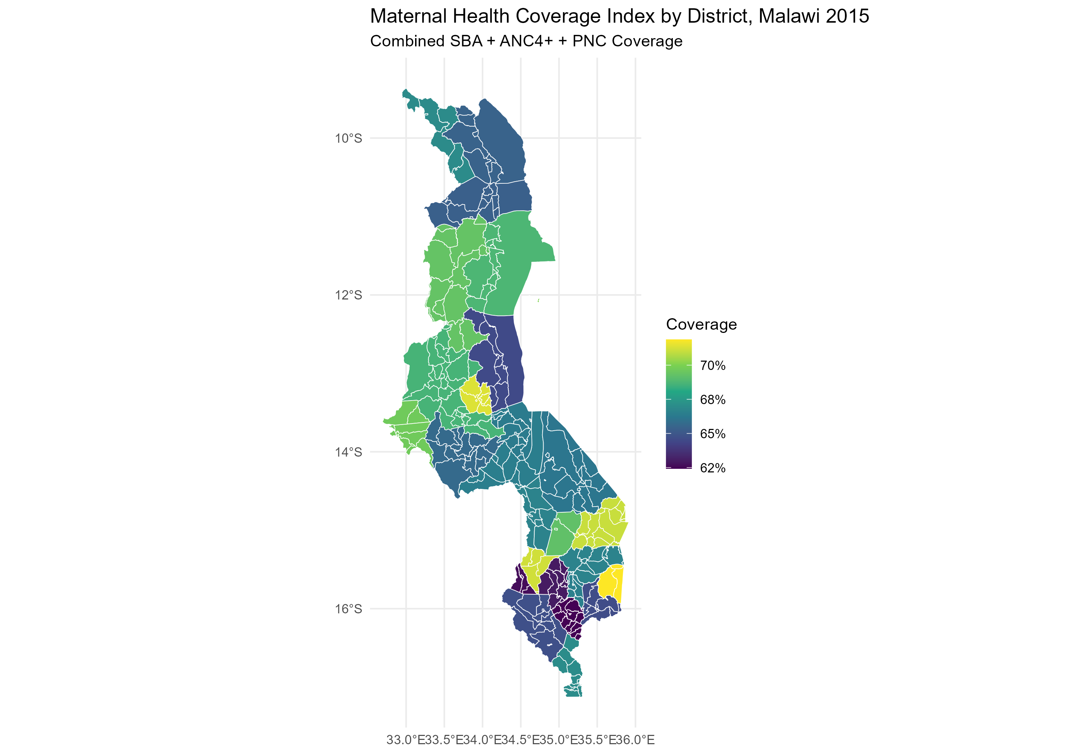
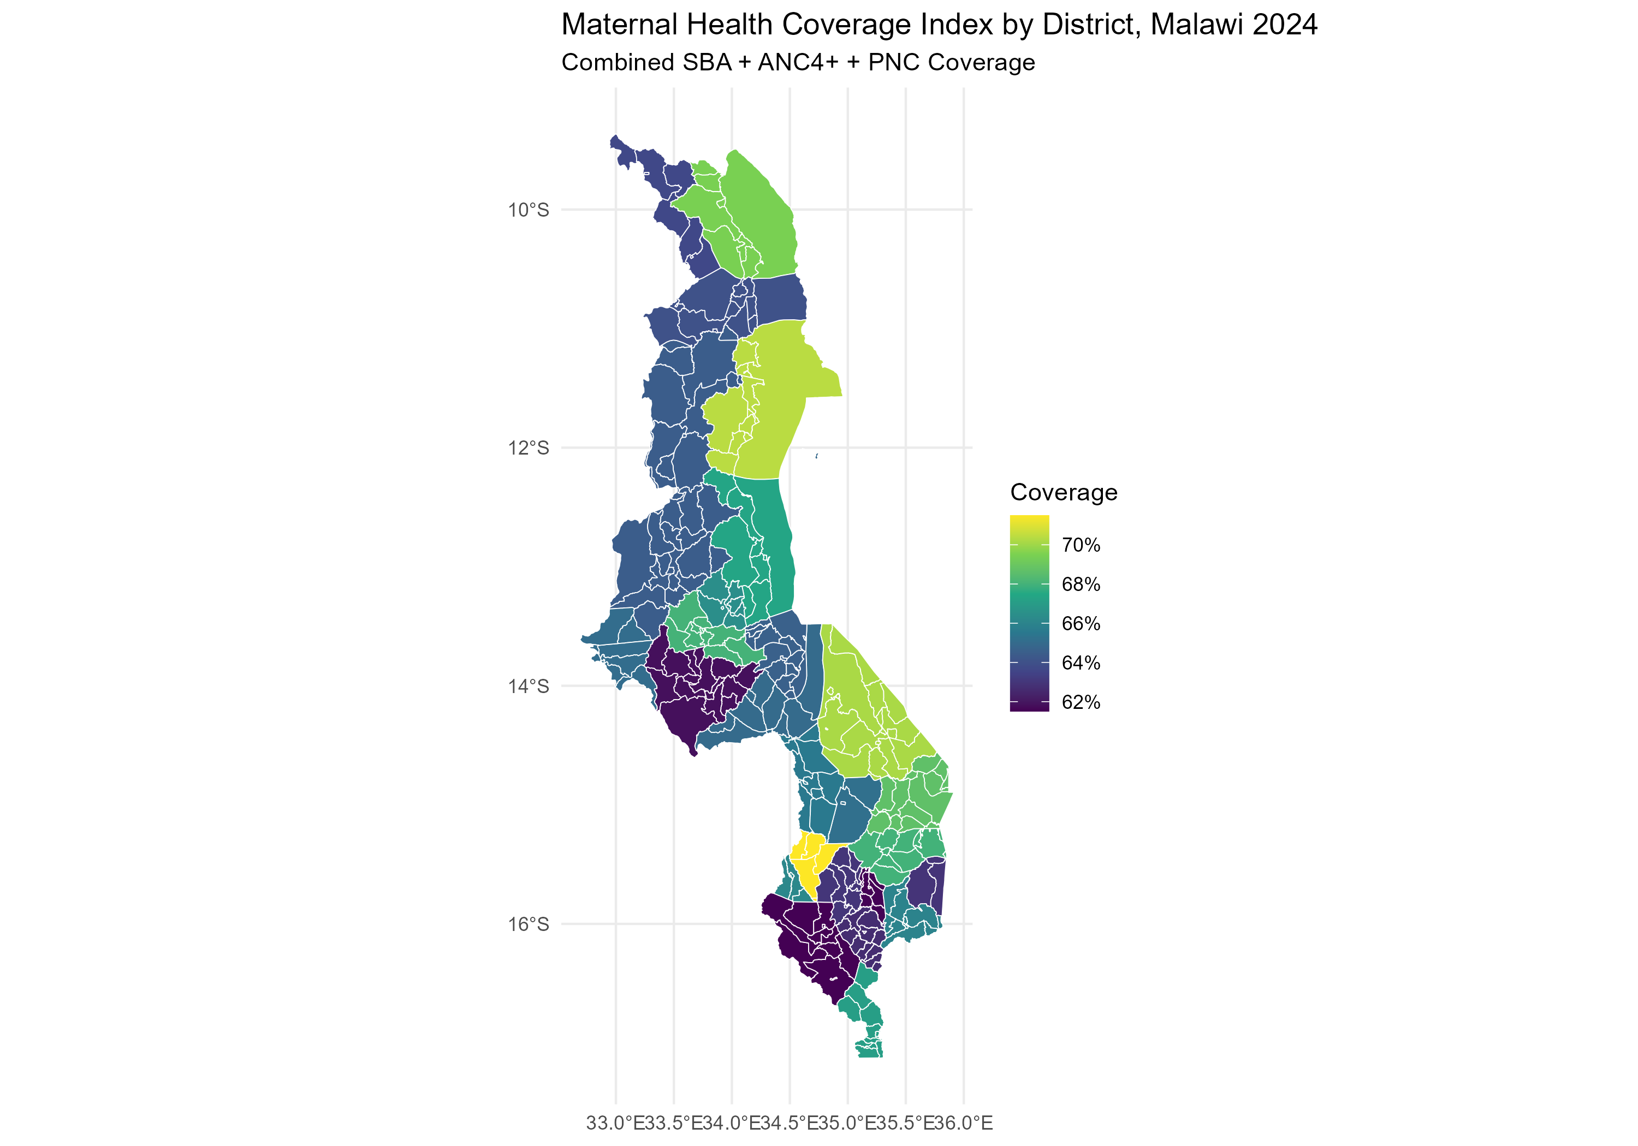
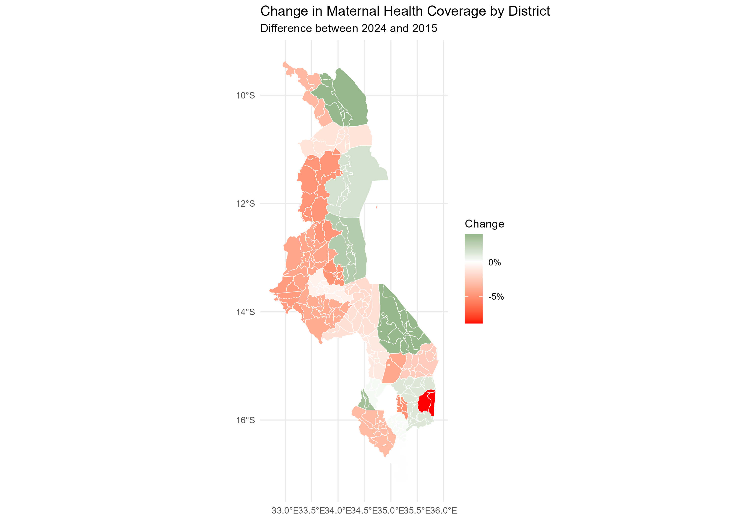
SPATIAL ANALYSIS
District-Level Maternal Health Coverage Index
Composite SBA + ANC4+ + PNC average — 2015, 2024, and the change between survey rounds
2015 Baseline
2024 Current
Change 2015→2024
Notes:
"This slide moves the analysis from who to where. These three maps show a composite maternal health coverage index, combining SBA, ANC4+, and PNC at the district level."
"The 2015 baseline on the left shows considerable variation already, some northern districts performing relatively well in green and yellow, while central and southern districts show weaker coverage in blue and purple. By 2024, the middle map shows that variation has deepened , more districts shifting toward the darker end of the scale, signaling broader deterioration in the composite index, driven primarily by the SBA decline."
"The map on the right is the most actionable. Green districts improved between 2015 and 2024, a handful in the north. But the dominant color is red and pink, covering much of the central and western regions, indicating coverage declined. One district in the south stands out in deep red, the sharpest deterioration in the country. These are the districts that need immediate attention from planners and resource allocators."
"This is precisely why national averages are dangerous. A country-level figure of 33% SBA masks the fact that some districts may be at 20% while others are at 50%. Spatial targeting is impossible without maps like these."
"This spatial layer fed directly into the Power BI dashboard, let me show you how that comes together."

Slide 10
FINAL DATA PRODUCT
Power BI Dashboard: Decision-Support Storytelling
Page 1
Executive Summary
Central Message
National KPIs for ANC4+, SBA, PNC with trend comparison banners. High-level entry point for policymakers.
ANC4+ improved — more women engaging with antenatal care
PNC remained near-universal — consistent postnatal reach
Page 2
Spatial Analysis
Interactive district-level maps for 2015, 2024, and coverage change. Filters by indicator and region.
SBA declined sharply — the most alarming gap in the continuum
District disparities persist — national averages are misleading
Page 3
Indicator Comparison
Side-by-side breakdown of ANC4+, SBA, PNC, and composite index — by wealth, education, and residence.
Equity gaps by wealth, education & residence remain structural
Notes:
"The final data product ties everything together, a three-page Power BI dashboard designed not for data scientists, but for district health planners and policymakers who need to act on this information."
"Page one is an executive summary, national KPIs for all three indicators with trend comparison banners, so a decision-maker can land on that page and immediately understand the direction of travel. Page two is the spatial analysis , interactive district-level maps for 2015, 2024, and the change between the two rounds, filterable by indicator and region. Page three is the indicator comparison, breaking down ANC4+, SBA, PNC, and the composite index side by side across wealth, education, and residence groups."
"The dashboard is built around five findings that together tell a coherent story: ANC4+ is improving, PNC is holding, SBA is in crisis, district disparities are real and masked by national averages, and the equity gaps are structural, not random."
"The goal was to make this analysis usable

Slide 11
CONCLUSIONS
Key Findings & Policy Recommendations
Key Findings
Recommendations
ANC4+ rose from 51% to 63% — progress in antenatal engagement
1
Prioritize reversing SBA decline: strengthen facility delivery, referrals & transport
SBA fell from 50% to 33% — critical breakdown in care continuum
2
Target declining districts with spatial planning & resource reallocation
PNC remained near-universal (>99%) across both rounds
3
Equity-focused programs for rural, poor & low-education women
Wealth, education & residence gaps are persistent and structural
4
Add quality-of-care, distance & community variables to predictive models
Predictive models useful for profiling risk, not precise prediction
5
Use Power BI dashboards as routine planning tools for district monitoring
Northern districts improved; central/southern stagnated or declined
6
Qualitative research to explain the ANC4+–SBA disconnect
Notes:
"Six findings, six recommendations — let me be brief."
"ANC4+ improved, PNC held. But SBA collapsed from 50% to 33% , that is the crisis. Wealth, education, and residence gaps are structural. Northern districts improved; central and southern declined."
"Priority one: reverse the SBA decline through better facility delivery, referrals, and transport. Priority two: use the spatial maps to target declining districts with resources. Priority three: equity-focused programs for the poorest and most rural women. And longer term, richer data for the predictive models, the dashboard as a routine planning tool, and qualitative research to explain why women who attend antenatal care are still not delivering with a skilled provider."
"Malawi has the data to act. This project provides the analytical clarity on where to act first. Thank you."

Slide 12
References & Acknowledgements
Data References
Acknowledgements
NSO [Malawi] & ICF. (2017). Malawi DHS 2015–16. Zomba & Rockville.
Prof. Rachel Saidi — DATA 205, Montgomery College
NSO [Malawi] & ICF. (2025). Malawi DHS 2024. Lilongwe & Rockville.
Prof. Lori A. Perine — DATA 205, Montgomery College
World Bank. (2024). World Development Indicators.
Asad Azhar — Data Scientist, Peloria Insights
GADM. (n.d.). Database of Global Administrative Areas: Malawi.
Tools
Madeleine Short Fabic — Public Health Leader, ICF
R/RStudio · Python/scikit-learn · Power BI · Quarto · GitHub · GADM · sf · ggplot2
Dr. John Borrazzo — Global Health & Development Advisor
AI Use Disclosure
Michael Iapalucci & Melissa Mostrom — Fiber Locator
ChatGPT used for code troubleshooting, export guidance, and editing support. Dataset selection, analytical decisions, and interpretation remain the author's own.
DATA 205 – CRN 3206 - Spring 2026 - Télesphore Evariste Larba KABORÉ - Montgomery College

