Slide 1

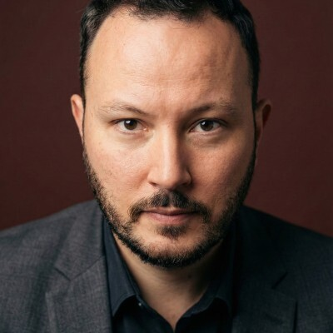
PowerToFly AI
×
CLIENT CASE STUDY
From a complex AI talent need to the right hire — in 8 weeks
Tiugo Technologies · CKEditor · Search brief: Principal AI Engineer
THE CHALLENGE
THE APPROACH
CKEditor needed a senior product engineer combining deep TypeScript & Node.js architecture with production AI experience — a rare mix — plus extra capacity for its lean internal HR team.
PowerToFly calibrated the target profile up front, then ran sourcing, screening and submissions with targeted, personalised outreach to the right candidates.
THE OUTCOME
5 days
8 of 10
8 weeks
Daniel Wojno — Senior Staff Engineer, CKEditor
Right profile from the start — a profile presented during the initial calibration became the successful hire.
Intake call to first candidate submitted
Submitted profiles approved by Tiugo
Search kickoff to accepted offer
PowerToFly AI · Client case study
1

Slide 2
CASE STUDY · TIUGO / CKEDITOR
PowerToFly AI
Senior AI Engineering hire
The top profile identified at the outset became the successful hire.
SEARCH PIPELINE
54
14
11
10
8
Potential candidates identified
Interested candidates
Candidates screened
Candidates submitted
Profiles approved
Why Daniel stood out
OUTCOME
Deep Node.js & TypeScript architecture experience
Production RAG, knowledge base & AI agent experience
Strong product judgement, relevant editor/CMS experience
Able to integrate AI into an established engineering team
Daniel Wojno
Principal AI Engineer · joined Sept 2026
5 days
8 weeks
Brief to first candidate
Kickoff to offer acceptance
PowerToFly AI · Client case study
2

