Slide 2
Notes:
png

Slide 3
Notes:
tiff

Slide 5
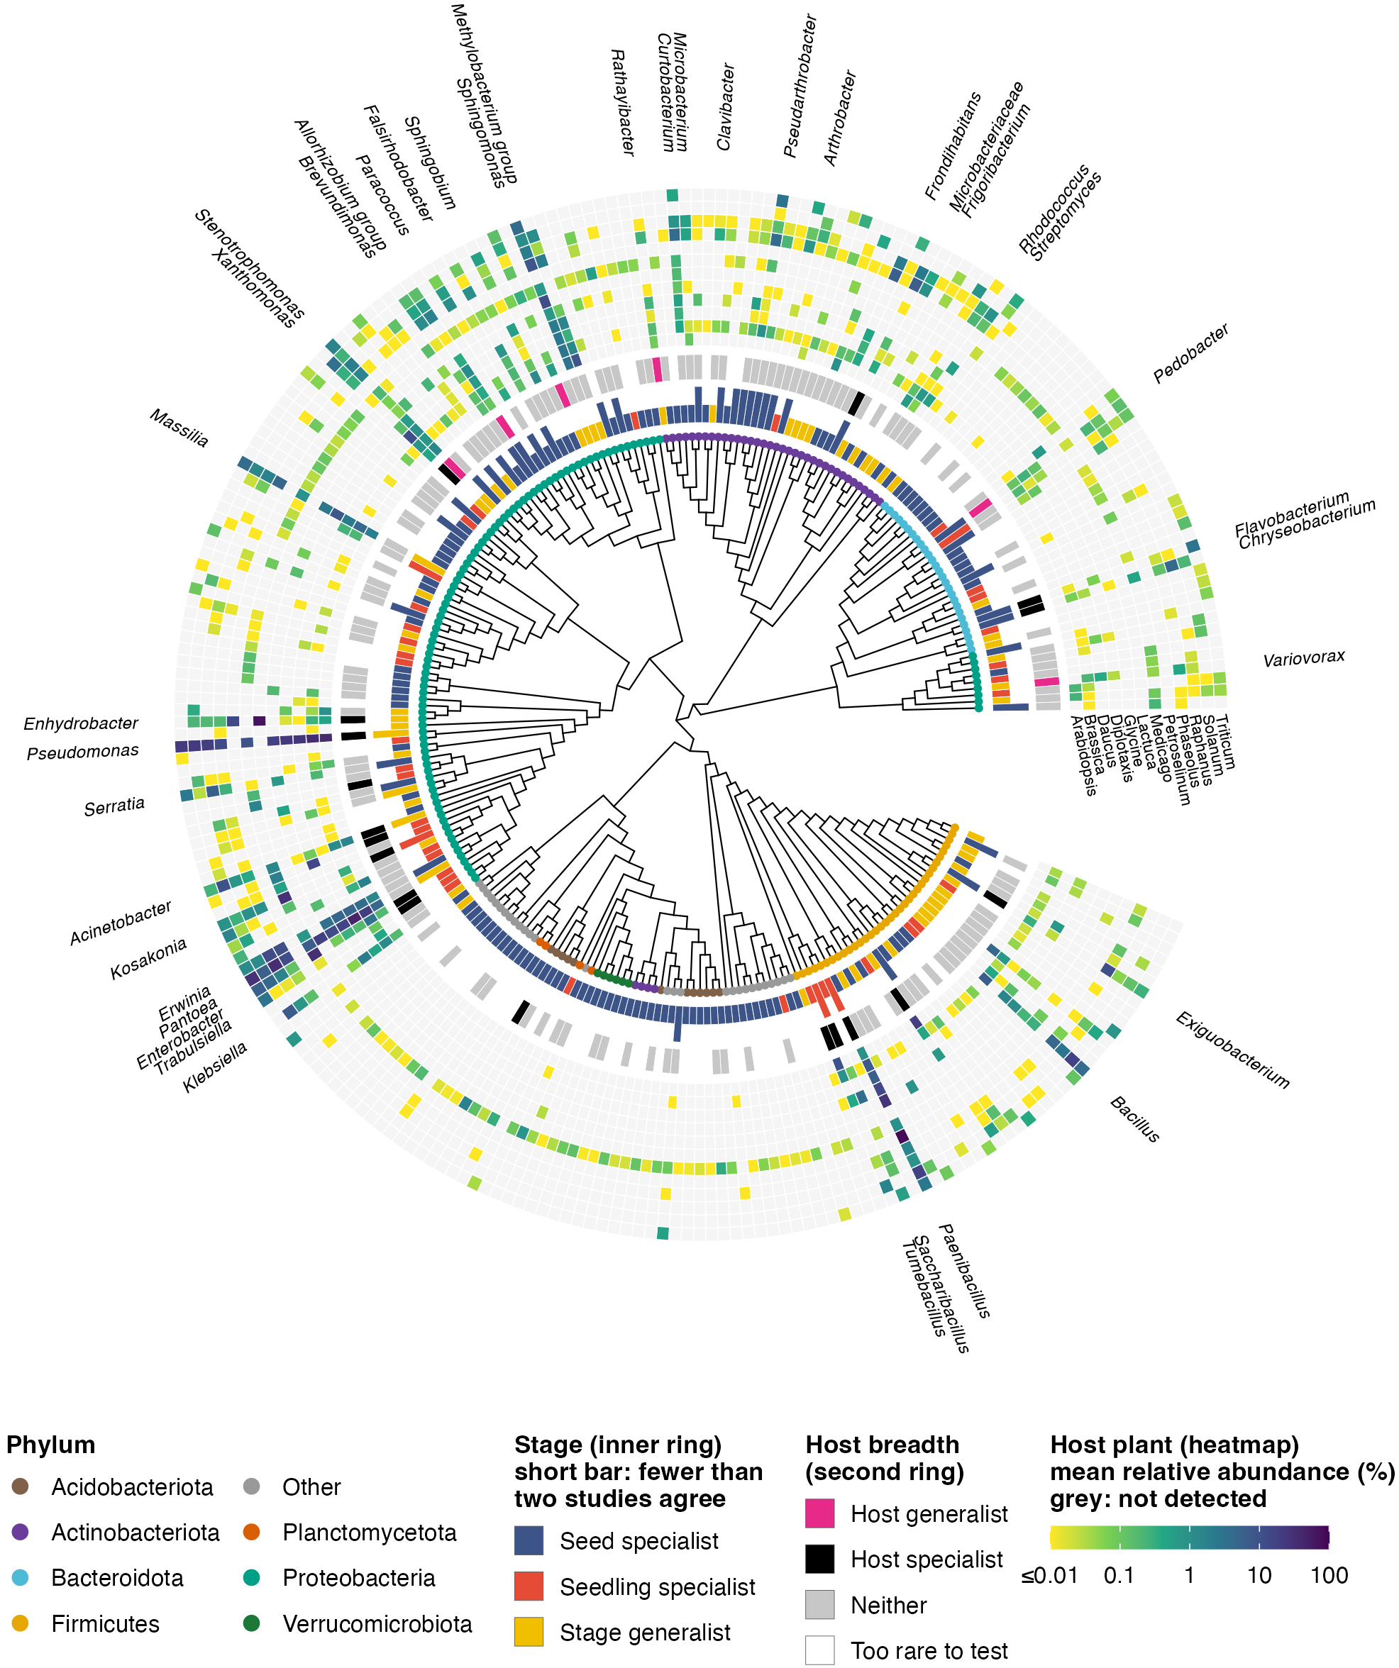

Slide 6
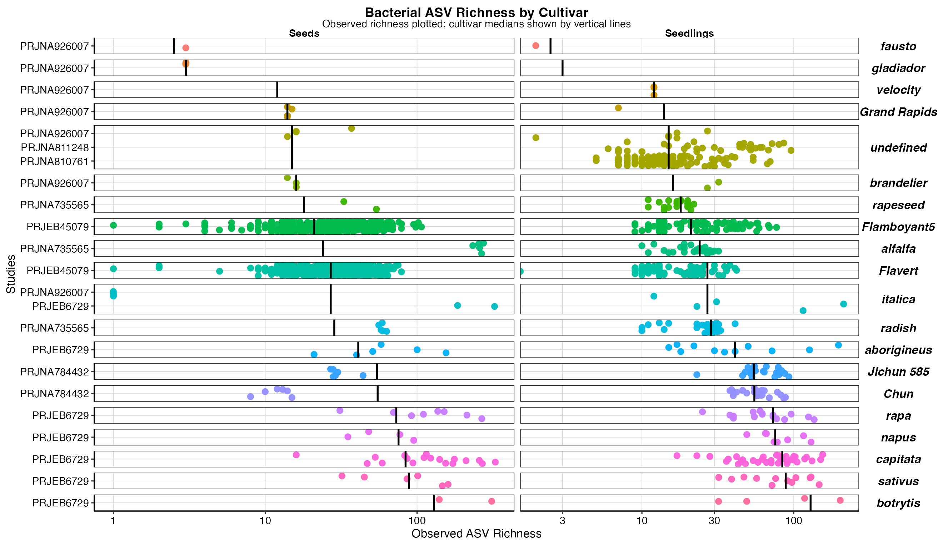
Seeds
Seedlings

