Slide 1
AMPLISEQ
Expedito Olimi
The Cernava Lab
University of Southampton, UK

Slide 2
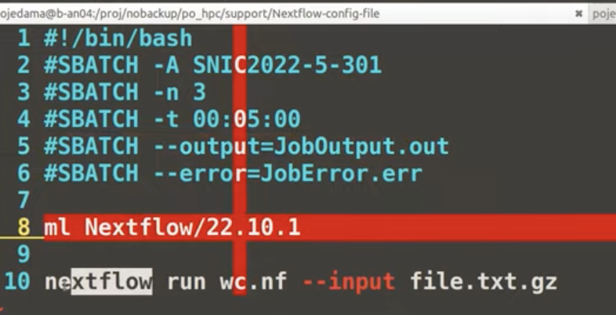
Use update upadated version on nexflow
#NXF_VER= 24.10.4 nextflow run hello-world
#NXF_VER=24.10.4 nextflow run nf-core/ampliseq -profile test,conda --outdir ampli
#NXF_VER=24.10.4 nextflow run nf-core/ampliseq -profile test,conda --outdir ampli
#NEXTFLOW % NXF_VER=24.10.4 nextflow run nf-core-ampliseq_2.12.0/2_12_0 -profile test,conda --outdir ampli
#sbatch job.sh
-submitted job #xx
#squeue –a –u eo2r24
#scontrol show job #xxx
#job usage ###xx
Material
https://youtu.be/7fIY0kV9x6o
https://youtu.be/nd4Az_tF3nY?t=1099**
https://hpc2n.github.io/intro-course/intro/
Notes:
-Climate controls where coffee can be grown [2]. Arabica coffee requires a climate with annual mean temperatures of about 20°C and over 1200 mm annual rainfall to be economically viable
-Temperatures over 30°C for extended periods reduce yields[3], while frost for a few days damages or even kills the plant [4].
-A short dry period of less than 40mm precipitation per month increases yield and promotes uniform flowering, but more than 3 dry months reduces yield [5].
-

Slide 3
# Download the workflow + transfer to offline cluster
nf-core download rnaseq
scp nf-core-rnaseq-3.0.tar.gz me@myserver.com:/path/to/workflows # or however you prefer to transfer files to your offline cluster
# Connect to offline cluster
ssh me@myserver.com
# Extract workflow files
cd /path/to/workflows
tar -xzf nf-core-rnaseq-3.0.tar.gz
# Run workflow
cd /path/to/data
nextflow run /path/to/workflows/nf-core-rnaseq-3.0/workflow -profile mycluster
https://youtu.be/iOLVqqHQsBU singularity
https://carpentries-incubator.github.io/workflows-nextflow/index.html

Slide 4
Install pipeline
Check nfcore: https://nf-co.re/docs/usage/getting_started/installation
NXF_VER=24.10.4 nextflow run nf-core/ampliseq -r 2.12.0 -profile conda --input "samplesheet.tsv" --skip_cutadapt --outdir amplis_test --single_end
https://genomicsaotearoa.github.io/Nextflow_Workshop/session_1/4_commands/

Slide 5
snakemake
https://github.com/olabiyi/snakemake-workflow-qiime2?tab=readme-ov-file

Slide 6
What to learn from ”good news” regions of Coffea arabica?
Examining the biology, geography, & soil physico-chemistry of these zones can provide insights into the strategies towards enhancing the resilience of C. arabica.
The phyllosphere microbiome can be a good model in examining dynamics of plant microbiomes (i.e. coffee microbiome) in climate-change resilient coffee niches.
Could also provide the consortium of microorganisms
Notes:
https://worldcoffeeresearch.org/resources/multiclass-classification-of-agro-ecological-zones-for-arabica-coffee

Slide 7
Team
Dr Tomislav Cernava (University of Southampton)
Dr Expedito Olimi (University of Southampton)
Dr Godfrey Sseremba (National Agricultural Research Organisation, Uganda)
Can engage:
IITA-Uganda/Kenya

Slide 8
Candidate grants for consideration
No calls yet
Notes:
-https://www.gcbc.org.uk/grants/
https://op.europa.eu/en/publication-detail/-/publication/461b6869-2b60-11ee-95a2-01aa75ed71a1/language-en

