Slide 1
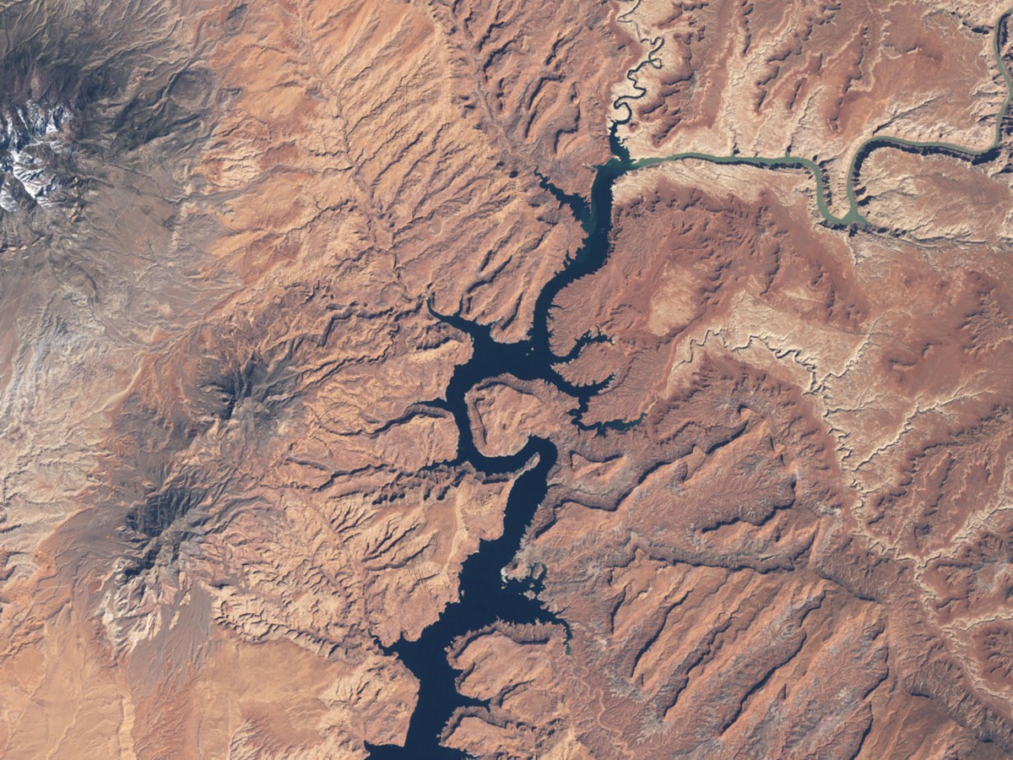
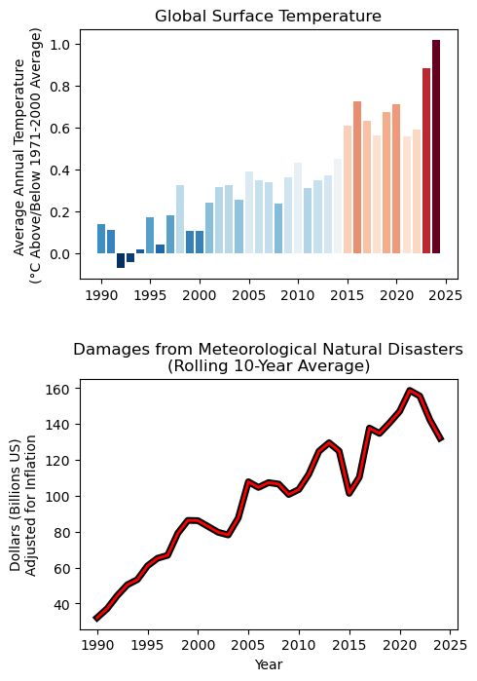
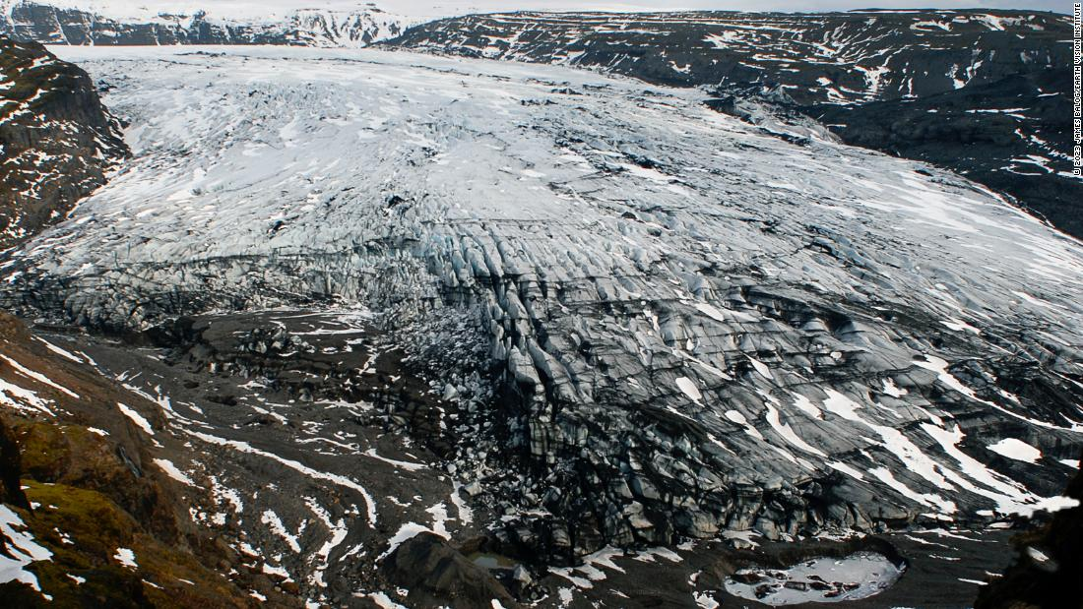
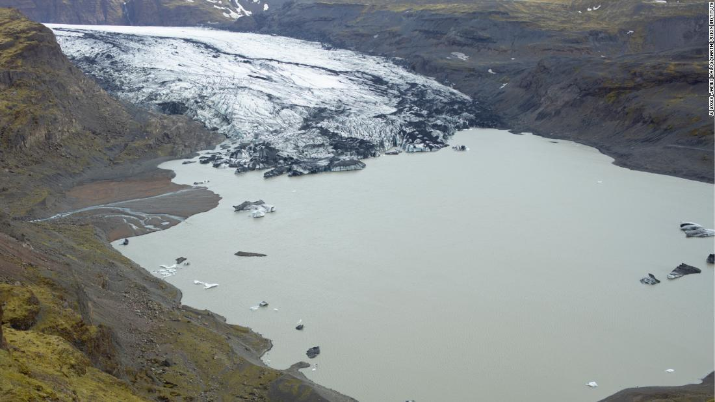
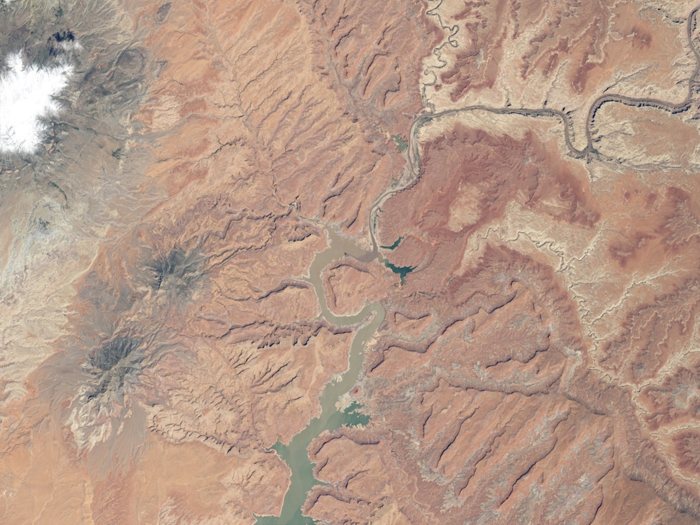
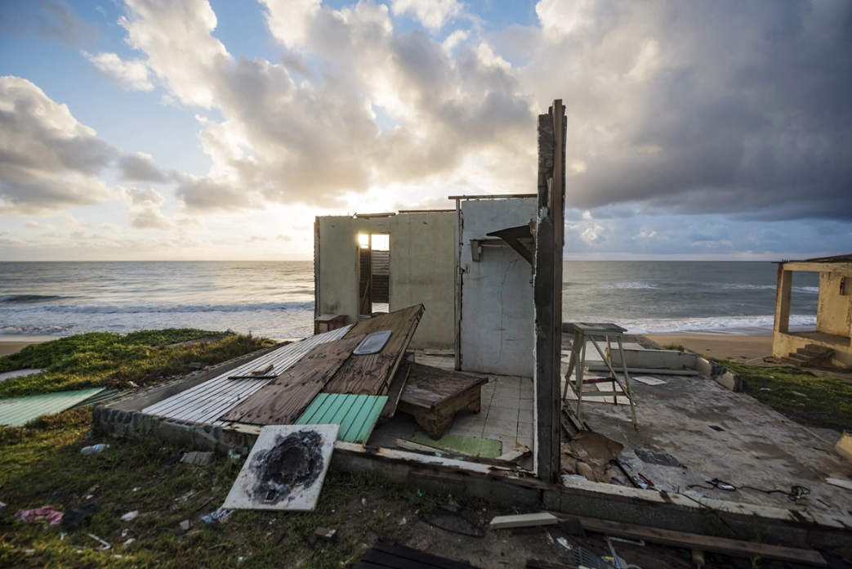
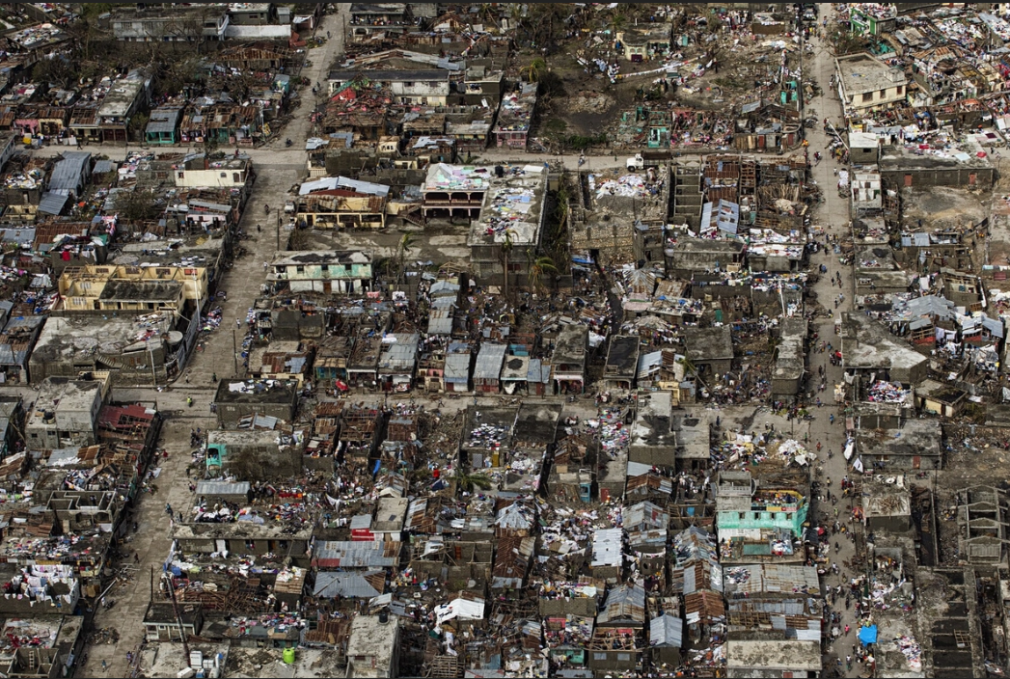
As global temperatures increased over the past 25 years...
Top (2): Lake Powell, Utah, 1999 vs 2014; CNN
Bottom: Jeremie, Haiti after Hurricane Matthew 2016; NatGeo
Data from NOAA and EM-DAT
Top (2): Sólheimajökull Glacier, Iceland, 2007 vs 2022; CNN
Bottom: Playa El Negro, Puerto Rico after Hurricane Maria, 2017; NatGeo
…so did the impact of storms and cyclones.

