Slide 1
Model Validation in Financial Services
Data Science in Context
Keith Colella
April 2023
All opinions expressed in this presentation are my own.

Slide 2
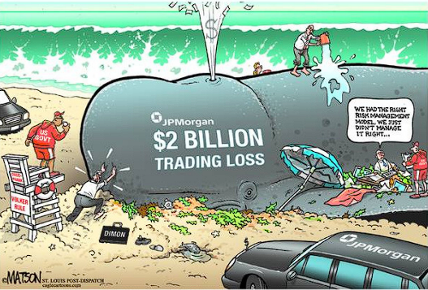
JPMorgan’s London Whale
“…the model operated through a series of Excel spreadsheets, which had to be completed manually, by a process of copying and pasting data from one spreadsheet to another…”
-Business Insider
Source: https://www.businessinsider.com/excel-partly-to-blame-for-trading-loss-2013-2

Slide 3
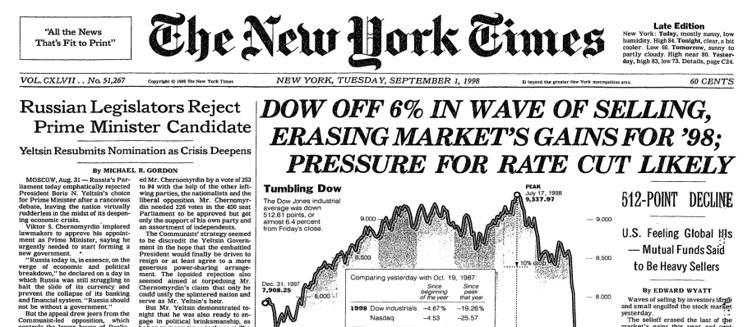
Long-Term Capital Management
“On the one hand, LTCM’s VaR calculations suggested a nearly impossible event that would happen once in 6.4 trillion years. On the other hand, we have a highly probable event that was well understood by the currency markets.”
-Ron Rimkus, CFA Institute
Source: https://www.econcrises.org/2016/04/18/long-term-capital-management/

Slide 4
What is model validation?
The process of ensuring models achieve their intended purpose
Identify flaws, shortcomings and limitations that may require remediation
Propose alternative approaches and benchmarks
Validation groups are ideally independent, with separate reporting lines from the businesses they oversee
Reference: https://www.moodysanalytics.com/-/media/article/2019/Effective-Model-Validation.pdf

Slide 5

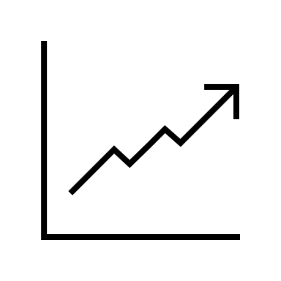


How do financial institutions use models?
Risk Management
Trading
Consumer Credit
Value-at-Risk (VaR)
Stress Testing
Pricing & Valuation
Hedging
Algo Strategies
Economic Forecasting
Fraud Detection / Compliance
Unemployment, GDP
Interest Rates
Inflation
Credit Card Fraud
Anti-Money Laundering
Communication Monitoring

Slide 6
How do we validate models?
Input
Specification / Conceptual Soundness
Output
Performance Monitoring
Implementation / Replication

Slide 7
Regulatory Framework
Basel Committee on Banking Supervision
Federal Reserve
SR 11-7: Guidance on Model Risk Management
SR 15-18: Federal Reserve Supervisory Assessment of Capital Planning
European Central Bank
Guidelines on Internal Governance (EBA-GL-2017-11)
Guide to the internal capital adequacy assessment process
Broader Compliance
Fair Housing Act (FHA), Equal Credit Opportunity Act (ECOA)
General Data Protection Act (GDPR), California Consumer Protection Act (CCPA)
Enforced through regulatory submissions (e.g., CCAR, ICAAP), on-site exams (similar to audits), and in cases of material violations, fines

Slide 8
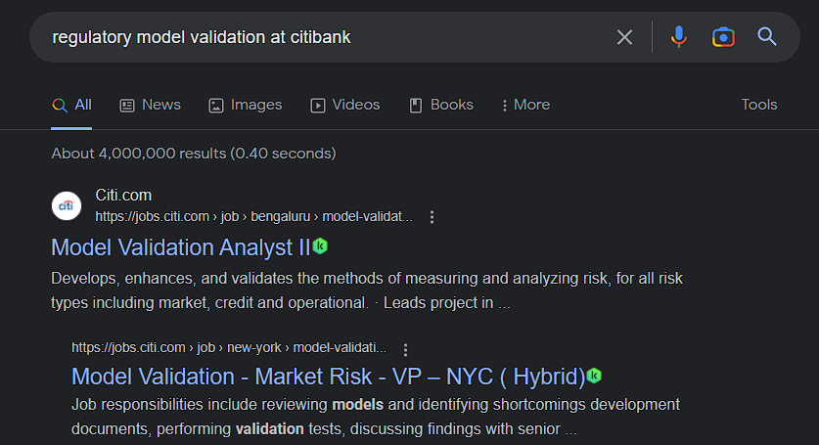
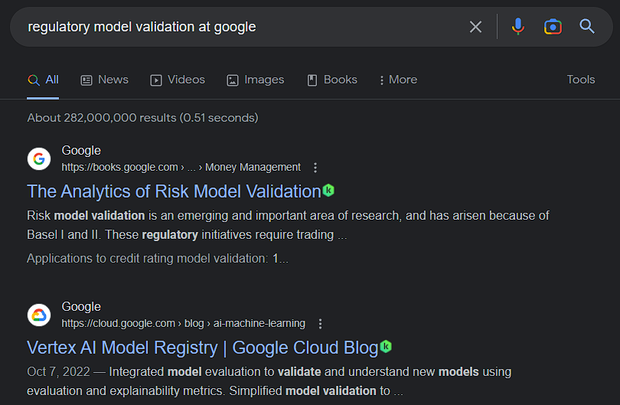
For your consideration…

Slide 9
Questions!

