Slide 1
Partisanship and Competitive Elections
Keith Colella
DATA607
May 2023

Slide 2
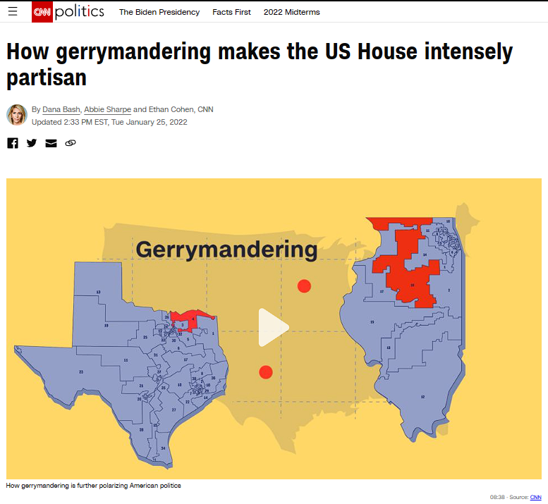
Is there empirical evidence of a significant relationship between competitive elections and ideological moderation?
“…residents who live in this progressive neighborhood are represented in the US House by a Republican congressman, thanks to gerrymandering after the 2010 census intended to dilute the power of the Democratic vote here…”
Dana Bash, Abbie Sharpe and
Ethan Cohen
CNN
January 2022
https://www.cnn.com/2022/01/25/politics/gerrymandering-us-house-partisan/index.html

Slide 3
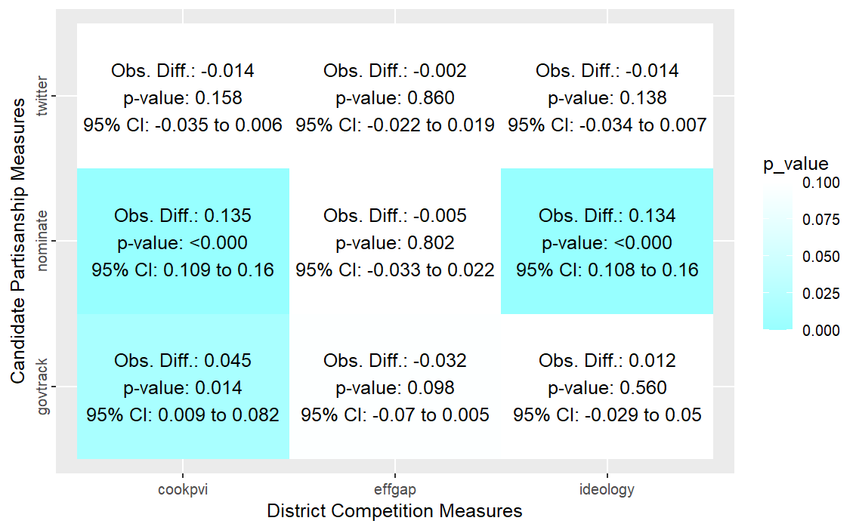
End Goal Null Hypothesis Testing Across Measures

Slide 4
Data to Gather
Dependent Variable
Candidate Partisanship
Measures
Twitter-based Rhetoric Score
NOMINATE Score
GovTrack Ideology Score
Independent Variable
Electoral Competitiveness
Measures
Efficiency Gap
Popular Ideological Preference
Cook Political Voting Index

Slide 5
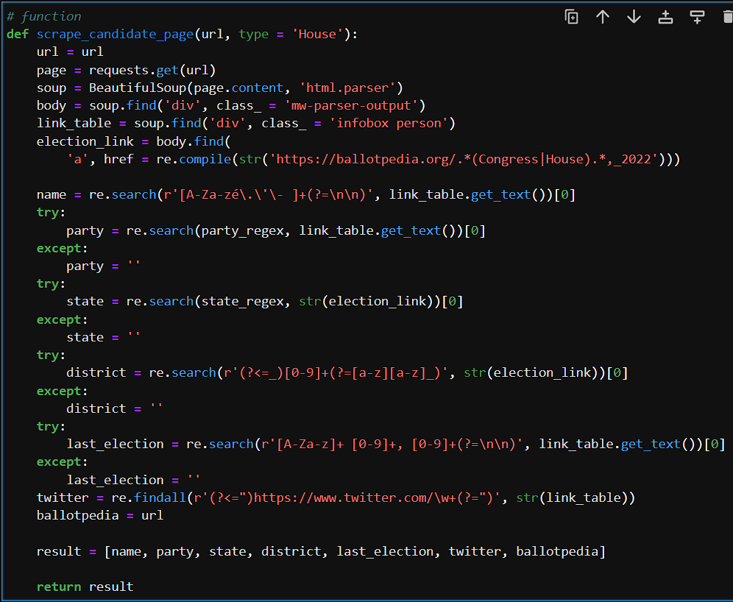
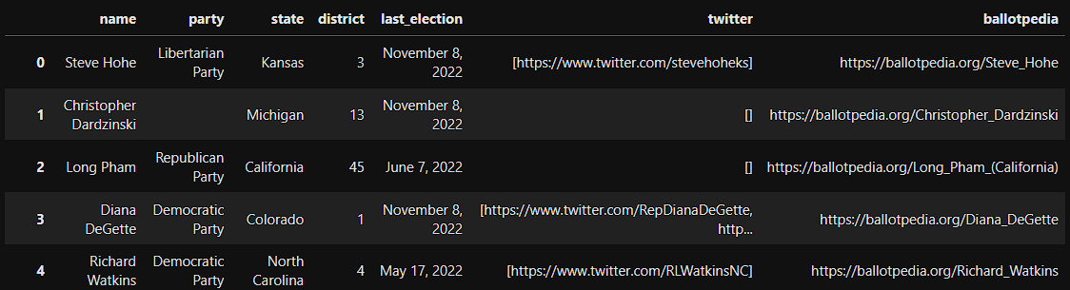
Notebook 1 Gather Twitter Handles from Ballotpedia
Packages Used
BeautifulSoup
Selenium
Key Challenges
Accounting for inconsistent page values
Handling missing values

Slide 6
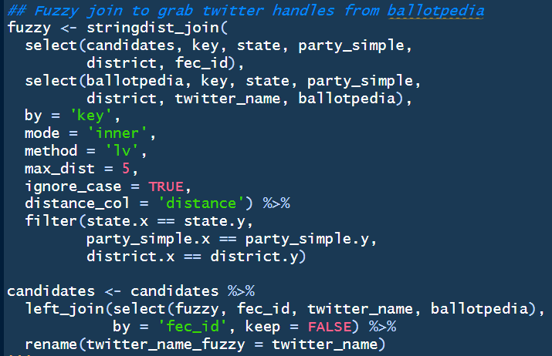
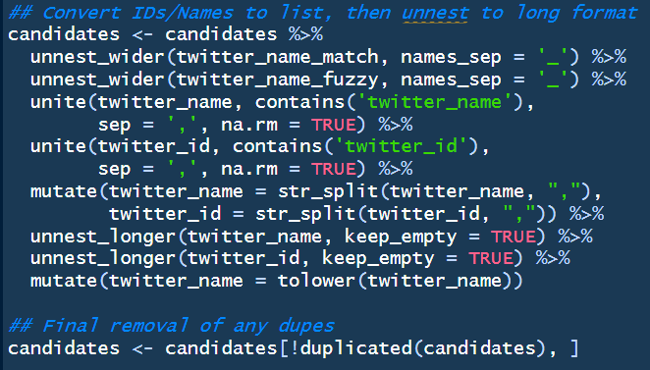
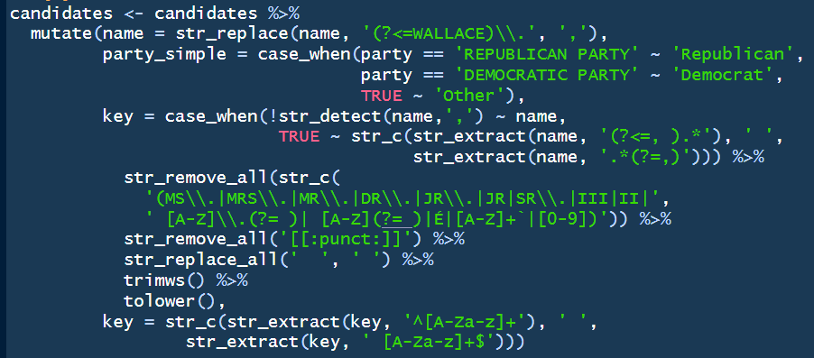
Notebook 2 Consolidate Candidate List and Twitter Names
Packages Used
Tidyverse
Httr / JsonLite
FuzzyJoin
Key Challenges
Cleaning names for accurate fuzzy joins
Manually reviewing multiple matches to ensure accuracy
Minimizing duplication from joining multiple data sources

Slide 7
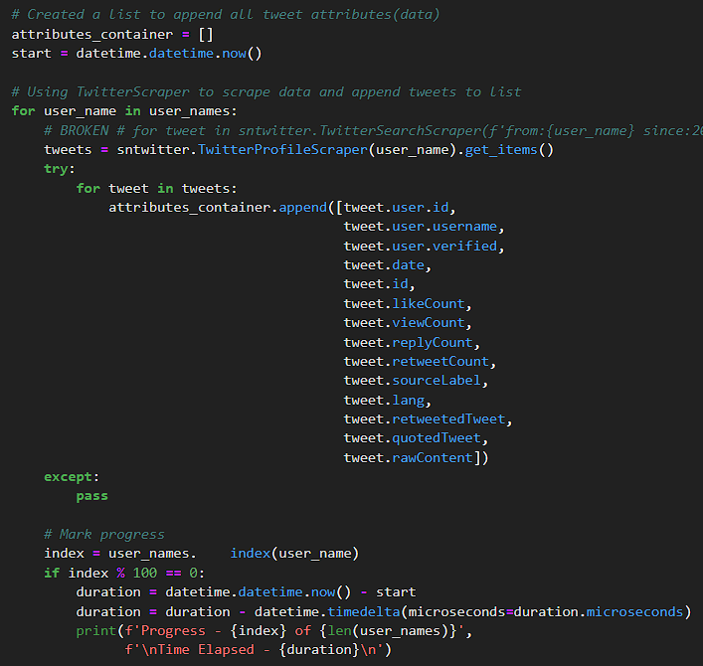
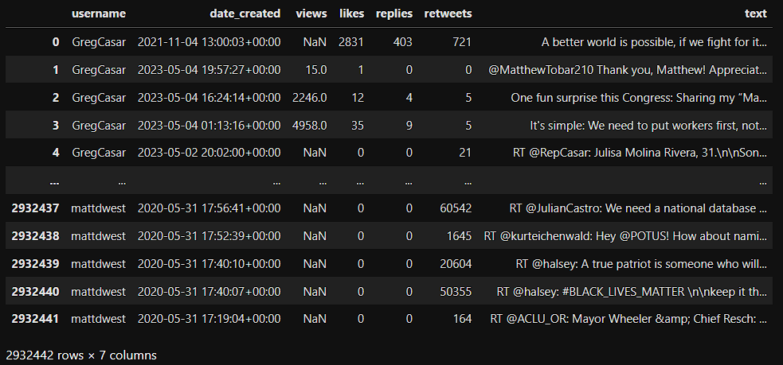
Notebook 3 Scrape Twitter
Packages Used
Snscrape
Key Challenges
Dealing with Twitter in 2023

Slide 8
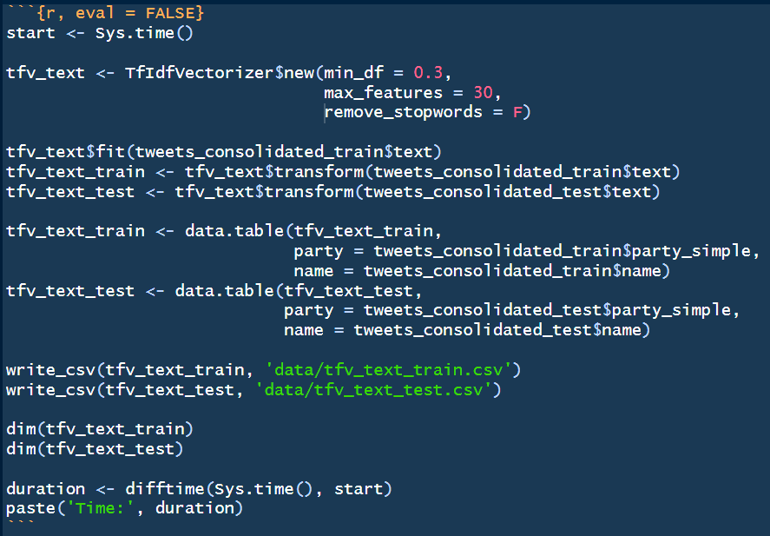
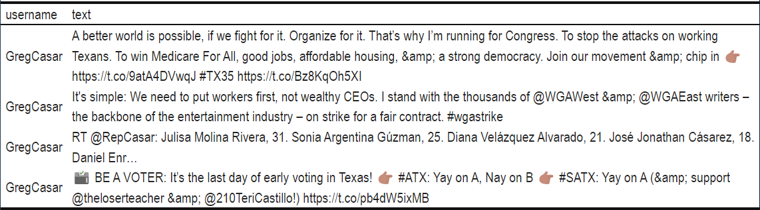
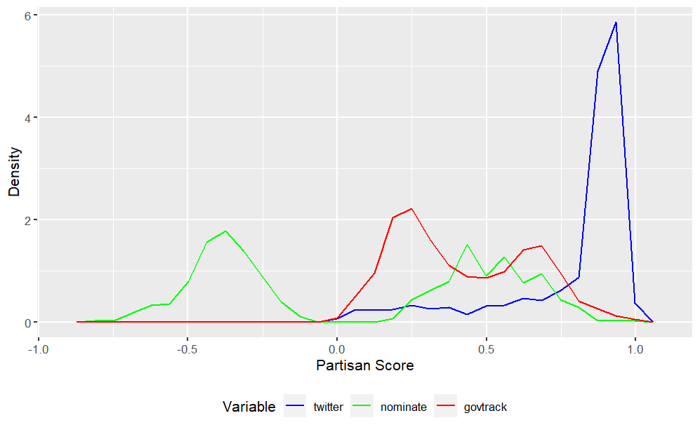
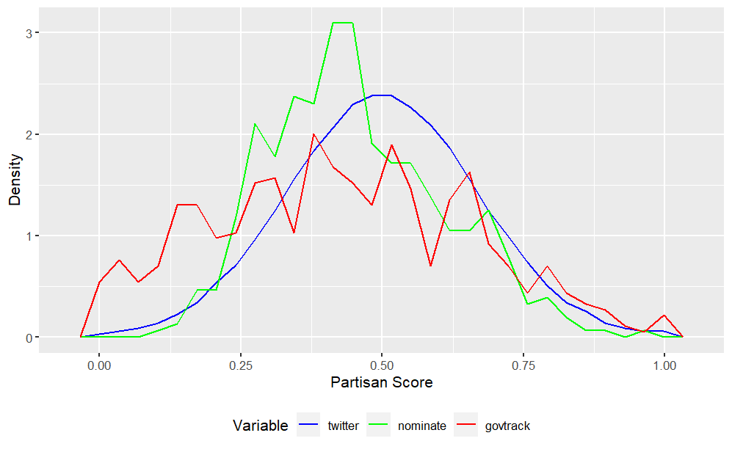
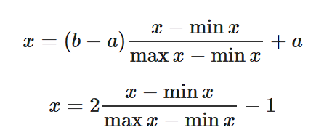
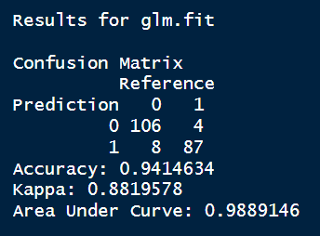
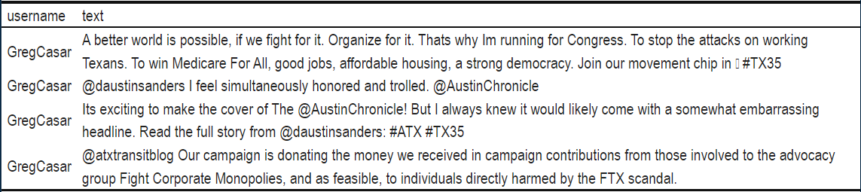
Notebook 4 Tweets Analysis + Partisanship Scores
Packages Used
Tidyverse
Httr
Tidytext
Superml
Key Challenges
Cleaning tweets
Feature engineering with TF-IDF
Normalizing different scores

Slide 9
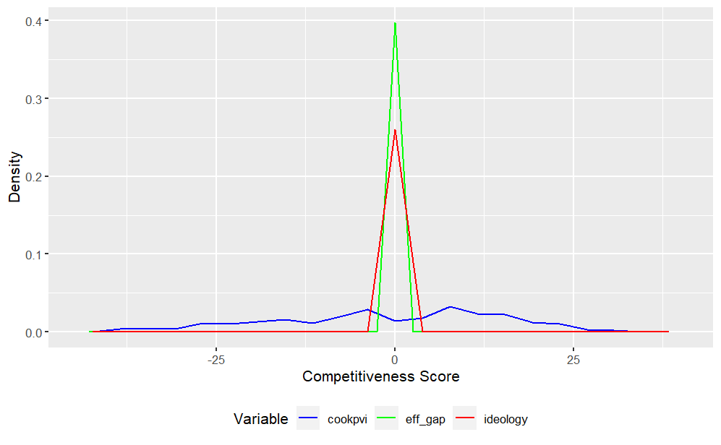
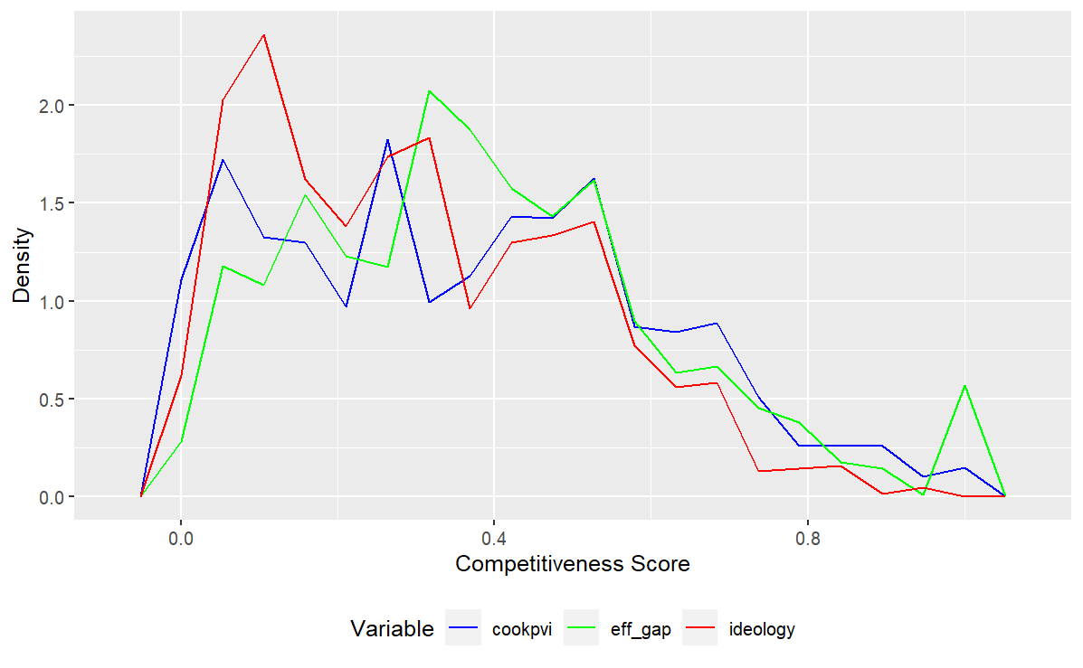
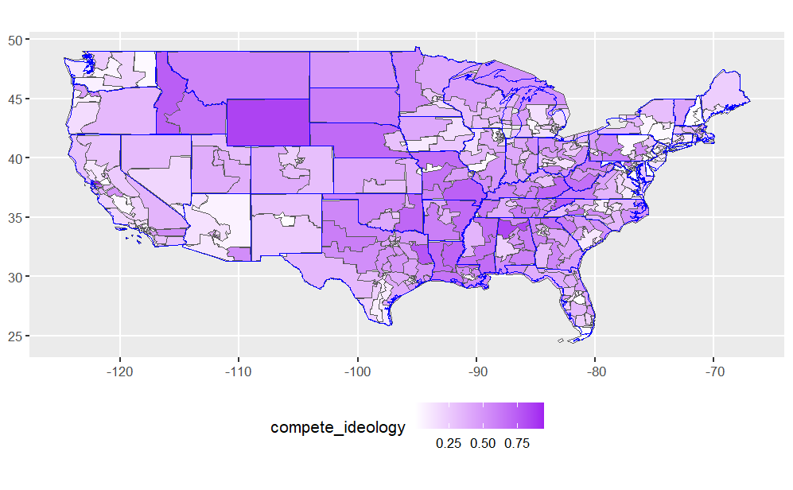
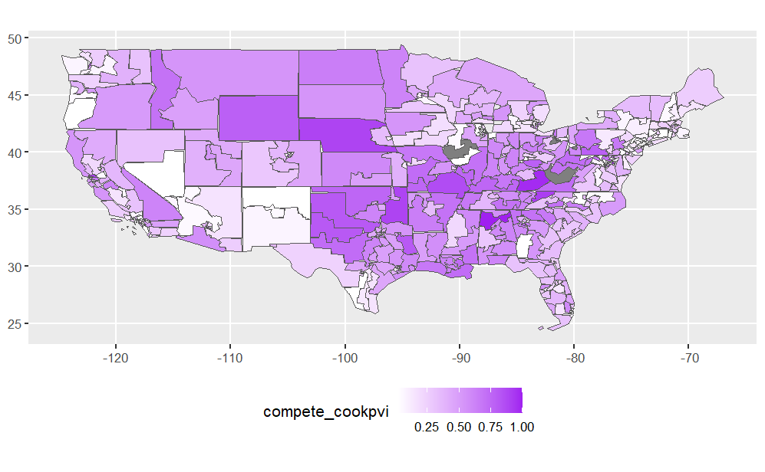
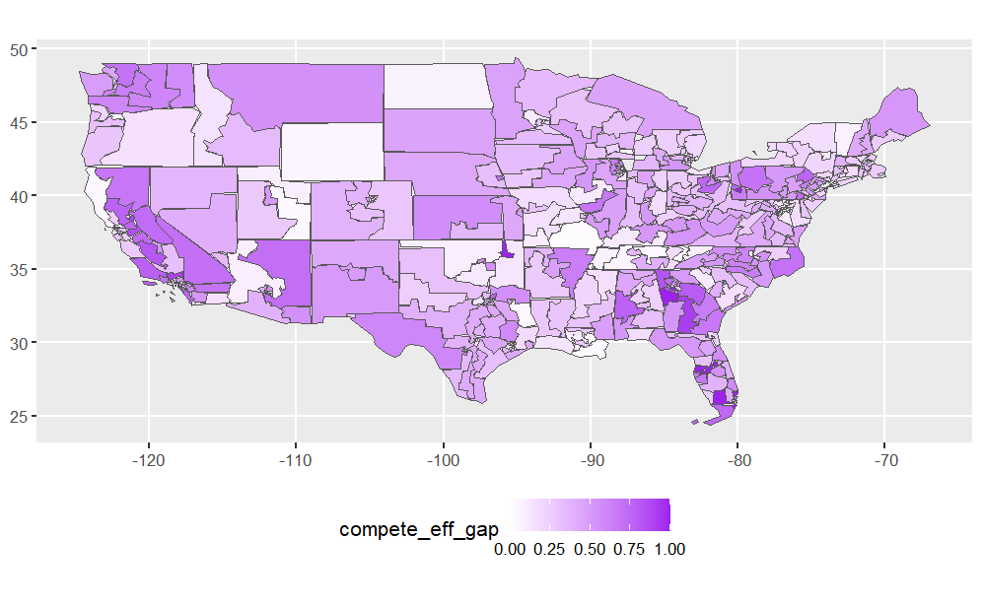
Notebook 5 Competitiveness Scores
Packages Used
Tidyverse
Tigris
Sf
Key Challenges
Normalizing different scores
Producing geographic visualizations

Slide 10
Notebook 6 Statistical Analysis (DATA606)

Slide 11
Conclusions
Limited evidence of persistent relationship between competitive districts and partisan leanings.
Limitations:
Quality of proxy measures
Scope of data (2022 only) limits ability for broader inference
Additional variables not considered

Slide 12
Citations
Lewis, Jeffrey B., Keith Poole, Howard Rosenthal, Adam Boche, Aaron Rudkin, and Luke Sonnet. "Voteview: Congressional Roll-Call Votes Database." 2023. https://voteview.com/.
GovTrack.us. "Ideology Analysis of Members of Congress." 2013. https://www.govtrack.us/about/analysis.
Warshaw, Christopher, and Chris Tausanovitch. "Subnational ideology and presidential vote estimates (v2022)." Harvard Dataverse, 2022. https://doi.org/10.7910/DVN/BQKU4M.
The Cook Political Report. "The 2022 Cook Partisan Voting Index (Cook PVI) | Cook Political Report.“ 2022. https://www.cookpolitical.com/cook-pvi/2022-partisan-voting-index.
Stephanopoulos, Nicholas, and Eric McGhee. "Partisan Gerrymandering and the Efficiency Gap." University of Chicago Law Review 82 (2014): 831–900.
Colella, Keith. “Political Party Prediction based on TF-IDF Analysis of Tweets.” May 2023. https://github.com/kac624/cuny/tree/main/election_tweets.

Slide 13
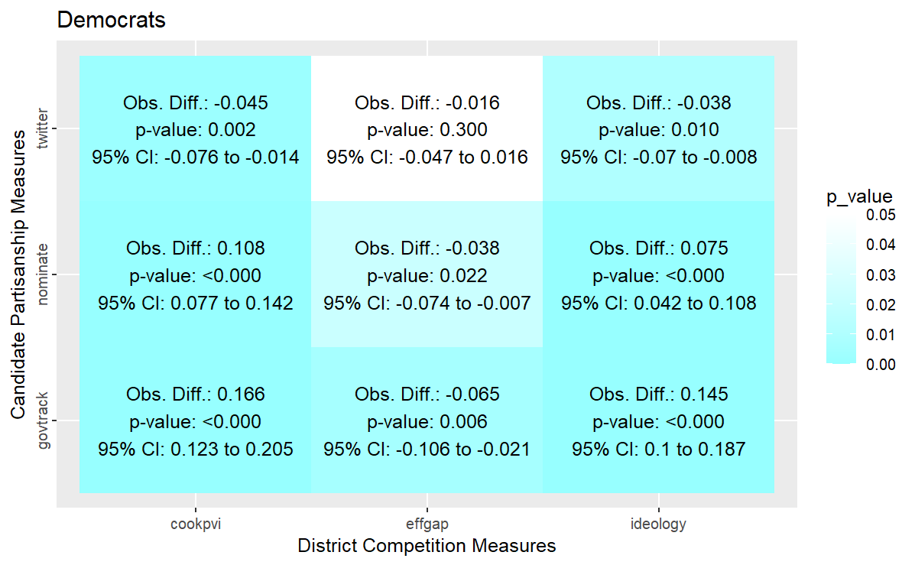
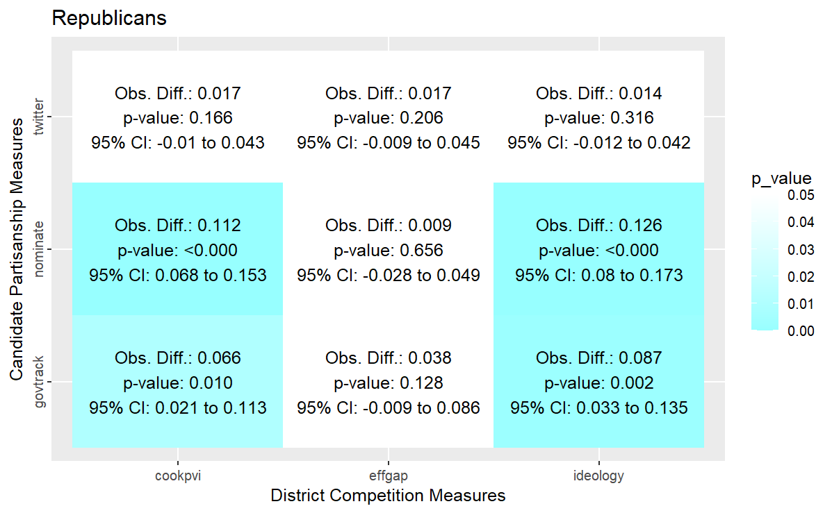
Testing and Inference Null Hypothesis Testing: Results by Party (α = 0.05 / α* = 0.025)

Slide 14
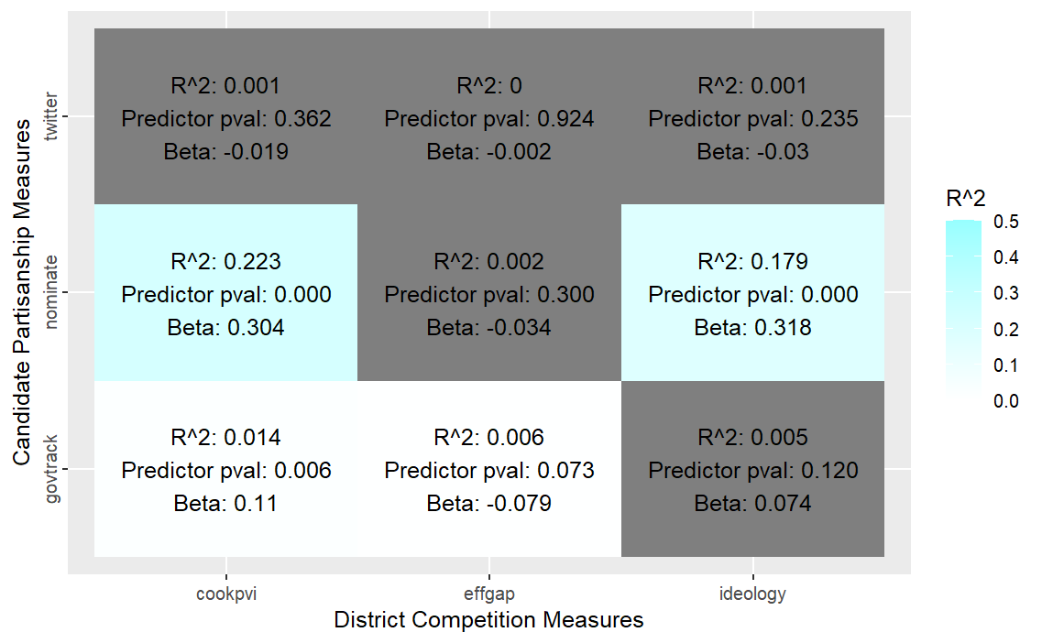
Testing and Inference Linear Regression: Results

Slide 15
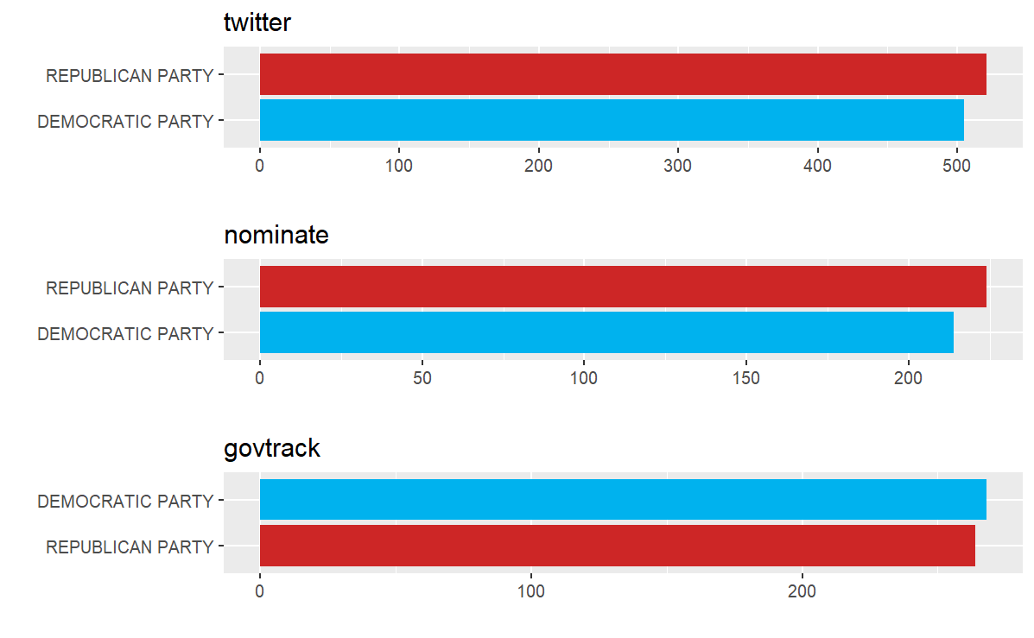
Exploratory Data Analysis Party Coverage

Slide 16
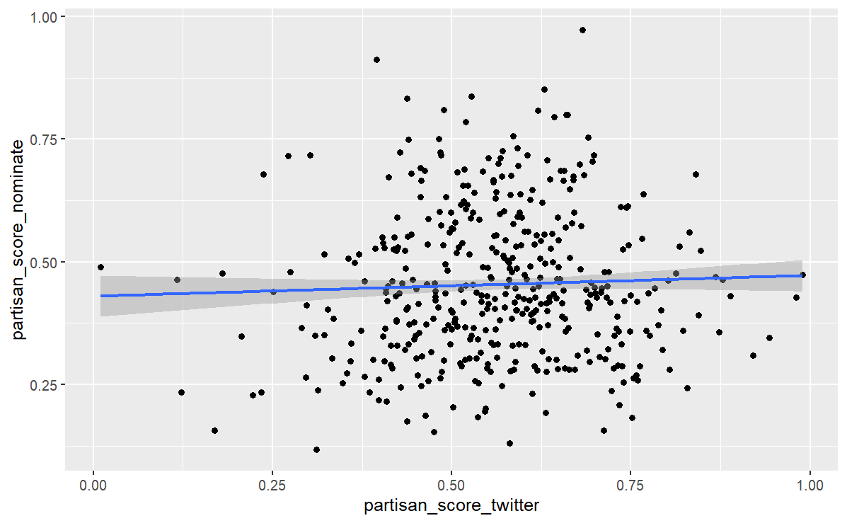
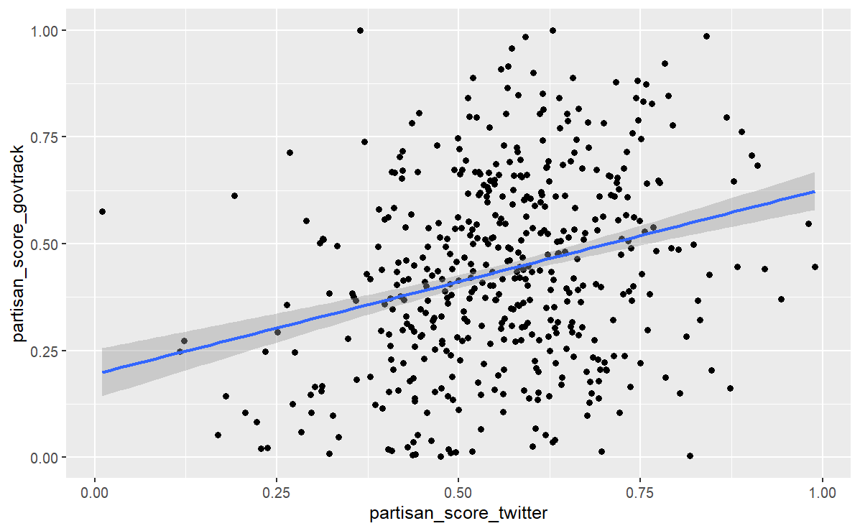
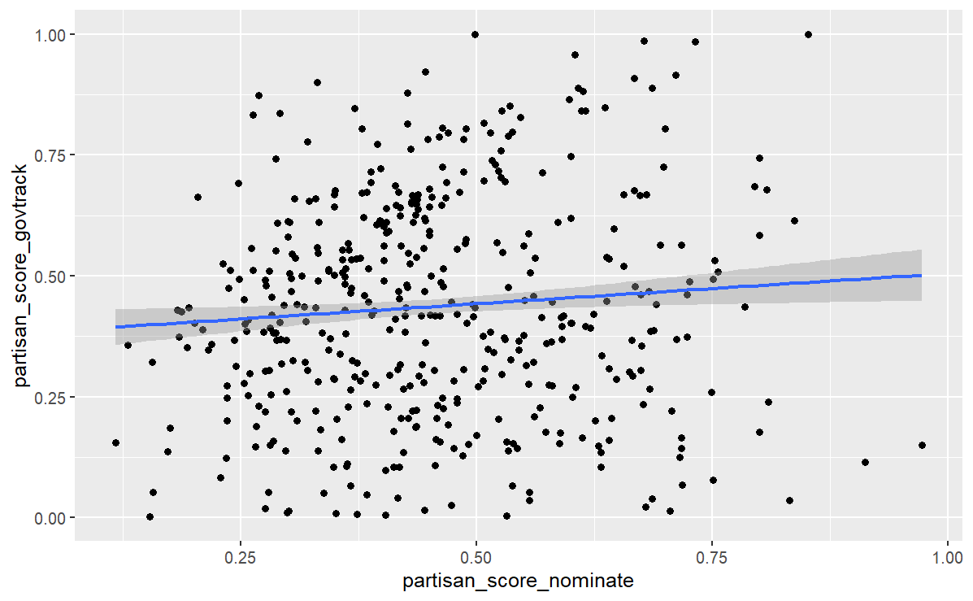
Additional Plots Relationship among dependent variable proxies

Slide 17
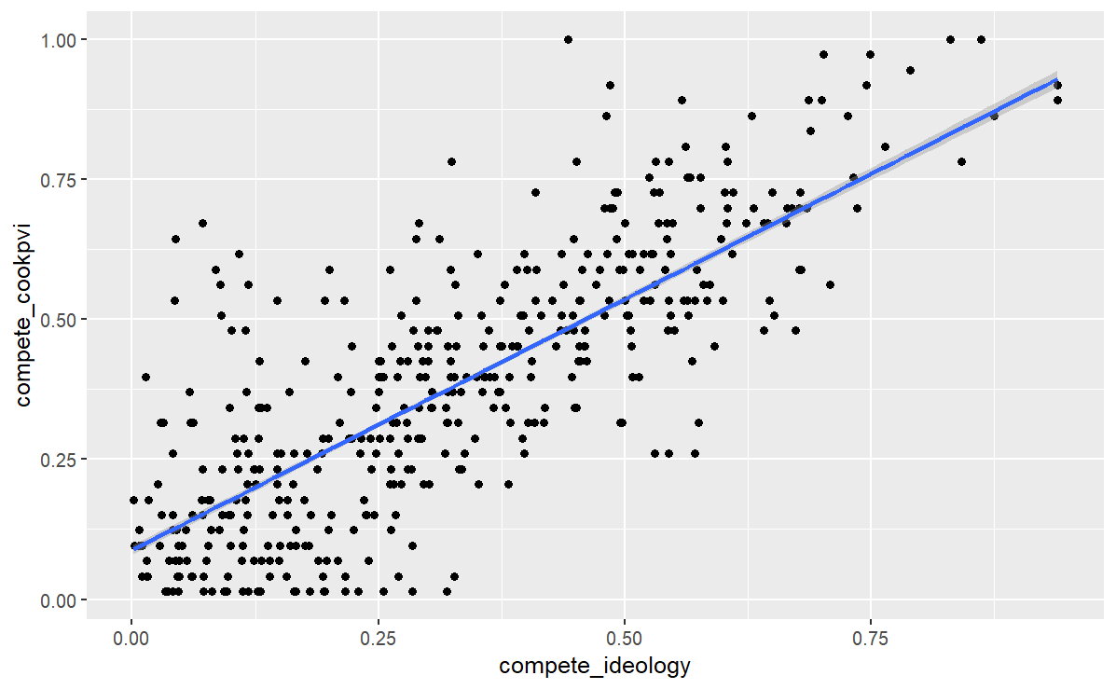
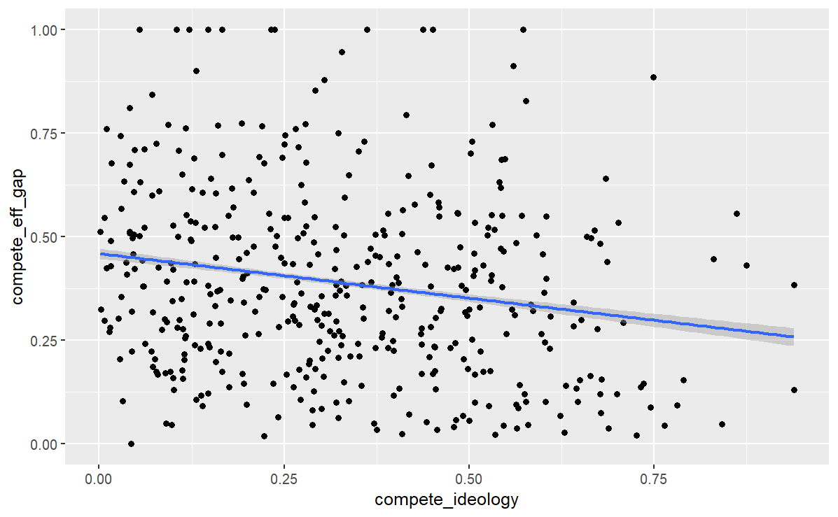
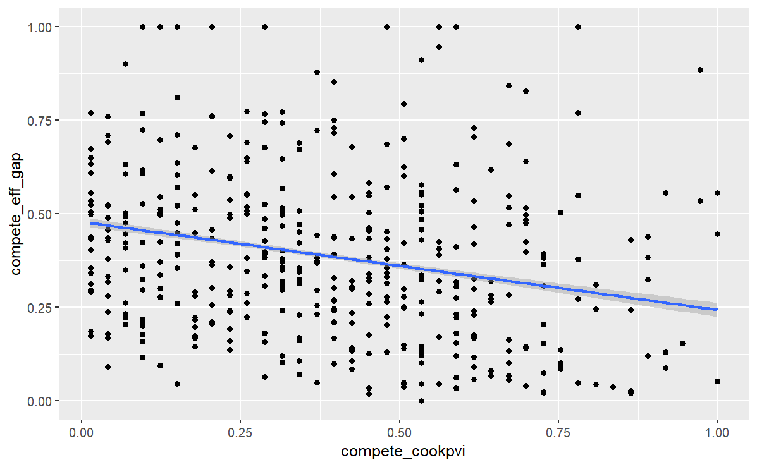
Additional Plots Relationship among independent variable proxies

