Slide 1
Partisanship and Competitive Elections
Keith Colella
DATA606
May 2023

Slide 2
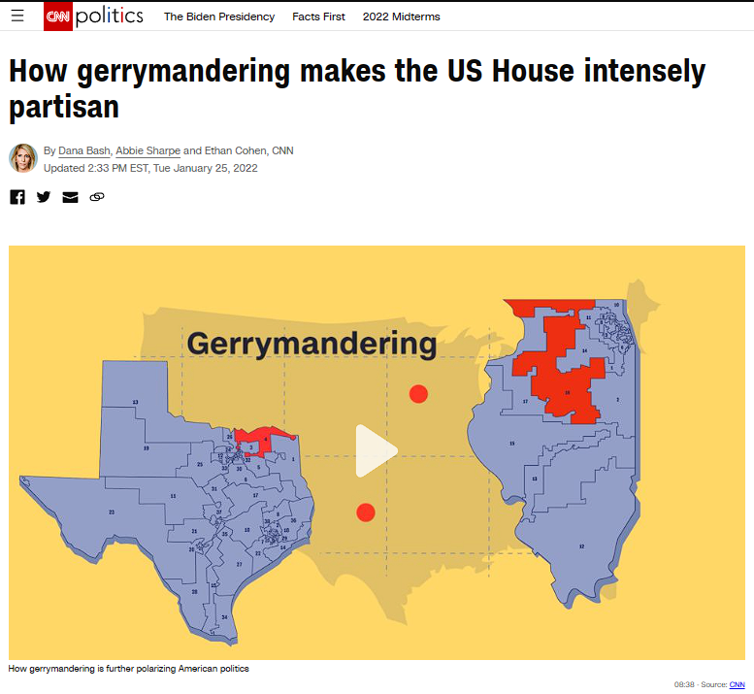
“…residents who live in this progressive neighborhood are represented in the US House by a Republican congressman, thanks to gerrymandering after the 2010 census intended to dilute the power of the Democratic vote here…”
Dana Bash, Abbie Sharpe and
Ethan Cohen
CNN
January 2022
https://www.cnn.com/2022/01/25/politics/gerrymandering-us-house-partisan/index.html

Slide 3
Is there empirical evidence of a significant relationship between competitive elections and ideological moderation?
Abstract
In this paper, I investigate the relationship between the competitiveness of electoral districts and the partisan leanings of candidates elected in those districts, focusing on candidates in House races in the 2022 midterm elections. Because these phenomena are not directly observable — referred to as "latent" variables — I consider six different proxy variables that attempt to quantify competitiveness and partisanship. To represent competitiveness, I consider three variables: survey results measuring voter policy preferences, the Cook Partisan Voting Index, and the "efficiency gap,” which measures “wasted” votes. To represent partisanship, I consider another three variables: the Poole-Rosenthal NOMINATE measure of ideological leanings in Congressional voting, GovTrack's measure of partisan cooperation in Congress, and a measure of partisan rhetoric based on a corpus of candidate tweets. Because of the latent nature of these variables, it is difficult to assign a high degree of confidence to any one test. So, testing is performed on all nine pairs of the above six variables. I first conduct null hypothesis tests to compare the mean partisanship score of candidates from highly partisan districts (i.e., less competitive) versus those from less partisan districts (i.e., more competitive). Results appear mixed, but tend to indicate only a weak relationship, if any, with three of the nine pairs of variables showing a statistically significant relationship. To follow up on this finding, I fit a series of linear regression models. Of the nine models, only three had statistically significant predictors, corresponding to the same three significant pairs from the first round of tests. Moreover, those three models offered only limited explanation of the variance in the dependent variable, as evidenced by low R-squared (all under 15%). In conclusion, the data provide little evidence of a persistent relationship between districts’ competitiveness and the extent of partisan leanings of their candidates.

Slide 4
Data Variables
Dependent Variable
Candidate Partisanship
Independent Variable
Electoral Competitiveness
Less
Partisan
More
Partisan
More
Competitive
Less
Competitive
*Lower does not mean more Liberal*

Slide 5
Data Proxies: Partisanship
Poole-Rosenthal NOMINATE Score* (“nominate”)
Based on ideological similarity of voting records in Congress
GovTrack Score* (“govtrack”)
Based on legislative co-sponsorship patterns in Congress
Twitter Score (“twitter”)
Based on corpus of >1mm tweets from >1000 candidates
*Limited to Members of Congress

Slide 6
Data Proxies: Competitiveness
Popular Ideological Preference (“ideology”)
Modeling of district-level ideology using 18 surveys from 2006 - 2021
Cook Political Voting Index (“cookpvi”)
Measurement of ideological leaning of districts based on recent voting
Efficiency Gap (“eff_gap”)
Estimate of “wasted votes” as an indication of gerrymandering

Slide 7
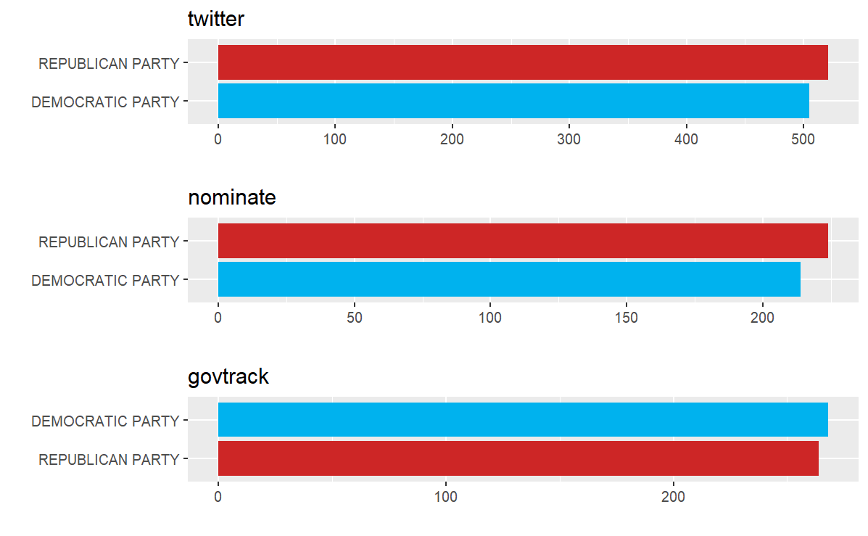
Exploratory Data Analysis Party Coverage

Slide 8
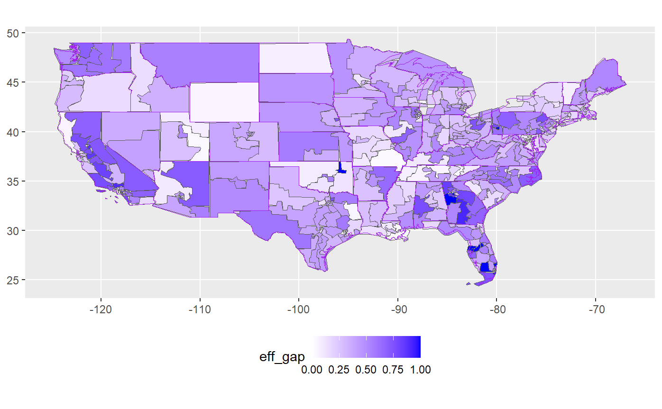
Exploratory Data Analysis Geographic Coverage

Slide 9
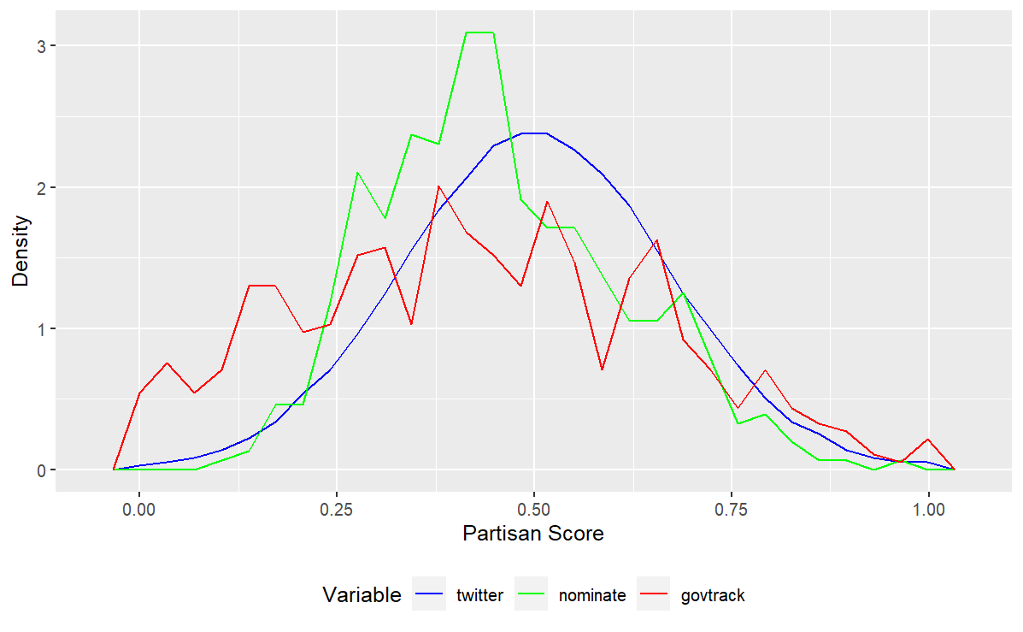
Exploratory Data Analysis Distributions: Dependent Variable

Slide 10
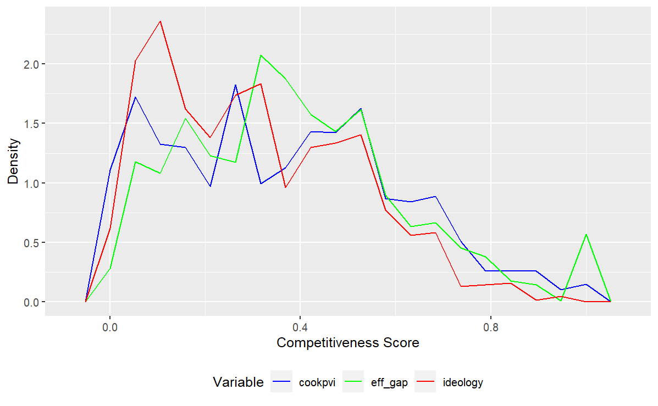
Exploratory Data Analysis Distributions: Independent Variable

Slide 11

Testing and Inference Conditions for Inference & Hypotheses
Independence
Candidate observations are distinct
Normal Sampling Distribution
Sample size exceeds 400 in the smallest case
Hypotheses:
$H_{0}⇒ μ_{Dep}= μ_{Ind}$
$H_{A}⇒ μ_{Dep}≠ μ_{Ind}$

Slide 12
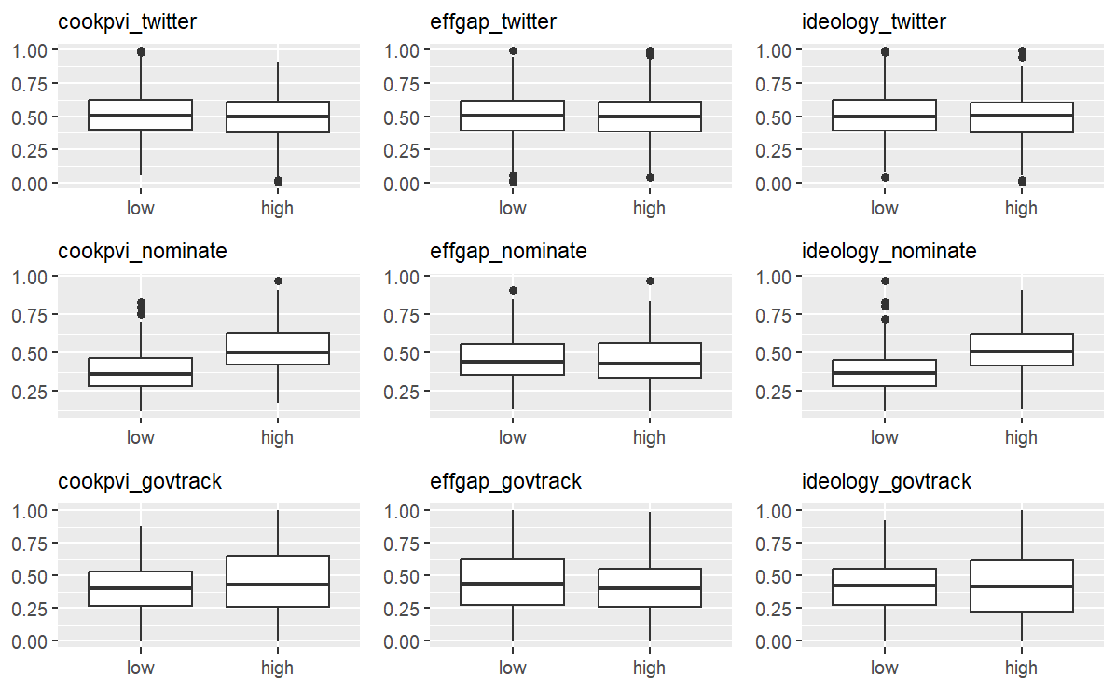
Testing and Inference Null Hypothesis Testing: Box Plots

Slide 13
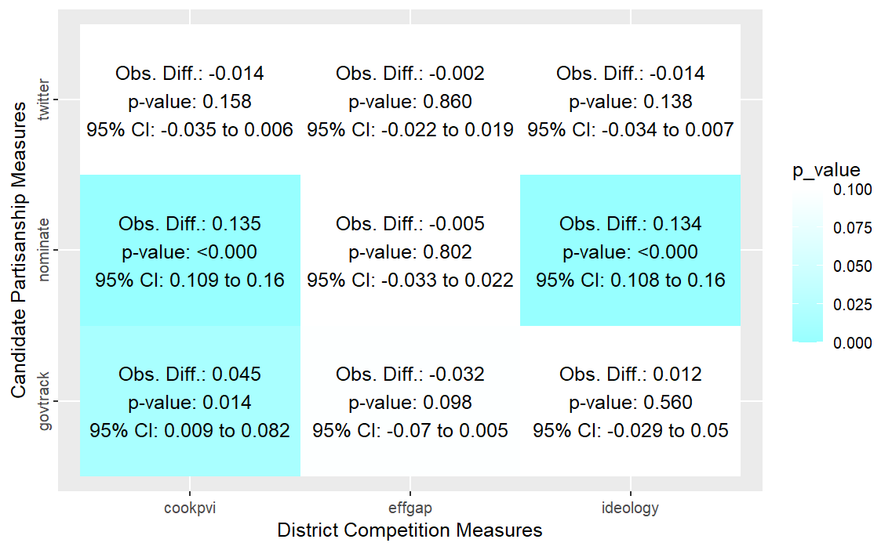
Testing and Inference Null Hypothesis Testing: Results (α = 0.05)

Slide 14
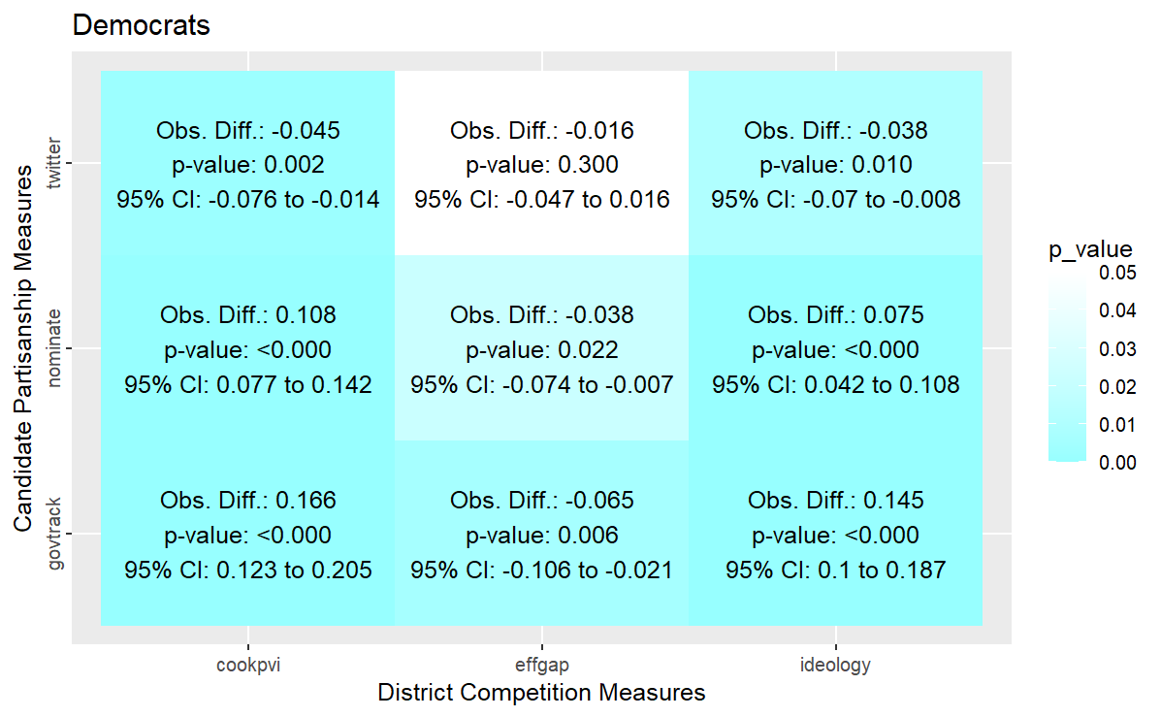
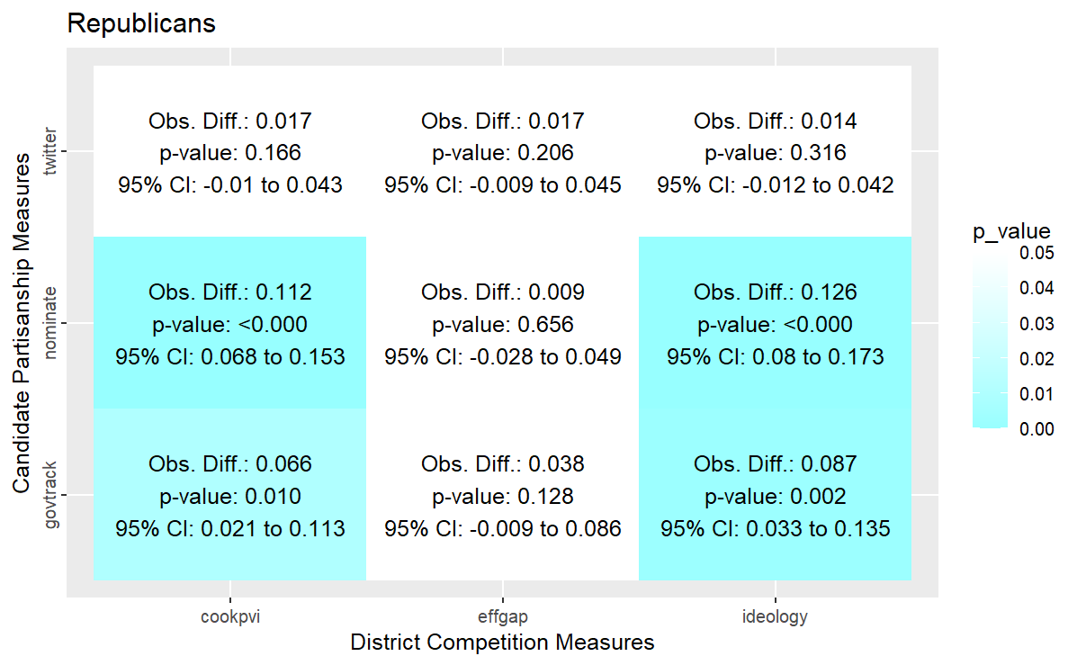
Testing and Inference Null Hypothesis Testing: Results by Party (α = 0.05 / α* = 0.025)

Slide 15
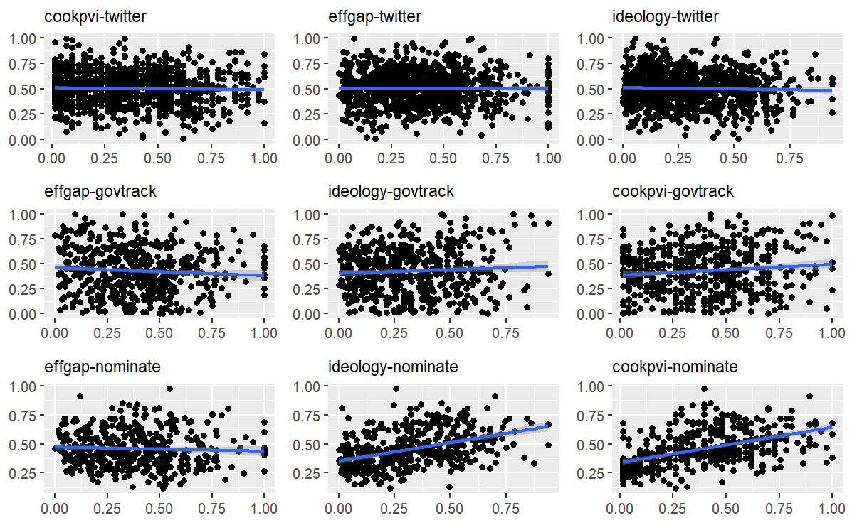
Testing and Inference Linear Regression: Scatter Plots

Slide 16
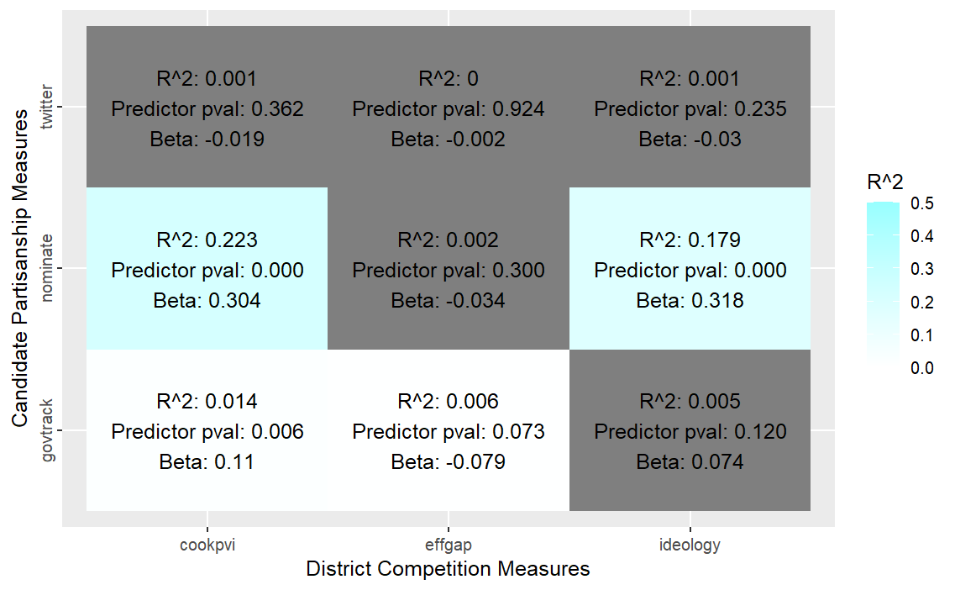
Testing and Inference Linear Regression: Results

Slide 17
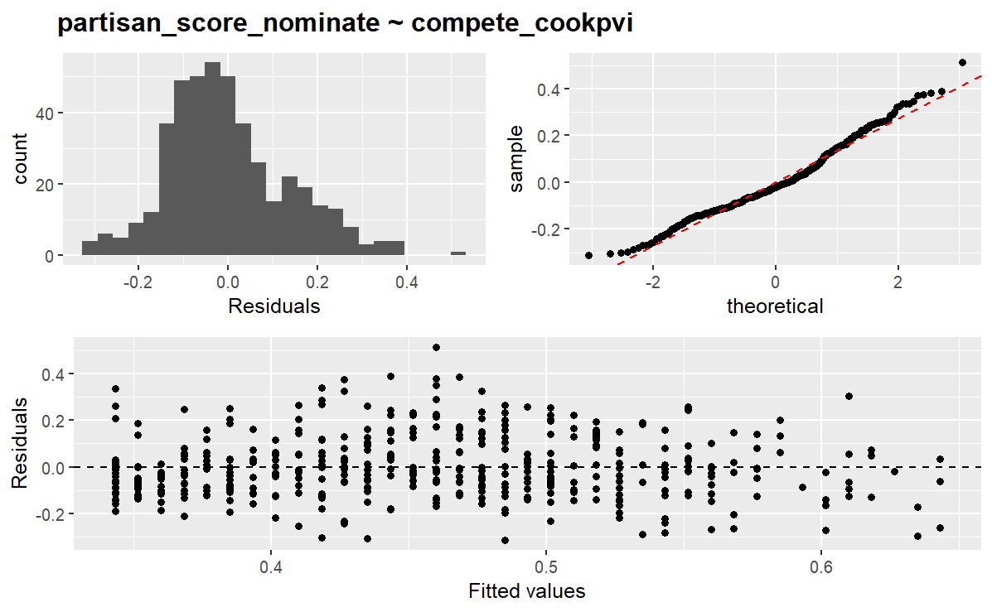
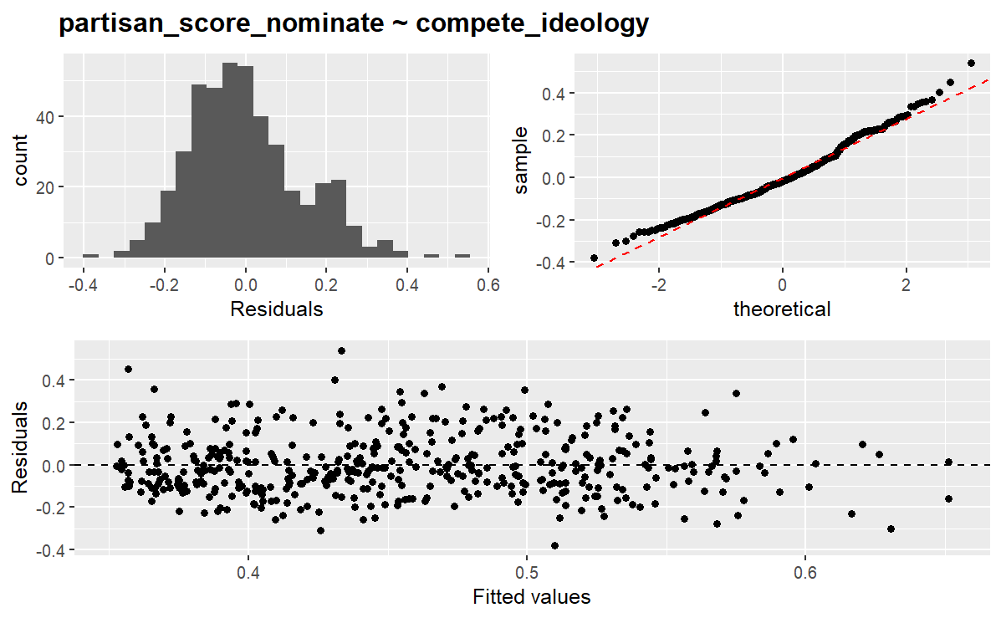
Testing and Inference Linear Regression: Residual Plots (1/2)

Slide 18
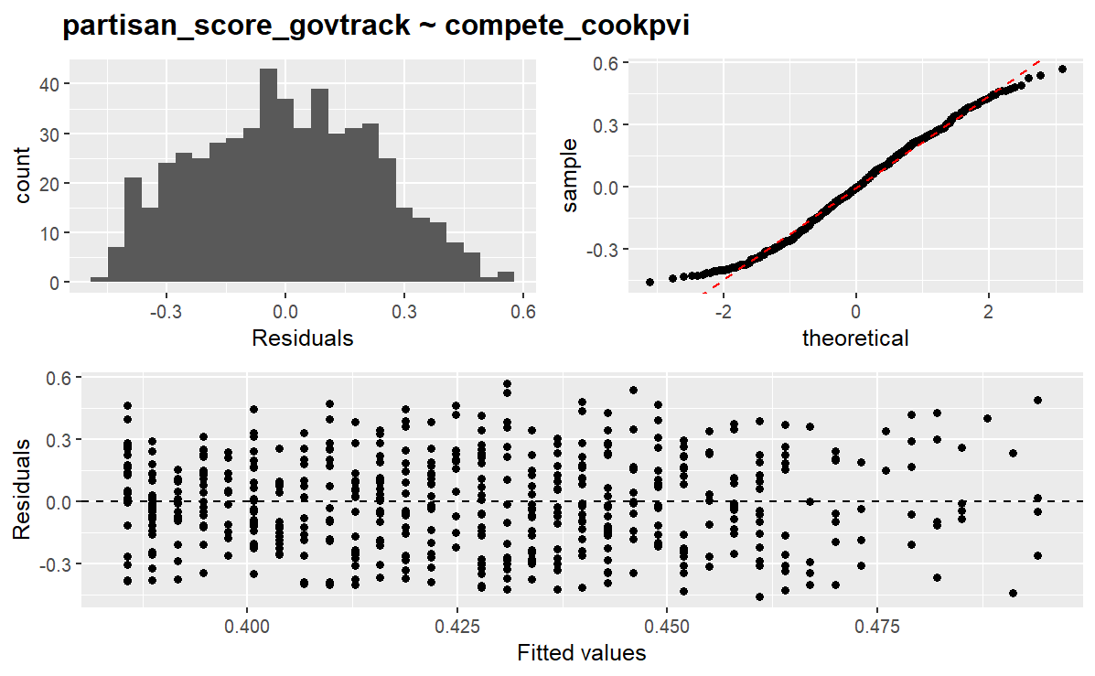
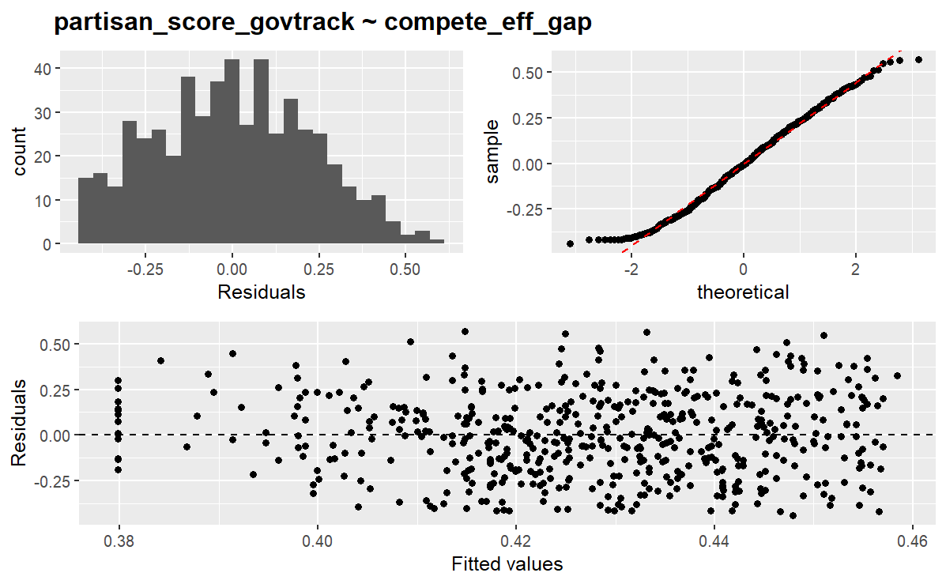
Testing and Inference Linear Regression: Residual Plots (2/2)

Slide 19
Conclusions
Limited evidence of persistent relationship between competitive districts and partisan leanings.
Limitations:
Quality of proxy measures
Scope of data (2022 only) limits ability for broader inference
Additional variables not considered

Slide 20
Citations
Lewis, Jeffrey B., Keith Poole, Howard Rosenthal, Adam Boche, Aaron Rudkin, and Luke Sonnet. "Voteview: Congressional Roll-Call Votes Database." 2023. https://voteview.com/.
GovTrack.us. "Ideology Analysis of Members of Congress." 2013. https://www.govtrack.us/about/analysis.
Warshaw, Christopher, and Chris Tausanovitch. "Subnational ideology and presidential vote estimates (v2022)." Harvard Dataverse, 2022. https://doi.org/10.7910/DVN/BQKU4M.
The Cook Political Report. "The 2022 Cook Partisan Voting Index (Cook PVI) | Cook Political Report.“ 2022. https://www.cookpolitical.com/cook-pvi/2022-partisan-voting-index.
Stephanopoulos, Nicholas, and Eric McGhee. "Partisan Gerrymandering and the Efficiency Gap." University of Chicago Law Review 82 (2014): 831–900.
Colella, Keith. “Political Party Prediction based on TF-IDF Analysis of Tweets.” May 2023. https://github.com/kac624/cuny/tree/main/election_tweets.

Slide 21
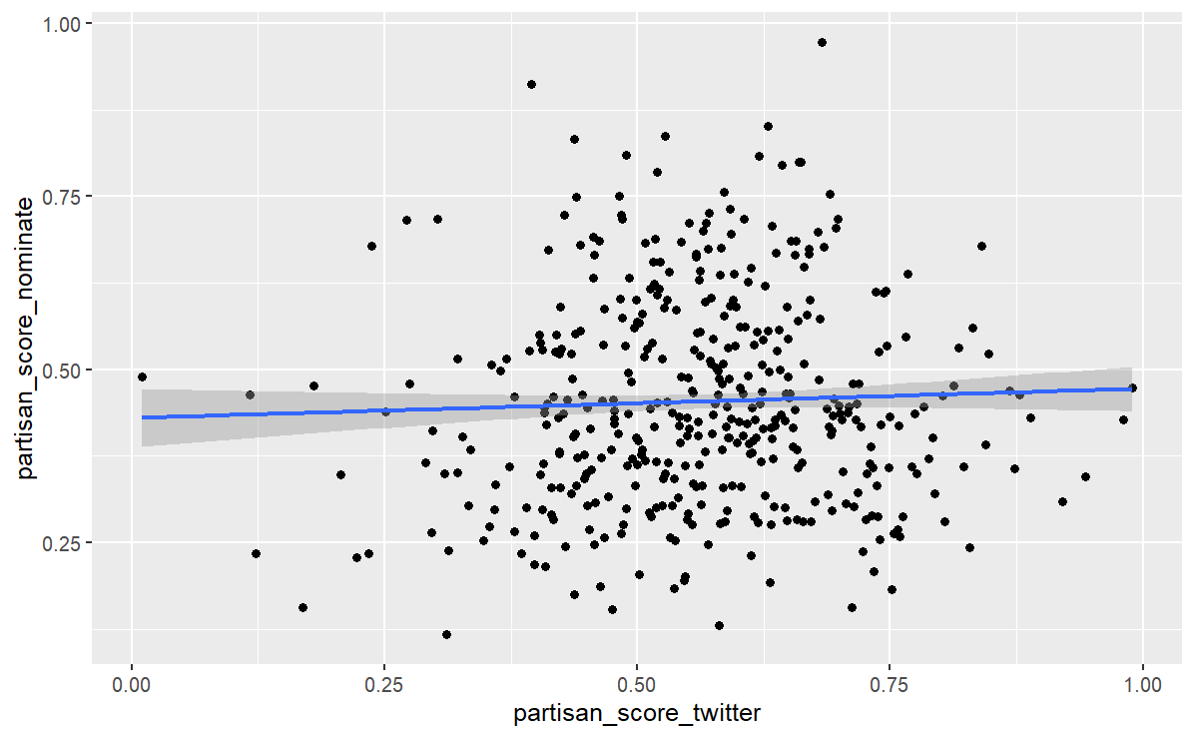
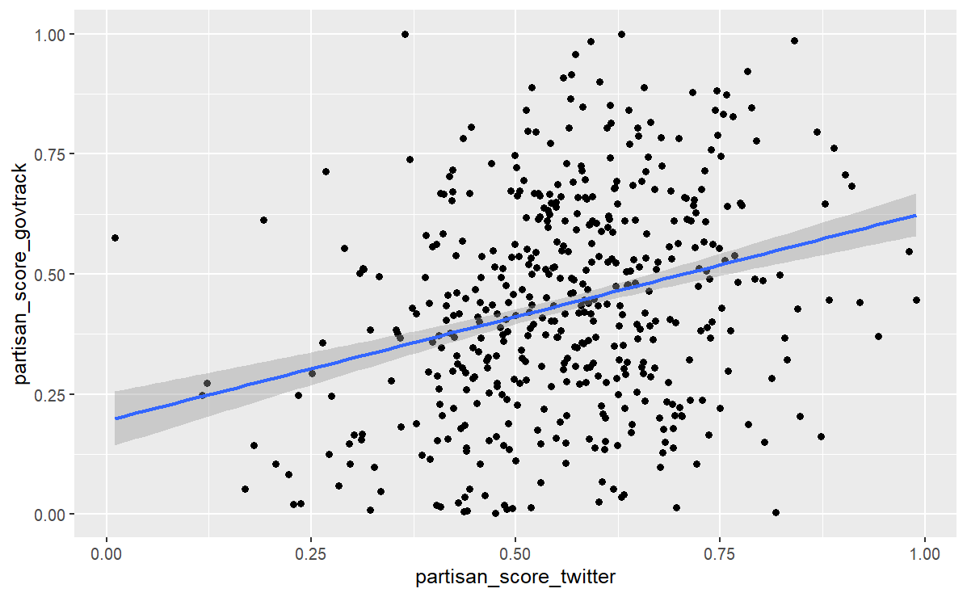
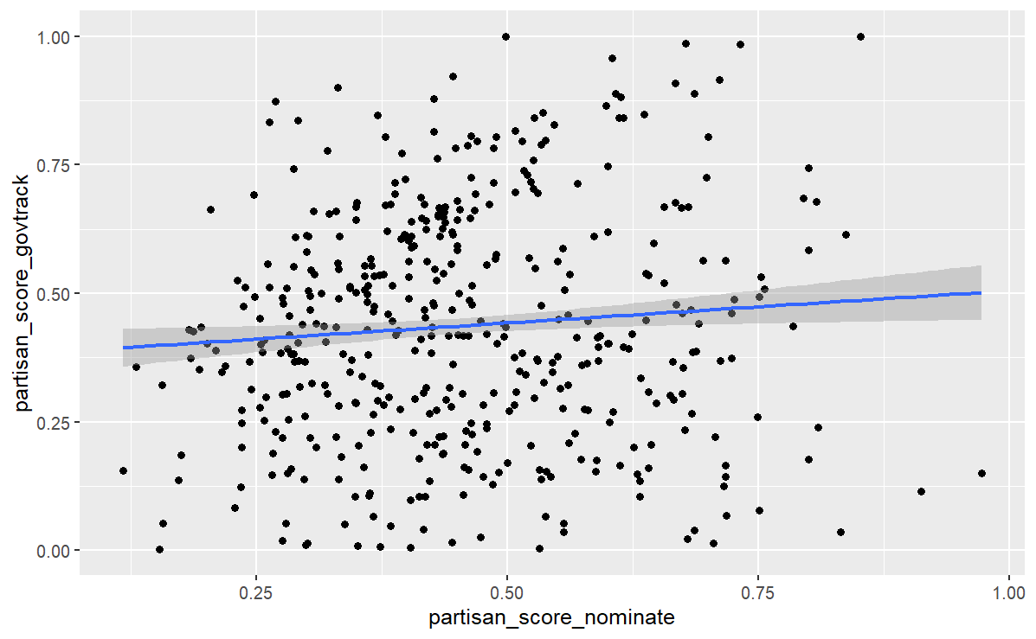
Additional Plots Relationship among dependent variable proxies

Slide 22
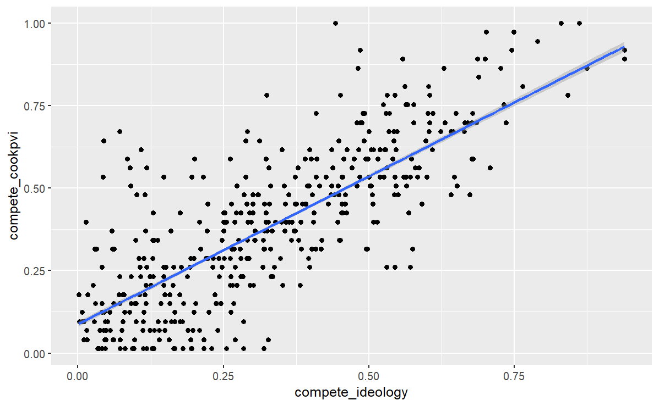
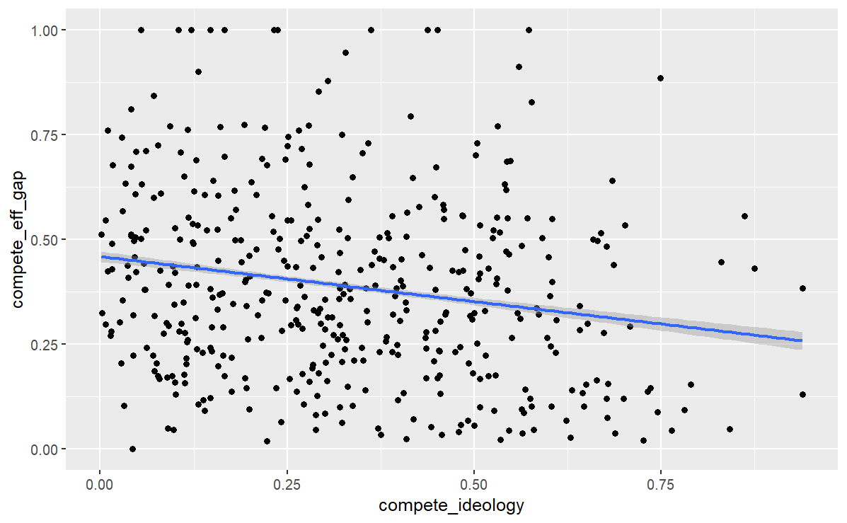
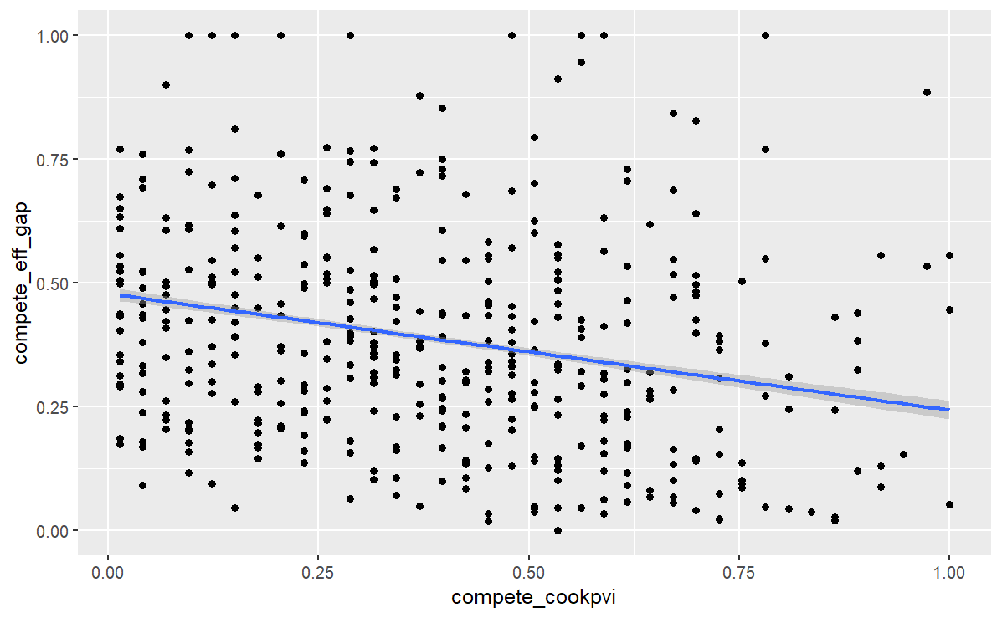
Additional Plots Relationship among independent variable proxies

Slide 23
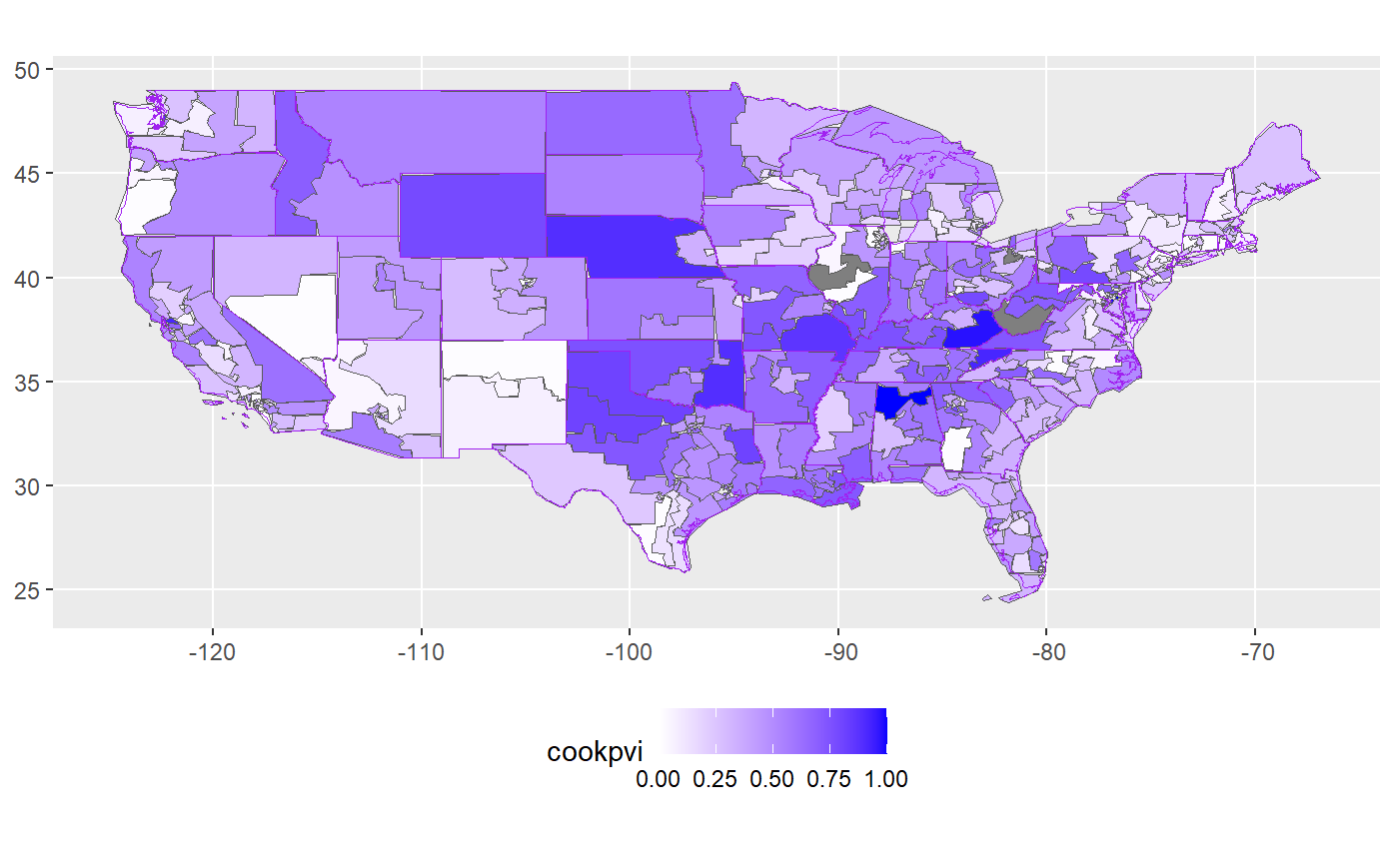
Additional Plots Geographic Coverage: Cook PVI

Slide 24
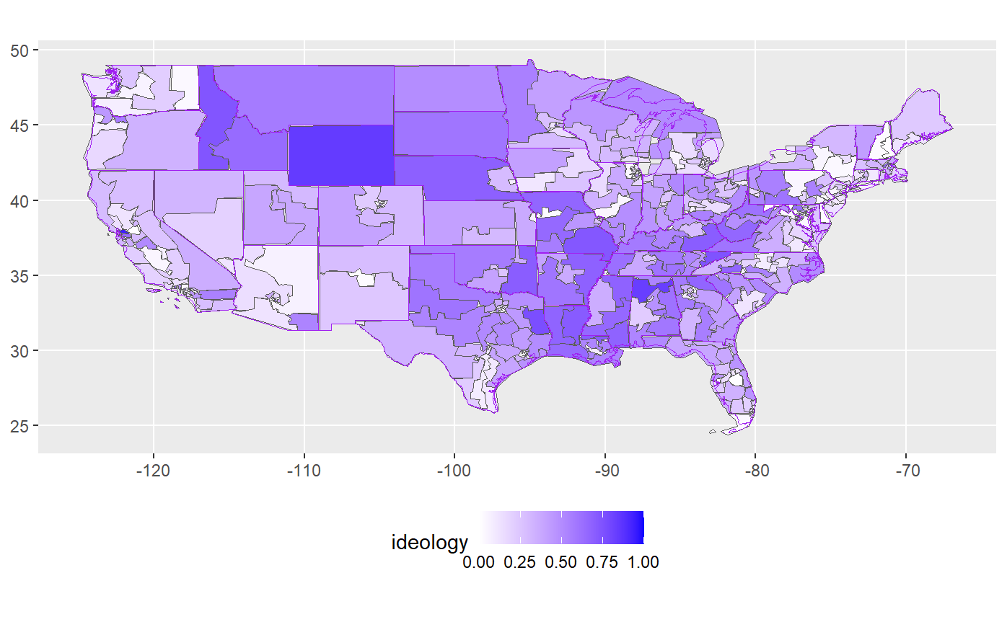
Additional Plots Geographic Coverage: Ideology

Slide 25
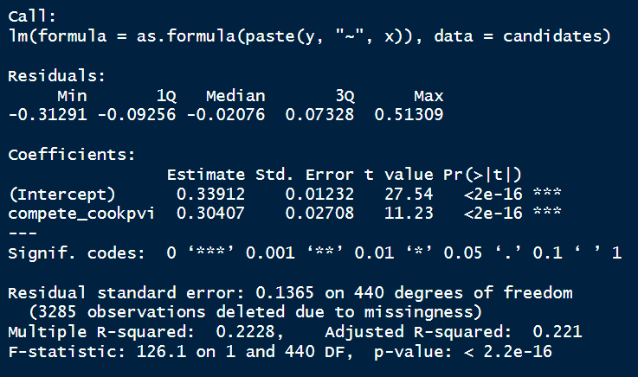
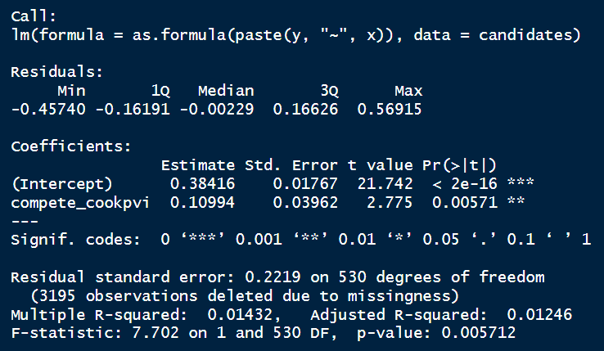
Full Regression Results (1/2) Dependent Variable: Nominate Score

Slide 26
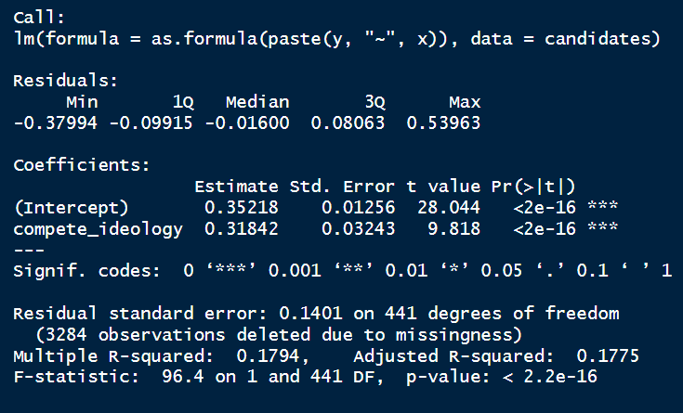
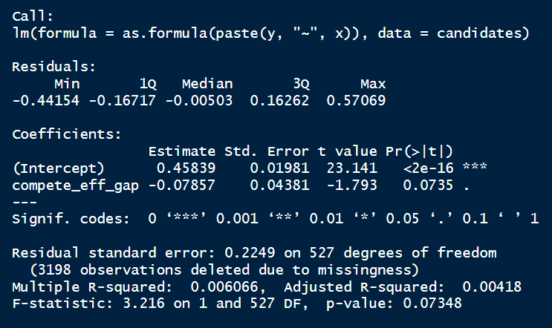
Full Regression Results (2/2) Dependent Variable: GovTrack Score

