Slide 1

Liar Liar Pants on Fire
False Statement Classification with scikit-learn and PyTorch
Keith Colella - CUNY SPS MSDS – DATA602

Slide 2
Abstract
This project aims to survey various Natural Language Processing (NLP) and Machine Learning (ML) techniques for their ability to detect false public statements (sometimes referred to as "fake news"). The project leverages a dataset of statements evaluated by POLITIFACT, a website focused on fact checking statements from public figures. The data contains more than 10,000 statements from a variety of public figures from a variety of contexts. Each statement is rated for its veracity on the following scale, ranging from totally bogus to totally true: "pants-fire", "false", "barely-true", "half-true", "mostly-true", and "true".
The project considers four different vectorization techniques (TF-IDF, Word2Vec, BERT and GPT embeddings) and four different modeling techniques (Logistic Regression, Random Forest, Support Vector Machines, and Recurrent Neural Networks) for 16 total models. Key packages leveraged include scikit-learn, pytorch, transformers, and spacy.
Initial performance on the 16 baseline models with multi-label classification was poor, so I binarized the labels. Performance improved overall, but the RNN-BERT combination showed the most promise. I proceeded to hyperparameter tuning with that model, which drove marginal improvements. The final tuned model ultimately predicted false statements with ~59% accuracy on the validation set, barely outperforming random guessing. I conclude that meaningful identification of false statements requires consideration of more than just semantic aspects of language. Instead, it likely requires consideration of context and facts. As such, large language models that have access to such facts in their training data may be better suited to the task.

Slide 3
Overview
Goal: Train a model to identify false statements
Data: Liar dataset, with >10k statements evaluated by PolitiFact. Labelled from totally bogus to totally true "pants-fire“>"false“>"barely-true“>"half-true“>"mostly-true“>"true“
Approach: Text Vectorization and Classification Models
Use Case: Content Moderation

Slide 4
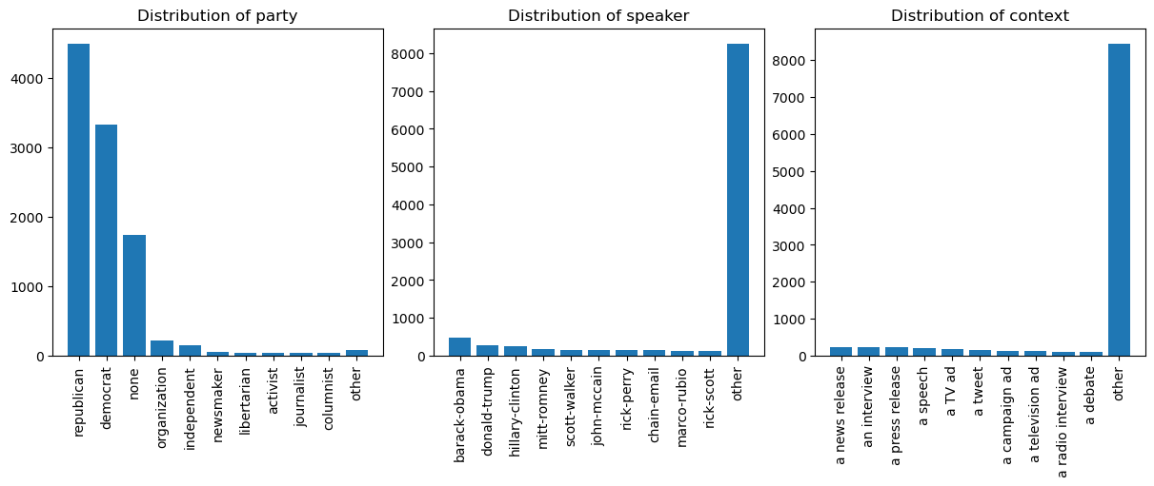
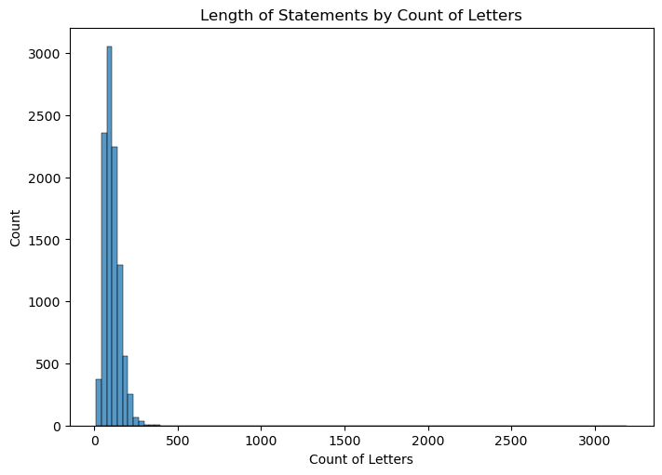
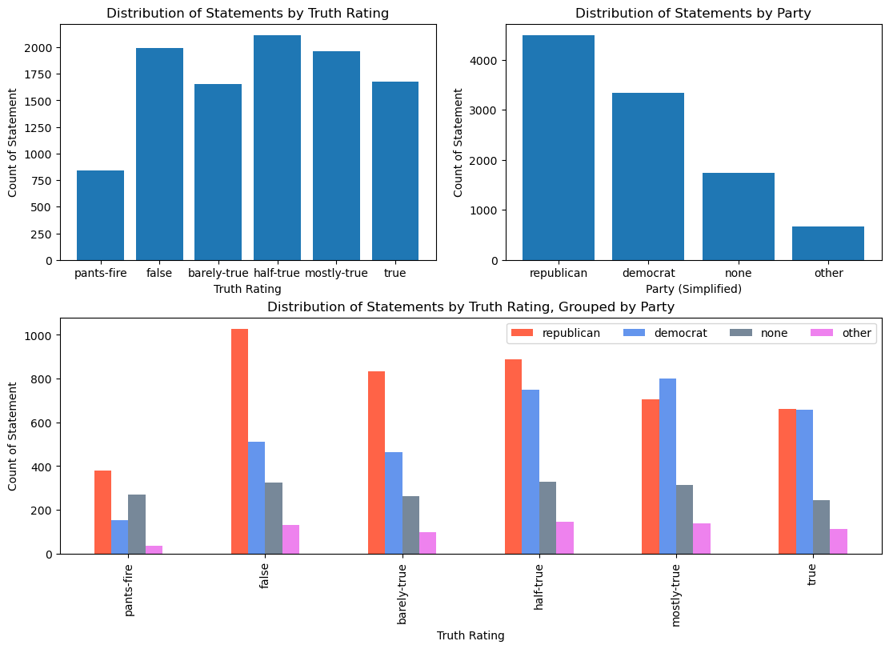
Data

Slide 5
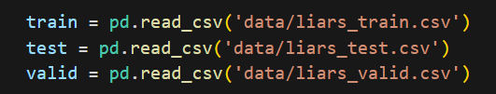
Preprocessing
Train-Test-Validation Split
Lemmatization

Slide 6
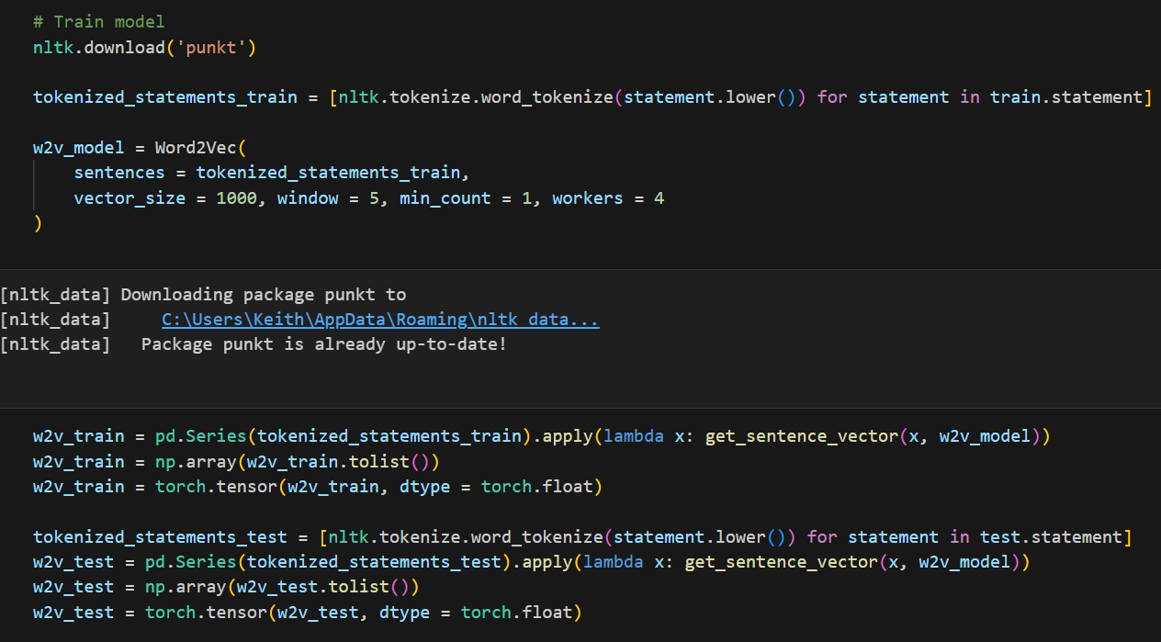
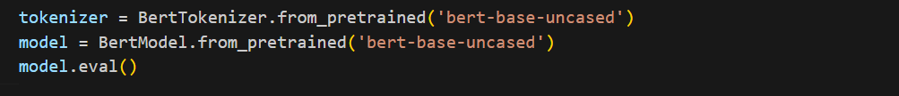
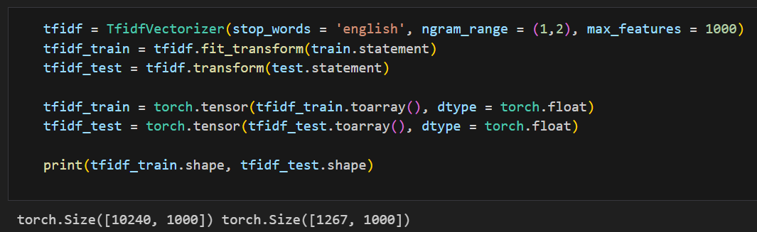
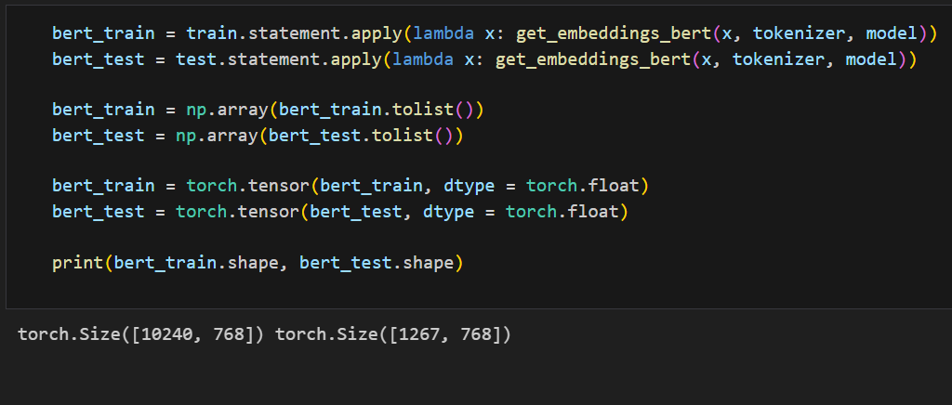
Vectorization
TF-IDF
Word2Vec
BERT Embeddings
GPT Embeddings

Slide 7
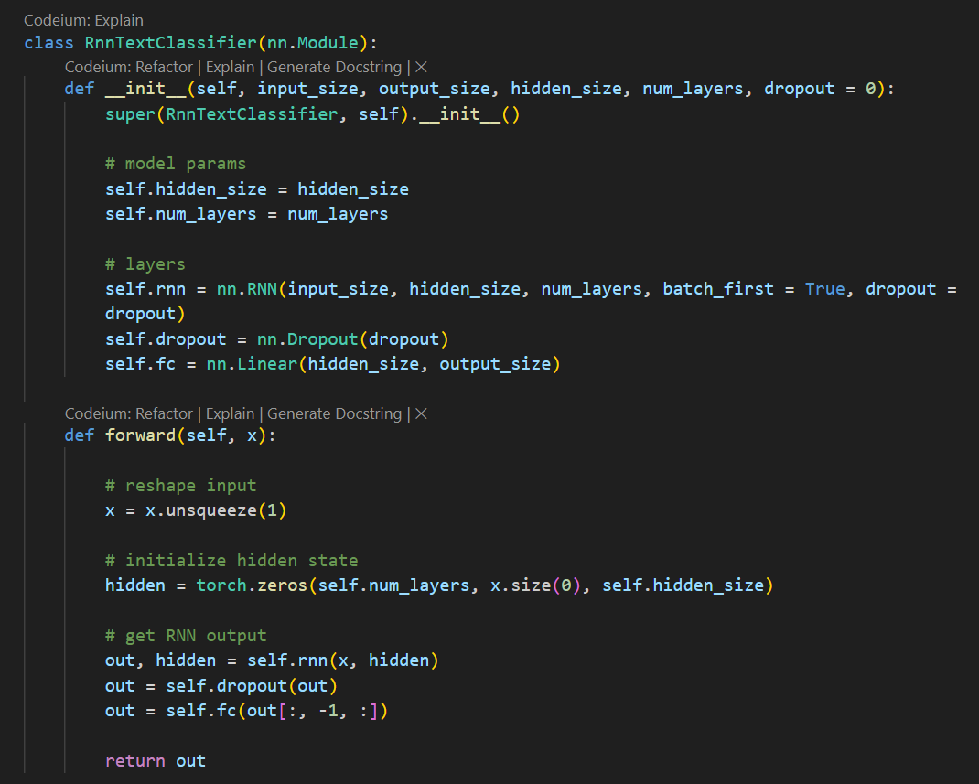
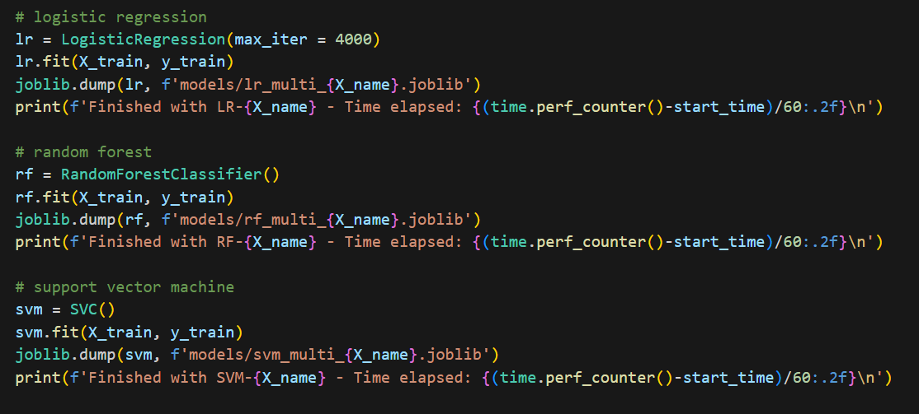
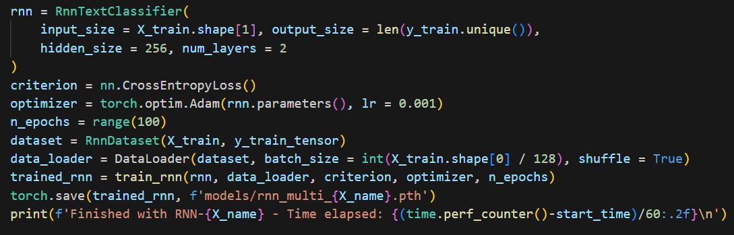
Modeling
Logistic Regression
Support Vector Machines
Random Forest
Recurrent Neural Network

Slide 8
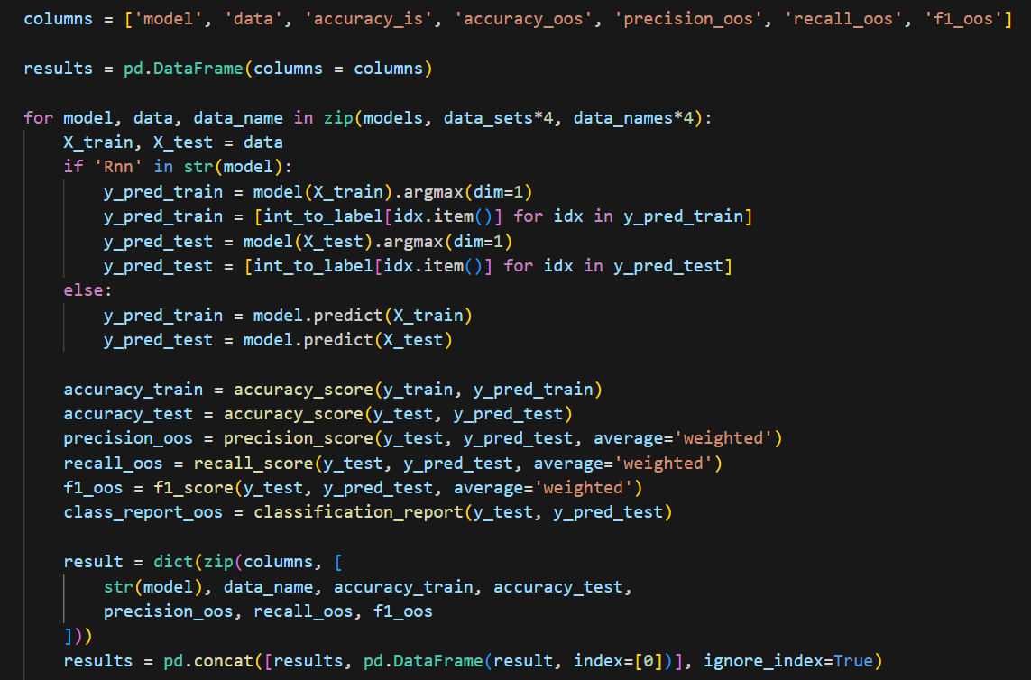
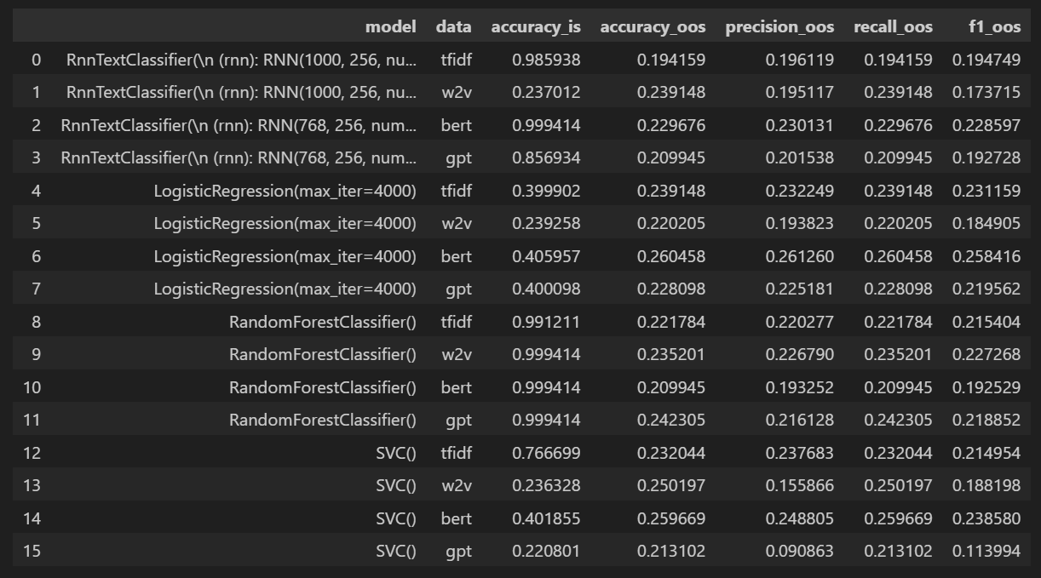
Initial Evaluation – Multilabel Classification

Slide 9
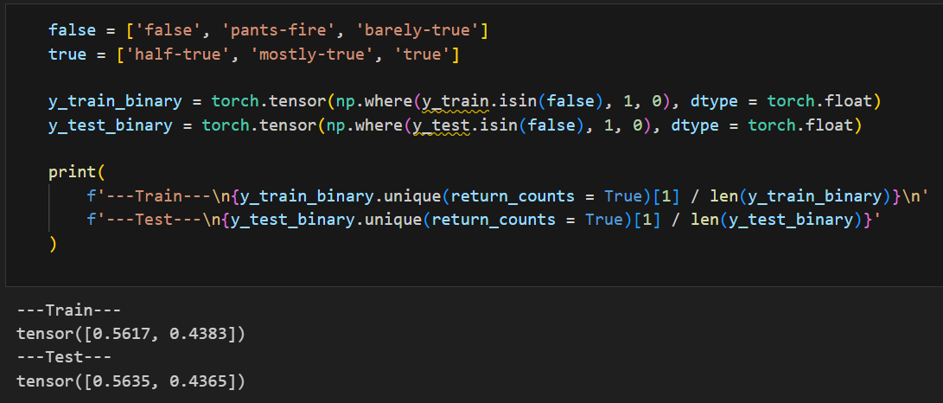
Binarizing Labels

Slide 10
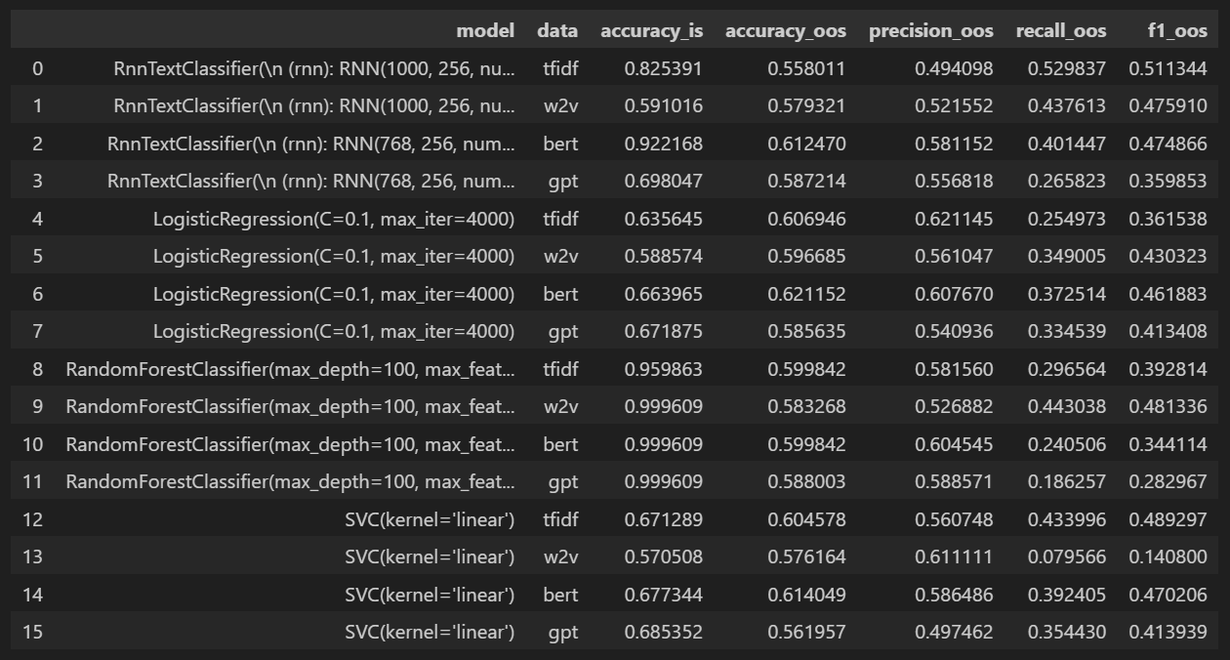
Initial Evaluation – Binary Classification

Slide 11
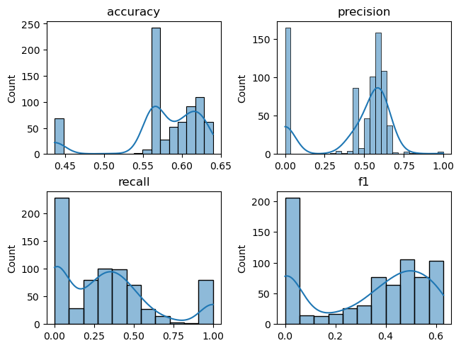
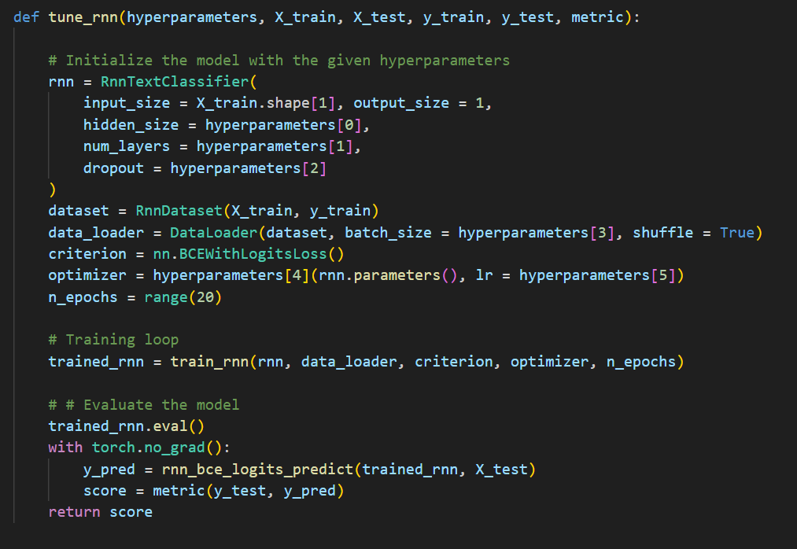
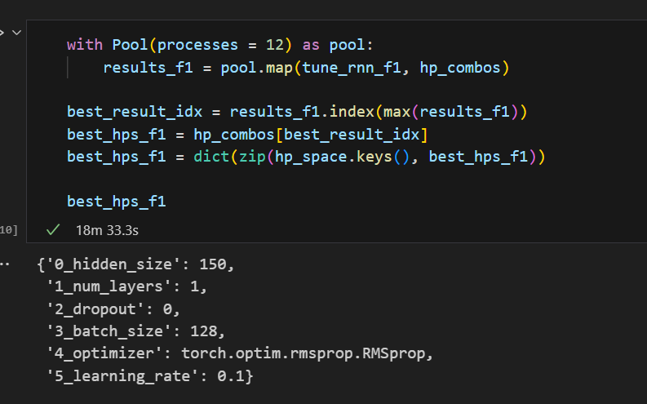
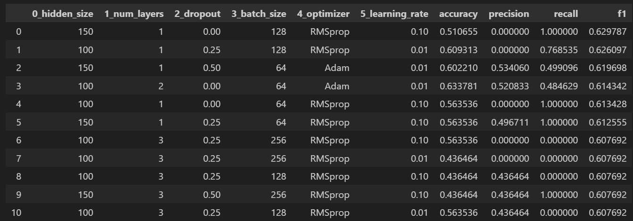
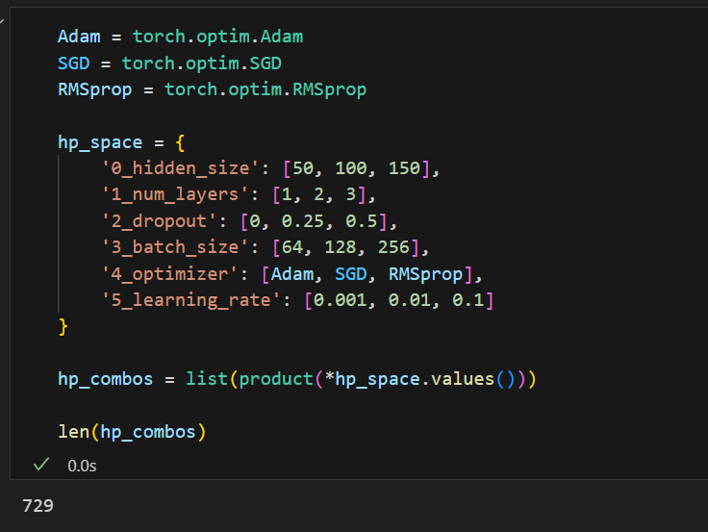
Hyperparameter tuning

Slide 12
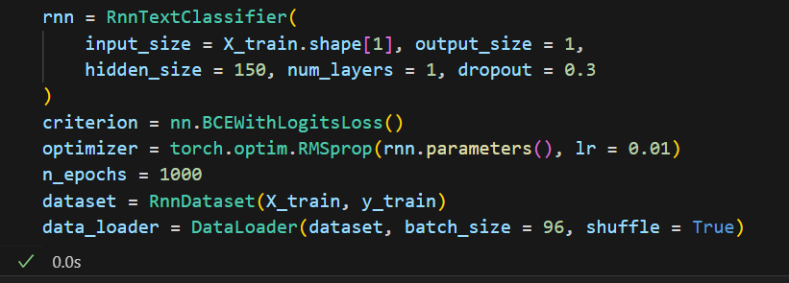
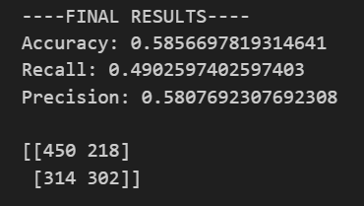
Final Model

Slide 13
Conclusions
Assessing truth requires more context
Identifying false statements is more than just a semantix exercise

