Slide 1

Recall
CAL HACKS 13.0
A room that remembers for you.
Notes:
Open on the person, not the tech. One sentence: a camera that remembers where things are, and a band that guides you to them.

Slide 2
7.4M
4.3M+
Americans 65+ with Alzheimer's
living alone with memory loss
When we forget, we recall.
With Alzheimer's, once forgotten stays forgotten.
Sources: Alzheimer's Association 2026 · UCSF Living Alone with Cognitive Impairment Project
Notes:
Say: "When you forget where you put something, you try to recall it. With Alzheimer's, that isn't easy. That's why we built Recall." 7.4M (about 1 in 9 over 65): Alzheimer's Association 2026. 4.3M+: UCSF (Portacolone), people 55+ with dementia or cognitive impairment who live alone. She puts her keys down and has no memory of it. She lives alone, or her caregiver wasn't in the room. There's no one to ask, and by the fourth time she's sure someone took them.

Slide 3
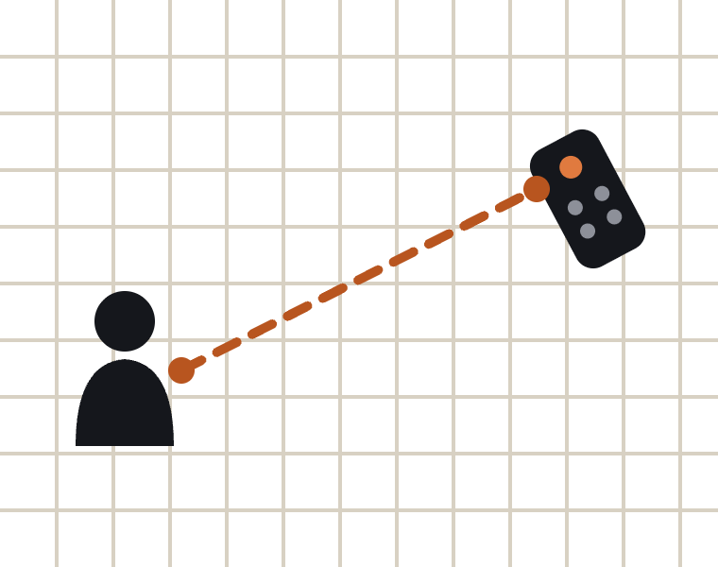
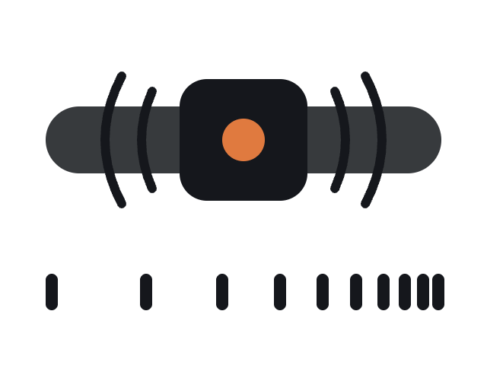

From a question to a direction
// state.json
"remote": {
"status": "observed",
"surface": "sofa1"
}
remote (x, y, z)
"Where's the remote?"
you (x, y, z)
STEP 01
STEP 02
STEP 03
STEP 04
Ask
Look up
Measure
Haptic Feedback
Notes:
1 Ask: tap the band's button and speak; a voice agent turns it into text. 2 Look it up: Recall checks its memory (state.json) and the agent speaks the answer, same words every time: "On the sofa." 3 Measure: the camera tracks where you are relative to the remote and how far away it is. 4 Buzz: that's streamed to the band many times a second; it buzzes faster as you close in and gives a distinct pulse when you've found it. If it's only a guess (inferred), the buzz is gentler.

Slide 4
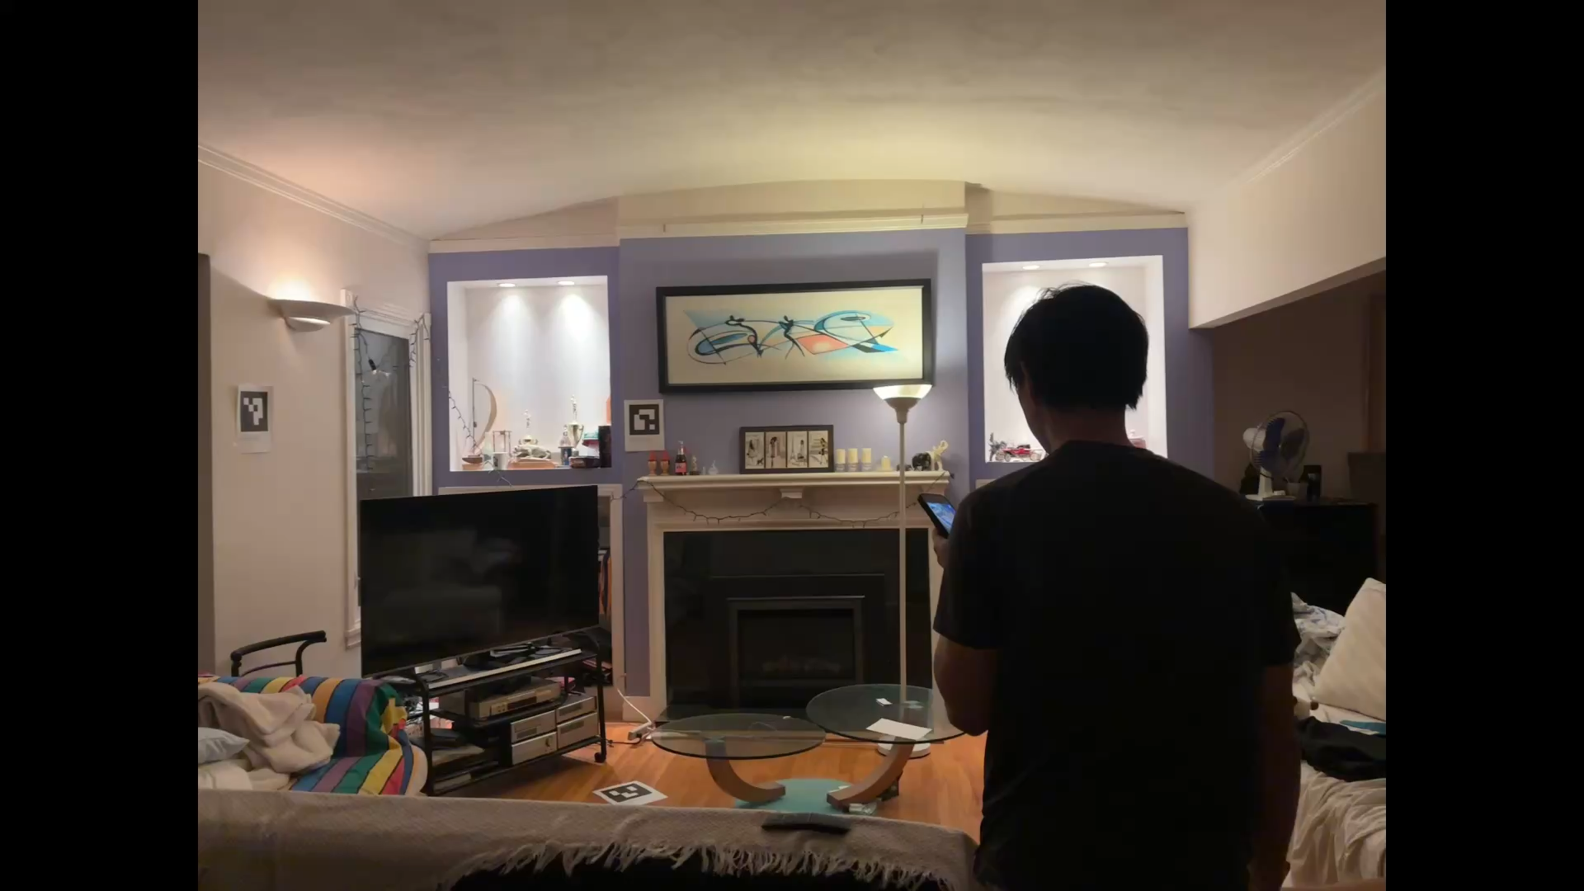
DEMO
Notes:
Live demo. Camera → memory → voice agent → band. Detection runs locally; no video leaves the house.

Slide 5
What sets us apart
Trackers
Cameras
AI assistants
Object states
3D mesh model
Haptic guide
Notes:
Trackers: too expensive to tag everything, and you can't tag your glasses. Recall needs no tags, just one camera. Cameras: large video files someone has to scrub through in 2D; Recall lets you query the room in 3D instantly. AI assistants: vague answers you have to remember; Recall guides you to exactly where it is.

Slide 6
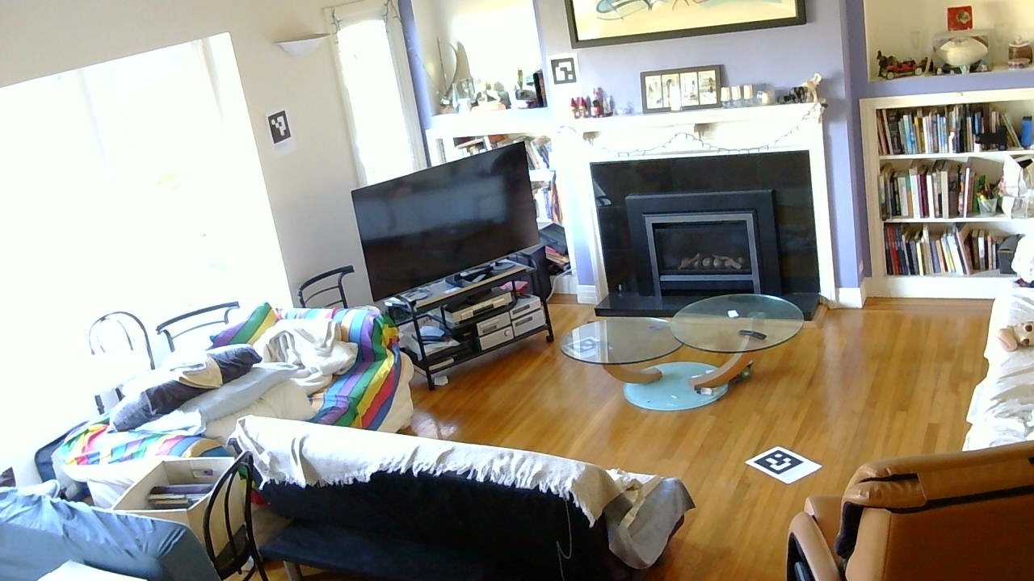
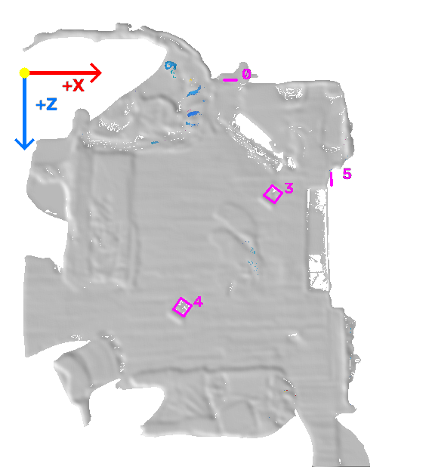
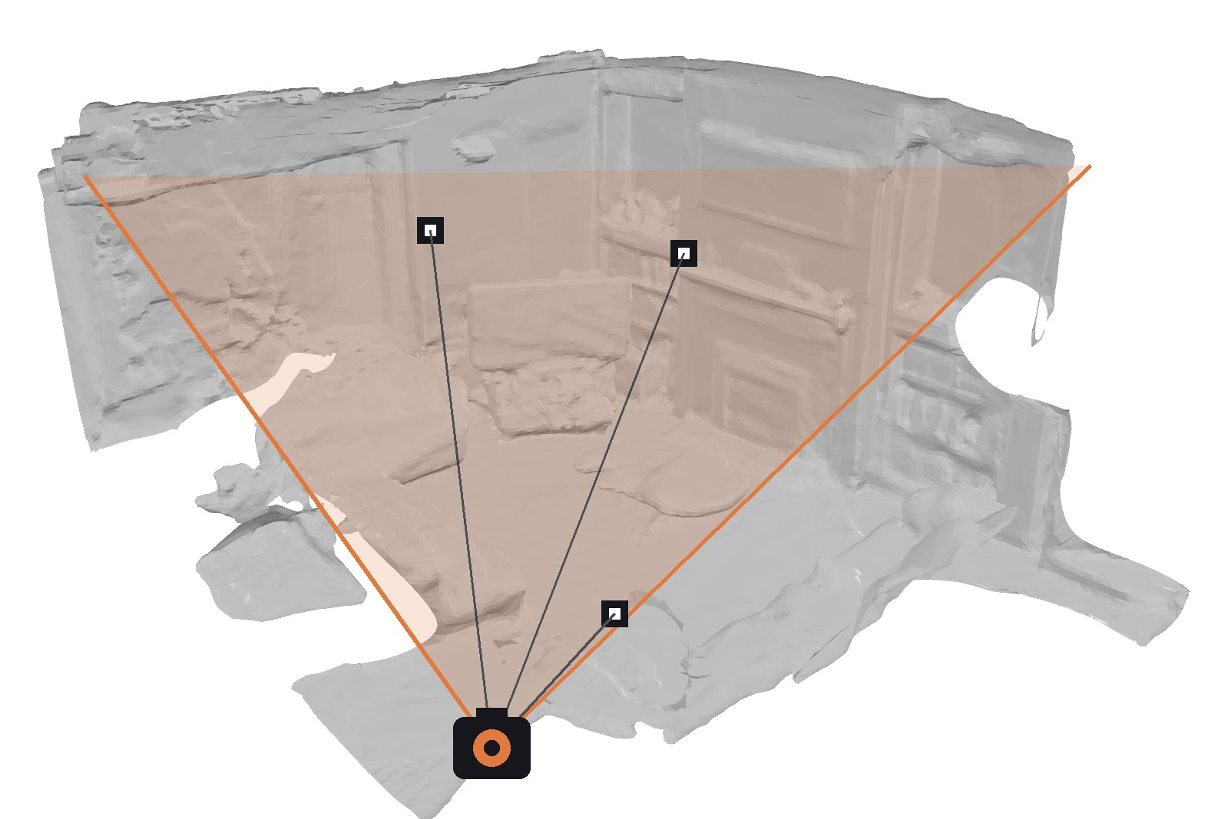

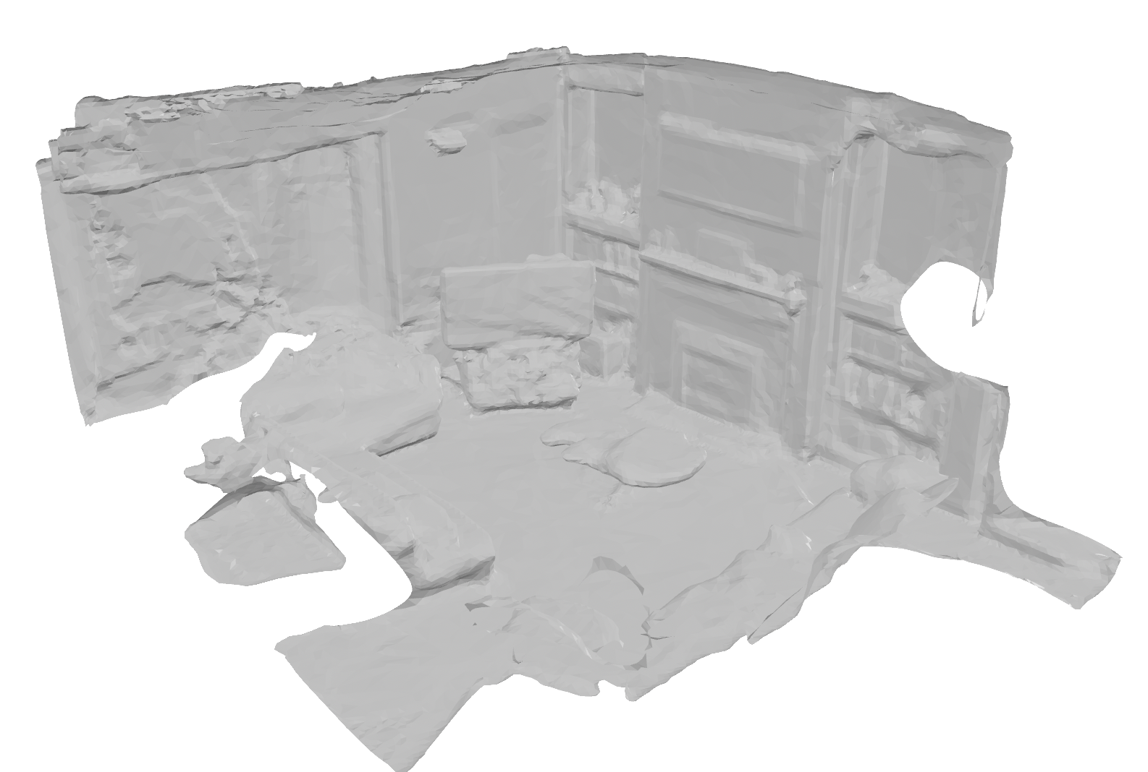
The room learns its own depth
Onboarding
Regular computer vision only sees flat pixels. So we give the camera a 3D room.
1 Scan the room
2 Pin markers, set coordinates
3 Place the camera in the model
Notes:
Why 3D: a regular detector like YOLO only gives a box in a flat picture. It can't tell how far away something is, which surface it's sitting on, or how far your hand is from it; two things that look side by side in the image can be metres apart. So we scan the room once and put the camera inside that 3D model: every detection becomes a real position in metres, which is what lets the band guide you. Step 2: each marker is found in the scan and pinned to the model; the floor becomes y = 0 and the walls give the X and Z axes, so every point in the room has coordinates in meters. Step 3: the camera sees the same markers that are pinned in the 3D model, so it works out exactly where it sits in that model and which way it's looking. From then on, every pixel it sees maps to a real spot in the room. The care partner does this once; it's never her job. Markers stay up, so a bumped camera just re-registers in seconds. Objects move freely afterwards; only moved furniture needs a rescan. Accuracy: roughly 5–8 cm on the floor with 3 markers in view.

Slide 7
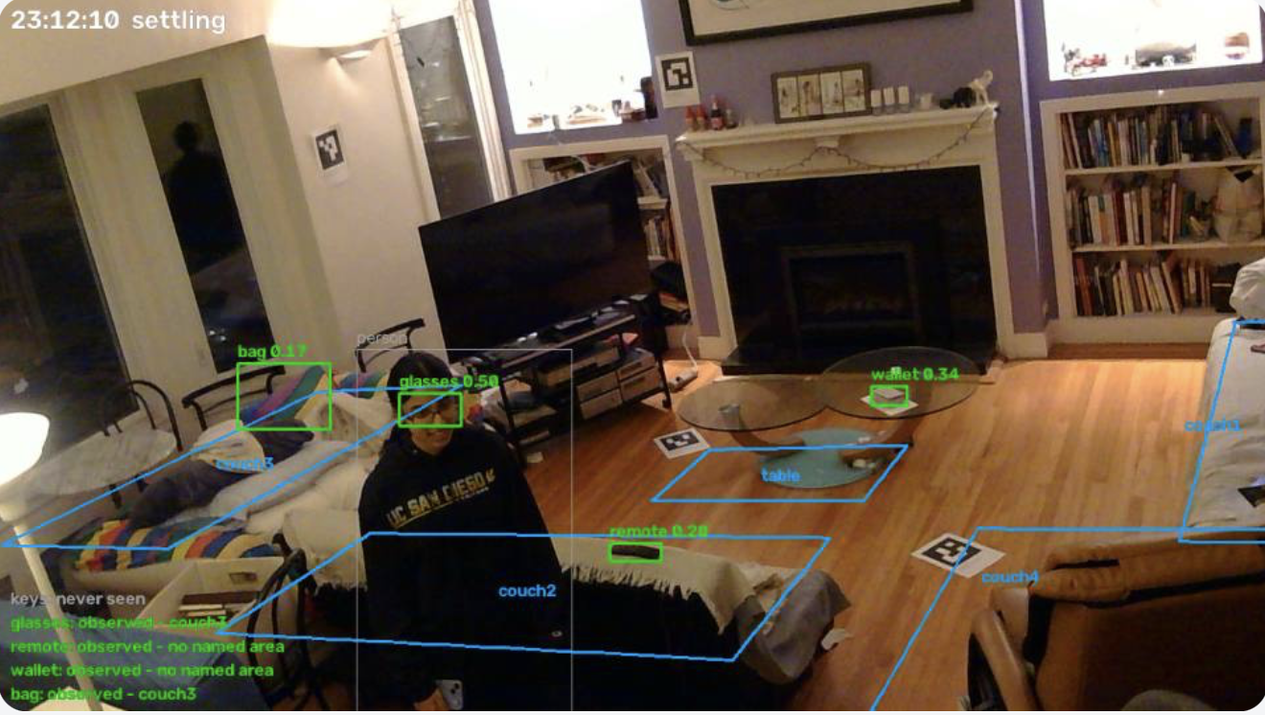
It finds each object and remembers where it is
DETECTION
// state.json: the whole memory
{
"glasses": {
"status": "observed",
"surface": "couch3",
"xyz": [x, y, z],
"reference": "glasses.png"
},
"bag": {
"status": "observed",
"surface": "couch3",
"xyz": [x, y, z],
"reference": "bag.png"
}
}
Notes:
YOLO-World spots each object by name; the 3D model says which surface it's on. Memory is plain JSON: state.json holds what's where right now and is rewritten atomically, so a crash never corrupts it. events.jsonl is append-only, one line per change (appeared, moved, disappeared, inferred), which powers "what changed today" and history. Every entry points at the photo behind it. It survives restarts and objects leaving and coming back into frame.

Slide 8
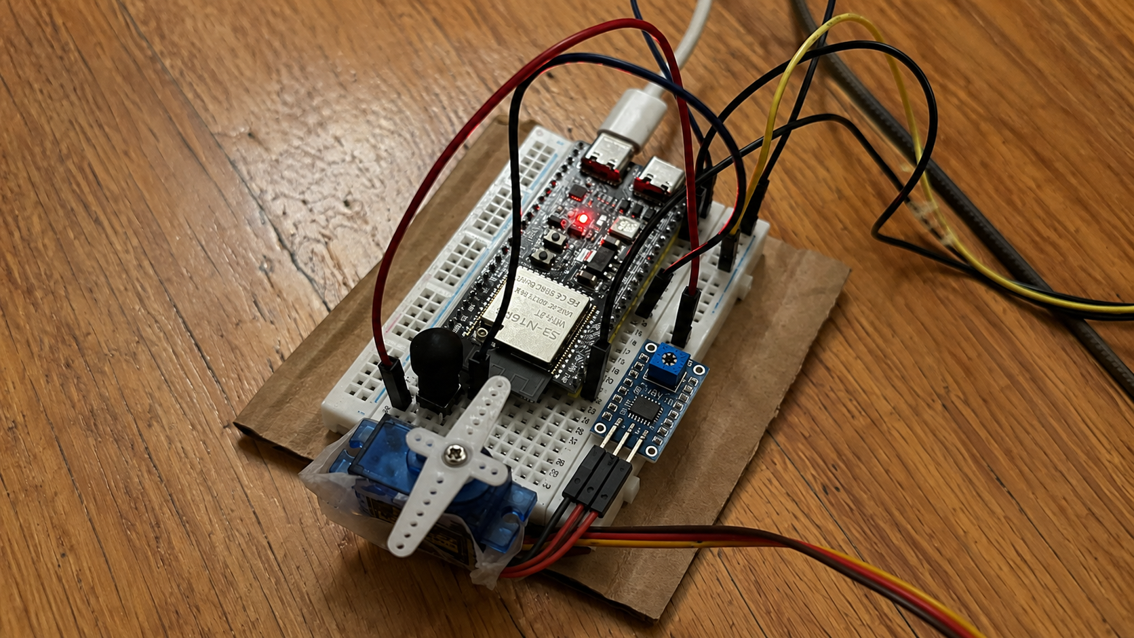






Haptic guidance helps you Recall.
THE BAND
ESP32 · Bluetooth
1
Click the button
Button
2
Mic turns on
3
Query
Microphone
4
Haptic feedback
Servo · haptic
Notes:
The prototype: an ESP32 on a breadboard with a servo, a microphone module and a battery pack. Deliberately dumb, about $10: the room does the thinking. It points the way and buzzes faster as your hand closes in, so there's nothing to remember, just follow it. An inferred answer never buzzes as hard as an observed one. Hand it over, don't describe it: strap it on the judge, stop talking, and let them find it by feel. Double-pulse on found.

