Slide 1

Java Basic and OOPs concept

Slide 2
Introduction to java
What is Java?
Java is a programming language and a platform. Java is a high level, robust, object-oriented and secure programming language.
Java was developed by Sun Microsystems (which is now the subsidiary of Oracle) in the year 1995
James Gosling is known as the father of Java. Before Java, its name was Oak. Since Oak was already a registered company, so James Gosling and his team changed the name from Oak to Java.
Platform: Any hardware or software environment in which a program runs, is known as a platform. Since Java has a runtime environment (JRE) and API, it is called a platform.

Slide 3
Java Example
class Simple{
public static void main(String args[]){
System.out.println("Hello Java");
}
}
o/p
Hello java

Slide 4
Application
Desktop Applications such as acrobat reader, media player, antivirus, etc.
Web Applications such as irctc.co.in, javatpoint.com, etc.
Enterprise Applications such as banking applications.
Mobile
Embedded System
Smart Card
Robotics
Games, etc.

Slide 5
Types of Java Applications
There are mainly 4 types of applications that can be created using Java programming:
1) Standalone Application
2) Web Application
3) Enterprise Application
4) Mobile Application

Slide 6
History of java
1) James Gosling, Mike Sheridan, and Patrick Naughton initiated the Java language project in June 1991. The small team of sun engineers called Green Team.
Initially it was designed for small, embedded systems in electronic appliances like set-top boxes.
Firstly, it was called "Greentalk" by James Gosling, and the file extension was .gt.
After that, it was called Oak and was developed as a part of the Green project.
In 1995, Oak was renamed as "Java" because it was already a trademark by Oak Technologies.
Initially developed by James Gosling at Sun Microsystems (which is now a subsidiary of Oracle Corporation) and released in 1995.
JDK 1.0 was released on January 23, 1996.

Slide 7
Paradigms of programming languages in java
Java is a versatile programming language that supports multiple programming paradigms, allowing developers to approach problems in different ways.
Object-Oriented Programming (OOP)
Object-Oriented Programming is the primary paradigm in Java. OOP is based on the concept of objects, which are instances of classes.
Encapsulation: Bundling the data (attributes) and methods (functions) that operate on the data into a single unit called a class. Encapsulation also involves restricting access to certain details of an object (through access modifiers like private, protected, and public).

Slide 8
Object-Oriented Programming (OOP) cont.
Inheritance: The mechanism by which one class (the subclass) can inherit fields and methods from another class (the superclass). This promotes code reuse and establishes a hierarchical relationship between classes.
Polymorphism: The ability of a single interface to represent different underlying forms (data types). In Java, polymorphism is typically achieved through method overloading and method overriding.
Abstraction: The concept of hiding the complex implementation details and showing only the essential features of the object. In Java, abstraction is achieved using abstract classes and interfaces.

Slide 9
2. Procedural Programming
Procedural Programming is a paradigm derived from structured programming, based on the concept of procedure calls, where statements are structured into procedures (also known as routines, functions, or subroutines). Java supports procedural programming, though it's not the primary paradigm.

Slide 10
3. Functional Programming
Functional Programming is a paradigm that treats computation as the evaluation of mathematical functions and avoids changing state or mutable data. Java supports functional programming to some extent, especially with the introduction of lambdas and the Stream API in Java 8.
4. Concurrent Programming
Concurrent Programming is a paradigm used to handle multiple tasks at the same time, often by dividing them into subtasks that can run in parallel. Java provides strong support for concurrency through the java.util.concurrent package, threads, and other synchronization mechanisms.

Slide 11
5. Event-Driven Programming
Event-Driven Programming is a paradigm where the flow of the program is determined by events such as user actions (clicks, key presses), sensor outputs, or messages from other programs. Java supports event-driven programming, particularly in GUI applications with the Swing and JavaFX libraries.

Slide 12
Evolution of OO methodology in java
Object-Oriented (OO) methodology in Java has evolved significantly since the language's inception. Java itself was designed with object-oriented principles at its core, but the methodologies and best practices for applying these principles have evolved over time. Here's a look at the evolution of OO methodology in Java:
1. Early OO Concepts (Pre-Java)
Simula and Smalltalk: The OO methodology began with languages like Simula (1960s) and Smalltalk (1970s), which introduced the core concepts of objects, classes, inheritance, and polymorphism.
C++ Influence: C++, an extension of C, added OO features and heavily influenced Java's development, although Java aimed to be simpler and more secure.

Slide 13
2. Java 1.0 (1995): The Beginning
Core OO Principles: Java was released by Sun Microsystems in 1995 with a strong focus on OO principles like encapsulation, inheritance, and polymorphism.
Platform Independence: The "Write Once, Run Anywhere" philosophy emphasized platform independence, which was achieved through the use of the Java Virtual Machine (JVM).
Basic OO Features: Early Java versions supported basic OO features—classes, objects, inheritance, interfaces, and simple exception handling.
Applets: Java initially gained popularity through applets, which were small, secure applications running within web browsers.

Slide 14
3. Java 2 (1998-2004): Strengthening OO Concepts
Swing and AWT: The introduction of Swing and the Abstract Window Toolkit (AWT) provided more robust and flexible GUI components, reinforcing the OO nature of Java applications.
Java Collections Framework: The introduction of the Collections Framework (Java 2) standardized data structures like lists, sets, and maps, promoting better OO design by encouraging the use of interfaces and polymorphism.
Enterprise JavaBeans (EJB): EJB and the broader Java Enterprise Edition (J2EE) framework promoted component-based development and the use of design patterns, particularly in enterprise-level applications.
JSP and Servlets: JavaServer Pages (JSP) and Servlets encouraged the development of web applications using Java, blending OO principles with web technologies.

Slide 15
4. Java 5 (2004): Enhanced OO Capabilities
Generics: Java 5 introduced generics, allowing for type-safe collections and reducing the need for type casting. This improved code reusability and robustness.
Enhanced for Loop: The enhanced for loop simplified iteration over collections, aligning with OO principles of abstraction and encapsulation.
Annotations: The introduction of annotations provided a way to add metadata to classes, methods, and fields, influencing how OO frameworks (like Spring) could automate certain processes.
Concurrency API: New concurrency utilities were introduced, promoting better design in multi-threaded applications.

Slide 16
5. Java 6 and 7 (2006-2011): Refinements and New Patterns
Java SE 6: Focused on performance improvements and enhancements to existing APIs, while continuing to support OO principles.
Java SE 7: Introduced try-with-resources, simplifying resource management and adhering to OO best practices like encapsulation and code clarity.
NIO.2: Enhanced the NIO package, improving how Java handled file systems and IO, encouraging more modular and maintainable code.

Slide 17
6. Java 8 (2014): Functional Programming Meets OO
Lambda Expressions: Introduced functional programming features, allowing functions to be treated as first-class citizens. This led to more concise and flexible code while maintaining OO principles.
Streams API: The Streams API enabled functional-style operations on collections, promoting immutability and encouraging a more declarative approach to processing data.
Default Methods in Interfaces: Interfaces could now have default methods, allowing for backward-compatible evolution of APIs and promoting better interface design.
Optional Class: Introduced to help avoid NullPointerException, promoting more robust and safe OO code.

Slide 18
7. Java 9 and Beyond (2017-Present): Modularity and New Features
Java Platform Module System (JPMS): Java 9 introduced the module system (Project Jigsaw), which redefined how large applications were structured, improving encapsulation and maintainability.
Reactive Streams: Introduced in Java 9, enabling reactive programming, which complements OO by handling asynchronous data streams more effectively.
Enhanced APIs: Continuous improvement in APIs, including Collections, Streams, and Concurrency utilities, refined OO practices in Java.
Records (Java 14): Introduced as a preview feature and officially in Java 16, records are a new kind of class in Java that succinctly defines immutable data carriers, reducing boilerplate code while adhering to OO principles.

Slide 19
8. Modern Trends:
Microservices: Java’s OO principles have adapted to new architectural paradigms like microservices, where modularity and encapsulation are crucial.
Cloud-Native Java: With the rise of cloud computing, Java frameworks like Spring Boot have evolved to embrace OO principles in distributed, cloud-native environments.
Kotlin and Scala Influence: While Java remains dominant, languages like Kotlin and Scala (which run on the JVM) have influenced modern Java practices, bringing in new OO and functional programming paradigms.

Slide 20
9. Best Practices and Design Patterns:
Design Patterns: The adoption of design patterns like Singleton, Factory, and Observer in Java applications became widespread, promoting best practices in OO design.
SOLID Principles: These principles (Single Responsibility, Open/Closed, Liskov Substitution, Interface Segregation, and Dependency Inversion) became widely adopted, guiding OO design in Java.

Slide 21
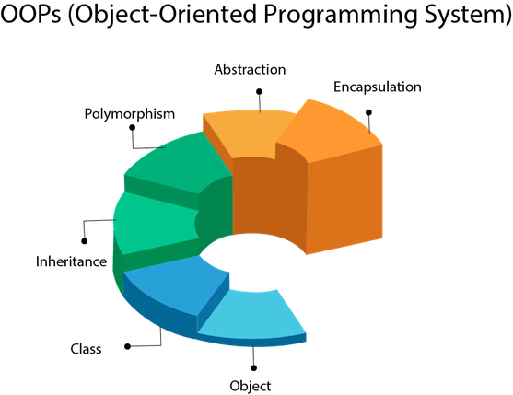
OOPs

Slide 22
Java OOPs Concepts
What is an object in Java
An entity that has state and behavior is known as an object e.g., chair, bike, marker, pen, table, car, etc. It can be physical or logical.
An object has three characteristics:
State: represents the data (value) of an object.
Behavior: represents the behavior (functionality) of an object such as deposit, withdraw, etc.
Identity: An object identity is typically implemented via a unique ID. The value of the ID is not visible to the external user. However, it is used internally by the JVM to identify each object uniquely.

Slide 23
Object
An object is an instance of a class. A class is a template or blueprint from which objects are created. So, an object is the instance(result) of a class.
Object Definitions:
An object is a real-world entity.
An object is a runtime entity.
The object is an entity which has state and behavior.
The object is an instance of a class.

Slide 24
CLASS
What is a class in Java
A class is a group of objects which have common properties. It is a template or blueprint from which objects are created. It is a logical entity. It can't be physical.
A class in Java can contain:
Fields
Methods
Constructors
Blocks
Nested class and interface

Slide 25
Inheritance in Java
nheritance in Java is a mechanism in which one object acquires all the properties and behaviors of a parent object.
Why use inheritance in java
For Method Overriding (so runtime polymorphism can be achieved).
For Code Reusability.
The syntax of Java Inheritance
class Subclass-name extends Superclass-name
{
//methods and fields
}

Slide 26
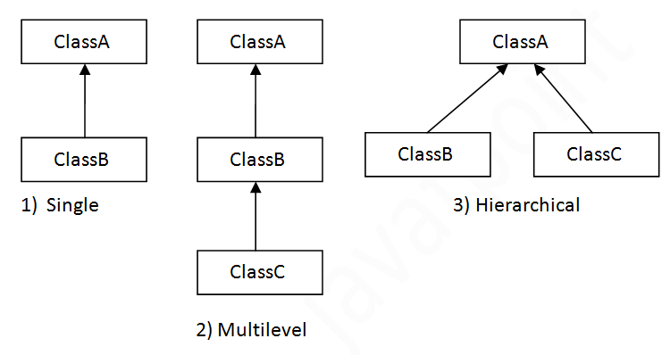
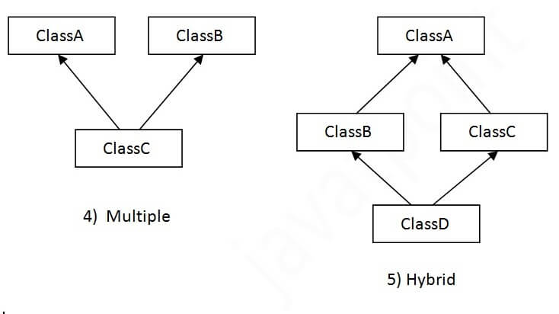
Types of inheritance in java

Slide 27
Java Polymorphism
If one task is performed in different ways, it is known as polymorphism. For example: to convince the customer differently, to draw something, for example, shape, triangle, rectangle, etc.
In Java, we use method overloading and method overriding to achieve polymorphism.
Another example can be to speak something; for example, a cat speaks meow, dog barks woof, etc.

Slide 28
Abstraction
Hiding internal details and showing functionality is known as abstraction. For example phone call, we don't know the internal processing.
In Java, we use abstract class and interface to achieve abstraction.

Slide 29

Encapsulation
Binding (or wrapping) code and data together into a single unit are known as encapsulation. For example, a capsule, it is wrapped with different medicines.
A java class is the example of encapsulation. Java bean is the fully encapsulated class because all the data members are private here.

Slide 30
Comparison of object oriented and procedure oriented approaches.
1. Basic Concept:
Object-Oriented Programming (OOP):
Organizes code around objects, which are instances of classes.
Focuses on representing real-world entities through objects that encapsulate data and behavior.
Procedural Programming:
Organizes code into procedures or functions.
Focuses on the sequence of tasks or steps to be performed, typically using functions or subroutines.

Slide 31
Cont.
2. Structure:
OOP:
Programs are divided into objects, each containing both data (attributes) and methods (functions).
Emphasizes the relationships between objects and how they interact.
Procedural:
Programs are divided into functions, each performing a specific task.
Emphasizes the flow of control and the order in which functions are called.

Slide 32
Cont.
3. Data Handling:
OOP:
Data is encapsulated within objects, and access to it is controlled through methods.
Promotes data hiding and abstraction, ensuring that data is only accessible in ways that are intended.
Procedural:
Data is often passed between functions using parameters or global variables.
Less emphasis on data encapsulation, which can lead to unintended side effects if data is modified unexpectedly.

Slide 33
Cont.
4. Reusability:
OOP:
High reusability through inheritance and polymorphism.
Allows new classes to reuse and extend existing ones, promoting code reuse and reducing redundancy.
Procedural:
Reusability is achieved through function libraries, but it is less flexible compared to OOP.
Functions can be reused, but extending or modifying functionality often requires rewriting or duplicating code.

Slide 34
Cont.
5. Maintainability:
OOP:
Easier to maintain and modify because objects are self-contained and modular.
Changes to one part of the system often have minimal impact on other parts.
Procedural:
Can be harder to maintain, especially in large programs, as changes in one function may affect many other functions.
Tightly coupled code can lead to cascading changes when modifications are required.

Slide 35
Cont.
6. Scalability:
OOP:
More scalable due to its modular nature. New features can be added by creating new classes or extending existing ones.
Better suited for large, complex systems.
Procedural:
Less scalable for large projects, as the code can become unwieldy with many interdependent functions.
More suitable for smaller, simpler programs.

Slide 36
Cont.
7. Approach to Problem-Solving:
OOP:
Models problems in terms of objects, focusing on the entities involved and their interactions.
Encourages thinking about the system as a collection of interacting objects.
Procedural:
Models problems in terms of a sequence of steps or operations.
Encourages thinking about the problem in terms of tasks and procedures to be executed.

Slide 37
Cont.
8. Examples:
OOP:
Languages like Java, C++, Python (with OOP features), Ruby.
Procedural:
Languages like C, Pascal, Fortran, and Python (when used in a procedural style).

Slide 38
Cont.
9. Performance:
OOP:
May have a slight overhead due to object creation and method calls, but modern optimizations reduce this impact.
Performance can be optimized through proper design patterns and techniques.
Procedural:
Generally more straightforward and can be more efficient for small, simple programs.
Directly executes a series of commands, often leading to faster execution in certain cases.

Slide 39
Cont.
10. Examples of Usage:
OOP:
Suitable for complex applications like GUIs, simulations, and games, where modeling real-world entities is beneficial.
Procedural:
Suitable for tasks like scripting, system programming, and small utilities where straightforward execution of a sequence of tasks is needed

Slide 40
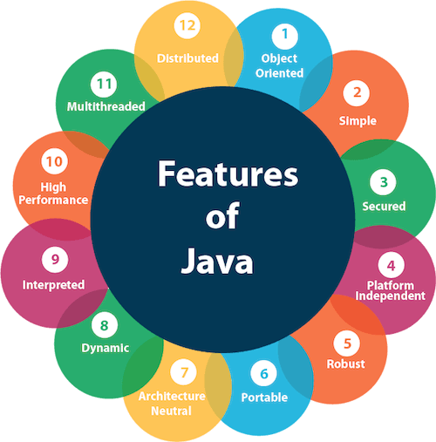
Features of Java

Slide 41
Features (cont.)
Simple
Java is very easy to learn, and its syntax is simple, clean and easy to understand. According to Sun Microsystem, Java language is a simple programming language because:
Object-oriented
Java is an object-oriented programming language. Everything in Java is an object. Object-oriented means we organize our software as a combination of different types of objects that incorporate both data and behavior.

Slide 42
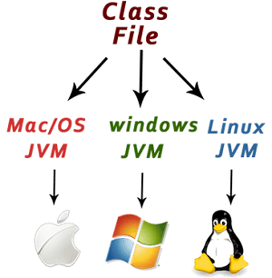
Features(cont.)
Platform Independent
Java is platform independent because it is different from other languages like C, C++, etc. which are compiled into platform specific machines while Java is a write once, run anywhere language. A platform is the hardware or software environment in which a program runs.

Slide 43
FEATURES(CONT.)
Secured
Java is best known for its security. With Java, we can develop virus-free systems. Java is secured because:
1 No explicit pointer
2 Java Programs run inside a virtual machine sandbox

Slide 44
Features (cont.)
Robust
The English mining of Robust is strong. Java is robust because:
It uses strong memory management.
There is a lack of pointers that avoids security problems.
Java provides automatic garbage collection which runs on the Java Virtual Machine to get rid of objects which are not being used by a Java application anymore.
There are exception handling and the type checking mechanism in Java. All these points make Java robust.

Slide 45
FEATURES (CONT.)
Portable
Java is portable because it facilitates you to carry the Java bytecode to any platform. It doesn't require any implementation.
High-performance
Java is faster than other traditional interpreted programming languages because Java bytecode is "close" to native code. It is still a little bit slower than a compiled language (e.g., C++). Java is an interpreted language that is why it is slower than compiled languages, e.g., C, C++, etc.

Slide 46
FEATURES (CONT.)
Distributed
Java is distributed because it facilitates users to create distributed applications in Java. RMI and EJB are used for creating distributed applications. This feature of Java makes us able to access files by calling the methods from any machine on the internet.
Multi-threaded
A thread is like a separate program, executing concurrently. We can write Java programs that deal with many tasks at once by defining multiple threads. The main advantage of multi-threading is that it doesn't occupy memory for each thread. It shares a common memory area. Threads are important for multi-media, Web applications, etc.

Slide 47
First Java Program | Hello World Example
The requirement for Java Hello World Example
Install the JDK if you don't have installed it, download the JDK and install it.
Set path of the jdk/bin directory. http://www.javatpoint.com/how-to-set-path-in-java
Create the Java program
Compile and run the Java program

Slide 48
Creating Hello World Example
class Simple{
public static void main(String args[]){
System.out.println("Hello Java");
}
}
O/P Hello Java
To compile: | javac Simple.java
To execute: | java Simple

Slide 49
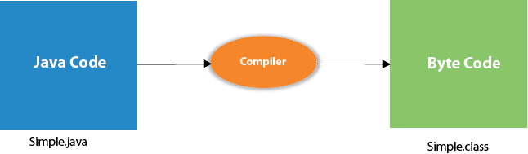
Compilation Flow:
When we compile Java program using javac tool, the Java compiler converts the source code into byte code.

Slide 50
Parameters used in First Java Program
class keyword is used to declare a class in Java.
public keyword is an access modifier that represents visibility. It means it is visible to all.
static is a keyword. If we declare any method as static, it is known as the static method. The core advantage of the static method is that there is no need to create an object to invoke the static method. The main() method is executed by the JVM, so it doesn't require creating an object to invoke the main() method. So, it saves memory.
void is the return type of the method. It means it doesn't return any value.
main represents the starting point of the program.
String[] args or String args[] is used for command line argument.
System.out.println() is used to print statement. Here, System is a class, out is an object of the PrintStream class, println() is a method of the PrintStream class.

Slide 51
In how many ways we can write a Java program?
1) By changing the sequence of the modifiers, method prototype is not changed in Java.
static public void main(String args[])
2) The subscript notation in the Java array can be used after type, before the variable or after the variable.
public static void main(String[] args)
public static void main(String []args)
public static void main(String args[])
3) You can provide var-args support to the main() method by passing 3 ellipses (dots)
public static void main(String... args)

Slide 52
In how many ways we can write a Java program?
4) Having a semicolon at the end of class is optional in Java.
class A{
static public void main(String... args){
System.out.println("hello java4");
}
};

Slide 53
Valid Java main() method signature
public static void main(String[] args)
public static void main(String []args)
public static void main(String args[])
public static void main(String... args)
static public void main(String[] args)
public static final void main(String[] args)
final public static void main(String[] args)
final strictfp public static void main(String[] args)

Slide 54
Invalid Java main() method signature
public void main(String[] args)
static void main(String[] args)
public void static main(String[] args)
abstract public static void main(String[] args)

Slide 55
Internal Details of Hello Java Program
What happens at compile time?

Slide 56
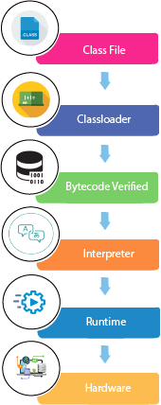
Internal Details of Hello Java Program
What happens at runtime?

Slide 57
Internal Details of Hello Java Program
Classloader: It is the subsystem of JVM that is used to load class files.
Bytecode Verifier: Checks the code fragments for illegal code that can violate access rights to objects.
Interpreter: Read bytecode stream then execute the instructions.
Q) Can you save a Java source file by another name than the class name?

Slide 58
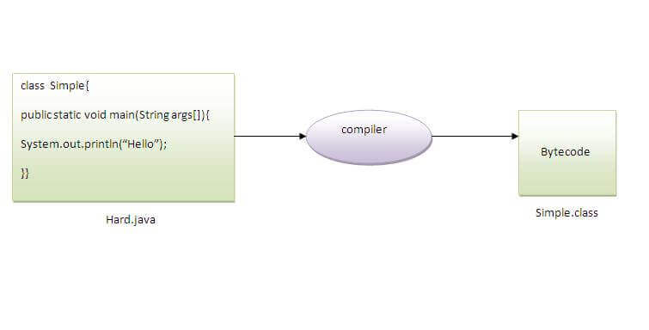
Q) Can you save a Java source file by another name than the class name?
Yes, if the class is not public.

Slide 59
JDK, JRE, and JVM
JVM
JVM (Java Virtual Machine) is an abstract machine. It is called a virtual machine because it doesn't physically exist.
It is a specification that provides a runtime environment in which Java bytecode can be executed.
It can also run those programs which are written in other languages and compiled to Java bytecode.
The JVM performs the following main tasks:
Loads code
Verifies code
Executes code
Provides runtime environment

Slide 60
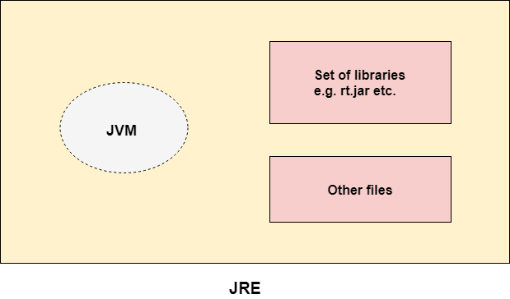
Java Runtime Environment
JRE
JRE is an acronym for Java Runtime Environment. The Java Runtime Environment is a set of software tools which are used for developing Java applications.
It is used to provide the runtime environment.
It is the implementation of JVM. It physically exists. It contains a set of libraries + other files that JVM uses at runtime.

Slide 61
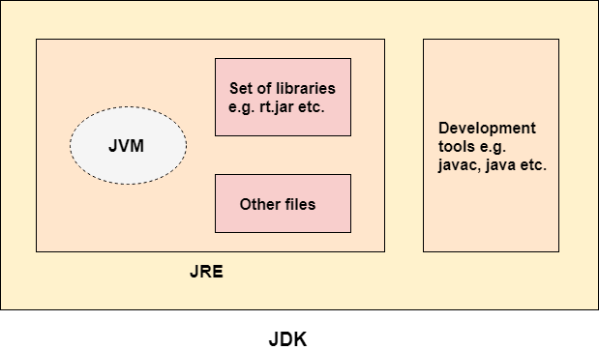
Java Development Kit
JDK is an acronym for Java Development Kit.
The Java Development Kit (JDK) is a software development environment which is used to develop Java applications and applets.
It physically exists. It contains JRE + development tools.

Slide 62
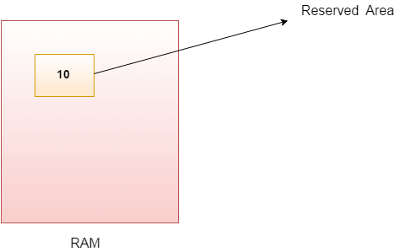
Java Variables
A variable is a container which holds the value while the Java program is executed. A variable is assigned with a data type.
Variable is a name of memory location.
A variable is the name of a reserved area allocated in memory. it is a name of the memory location. It is a combination of "vary + able" which means its value can be changed.

Slide 63
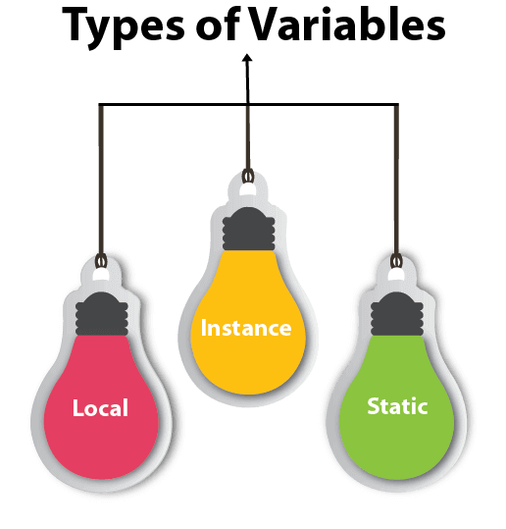
Types of Variables
There are three types of variables in Java:

Slide 64
types
1) Local Variable
A variable declared inside the body of the method is called local variable. You can use this variable only within that method and the other methods in the class aren't even aware that the variable exists.
A local variable cannot be defined with "static" keyword.
2) Instance Variable
A variable declared inside the class but outside the body of the method, is called an instance variable. It is not declared as static.
It is called an instance variable because its value is instance-specific and is not shared among instances.
3) Static variable
A variable that is declared as static is called a static variable. It cannot be local. You can create a single copy of the static variable and share it among all the instances of the class. Memory allocation for static variables happens only once when the class is loaded in the memory.

Slide 65
Example to understand the types of variables in java
public class A
{
static int m=100;//static variable
void method()
{
int n=90;//local variable
}
public static void main(String args[])
{
int data=50;//instance variable
}
}//end of class

Slide 66
Java Variable Example: Add Two Numbers
public class Simple{
public static void main(String[] args){
int a=10;
int b=10;
int c=a+b;
System.out.println(c);
}
}

Slide 67
Data Types in Java
Data types specify the different sizes and values that can be stored in the variable. There are two types of data types in Java:
Primitive data types: The primitive data types include boolean, char, byte, short, int, long, float and double.
Non-primitive data types: The non-primitive data types include Classes, Interfaces, and Arrays.
Java Primitive Data Types
In Java language, primitive data types are the building blocks of data manipulation. These are the most basic data types available in Java language.
boolean data type
byte data type
char data type
short data type
int data type
long data type
float data type
double data type

Slide 68
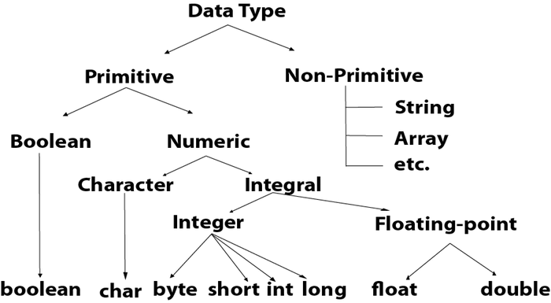
Data type

Slide 69
Data type value and size
Data Type | Default Value | Default size
boolean | false | 1 bit
char | '\u0000' | 2 byte
byte | 0 | 1 byte
short | 0 | 2 byte
int | 0 | 4 byte
long | 0L | 8 byte
float | 0.0f | 4 byte
double | 0.0d | 8 byte

Slide 70
Unicode System
Unicode is a universal international standard character encoding that is capable of representing most of the world's written languages.
Why java uses Unicode System?
Before Unicode, there were many language standards:
ASCII (American Standard Code for Information Interchange) for the United States. ISO 8859-1 for Western European Language. KOI-8 for Russian. GB18030 and BIG-5 for chinese, and so on.

Slide 71
Problem
This caused two problems:
A particular code value corresponds to different letters in the various language standards.
The encodings for languages with large character sets have variable length.Some common characters are encoded as single bytes, other require two or more byte
Solution
To solve these problems, a new language standard was developed i.e. Unicode System.
In unicode, character holds 2 byte, so java also uses 2 byte for characters.
lowest value:\u0000
highest value:\uFFFF

Slide 72
Operators in Java
Operator in Java is a symbol that is used to perform operations. For example: +, -, *, / etc.
There are many types of operators in Java which are given below:
Unary Operator,
Arithmetic Operator,
Shift Operator,
Relational Operator,
Bitwise Operator,
Logical Operator,
Ternary Operator and
Assignment Operator.

Slide 73
Java Operator Precedence
Operator Type | Category | Precedence
Unary | postfix | expr++ expr--
 | prefix | ++expr --expr +expr -expr ~ !
Arithmetic | multiplicative | * / %
 | additive | + -
Shift | shift | << >> >>>
Relational | comparison | < > <= >= instanceof
 | equality | == !=
Bitwise | bitwise AND | &
 | bitwise exclusive OR | ^
 | bitwise inclusive OR | |
Logical | logical AND | &&
 | logical OR | ||
Ternary | ternary | ? :
Assignment | assignment | = += -= *= /= %= &= ^= |= <<= >>= >>>=

Slide 74
Java Unary Operator
The Java unary operators require only one operand. Unary operators are used to perform various operations i.e.:
public class OperatorExample{
public static void main(String args[]){
int x=10;
System.out.println(x++);//10 (11)
System.out.println(++x);//12
System.out.println(x--);//12 (11)
System.out.println(--x);//10
}}
Output:
10 12 12 10

Slide 75
Java Unary Operator Example: ~ and !
public class OperatorExample{
public static void main(String args[]){
int a=10;
int b=-10;
boolean c=true;
boolean d=false;
System.out.println(~a);//-11 (minus of total positive value which starts from 0)
System.out.println(~b);//9 (positive of total minus, positive starts from 0)
System.out.println(!c);//false (opposite of boolean value)
System.out.println(!d);//true
}}
Output:
-11 9 false true

Slide 76
Java Arithmetic Operators
Java Arithmetic Operator Example
public class OperatorExample{
public static void main(String args[]){
int a=10;
int b=5;
System.out.println(a+b);//15
System.out.println(a-b);//5
System.out.println(a*b);//50
System.out.println(a/b);//2
System.out.println(a%b);//0
}}
Output:
15 5 50 2 0

Slide 77
Java Left Shift Operator
The Java left shift operator << is used to shift all of the bits in a value to the left side of a specified number of times.
Java Left Shift Operator Example
public class OperatorExample{
public static void main(String args[]){
System.out.println(10<<2);//10*2^2=10*4=40
System.out.println(10<<3);//10*2^3=10*8=80
System.out.println(20<<2);//20*2^2=20*4=80
System.out.println(15<<4);//15*2^4=15*16=240
}}
Output:
40 80 80 240

Slide 78
Java Right Shift Operator
The Java right shift operator >> is used to move the value of the left operand to right by the number of bits specified by the right operand.
Java Right Shift Operator Example
public OperatorExample{
public static void main(String args[]){
System.out.println(10>>2);//10/2^2=10/4=2
System.out.println(20>>2);//20/2^2=20/4=5
System.out.println(20>>3);//20/2^3=20/8=2
}}
Output:
2 5 2

Slide 79
Java AND Operator Example: Logical && and Bitwise &
The logical && operator doesn't check the second condition if the first condition is false. It checks the second condition only if the first one is true.
The bitwise & operator always checks both conditions whether first condition is true or false.
public class OperatorExample{
public static void main(String args[]){
int a=10;
int b=5;
int c=20;
System.out.println(a<b&&a<c);//false && true = false
System.out.println(a<b&a<c);//false & true = false
}}
Output:
false false

Slide 80
Java OR Operator Example: Logical || and Bitwise |
The logical || operator doesn't check the second condition if the first condition is true. It checks the second condition only if the first one is false.
The bitwise | operator always checks both conditions whether first condition is true or false.
public class OperatorExample{
public static void main(String args[]){
int a=10;
int b=5;
int c=20;
System.out.println(a>b||a<c);//true || true = true
System.out.println(a>b|a<c);//true | true = true
//|| vs |
System.out.println(a>b||a++<c);//true || true = true
System.out.println(a);//10 because second condition is not checked
System.out.println(a>b|a++<c);//true | true = true
System.out.println(a);//11 because second condition is checked
}}
Output:
true true true 10 true 11

Slide 81
Java Ternary Operator
Java Ternary operator is used as one line replacement for if-then-else statement and used a lot in Java programming. It is the only conditional operator which takes three operands.
Java Ternary Operator Example
public class OperatorExample{
public static void main(String args[]){
int a=2;
int b=5;
int min=(a<b)?a:b;
System.out.println(min);
}}
Output:
2

Slide 82
Java Assignment Operator
Java assignment operator is one of the most common operators. It is used to assign the value on its right to the operand on its left.
Java Assignment Operator Example
public class OperatorExample{
public static void main(String args[]){
int a=10;
int b=20;
a+=4;//a=a+4 (a=10+4)
b-=4;//b=b-4 (b=20-4)
System.out.println(a);
System.out.println(b);
}}
Output:
14 16

Slide 83
Control statements in java
java compiler executes the code from top to bottom.
The statements in the code are executed according to the order in which they appear. However, Java provides statements that can be used to control the flow of Java code.
Such statements are called control flow statements.
It is one of the fundamental features of Java, which provides a smooth flow of program.

Slide 84
Java provides three types of control flow statements.
Decision Making statements
if statements
switch statement
Loop statements
do while loop
while loop
for loop
for-each loop
Jump statements
break statement
continue statement

Slide 85
1 -Decision-Making statements:
Decision-making statements decide which statement to execute and when.
Decision-making statements evaluate the Boolean expression and control the program flow depending upon the result of the condition provided.
There are two types of decision-making statements in Java, i.e., If statement and switch statement.

Slide 86
a) If Statement:
The "if" statement is used to evaluate a condition.
The control of the program is diverted depending upon the specific condition.
The condition of the If statement gives a Boolean value, either true or false. In Java, there are four types of if-statements given below.
Simple if statement
if-else statement
if-else-if ladder
Nested if-statement

Slide 87
1) Simple if statement:
It is the most basic statement among all control flow statements in Java.
It evaluates a Boolean expression and enables the program to enter a block of code if the expression evaluates to true.
Syntax of if statement is given below.
if(condition) {
statement 1; //executes when condition is true
}

Slide 88
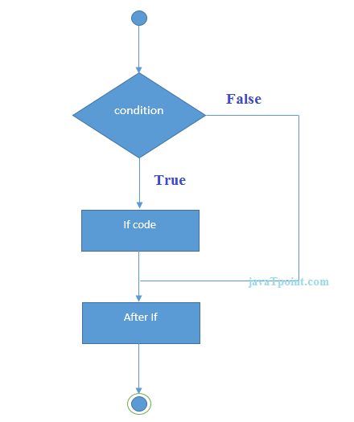
Flow chart

Slide 89
Example simple if statement
public class Student {
public static void main(String[] args) {
int x = 10;
int y = 12;
if(x+y > 20) {
System.out.println("x + y is greater than 20");
}
}
}

Slide 90
2) if-else statement
The if-else statement is an extension to the if-statement, which uses another block of code, i.e., else block.
The else block is executed if the condition of the if-block is evaluated as false.
Syntax:
if(condition) {
statement 1; //executes when condition is true
}
else{
statement 2; //executes when condition is false
}

Slide 91
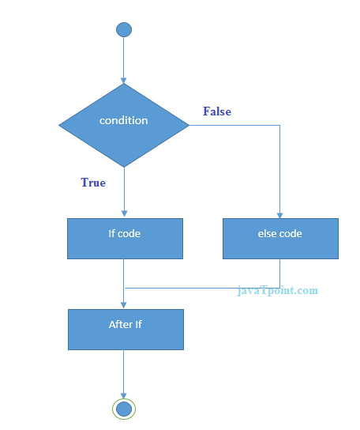
Flow chart

Slide 92
Student.java
public class Student {
public static void main(String[] args) {
int x = 10;
int y = 12;
if(x+y < 10) {
System.out.println("x + y is less than 10");
} else {
System.out.println("x + y is greater than 20");
}
}
}

Slide 93
Using Ternary Operator
We can also use ternary operator (? :) to perform the task of if...else statement.
It is a shorthand way to check the condition. If the condition is true, the result of ? is returned. But, if the condition is false, the result of : is returned.

Slide 94
example
public class IfElseTernaryExample {
public static void main(String[] args) {
int number=13;
//Using ternary operator
String output=(number%2==0)?"even number":"odd number";
System.out.println(output);
}
}

Slide 95
3) if-else-if ladder:
The if-else-if statement contains the if-statement followed by multiple else-if statements.
Syntax of if-else-if statement is given below.
if(condition 1) {
statement 1; //executes when condition 1 is true
}
else if(condition 2) {
statement 2; //executes when condition 2 is true
}
else {
statement 2; //executes when all the conditions are false
}

Slide 96
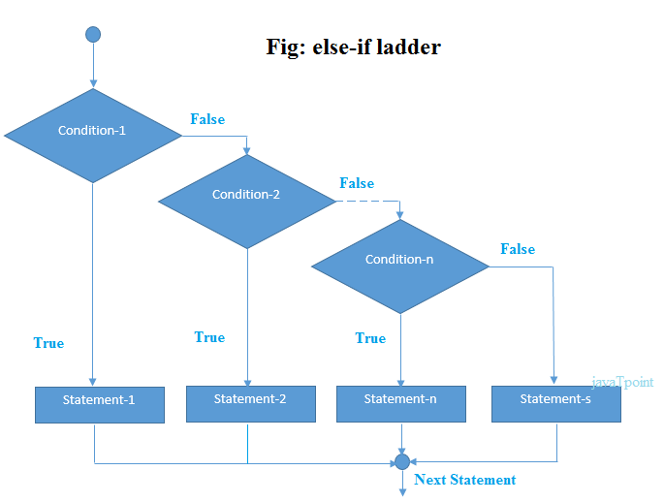
Flow chart

Slide 97
example
public class Student {
public static void main(String[] args) {
String city = "Delhi";
if(city == "Meerut") {
System.out.println("city is meerut");
}else if (city == "Noida") {
System.out.println("city is noida");
}else if(city == "Agra") {
System.out.println("city is agra");
}else {
System.out.println(city);
}
}
}

Slide 98
4. Nested if-statement
In nested if-statements, the if statement can contain a if or if-else statement inside another if or else-if statement.
Syntax of Nested if-statement is given below.
if(condition 1) {
statement 1; //executes when condition 1 is true
if(condition 2) {
statement 2; //executes when condition 2 is true
}
else{
statement 2; //executes when condition 2 is false
}
}

Slide 99
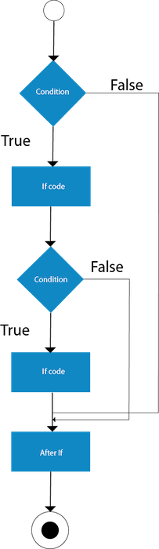
Flow chart

Slide 100
example
public class Student {
public static void main(String[] args) {
String address = "Delhi, India";
if(address.endsWith("India")) {
if(address.contains("Meerut")) {
System.out.println("Your city is Meerut");
}else if(address.contains("Noida")) {
System.out.println("Your city is Noida");
}else {
System.out.println(address.split(",")[0]);
}
}else {
System.out.println("You are not living in India");
}
}
}

Slide 101
Switch Statement:
In Java, Switch statements are similar to if-else-if statements.
The switch statement contains multiple blocks of code called cases and a single case is executed based on the variable which is being switched
The switch statement is easier to use instead of if-else-if statements.
It also enhances the readability of the program.

Slide 102
Points to be noted about switch statement
The case variables can be int, short, byte, char, or enumeration. String type is also supported since version 7 of Java
Cases cannot be duplicate
Default statement is executed when any of the case doesn't match the value of expression. It is optional.
Break statement terminates the switch block when the condition is satisfied. It is optional, if not used, next case is executed.
While using switch statements, we must notice that the case expression will be of the same type as the variable. However, it will also be a constant value.

Slide 103
The syntax to use the switch statement is given below.
switch (expression){
case value1:
statement1;
break;
.
.
.
case valueN:
statementN;
break;
default:
default statement;
}

Slide 104
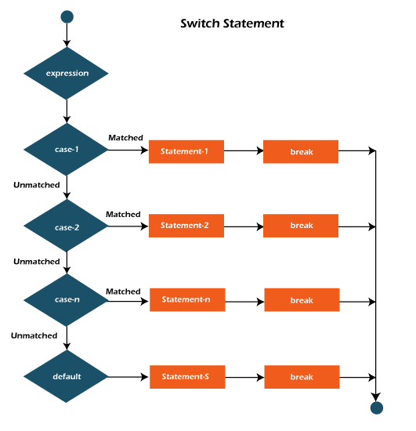
Flow chart of switch case

Slide 105
example
public class Student implements Cloneable {
public static void main(String[] args) {
int num = 2;
switch (num){
case 0:
System.out.println("number is 0");
break;
case 1:
System.out.println("number is 1");
break;
default:
System.out.println(num);
}}}

Slide 106
Java Nested Switch Statement
In Java, a nested switch-case is a switch statement inside another switch statement. This allows you to further refine the decision-making process based on more conditions.
switch (expression1) {
case value1:
// some code for outer switch case
switch (expression2) {
case value2:
// some code for inner switch case
break;
case value3:
// some code for inner switch case
break;
default:
// default code for inner switch
}
break;
case value4:
// code for another outer switch case
break;
default:
// default code for outer switch
}

Slide 107
example
// Nested switch for meal times
switch (mealTime) {
case "Breakfast":
System.out.println("Pancakes for breakfast.");
break;
case "Lunch":
System.out.println("Sandwich for lunch.");
break;
case "Dinner":
System.out.println("Pasta for dinner.");
break;
default:
System.out.println("Invalid meal time.");
}
break;
default:
System.out.println("Invalid day.");
}
}
}
public class NestedSwitchExample {
public static void main(String[] args) {
int day = 2;
String mealTime = "Lunch";
switch (day) {
case 1:
System.out.println("Monday");
break;
case 2:
System.out.println("Tuesday");

Slide 108
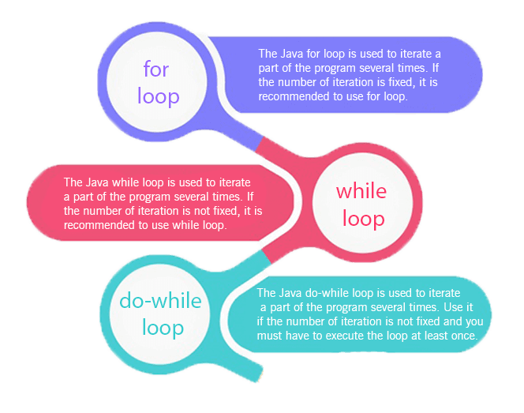
Loops in Java
The Java for loop is used to iterate a part of the program several times. If the number of iteration is fixed, it is recommended to use for loop.
There are three types of for loops in Java.

Slide 109
Java Simple for Loop
A simple for loop is the same as C/C++. We can initialize the variable, check condition and increment/decrement value. It consists of four parts:
Initialization: It is the initial condition which is executed once when the loop starts. Here, we can initialize the variable, or we can use an already initialized variable. It is an optional condition.
Condition: It is the second condition which is executed each time to test the condition of the loop. It continues execution until the condition is false. It must return boolean value either true or false. It is an optional condition.
Increment/Decrement: It increments or decrements the variable value. It is an optional condition.
Statement: The statement of the loop is executed each time until the second condition is false.

Slide 110
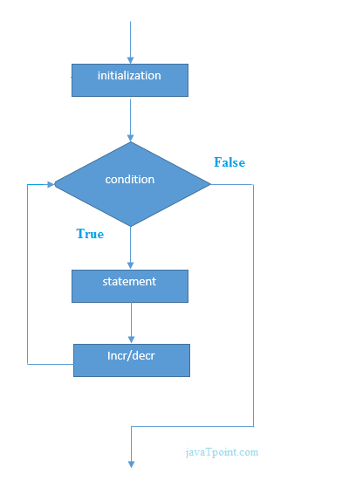
syntax
for(initialization; condition; increment/decrement){
//statement or code to be executed
}
Flow chart

Slide 111
Example of for loop
//Java Program to demonstrate the example of for loop
//which prints table of 1
public class ForExample {
public static void main(String[] args) {
//Code of Java for loop
for(int i=1;i<=10;i++){
System.out.println(i);
}
}
}

Slide 112
Java Nested for Loop
If we have a for loop inside the another loop, it is known as nested for loop. The inner loop executes completely whenever outer loop executes.
public class NestedForExample {
public static void main(String[] args) {
//loop of i
for(int i=1;i<=3;i++){
//loop of j
for(int j=1;j<=3;j++){
System.out.println(i+" "+j);
}//end of i
}//end of j
} }

Slide 113
Java for-each Loop
he for-each loop is used to traverse array or collection in Java. It is easier to use than simple for loop because we don't need to increment value and use subscript notation.
It works on the basis of elements and not the index. It returns element one by one in the defined variable.
Syntax:
for(data_type variable : array_name){
//code to be executed
}

Slide 114
example
//Java For-each loop example which prints the
//elements of the array
public class ForEachExample {
public static void main(String[] args) {
//Declaring an array
int arr[]={12,23,44,56,78};
//Printing array using for-each loop
for(int i:arr){
System.out.println(i);
}
}
}

Slide 115
Java While Loop
The Java while loop is used to iterate a part of the program repeatedly until the specified Boolean condition is true. As soon as the Boolean condition becomes false, the loop automatically stops.
The while loop is considered as a repeating if statement. If the number of iteration is not fixed, it is recommended to use the while loop
syntax
while (condition){
//code to be executed
I ncrement / decrement statement
}

Slide 116
The different parts of do-while loop:
1. Condition: It is an expression which is tested. If the condition is true, the loop body is executed and control goes to update expression. When the condition becomes false, we exit the while loop.
Example:
i <=100
2. Update expression: Every time the loop body is executed, this expression increments or decrements loop variable.
Example:
i++;

Slide 117
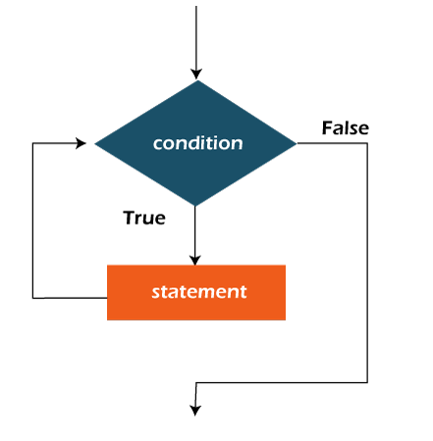
Flowchart of Java While Loop
the important thing about while loop is that, sometimes it may not even execute. If the condition to be tested results into false, the loop body is skipped and first statement after the while loop will be executed.

Slide 118
Example of while loop
public class WhileExample {
public static void main(String[] args) {
int i=1;
while(i<=10){
System.out.println(i);
i++;
}
}
}

Slide 119
Java Infinitive While Loop
If you pass true in the while loop, it will be infinitive while loop.
Syntax:
while(true){
//code to be executed
}
example
public class WhileExample2 {
public static void main(String[] args) {
// setting the infinite while loop by passing true to the condition
while(true){
System.out.println("infinitive while loop");
}
}
}

Slide 120
Java do-while Loop
The Java do-while loop is used to iterate a part of the program repeatedly, until the specified condition is true. If the number of iteration is not fixed and you must have to execute the loop at least once, it is recommended to use a do-while loop.
Java do-while loop is called an exit control loop. Therefore, unlike while loop and for loop, the do-while check the condition at the end of loop body. The Java do-while loop is executed at least once because condition is checked after loop body.
Syntax:
do{
//code to be executed / loop body
//update statement
}while (conditi

Slide 121
The different parts of do-while loop:
1. Condition: It is an expression which is tested. If the condition is true, the loop body is executed and control goes to update expression. As soon as the condition becomes false, loop breaks automatically.
Example:
i <=100
2. Update expression: Every time the loop body is executed, the this expression increments or decrements loop variable.
Example:
i++;

Slide 122
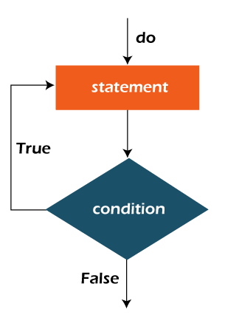
Flowchart of do-while loop:

Slide 123
example
public class DoWhileExample {
public static void main(String[] args) {
int i=1;
do{
System.out.println(i);
i++;
}while(i<=10);
}
}
Java Infinitive do-while Loop
If you pass true in the do-while loop, it will be infinitive do-while loop.
Syntax:
do{
//code to be executed
}while(true
Output:
1 2 3 4 5 6 7 8 9 10

Slide 124
Java Break Statement
When a break statement is encountered inside a loop, the loop is immediately terminated and the program control resumes at the next statement following the loop.
The Java break statement is used to break loop or switch statement. It breaks the current flow of the program at specified condition. In case of inner loop, it breaks only inner loop.
We can use Java break statement in all types of loops such as for loop, while loop and do-while loop.

Slide 125
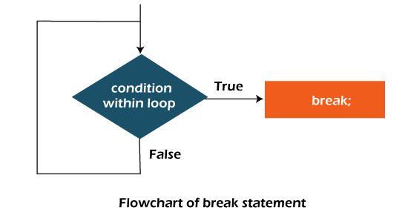
Flow chart
Syntax
jump-statement;
break;
public class BreakExample {
public static void main(String[] args) {
//using for loop
for(int i=1;i<=10;i++){
if(i==5){
//breaking the loop
break;
}
System.out.println(i);
}
}
}

Slide 126
Java Continue Statement
The continue statement is used in loop control structure when you need to jump to the next iteration of the loop immediately. It can be used with for loop or while loop.
The Java continue statement is used to continue the loop. It continues the current flow of the program and skips the remaining code at the specified condition. In case of an inner loop, it continues the inner loop only.
We can use Java continue statement in all types of loops such as for loop, while loop and do-while loop.

Slide 127
Cont.
Syntax
jump-statement;
continue;
//Java Program to demonstrate the use of continue statement
//inside the for loop.
public class ContinueExample {
public static void main(String[] args) {
//for loop
for(int i=1;i<=10;i++){
if(i==5){
//using continue statement
continue;//it will skip the rest statement
} System.out.println(i);
}
}
}

Slide 128
Java return Keyword
The return keyword finishes the execution of a method, and can be used to return a value from a method.
public class Main {
static int myMethod(int x) {
return 5 + x; }
public static void main(String[] args) { System.out.println(myMethod(3));
}
}
// Outputs 8 (5 + 3)

Slide 129
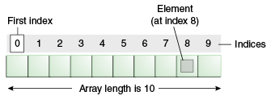
Java Arrays
Normally, an array is a collection of similar type of elements which has contiguous memory location.
Java array is an object which contains elements of a similar data type. Additionally, The elements of an array are stored in a contiguous memory location. It is a data structure where we store similar elements. We can store only a fixed set of elements in a Java array.
Array in Java is index-based, the first element of the array is stored at the 0th index, 2nd element is stored on 1st index and so on.
Unlike C/C++, we can get the length of the array using the length member. In C/C++, we need to use the sizeof operator.

Slide 130
Advantage and disadvantage
Advantage
Code Optimization: It makes the code optimized, we can retrieve or sort the data efficiently.
Random access: We can get any data located at an index position.
Disadvantages
Size Limit: We can store only the fixed size of elements in the array. It doesn't grow its size at runtime. To solve this problem, collection framework is used in Java which grows automatically.

Slide 131
Types of Array in java
There are two types of array.
Single Dimensional Array
Multidimensional Array
Single Dimensional Array in Java
Syntax to Declare an Array in Java
dataType[] arr; (or)
dataType []arr; (or)
dataType arr[];
Instantiation of an Array in Java
arrayRefVar=new datatype[size];

Slide 132
example
//Java Program to illustrate how to declare, instantiate, initialize
//and traverse the Java array.
class Testarray{
public static void main(String args[]){
int a[]=new int[5];//declaration and instantiation
a[0]=10;//initialization
a[1]=20;
a[2]=70;
a[3]=40;
a[4]=50;
//traversing array
for(int i=0;i<a.length;i++)//length is the property of array
System.out.println(a[i]);
}}

Slide 133
Declaration, Instantiation and Initialization of Java Array
We can declare, instantiate and initialize the java array together by:
int a[]={33,3,4,5};//declaration, instantiation and initialization
example
//Java Program to illustrate the use of declaration, instantiation
//and initialization of Java array in a single line
class Testarray1{
public static void main(String args[]){
int a[]={33,3,4,5};//declaration, instantiation and initialization
//printing array
for(int i=0;i<a.length;i++)//length is the property of array
System.out.println(a[i]);
}}

Slide 134
Multidimensional Array in Java
In such case, data is stored in row and column based index (also known as matrix form).
Syntax to Declare Multidimensional Array in Java
dataType[][] arrayRefVar; (or)
dataType [][]arrayRefVar; (or)
dataType arrayRefVar[][]; (or)
dataType []arrayRefVar[];

Slide 135
Cont.
Example to instantiate Multidimensional Array in Java
int[][] arr=new int[3][3];//3 row and 3 column
Example to initialize Multidimensional Array in Java
arr[0][0]=1;
arr[0][1]=2;
arr[0][2]=3;
arr[1][0]=4;
arr[1][1]=5;
arr[1][2]=6;
arr[2][0]=7;
arr[2][1]=8;
arr[2][2]=9;

Slide 136
Example of Multidimensional Java Array
//Java Program to illustrate the use of multidimensional array
class Testarray3{
public static void main(String args[]){
//declaring and initializing 2D array
int arr[][]={{1,2,3},{2,4,5},{4,4,5}};
//printing 2D array
for(int i=0;i<3;i++){
for(int j=0;j<3;j++){
System.out.print(arr[i][j]+" ");
}
System.out.println();
}
}}

Slide 137


