Slide 1

Unit 2
nheritance, Sub Classing, Package

Slide 2
Inheritance, Sub Classing, Package
Inheritance Concepts
Defining sub classes, method overriding
using super keyword
Variable shadowing, Method and variable binding
Using final keyword
Abstract classes and interfaces
Object class, Packages - Creating package
CLASSPATH environment variable
access specifiers, Access Control / visibility.

Slide 3
Inheritance Concepts
Inheritance is a fundamental concept in object-oriented programming (OOP) that allows one class to inherit the fields and methods of another class. In Java, it provides a way to establish a relationship between classes and promote code reuse. Here’s a breakdown of the key concepts related to inheritance in Java:
Super Class (Parent Class): The class whose properties and methods are inherited by another class. It’s also called the base class or parent class.
Sub Class (Child Class): The class that inherits the properties and methods of another class. It’s also known as the derived class or child class
Syntax
class Parent {
// Parent class code
}
class Child extends Parent {
// Child class code
}
Why use inheritance in java
For Method Overriding (so runtime polymorphism can be achieved).
For Code Reusability.

Slide 4
Terms used in Inheritance
Class: A class is a group of objects which have common properties. It is a template or blueprint from which objects are created.
Sub Class/Child Class: Subclass is a class which inherits the other class. It is also called a derived class, extended class, or child class.
Super Class/Parent Class: Superclass is the class from where a subclass inherits the features. It is also called a base class or a parent class.
Reusability: As the name specifies, reusability is a mechanism which facilitates you to reuse the fields and methods of the existing class when you create a new class. You can use the same fields and methods already defined in the previous class.

Slide 5
Types of Inheritance
Single Inheritance: A class inherits from only one superclass.
Multiple Inheritance: Java does not support multiple inheritance through classes directly. However, it can be achieved using interfaces.
Multilevel Inheritance: A class is derived from another class, which is also derived from another class.
Hierarchical Inheritance: Multiple classes inherit from a single superclass.
Hybrid Inheritance: A combination of two or more types of inheritance. Java does not support hybrid inheritance through classes but supports it using interfaces
Note: Multiple inheritance is not supported in Java through class.

Slide 6
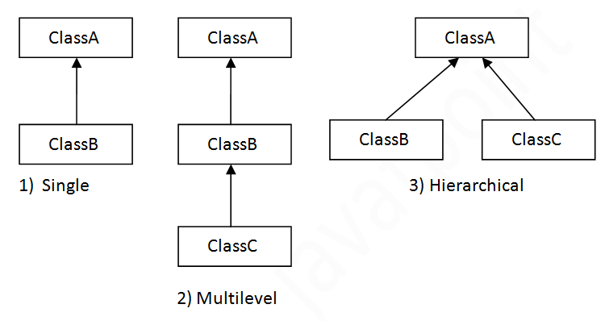
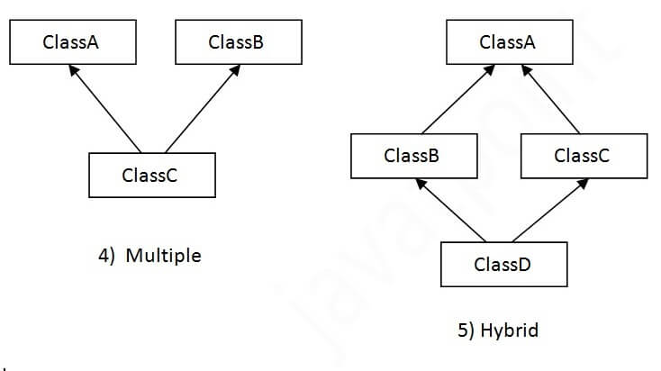
Type (cont.)

Slide 7
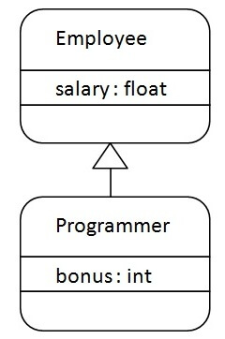
Example
Programmer is the subclass and Employee is the superclass. The relationship between the two classes is Programmer IS-A Employee. It means that Programmer is a type of Employee.
class Employee{
float salary=40000;
}
class Programmer extends Employee{
int bonus=10000;
public static void main(String args[]){
Programmer p=new Programmer();
System.out.println("Programmer salary is:"+p.salary);
System.out.println("Bonus of Programmer is:"+p.bonus);
}
}

Slide 8
Single Inheritance Example
class Animal{
void eat(){System.out.println("eating...");}
}
class Dog extends Animal{
void bark(){System.out.println("barking...");}
}
class TestInheritance{
public static void main(String args[]){
Dog d=new Dog();
d.bark();
d.eat();
}}

Slide 9
Multilevel Inheritance Example
class Animal{
void eat(){
System.out.println("eating...");
} }
class Dog extends Animal{
void bark(){
System.out.println("barking...");
} }
class BabyDog extends Dog{
void weep(){
System.out.println("weeping...");
} }
class TestInheritance2{
public static void main(String args[]){
BabyDog d=new BabyDog();
d.weep();
d.bark();
d.eat();
}}
When there is a chain of inheritance, it is known as multilevel inheritance.

Slide 10
Hierarchical Inheritance Example
class Animal{
void eat(){System.out.println("eating...");}
}
class Dog extends Animal{
void bark(){System.out.println("barking...");}
}
class Cat extends Animal{
void meow(){System.out.println("meowing...");}
}
class TestInheritance3{
public static void main(String args[]){
Cat c=new Cat();
c.meow();
c.eat();
//c.bark();//C.T.Error
}}
When two or more classes inherits a single class, it is known as hierarchical inheritance.
Q) Why multiple inheritance is not supported in java?

Slide 11
Q) Why multiple inheritance is not supported in java?
class A{
void msg(){System.out.println("Hello");}
}
class B{
void msg(){System.out.println("Welcome");}
}
class C extends A,B{//suppose if it were
public static void main(String args[]){
C obj=new C();
obj.msg();//Now which msg() method would be invoked?
}
}
Answer
To reduce the complexity and simplify the language, multiple inheritance is not supported in java.
Since compile-time errors are better than runtime errors, Java renders compile-time error if you inherit 2 classes. So whether you have same method

Slide 12
Hybrid inheritance
Hybrid inheritance refers to a combination of two or more types of inheritance (single, multiple, hierarchical, or multilevel).
However, Java does not support multiple inheritance through classes directly to avoid the Diamond Problem, which occurs when two parent classes have the same method, and a child class inherits from both. This can cause ambiguity in which method to call.
To achieve hybrid inheritance in Java, you can use interfaces. Interfaces allow multiple inheritance of behavior, meaning a class can implement multiple interfaces and combine them with other types of inheritance.

Slide 13
Example
// Child class
class Dog extends LivingBeing implements Animal, Mammal {
// Implementing methods from interfaces
public void eat() {
System.out.println("Dog is eating.");
}
public void giveBirth() {
System.out.println("Dog gives birth to puppies.");
}
}
public class Main {
public static void main(String[] args) {
Dog dog = new Dog();
dog.breathe(); // Inherited from LivingBeing
dog.eat(); // Implemented from Animal interface
dog.giveBirth(); // Implemented from Mammal interface
}
}
// Interface 1
interface Animal {
void eat();
}
// Interface 2
interface Mammal {
void giveBirth();
}
// Parent class
class LivingBeing {
void breathe() {
System.out.println("Breathing...");
}
}

Slide 14
Polymorphism in Java
Polymorphism in Java is a concept by which we can perform a single action in different ways.
There are two types of polymorphism in Java: compile-time polymorphism and runtime polymorphism. We can perform polymorphism in java by method overloading and method overriding.

Slide 15
Method Overloading in Java
If a class has multiple methods having same name but different in parameters, it is known as Method Overloading.
If we have to perform only one operation, having same name of the methods increases the readability of the program.
Note In Java, Method Overloading is not possible by changing the return type of the method only.
Different ways to overload the method
There are two ways to overload the method in java
By changing number of arguments
By changing the data type
Advantage of method overloading
Method overloading increases the readability of the program.

Slide 16
1) Method Overloading: changing no. of arguments
we have created two methods, first add() method performs addition of two numbers and second add method performs addition of three numbers.
class Adder{
static int add(int a,int b){return a+b;}
static int add(int a,int b,int c){return a+b+c;}
}
class TestOverloading1{
public static void main(String[] args){
System.out.println(Adder.add(11,11));
System.out.println(Adder.add(11,11,11));
}}

Slide 17
2) Method Overloading: changing data type of arguments
we have created two methods that differs in data type. The first add method receives two integer arguments and second add method receives two double arguments.
class Adder{
static int add(int a, int b){return a+b;}
static double add(double a, double b){return a+b;}
}
class TestOverloading2{
public static void main(String[] args){
System.out.println(Adder.add(11,11));
System.out.println(Adder.add(12.3,12.6));
}}
Now
Q) Why Method Overloading is not possible by changing the return type of method only?

Slide 18
Q) Why Method Overloading is not possible by changing the return type of method only?
In java, method overloading is not possible by changing the return type of the method only because of ambiguity. Let's see how ambiguity may occur:
class Adder{
static int add(int a,int b){return a+b;}
static double add(int a,int b){return a+b;}
}
class TestOverloading3{
public static void main(String[] args){
System.out.println(Adder.add(11,11));//ambiguity
}}
Can we overload java main() method?

Slide 19
Can we overload java main() method?
Yes, by method overloading. You can have any number of main methods in a class by method overloading. But JVM calls main() method which receives string array as arguments only. Let's see the simple example:
class TestOverloading4{
public static void main(String[] args)
{System.out.println("main with String[]");}
public static void main(String args)
{System.out.println("main with String");}
public static void main()
{System.out.println("main without args");}
}
o/p
main with String[]

Slide 20
Method Overriding in Java
If subclass (child class) has the same method as declared in the parent class, it is known as method overriding in Java.
Usage of Java Method Overriding
Method overriding is used to provide the specific implementation of a method which is already provided by its superclass.
Method overriding is used for runtime polymorphism
Rules for Java Method Overriding
The method must have the same name as in the parent class
The method must have the same parameter as in the parent class.
There must be an IS-A relationship (inheritance).

Slide 21
Understanding the problem without method overriding
//Java Program to demonstrate why we need method overriding
//Here, we are calling the method of parent class with child
//class object.
//Creating a parent class
class Vehicle{
void run(){System.out.println("Vehicle is running");}
}
//Creating a child class
class Bike extends Vehicle{
public static void main(String args[]){
//creating an instance of child class
Bike obj = new Bike();
//calling the method with child class instance
obj.run();
}
}
Let's understand the problem that we may face in the program if we don’t use method overriding
Problem is that I have to provide a specific implementation of run() method in subclass that is why we use method overriding.

Slide 22
Example of method overriding
//Java Program to illustrate the use of Java Method Overriding
//Creating a parent class.
class Vehicle{
//defining a method
void run(){System.out.println("Vehicle is running");}
}
//Creating a child class
class Bike2 extends Vehicle{
//defining the same method as in the parent class
void run(){System.out.println("Bike is running safely");}
public static void main(String args[]){
Bike2 obj = new Bike2();//creating object
obj.run();//calling method
}
}

Slide 23
Questions
Can we override static method?
Why can we not override static method?
Can we override java main method?

Slide 24
Questions
Can we override static method?
No, a static method cannot be overridden. It can be proved by runtime polymorphism
Why can we not override static method?
It is because the static method is bound with class whereas instance method is bound with an object. Static belongs to the class area, and an instance belongs to the heap area.
Can we override java main method?
No, because the main is a static method.

Slide 25
Super Keyword in Java
The super keyword in Java is a reference variable which is used to refer immediate parent class object.
Whenever you create the instance of subclass, an instance of parent class is created implicitly which is referred by super reference variable.
Usage of Java super Keyword
super can be used to refer immediate parent class instance variable.
super can be used to invoke immediate parent class method.
super() can be used to invoke immediate parent class constructor.

Slide 26
1) super is used to refer immediate parent class instance variable.
class Animal{
String color="white";
}
class Dog extends Animal{
String color="black";
void printColor(){
System.out.println(color);//prints color of Dog class
System.out.println(super.color);//prints color of Animal class
}
}
class TestSuper1{
public static void main(String args[]){
Dog d=new Dog();
d.printColor();
}}
We can use super keyword to access the data member or field of parent class. It is used if parent class and child class have same fields.

Slide 27
2) super can be used to invoke parent class method
class Animal{
void eat(){System.out.println("eating...");}
}
class Dog extends Animal{
void eat(){System.out.println("eating bread...");}
void bark(){System.out.println("barking...");}
void work(){
super.eat();
bark();
}
}
class TestSuper2{
public static void main(String args[]){
Dog d=new Dog();
d.work();
}}
The super keyword can also be used to invoke parent class method. It should be used if subclass contains the same method as parent class. In other words, it is used if method is overridden.

Slide 28
3) super is used to invoke parent class constructor.
The super keyword can also be used to invoke the parent class constructor. Let's see a simple example:
class Animal{
Animal(){System.out.println("animal is created");}
}
class Dog extends Animal{
Dog(){
super();
System.out.println("dog is created");
}
}
class TestSuper3{
public static void main(String args[]){
Dog d=new Dog();
}}

Slide 29
Shadowing in Java
Shadowing is the concept of OOP paradigm. It provides a new implementation to the base member without overriding it. Both shadowing and hiding are the same concepts but uses in different context. These are compile-time process.
variable shadowing occurs when a variable declared in a local scope (e.g., a method or block) hides or "shadows" a variable with the same name declared in an outer scope (such as a class field or an inherited field). This means that the local variable "shadows" the instance variable or field, making it inaccessible in that scope.

Slide 30
Key Points:
Shadowing happens when a local variable (e.g., in a method or constructor) has the same name as a class-level field.
In the local scope, the local variable will take precedence over the class-level field
You can access the shadowed class-level field using the this keyword

Slide 31
Variable Shadowing and Variable Hiding
Java allows us to declare three type of variables:
Local Variables
Instance Variables
Class Variables
If the instance variable and the local variable declared with the same name and we want to print the instance variable, in this case, it will print the local variable instead of instance variable.
When we print the variables declared inside the method, the local values will be printed on the console. Hence, we can say that local variables shadowing the instance variables.

Slide 32
Let's understand the concept of shadowing through a Java program.
public class Shadowing
{
String car_name = "Ferrari;
double price = 50000000;
public void showCar()
{
String car_name = "Bugat;
long price = 43000000;
System.out.println("Car Name: "+car_name);
System.out.println("Price: "+price);
}
public static void main(String args[])
{
new Shadowing().showCar();
}
}
.
Car Name: Bugatti Price: 43000000

Slide 33
example
public class Shadowing
{
String car_name = "Ferrari";
long price = 50000000;
public void showCar()
{
String car_name = "Bugatti";
long price = 43000000;
System.out.println("Car Name: "+car_name);
System.out.println("Price: "+price);
System.out.println("Car Name: "+this.car_name);
System.out.println("Price: "+this.price);
}
public static void main(String args[])
{
new Shadowing().showCar();
}
}
What if want to access instance variables in a method also? We can access instance variables by using this keyword.
.
Car Name: Bugatti Price: 43000000 Car Name: Ferrari Price: 50000000

Slide 34
Example of Shadowing in Java:
class ShadowingExample {
int x = 10; // Class-level field (instance variable)
void display(int x) {
// The parameter 'x' shadows the instance variable 'x'
System.out.println("Local x: " + x); // Refers to the method parameter 'x'
System.out.println("Instance x: " + this.x); // Refers to the class field 'x'
}
o/p
Local x: 20
Instance x: 10
public static void main(String[] args) {
ShadowingExample obj = new ShadowingExample();
obj.display(20); // Calling display() with local variable value 20
}
}

Slide 35
Method and variable binding in java
In Java, method and variable binding refer to the mechanisms by which methods and variables are associated with their respective objects or classes during program execution. This concept is crucial in understanding how Java handles polymorphism, inheritance, and variable shadowing
1. Method Binding
Method binding in Java occurs in two main ways: static (or early) binding and dynamic (or late) binding.
a. Static Binding
Definition: Static binding occurs at compile-time. The compiler determines which method to invoke based on the reference type.
Usage: It is used with:
Static methods: Because static methods belong to the class rather than any instance.
Final methods: Since they cannot be overridden.
Private methods: Since they are not accessible outside the class.

Slide 36
example
class Animal {
static void sound() {
System.out.println("Animal sound");
}
}
class Dog extends Animal {
static void sound() {
System.out.println("Bark");
}
}
public class Main {
public static void main(String[] args) {
Animal animal = new Dog(); // Reference type is Animal, object is Dog
animal.sound(); // Outputs: Animal sound (static binding)
}
}
o/p Animal sound

Slide 37
b. Dynamic Binding
Definition: Dynamic binding occurs at runtime. The method to be invoked is determined based on the actual object being referenced, not the reference type.
Usage: It is used with instance methods that can be overridden.

Slide 38
b. Dynamic Binding
class Animal {
void sound() {
System.out.println("Animal sound");
}
}
class Dog extends Animal {
@Override
void sound() {
System.out.println("Bark");
}
}
}
public class Main {
public static void main(String[] args) {
Animal animal = new Dog(); // Reference type is Animal, object is Dog
animal.sound(); // Dynamic binding occurs
}
o/p Bark

Slide 39
2. Variable Binding
Variable binding refers to how variables are associated with their values and scopes. In Java, this is closely related to the concept of shadowing.
Shadowing
Definition: Variable shadowing occurs when a variable in a subclass or a method has the same name as a variable in a superclass or an enclosing scope. The variable in the inner scope "shadows" the one in the outer scope.

Slide 40
Example
class Parent {
int x = 10; // Parent class variable
}
class Child extends Parent {
int x = 20; // Child class variable (shadows parent's variable)
void display() {
System.out.println("Child's x: " + x); // Accesses child's variable (x = 20)
System.out.println("Parent's x: " + super.x); // Accesses parent's variable (x = 10)
}
}
public class Main {
public static void main(String[] args) {
Child child = new Child();
child.display();
}
}
Child's x: 20
Parent's x: 10

Slide 41
Final Keyword In Java
The final keyword in java is used to restrict the user. The java final keyword can be used in many context. Final can be:
variable
method
class
The final keyword can be applied with the variables, a final variable that have no value it is called blank final variable or uninitialized final variable. It can be initialized in the constructor only. The blank final variable can be static also which will be initialized in the static block only.

Slide 42
1) Java final variable
class Bike9{
final int speedlimit=90;//final variable
void run(){
speedlimit=400;
}
public static void main(String args[]){
Bike9 obj=new Bike9();
obj.run();
}
}//end of class
Output:Compile Time Error

Slide 43
2) Java final method
If you make any method as final, you cannot override it.
class Bike{
final void run(){System.out.println("running");}
}
class Honda extends Bike{
void run(){System.out.println("running safely with 100kmph");}
public static void main(String args[]){
Honda honda= new Honda();
honda.run();
}
}
Output:Compile Time Error

Slide 44
3) Java final class
If you make any class as final, you cannot extend it.
final class Bike{}
class Honda1 extends Bike{
void run(){System.out.println("running safely with 100kmph");}
public static void main(String args[]){
Honda1 honda= new Honda1();
honda.run();
}
}
Output:Compile Time Error
Q) Is final method inherited?

Slide 45
Q) Is final method inherited?
Que) Can we initialize blank final variable?
class Bike{
final void run(){System.out.println("running...");}
}
class Honda2 extends Bike{
public static void main(String args[]){
new Honda2().run();
}
}
Que) Can we initialize blank final variable?
Output:running...

Slide 46
Que) Can we initialize blank final variable?
Yes, but only in constructor. For example:
class Bike10{
final int speedlimit;//blank final variable
Bike10(){
speedlimit=70;
}
public static void main(String args[]){
new Bike10();
}
System.out.println(speedlimit); }

Slide 47
static blank final variable
A static final variable that is not initialized at the time of declaration is known as static blank final variable. It can be initialized only in static block.
class A{
static final int data;//static blank final variable
static{ data=50;}
public static void main(String args[]){
System.out.println(A.data);
}
}

Slide 48
Abstract classes
A class which is declared with the abstract keyword is known as an abstract class in Java. It can have abstract and non-abstract methods (method with the body).
Abstraction in Java
Abstraction is a process of hiding the implementation details and showing only functionality to the user.
Ways to achieve Abstraction
There are two ways to achieve abstraction in java
Abstract class (0 to 100%)
Interface (100%)

Slide 49
Abstract class in Java
A class which is declared as abstract is known as an abstract class. It can have abstract and non-abstract methods. It needs to be extended and its method implemented. It cannot be instantiated.
Points to Remember
An abstract class must be declared with an abstract keyword.
It can have abstract and non-abstract methods.
It cannot be instantiated.
It can have constructors and static methods also.
It can have final methods which will force the subclass not to change the body of the method.

Slide 50
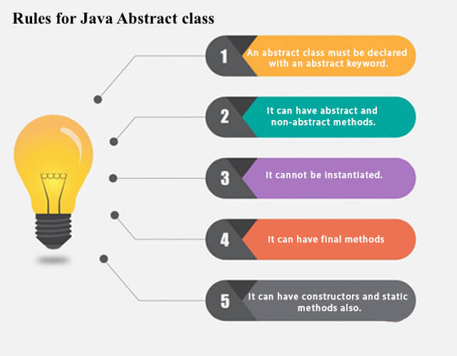

Slide 51
Abstract Method in Java
A method which is declared as abstract and does not have implementation is known as an abstract method.
Example of abstract method
abstract void printStatus();//no method body and abstract

Slide 52
Example of Abstract class that has an abstract method
In this example, Bike is an abstract class that contains only one abstract method run. Its implementation is provided by the Honda class.
abstract class Bike{
abstract void run();
}
class Honda4 extends Bike{
void run(){System.out.println("running safely");}
public static void main(String args[]){
Bike obj = new Honda4();
obj.run();
}
}
running safely

Slide 53
Understanding the real scenario of Abstract class
abstract class Shape{
abstract void draw();
}
//In real scenario, implementation is provided by ot hers i.e. unknown by end user
class Rectangle extends Shape{
void draw(){System.out.println("drawing rectangle");}
}
class Circle1 extends Shape{
void draw(){System.out.println("drawing circle");}
}
//In real scenario, method is called by programmer or user
class TestAbstraction1{
public static void main(String args[]){
Shape s=new Circle1();//In a real scenario, object is p//rovided through method, e.g., getShape() method
s.draw();
}
}
In this example, Shape is the abstract class, and its implementation is provided by the Rectangle and Circle classes.
Mostly, we don't know about the implementation class (which is hidden to the end user), and an object of the implementation class is provided by the factory method.
drawing circle

Slide 54
Abstract class having constructor, data member and methods
An abstract class can have a data member, abstract method, method body (non-abstract method), constructor, and even main() method.
//Example of an abstract class that has abstract and non-//abstract methods
abstract class Bike{
Bike(){System.out.println("bike is created");}
abstract void run();
void changeGear(){System.out.println("gear changed");}
}
//Creating a Child class which inherits Abstract class
class Honda extends Bike{
void run(){System.out.println("running safely..");}
}
//Creating a Test class which calls abstract and non-abstract methods
class TestAbstraction2{
public static void main(String args[]){
Bike obj = new Honda();
obj.run();
obj.changeGear();
}
}
Rule: If there is an abstract method in a class, that class must be abstract.
bike is created running safely.. gear changed

Slide 55
Interface in Java
An interface in Java is a blueprint of a class. It has static constants and abstract methods.
The interface in Java is a mechanism to achieve abstraction. There can be only abstract methods in the Java interface, not method body. It is used to achieve abstraction and multiple inheritance in Java.
In other words, you can say that interfaces can have abstract methods and variables. It cannot have a method body.
Java Interface also represents the IS-A relationship.

Slide 56
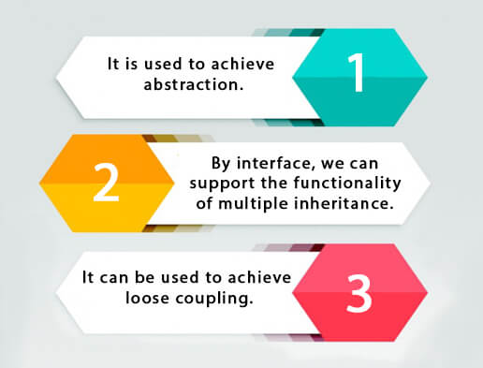
Why use Java interface?
There are mainly three reasons to use interface. They are given below.

Slide 57
How to declare an interface?
An interface is declared by using the interface keyword. It provides total abstraction; means all the methods in an interface are declared with the empty body, and all the fields are public, static and final by default. A class that implements an interface must implement all the methods declared in the interface.
Syntax
interface <interface_name>{
// declare constant fields
// declare methods that abstract
// by default.
}

Slide 58
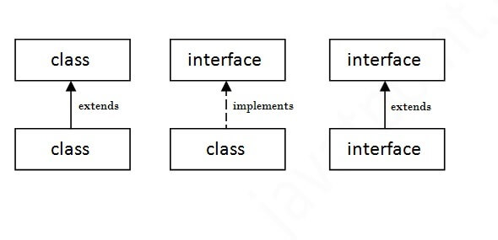
The relationship between classes and interfaces
As shown in the figure given below, a class extends another class, an interface extends another interface, but a class implements an interface.

Slide 59
Java Interface Example
In this example, the Printable interface has only one method, and its implementation is provided in the A6 class.
interface printable{
void print();
}
class A6 implements printable{
public void print(){System.out.println("Hello");}
public static void main(String args[]){
A6 obj = new A6();
obj.print();
}
}
Hello

Slide 60
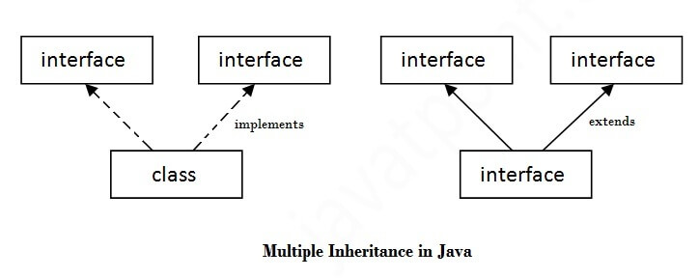
Multiple inheritance in Java by interface
If a class implements multiple interfaces, or an interface extends multiple interfaces, it is known as multiple inheritance.

Slide 61
example
interface Printable{
void print();
}
interface Showable{
void show();
}
class A7 implements Printable,Showable{
public void print(){System.out.println("Hello");}
public void show(){System.out.println("Welcome");}
public static void main(String args[]){
A7 obj = new A7();
obj.print();
obj.show();
}
}
Output:Hello Welcome
Q) Multiple inheritance is not supported through class in java, but it is possible by an interface, why?

Slide 62
Q) Multiple inheritance is not supported through class in java, but it is possible by an interface, why?
As we have explained in the inheritance chapter, multiple inheritance is not supported in the case of class because of ambiguity. However, it is supported in case of an interface because there is no ambiguity. It is because its implementation is provided by the implementation class.

Slide 63
Interface inheritance
A class implements an interface, but one interface extends another interface.
interface Printable{
void print();
}
interface Showable extends Printable{
void show();
}
class TestInterface4 implements Showable{
public void print(){System.out.println("Hello");}
public void show(){System.out.println("Welcome");}
public static void main(String args[]){
TestInterface4 obj = new TestInterface4();
obj.print();
obj.show();
}
}

Slide 64
Java 8 Default Method in Interface
Since Java 8, we can have method body in interface. But we need to make it default method
interface Drawable{
void draw();
default void msg(){System.out.println("default method");}
}
class Rectangle implements Drawable{
public void draw(){System.out.println("drawing rectangle");}
}
class TestInterfaceDefault{
public static void main(String args[]){
Drawable d=new Rectangle();
d.draw();
d.msg();
}}
drawing rectangle default method

Slide 65
Java 8 Static Method in Interface
Since Java 8, we can have static method in interface.
interface Drawable{
void draw();
static int cube(int x){return x*x*x;}
}
class Rectangle implements Drawable{
public void draw(){System.out.println("drawing rectangle");}
}
class TestInterfaceStatic{
public static void main(String args[]){
Drawable d=new Rectangle();
d.draw();
System.out.println(Drawable.cube(3));
}}

Slide 66
Encapsulation in Java
Encapsulation in Java is a process of wrapping code and data together into a single unit, for example, a capsule which is mixed of several medicines.
We can create a fully encapsulated class in Java by making all the data members of the class private. Now we can use setter and getter methods to set and get the data in it.
Advantage of Encapsulation in Java
By providing only a setter or getter method, you can make the class read-only or write-only. In other words, you can skip the getter or setter methods.
It provides you the control over the data. Suppose you want to set the value of id which should be greater than 100 only, you can write the logic inside the setter method. You can write the logic not to store the negative numbers in the setter methods.

Slide 67
Cont.
It is a way to achieve data hiding in Java because other class will not be able to access the data through the private data members.
The encapsulate class is easy to test. So, it is better for unit testing.
The standard IDE's are providing the facility to generate the getters and setters. So, it is easy and fast to create an encapsulated class in Java.

Slide 68
Simple Example of Encapsulation in Java
Let's see the simple example of encapsulation that has only one field with its setter and getter methods.
//A Java class which is a fully encapsulated class.
//It has a private data member and getter and setter methods.
package com.javatpoint;
public class Student{
//private data member
private String name;
//getter method for name
public String getName(){
return name;
}
//setter method for name
public void setName(String name){
this.name=name
}
}
//A Java class to test the encapsulated class.
package com.javatpoint;
class Test{
public static void main(String[] args){
//creating instance of the encapsulated class
Student s=new Student();
//setting value in the name member
s.setName("vijay");
//getting value of the name member
System.out.println(s.getName());
}
}
Compile By: javac -d . Test.java Run By: java com.javatpoint.Test
vijay

Slide 69
Read-Only class
//A Java class which has only getter methods.
public class Student{
//private data member
private String college="AKG";
//getter method for college
public String getCollege(){
return college;
}
}
Now, you can't change the value of the college data member which is "AKG".
s.setCollege("KITE");//will render compile time error

Slide 70
Write-Only class
//A Java class which has only setter methods.
public class Student{
//private data member
private String college;
//getter method for college
public void setCollege(String college){
this.college=college;
}
}
Now, you can't get the value of the college, you can only change the value of college data member.
System.out.println(s.getCollege());//Compile Time Error, because there is no such method
System.out.println(s.college);//Compile Time Error, because the college data member is private.
//So, it can't be accessed from outside the class

Slide 71
Java Package
A java package is a group of similar types of classes, interfaces and sub-packages.
Package in java can be categorized in two form, built-in package and user-defined package.
There are many built-in packages such as java, lang, awt, javax, swing, net, io, util, sql etc

Slide 72
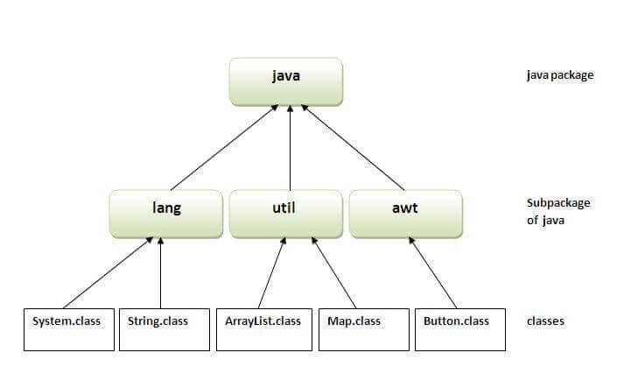
Advantage of Java Package
1) Java package is used to categorize the classes and interfaces so that they can be easily maintained.
2) Java package provides access protection.
3) Java package removes naming collision.

Slide 73
Simple example of java package
The package keyword is used to create a package in java.
//save as Simple.java
package mypack;
public class Simple{
public static void main(String args[]){
System.out.println("Welcome to package");
}
How to compile java package
If you are not using any IDE, you need to follow the syntax given below:
javac -d directory javafilename
For example
javac -d . Simple.java

Slide 74
How to run java package program
You need to use fully qualified name e.g. mypack.Simple etc to run the class.
To Compile: javac -d . Simple.java
To Run: java mypack.Simple
Output:Welcome to package

Slide 75
How to access package from another package?
There are three ways to access the package from outside the package.
import package.*;
import package.classname;
fully qualified name.

Slide 76
1) Using packagename.*
If you use package.* then all the classes and interfaces of this package will be accessible but not subpackages.
The import keyword is used to make the classes and interface of another package accessible to the current package.

Slide 77
Example of package that import the packagename.*
//save by A.java
package pack;
public class A{
public void msg(){System.out.println("Hello");}
}
//save by B.java
package mypack;
import pack.*;
class B{
public static void main(String args[]){
A obj = new A();
obj.msg();
}
}
Output:Hello

Slide 78
2) Using packagename.classname
If you import package.classname then only declared class of this package will be accessible.
//save by B.java
package mypack;
import pack.A;
class B{
public static void main(String args[]){
A obj = new A();
obj.msg();
}
}
//save by A.java
package pack;
public class A{
public void msg(){System.out.println("Hello");}
}
Output:Hello

Slide 79
3) Using fully qualified name
If you use fully qualified name then only declared class of this package will be accessible. Now there is no need to import. But you need to use fully qualified name every time when you are accessing the class or interface.
It is generally used when two packages have same class name e.g. java.util and java.sql packages contain Date class.

Slide 80
Example of package by import fully qualified name
//save by A.java
package pack;
public class A{
public void msg(){System.out.println("Hello");}
}
//save by B.java
package mypack;
class B{
public static void main(String args[]){
pack.A obj = new pack.A();//using fully qualified name
obj.msg();
}
}
Output:Hello
Note: If you import a package, subpackages will not be imported.

Slide 81
What is CLASSPATH in Java?
The CLASSPATH environment variable is used by the Java Virtual Machine (JVM) and the Java compiler (javac) to determine the location of user-defined classes, libraries, and packages. It helps Java programs find and load the required .class files and libraries (JAR files) that are not part of the standard Java runtime.
Key Concepts of CLASSPATH:
Directories: Can contain compiled .class files.
JAR files: External libraries bundled as Java ARchive (JAR) files.
Default Value: If the CLASSPATH is not set, Java looks in the current directory (.) by default.
Setting CLASSPATH: Can be done through environment variables or overridden at runtime using the -cp or -classpath option.
How to Set CLASSPATH?
You can set CLASSPATH in two ways:
As an Environment Variable: Permanently or temporarily set in the operating system.
At runtime: Override the CLASSPATH value with the -cp or -classpath flag during program execution.

Slide 82
Example Scenario
Assume we have the following project structure:
/project
/lib
utility-library.jar
/src
Main.java
/classes
Main.class
utility-library.jar: External library file located in the lib directory.
Main.java: Your Java program located in the src directory.
Main.class: Compiled class file of Main.java located in the classes directory.

Slide 83
Step-by-Step Example
1. Create and Compile a Simple Java Program
Let's create a basic Java program (Main.java):
// File: Main.java
public class Main {
public static void main(String[] args) {
System.out.println("Hello, CLASSPATH!");
}
}
2. Setting CLASSPATH
Now, we need to set the CLASSPATH so that Java knows where to find the Main.class and any external libraries.
On Windows:
set CLASSPATH=.;C:\project\classes;C:\project\lib\utility-library.jar;
Here’s what we’re doing:
.: Refers to the current directory.
C:\project\classes: Path to the directory where Main.class is stored.
C:\project\lib\utility-library.jar: Path to the external JAR file.
3. Running the Program
Once CLASSPATH is set, you can run the Java program using the java command:
java Main
Output Hello, CLASSPATH!
Navigate to the src directory and compile the program:
javac -d ../classes Main.java
This command will place the Main.class file in the classes directory.

Slide 84
4. Overriding CLASSPATH at Runtime
You can also override the CLASSPATH temporarily at runtime using the -cp or -classpath flag:
java -cp .;C:\project\classes;C:\project\lib\utility-library.jar Main
This command overrides the globally set CLASSPATH and tells Java where to look for class files and libraries during program execution.
Common Errors Related to CLASSPATH:
ClassNotFoundException: If Java cannot find the class you're trying to run.
NoClassDefFoundError: If the class was available during compile time but is not found during runtime.

Slide 85
Access Modifiers in Java
There are two types of modifiers in Java: access modifiers and non-access modifiers.
The access modifiers in Java specifies the accessibility or scope of a field, method, constructor, or class. We can change the access level of fields, constructors, methods, and class by applying the access modifier on it.
There are four types of Java access modifiers:
Private: The access level of a private modifier is only within the class. It cannot be accessed from outside the class.
Default: The access level of a default modifier is only within the package. It cannot be accessed from outside the package. If you do not specify any access level, it will be the default.
Protected: The access level of a protected modifier is within the package and outside the package through child class. If you do not make the child class, it cannot be accessed from outside the package.
Public: The access level of a public modifier is everywhere. It can be accessed from within the class, outside the class, within the package and outside the package.

Slide 86

Understanding Java Access Modifiers

Slide 87
1) Private
The private access modifier is accessible only within the class.
Simple example of private access modifier
In this example, we have created two classes A and Simple. A class contains private data member and private method. We are accessing these private members from outside the class, so there is a compile-time error.
class A{
private int data=40;
private void msg(){System.out.println("Hello java");}
}
public class Simple{
public static void main(String args[]){
A obj=new A();
System.out.println(obj.data);//Compile Time Error
obj.msg();//Compile Time Error
}
}

Slide 88
Role of Private Constructor
If you make any class constructor private, you cannot create the instance of that class from outside the class. For example:
class A{
private A(){}//private constructor
void msg(){System.out.println("Hello java");}
}
public class Simple{
public static void main(String args[]){
A obj=new A();//Compile Time Error
}
}
Note: A class cannot be private or protected except nested class.

Slide 89
//save by A.java
package pack;
class A{
void msg(){System.out.println("Hello");}
}
2) Default
if you don't use any modifier, it is treated as default by default. The default modifier is accessible only within package. It cannot be accessed from outside the package. It provides more accessibility than private. But, it is more restrictive than protected, and public.
Example of default access modifier
In this example, we have created two packages pack and mypack. We are accessing the A class from outside its package, since A class is not public, so it cannot be accessed from outside the package.
//save by B.java
package mypack;
import pack.*;
class B{
public static void main(String args[]){
A obj = new A();//Compile Time Error
obj.msg();//Compile Time Error
}
}
In the above example, the scope of class A and its method msg() is default so it cannot be accessed from outside the package.

Slide 90
3) Protected
The protected access modifier is accessible within package and outside the package but through inheritance only.
The protected access modifier can be applied on the data member, method and constructor. It can't be applied on the class.
It provides more accessibility than the default modifer.

Slide 91
Example of protected access modifier
//save by A.java
package pack;
public class A{
protected void msg(){System.out.println("Hello");}
}
In this example, we have created the two packages pack and mypack. The A class of pack package is public, so can be accessed from outside the package. But msg method of this package is declared as protected, so it can be accessed from outside the class only through inheritance.
//save by B.java
package mypack;
import pack.*;
class B extends A{
public static void main(String args[]){
B obj = new B();
obj.msg();
}
}
Output:Hello

Slide 92
4) Public
The public access modifier is accessible everywhere. It has the widest scope among all other modifiers.
Example of public access modifier
//save by A.java
package pack;
public class A{
public void msg(){System.out.println("Hello");}
}
//save by B.java
package mypack;
import pack.*;
class B{
public static void main(String args[]){
A obj = new A();
obj.msg();
}
}
Output:Hello

Slide 93
Java Access Modifiers with Method Overriding
If you are overriding any method, overridden method (i.e. declared in subclass) must not be more restrictive.
class A{
protected void msg(){System.out.println("Hello java");}
}
public class Simple extends A{
void msg(){System.out.println("Hello java");}//C.T.Error
public static void main(String args[]){
Simple obj=new Simple();
obj.msg();
}
}
The default modifier is more restrictive than protected. That is why, there is a compile-time error.

Slide 94
Thank you

