Slide 1
Phylogenetic analysis of the sars-cov-2 spike variants
Prepared by- Kavi raj Acharya
Final project- EEob563

Slide 2
How bad is the current covid-19 situation?
Total cases- 147,783,379
Deaths- 3,122,538
Worldwide- Over 700,000 new cases per day and 9000+ deaths
In the US- 32,000,000+ total cases, 586,000+ deaths
weekly- 400,000+ cases, 5,000+ deaths

Slide 3
Data Source
GISAID
Global Initiative on Sharing Avian Influenza Data
Non-profit organization for data sharing on multiple epidemics and pandemics

Slide 4
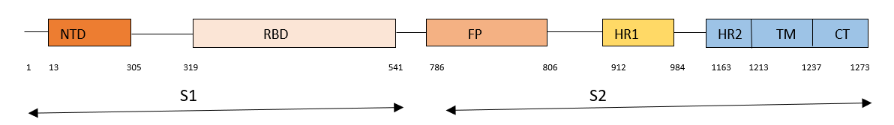
What is a Spike Protein?
Cell entry is mediated by the homotrimer transmembrane Spike glycoprotein
Two subunits- S1 (binding to the host receptor cells)
S2 (fusion of viral and cellular membrane)
Type I Viral fusion protein requiring proteolytic cleavage
Two cleavages- priming cleavage between S1 and S2 and activating cleavage at S2 site

Slide 5
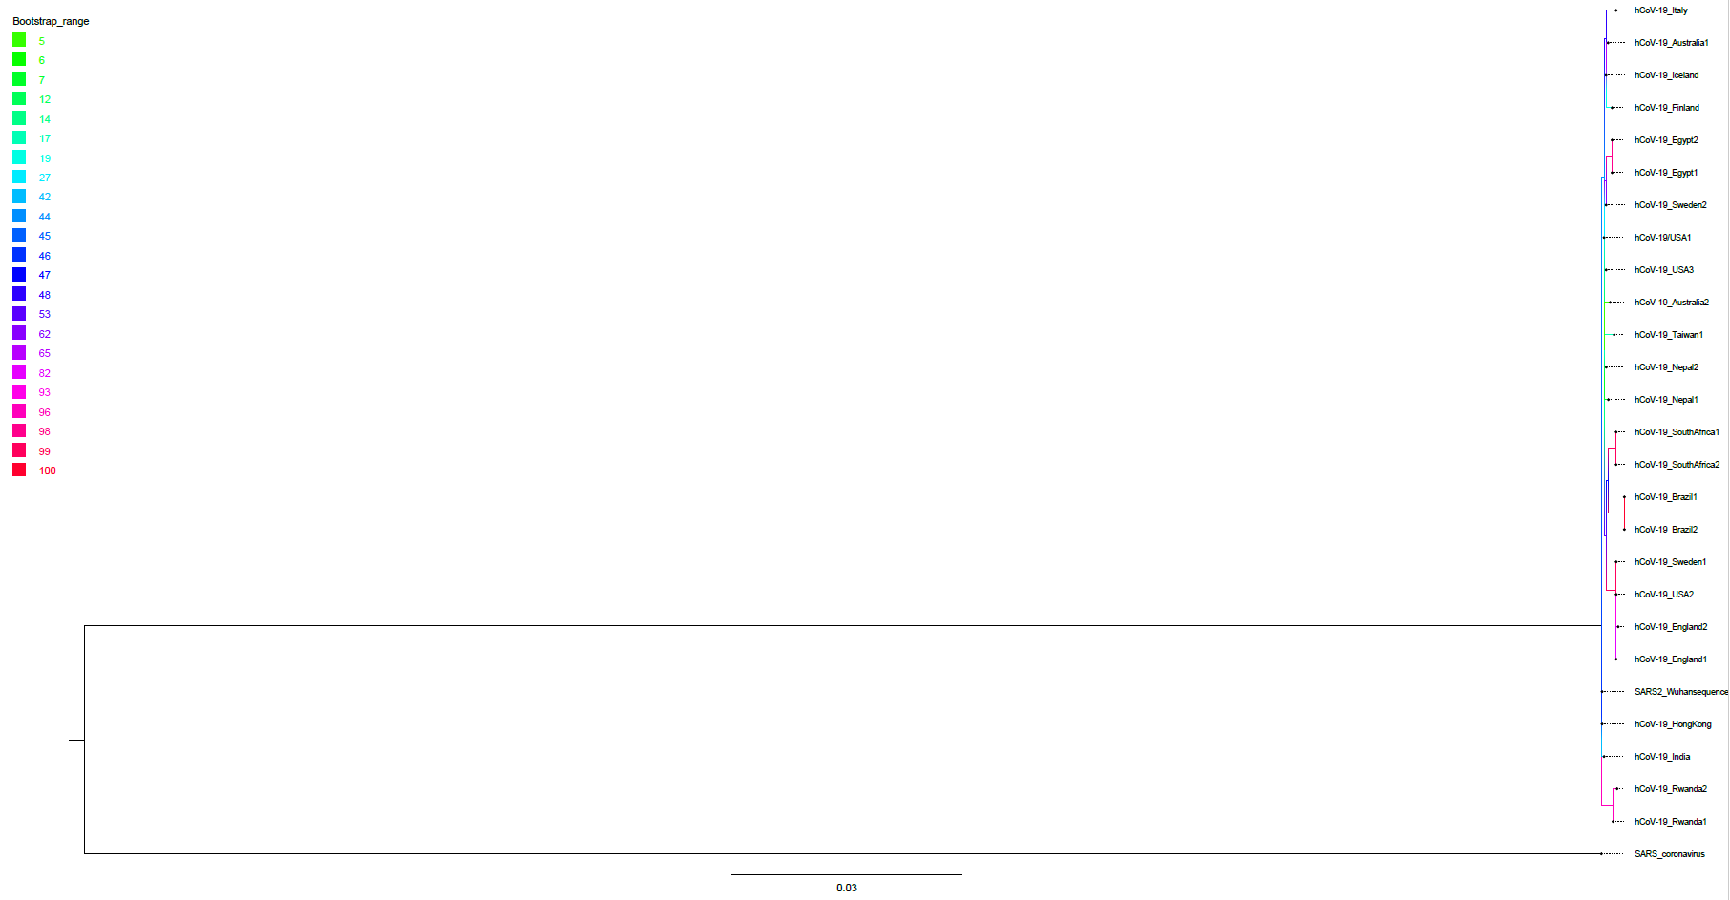
Bootstrap support tree

Slide 6
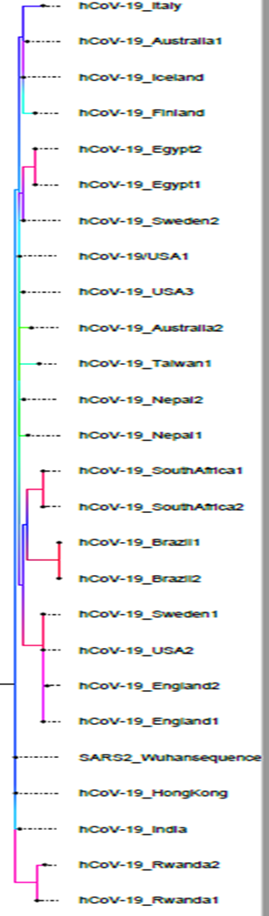
Maximum Likelihood using RAXML-NG
1000 bootstrap supports
Loglikelihood value = -8881.281122
SARS-Coronavirus sequences as an outgroup

Slide 7
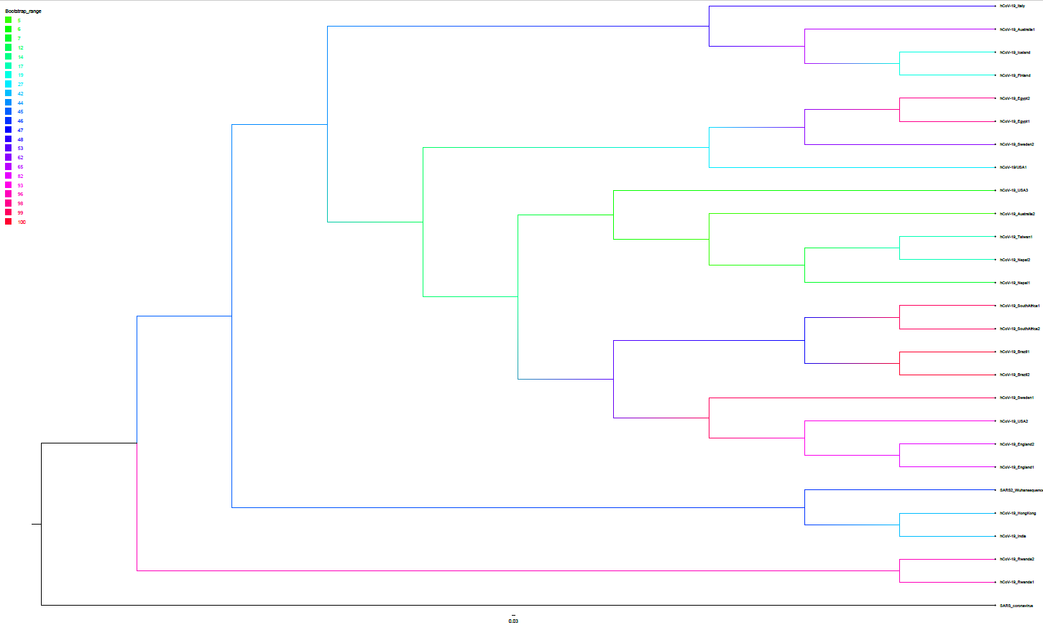
Cladogram

Slide 8
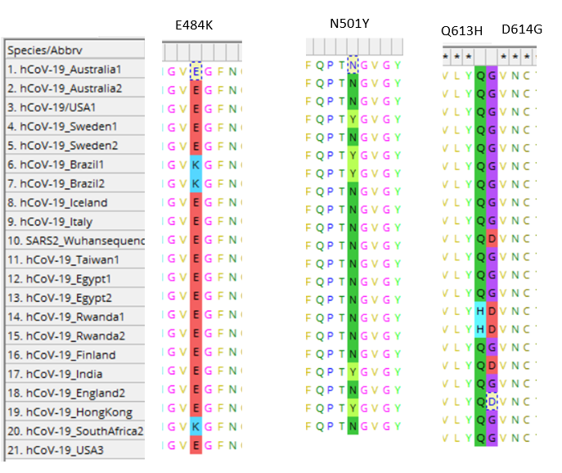
Key Amino Acid changes

Slide 9
Things I wanted to add
Selective evolution using PAML

Slide 10
Known major lineages so far
B.1.1.7
Also known as UK Variant, 8 mutations in Receptor binding domain
Highly transmissible
Major mutation- N501Y
Moderna and Pfizer vaccines were found efficacious
B.1.351
Found in South Africa
9 mutations on the spike protein
Point mutations like D614G, N501Y made them highly transmissible
Highly resistant to antibody binding and neutralization

Slide 11
P.1
Originated in Brazil
Very similar to B.1.351
12 amino acid changes on spike protein
Mutations like N501Y, E484K, L18F affect the antibody neutralizations
Cases of re-infection
Antibody resistance was more than 2 folds for Moderna and Pfizer
B.1.167
Going rampant in India, 250,000+ cases per day
Incorrectly called ‘double mutant’ as it has two famous mutations- L452R and E484Q
Highly transmissible and likely to evade immune response
Further study is going on

Slide 12
References
Ogawa, Junko, et al. The d614g Mutation in the Sars-cov2 Spike Protein Increases Infectivity in an ace2 Receptor Dependent Manner. 22 July 2020, www.ncbi.nlm.nih.gov/pmc/articles/PMC7386486/
Wang, Dawei, et al. “Clinical Characteristics of 138 Hospitalized Patients With 2019 Novel Coronavirus-Infected Pneumonia in Wuhan, China.” JAMA, American Medical Association, 17 Mar. 2020, www.ncbi.nlm.nih.gov/pmc/articles/PMC7042881/.
Ou, Xiuyuan, et al. “Characterization of Spike Glycoprotein of SARS-CoV-2 on Virus Entry and Its Immune Cross-Reactivity with SARS-CoV.” Nature News, Nature Publishing Group, 27 Mar. 2020, www.nature.com/articles/s41467-020-15562-9?report=reader.
Huang, Yuan, et al. “Structural and Functional Properties of SARS-CoV-2 Spike Protein: Potential Antivirus Drug Development for COVID-19.” Nature News, Nature Publishing Group, 3 Aug. 2020, www.nature.com/articles/s41401-020-0485-4.
Supasa, Piyuda et al. “Reduced neutralization of SARS-CoV-2 B.1.1.7 variant by convalescent and vaccine sera” Cell, Elsevier Inc. 18 February, 2021, https://doi.org/10.1016/j.cell.2021.02.033
Zhang, Lizhou et al. “The D614G mutation in the SARS-CoV-2 spike protein reduces S1 shedding and increases infectivity” preprint. https://www.biorxiv.org/content/10.1101/2020.06.12.148726v1.full.pdf
Katoh, et al. “MAFFT: a Novel Method for Rapid Multiple Sequence Alignment Based on Fast Fourier Transform.” OUP Academic, Oxford University Press, 15 July 2002, academic.oup.com/nar/article/30/14/3059/2904316
Wang, Pengfei, et al. Antibody Resistance OF SARS-CoV-2 Variants B.1.351 and B.1.1.7. 8 Mar. 2021, www.nature.com/articles/s41586-021-03398-2.
Faria et al “Genomic Characterisation of an Emergent SARS-CoV-2 Lineage in Manaus: Preliminary Findings.” Virological, 12 Jan. 2021, virological.org/t/genomic-characterisation-of-an-emergent-sars-cov-2-lineage-in-manaus-preliminary-findings/586.
https://www.npr.org/sections/goatsandsoda/2021/04/24/988744811/people-are-talking-about-a-double-mutant-variant-in-india-what-does-that-mean

Slide 13
Thank you everyone
Questions?

