Slide 1
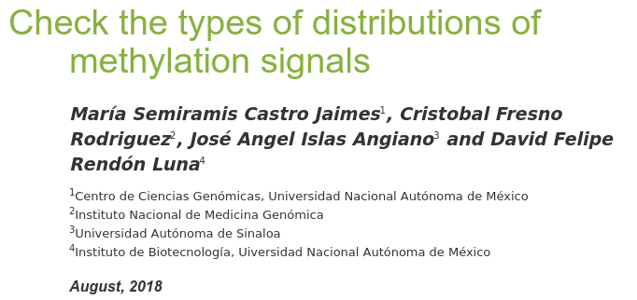
Methylation Project

Slide 2
Annotation
(DATAFRAME)
SampleSheet
(data.frame)
Red/Green Channel Set
Methylated
Unmethylated
Methylation Experiment Data
Platform:
Illumina 450k
12 samples:
2 experimental conditions + 1 control
4 replicates by conditions
MethylSet
GenomicRatioSet
M-values
β-values

Slide 3
Object of class SummarizedExperiment
ColData
SampleSheet
(data.frame)
RawData
Annotation
(DATAFRAME)
Matrix
(list)
RAW
  Methylated
  Unmethylated
NORMALIZED
  M-values
  Β-values
...

Slide 4
How to access the SummarizedExperiment?
Functions:
Load
Quality_Control
  Detection
  Filter
    Sample
    X, Y
    Detection_by_probe
    Cross_reactivity
Normalization
Ajustment
  Limma
  Beta
Plot
Contrast
Object
class()
“SummarizedExperiment”

Slide 5
Load
“SummarizedExperiment”
Quality control
Raw
Filtered
MethylationExperiment
ModelFit
Contrast
Normalization
Adjustment
MethylationExperiment_M
MethylationExperiment_B
Plot
Contrast
Plot

