Slide 1
MapAction Dashboard Summary and History of Updates

Slide 2
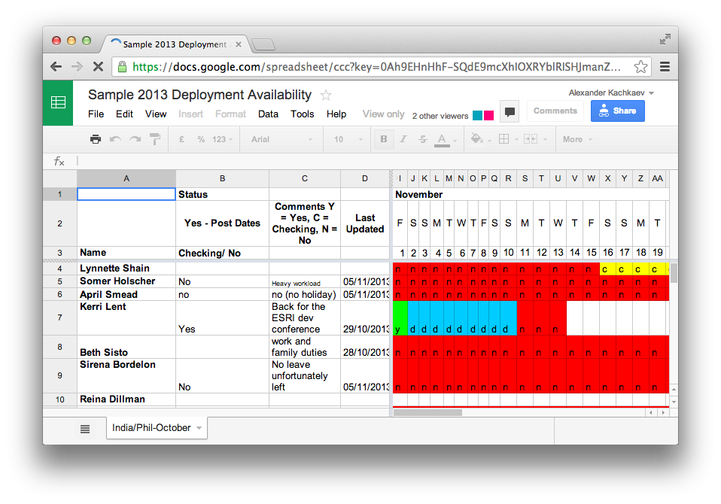

Slide 3
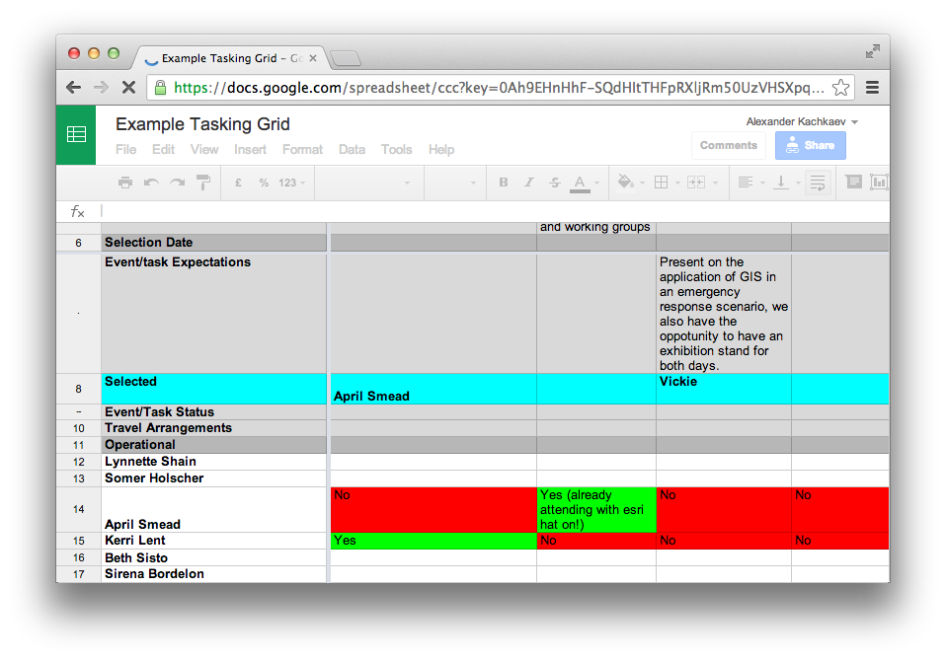

Slide 4
Google spreadsheets ↓ structured YAML files ↓ diffs ↓ summary

Slide 5
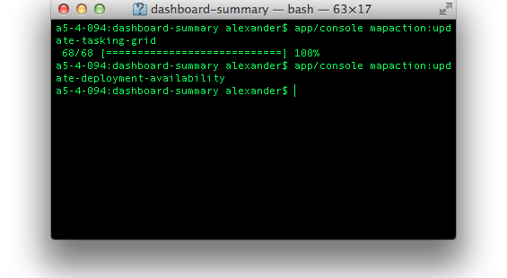

Slide 6
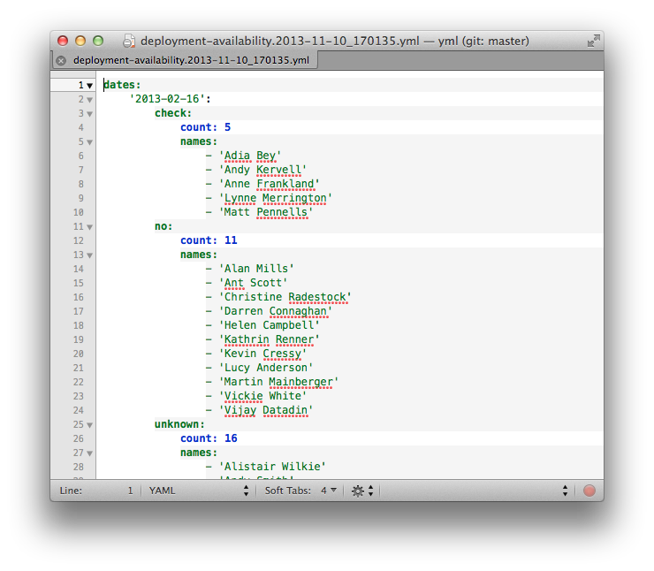

Slide 7
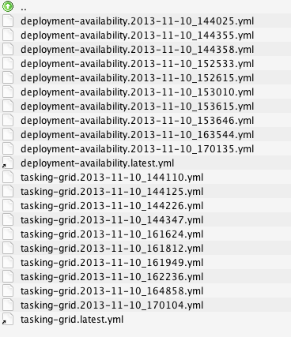

Slide 8
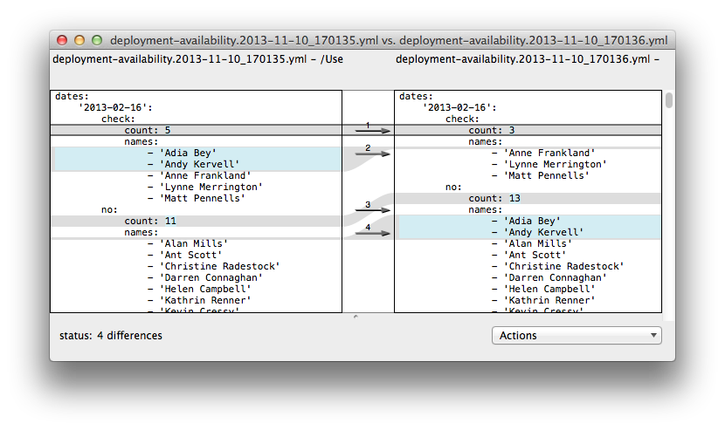

Slide 9
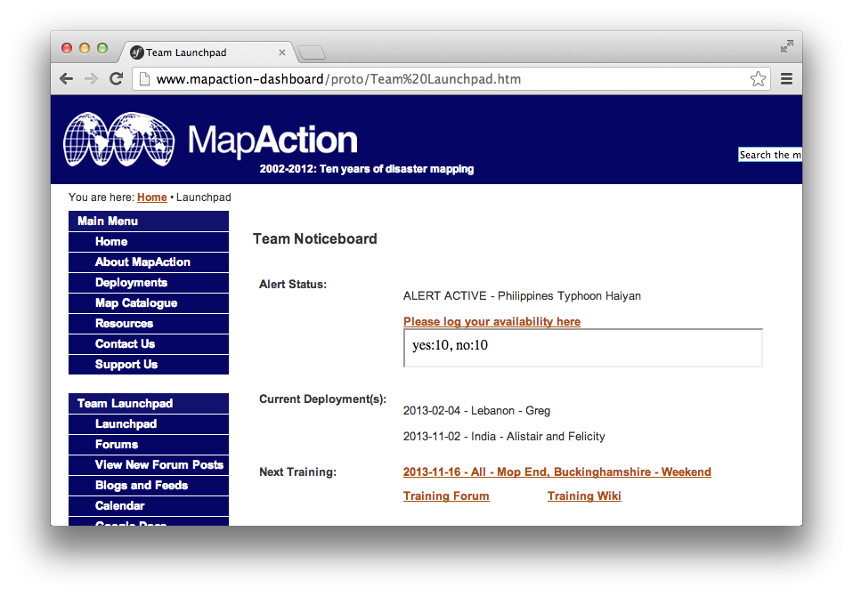

Slide 10
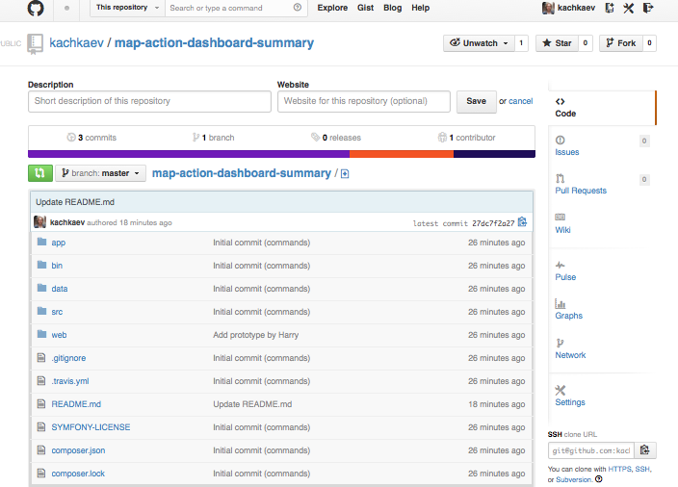

kachkaev/map-action-dashboard-summary

