Slide 1

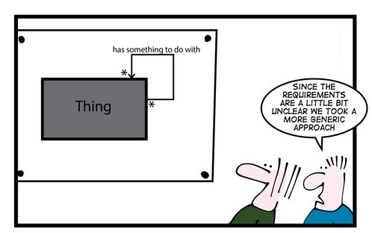
Proposed Contract Fact Table
In determining these Fact tables, We considered the Business Metrics and Core Business Operations of the Company.
The Two Fact Tables we considered are
Contract Fact Table
Equipment Fact Table

Slide 2
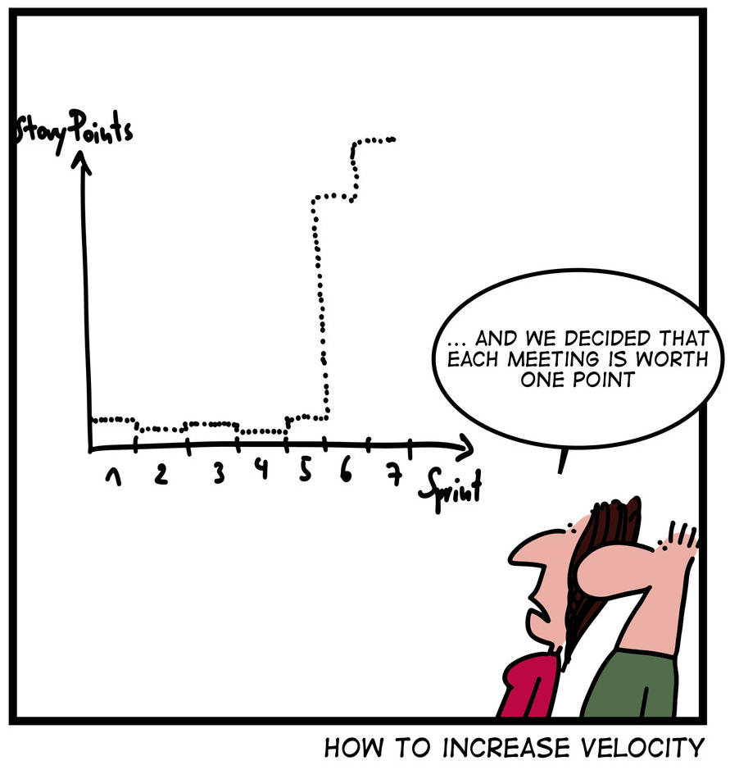
Proposed Contract Fact Table
The Approach we took was to profile the Contract Tables as Provided to us by LJ

Slide 3
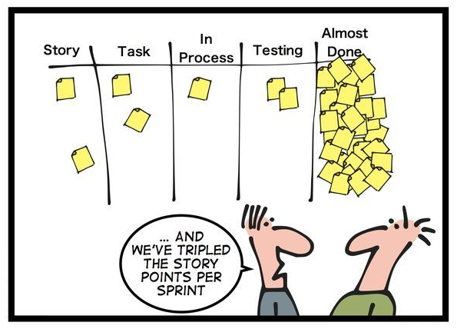
Proposed Contract Fact Table
We Captured Some Key Entities that are potential Dimensional Tables that will also have sub dimensional tables.
CONTRACT NUMBER
CONTRACT VALUE
CONTRACT NAME
BRANCH ID
EMPLOYEE ID
CUSTOMER ID
JOBSITE ID
DATE ID
REVENUE ID
DELIVERY ID
EXPENSE ID
WORK_ORDER ID
ADDRESS ID
BILLING ID
MAINTENANCE ID
SALES ID
PRICING ID
Notes:
Dimension tables should be wide. A rich set of dimensional attributes enables useful and powerful reports.

Slide 4
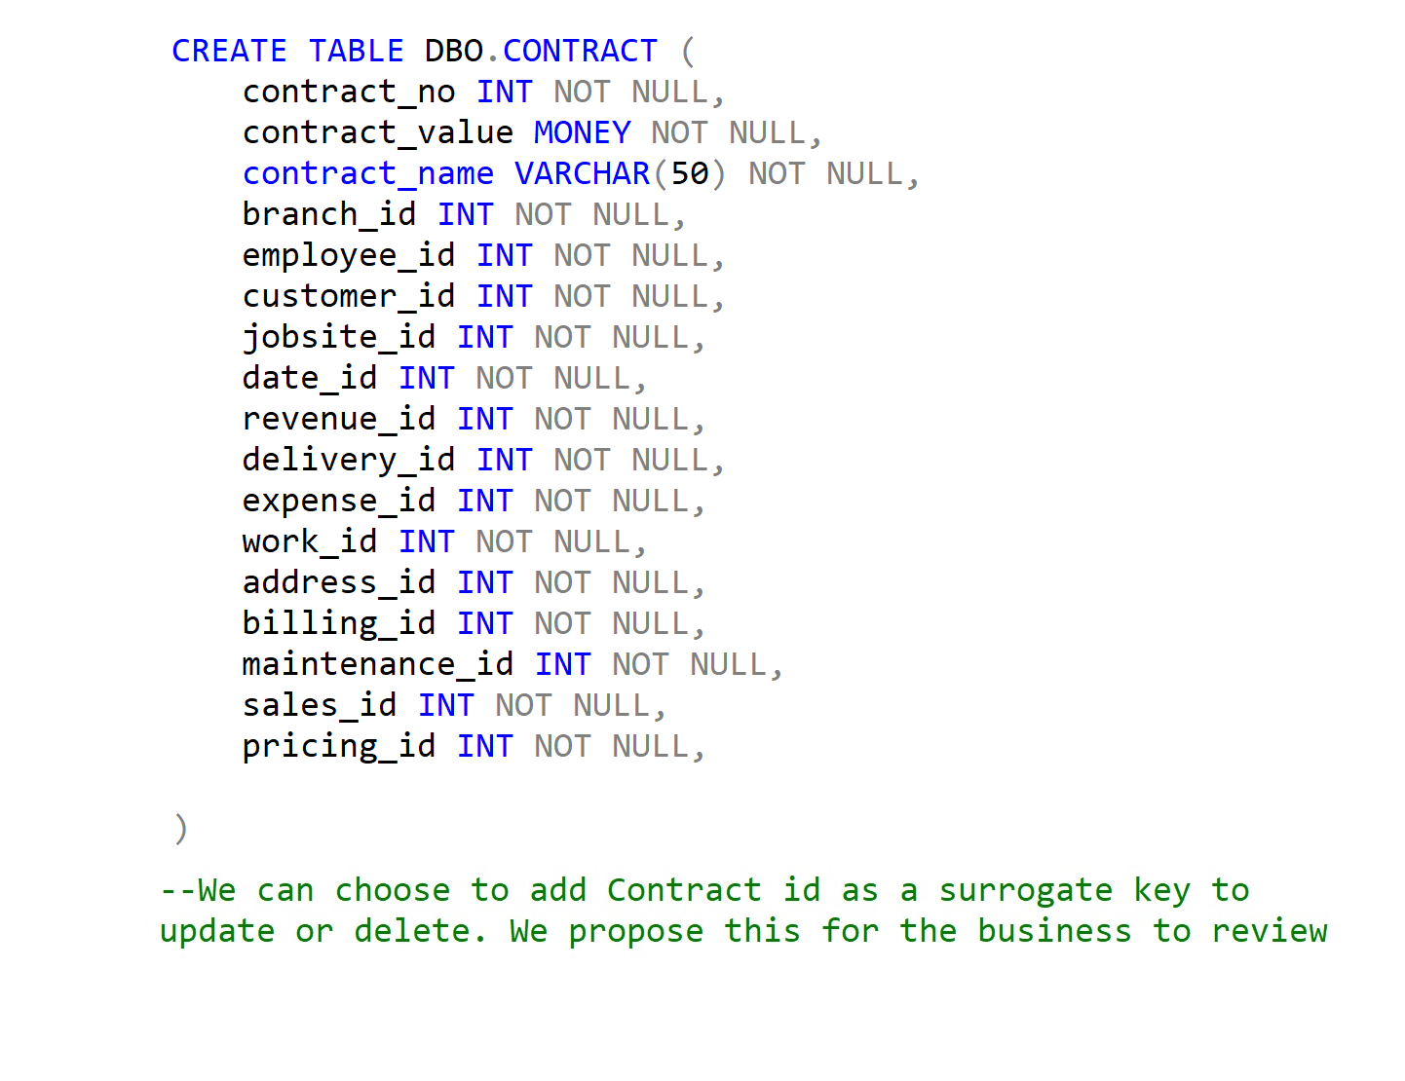
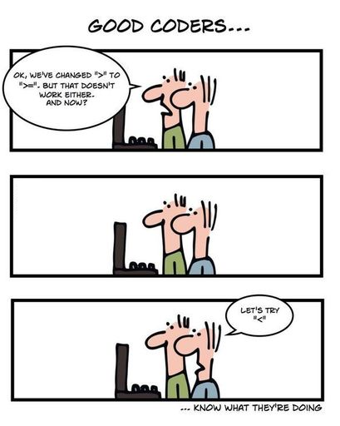
Proposed Contract Fact Table

Slide 5
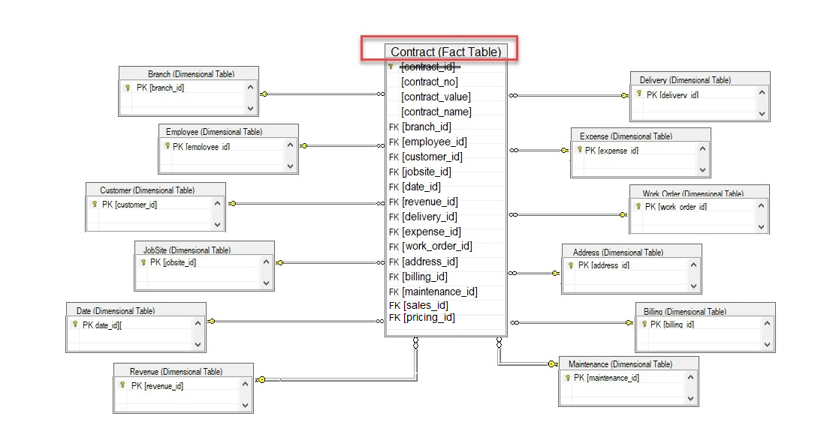
Proposed Contract Fact Table
Notes:
The contract ID is not best Practice. I included that as option for update and delete. Fact table can't have / be a foreign key in a dimension table.

Slide 6
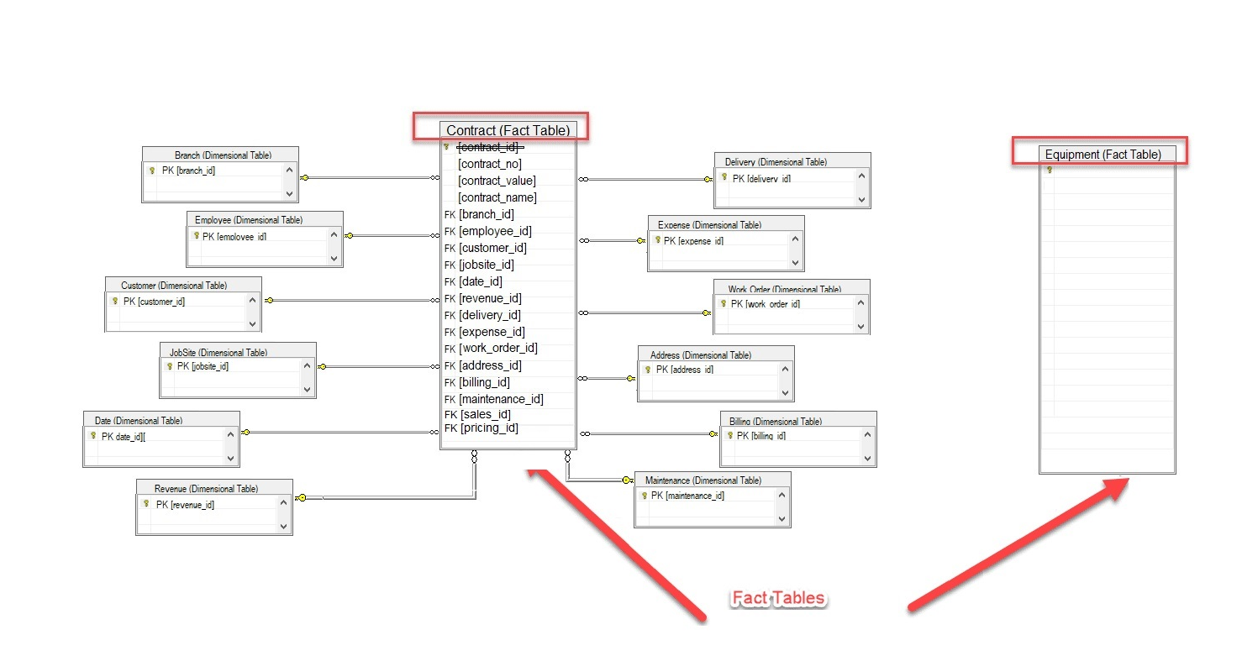
Proposed Contract Fact Table
Notes:
Based on further studies on Fact Table Data Modelling, Fact table defines the business metrics, what the company is known for. At Sunstate we are equipment rental company, and the metric definition here is CONTRACT. There is no limit to rows in fact table. Equipment technically does not define the company, rather it’s a tool (Product) that provides the context of the business. So, Equipment should be a dimensional table. We can have one fact table (CONTRACT), the define constructive dimensional tables that answers all the business requirements questions.

Slide 7
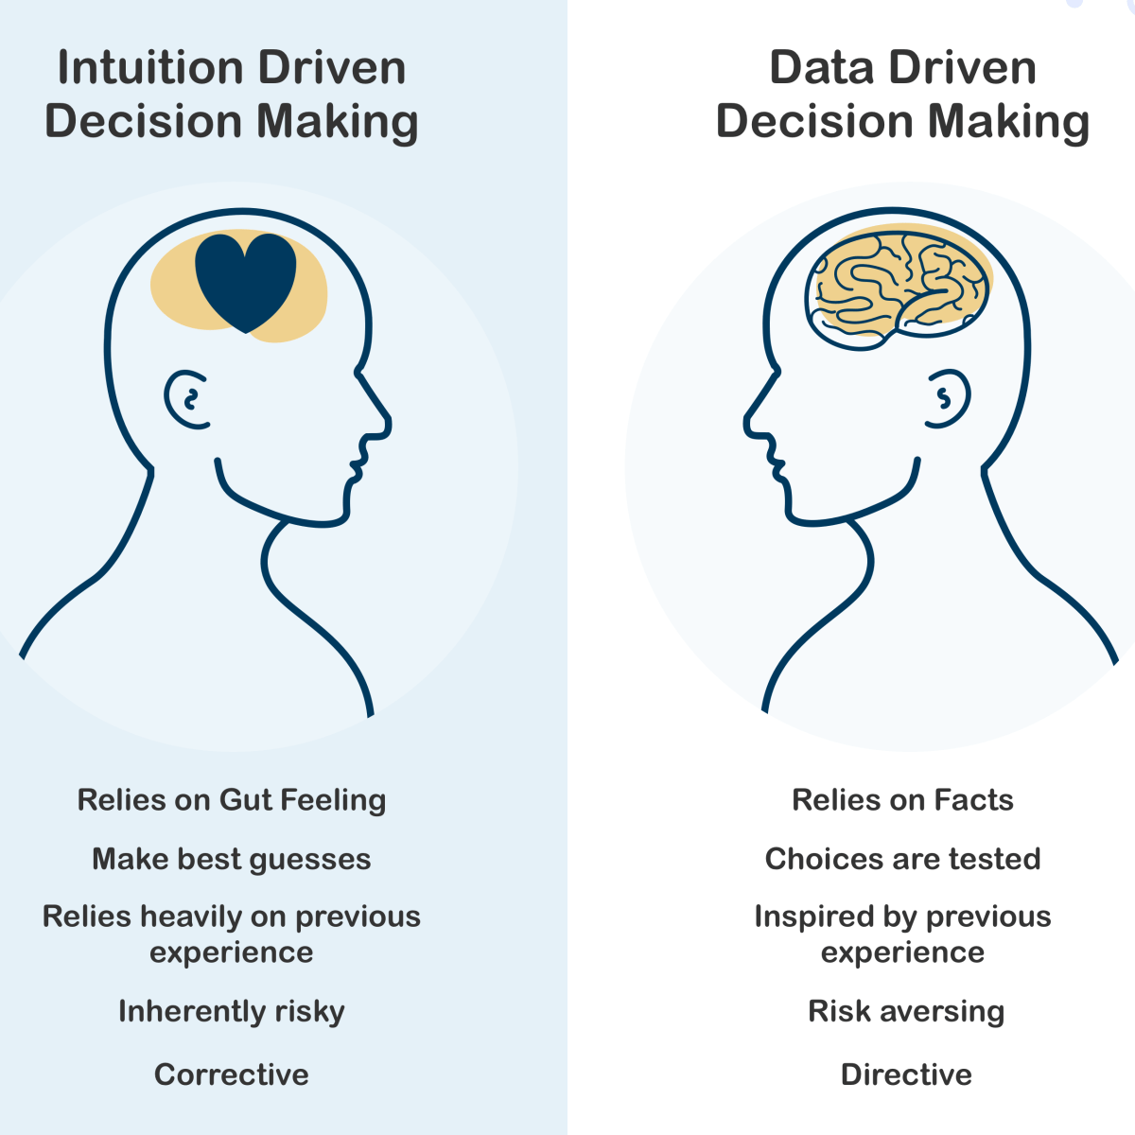
Proposed Contract Fact Table

