Slide 1
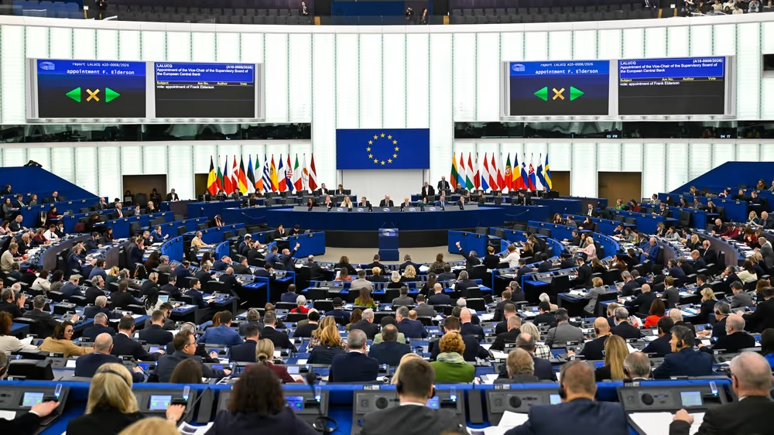
Hurka and Kaplaner (2020): Are popular and powerful committees more representative? Evidence from the 9th European Parliament
Quantitative Methods II
Mairi Kachur, PhD Candidate
Lecturer: Jeffrey Ziegler
10 April 2026

Slide 2
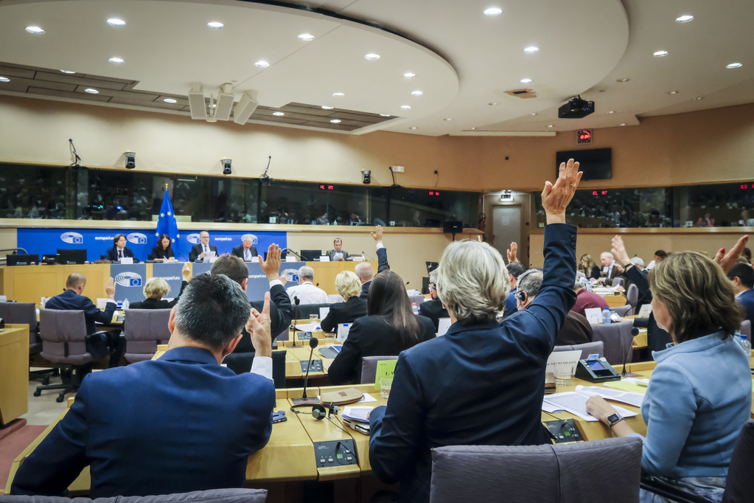
Introduction
Paper assesses representativeness of the committees of the 9th European Parliament (EP) (2019-2024).
Compares committee preference distributions with Plenary on the left/right and pro/anti EU dimension for both popular and powerful committees.

Slide 3
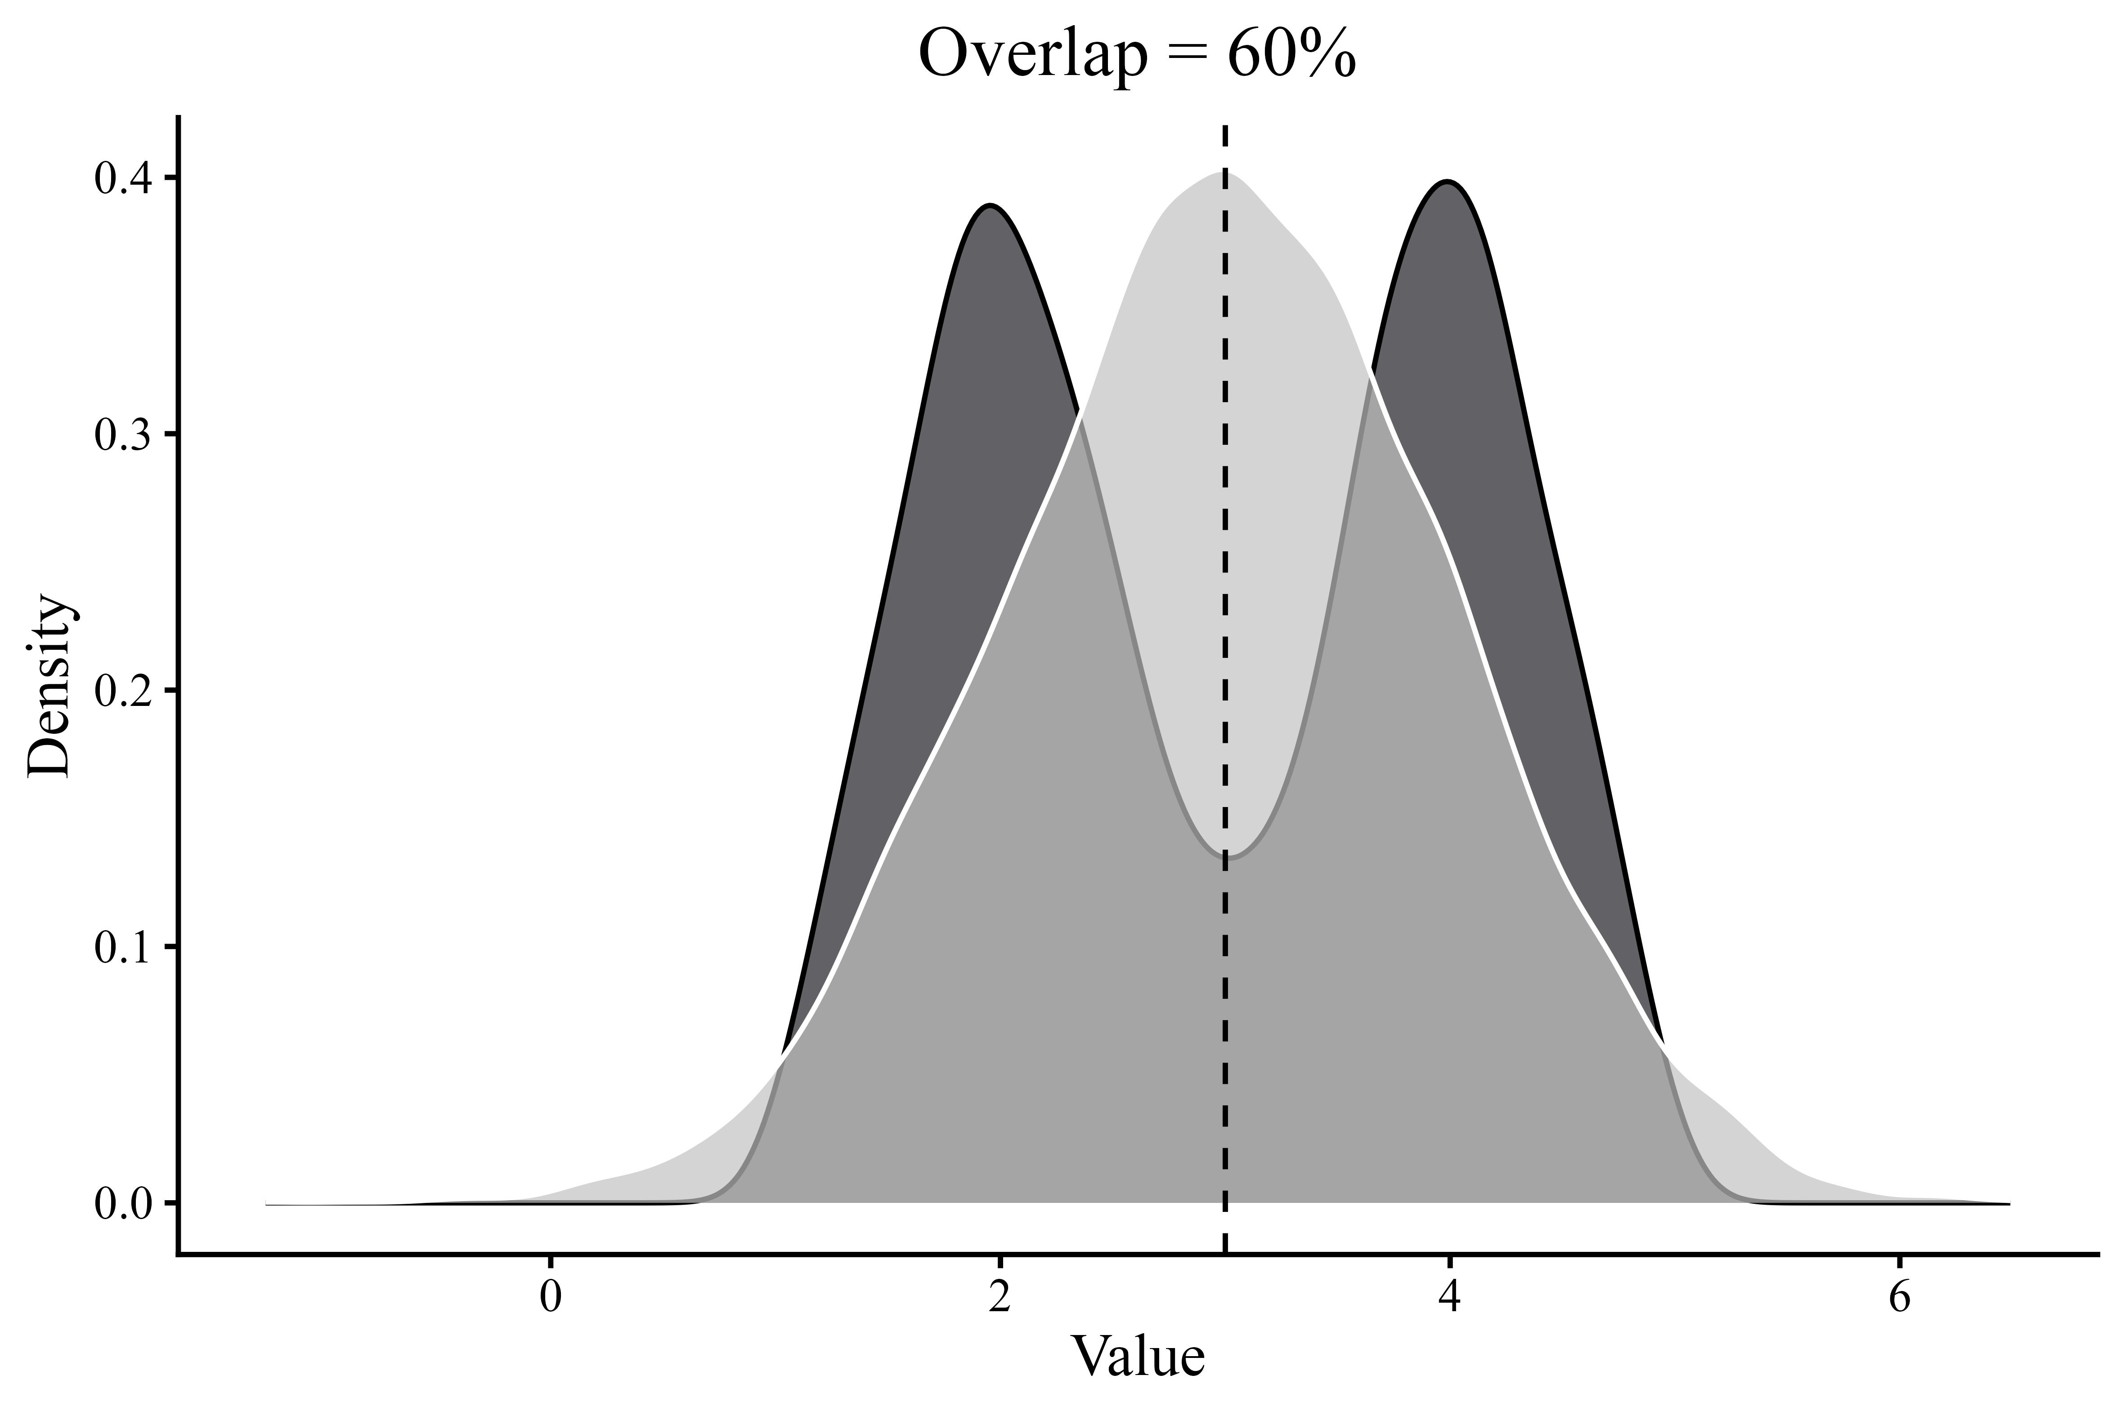
Data and Approach
Hypothesis: More popular and more powerful committees are more representative of the plenary on key dimensions of political conflict than less popular and less powerful committees.
Data: Combine new data on committee memberships in the ninth EP with data on policy preferences of national parties from the Chapel Hill Expert Survey (CHES).
Approach: Calculate the extent to which the preference distributions on left/right and pro/anti EU dimensions of committees and the plenary overlap.
Figure: Simulation of two distributions with the same mean, median and standard deviation

Slide 4

Analysis
Test for representativeness on 2 dimensions using CHES data (dependent variable):
general left/right dimension, ranging from 0 (extreme left) to 10 (extreme right); and
pro/anti EU dimension, ranging from 1 (strongly opposed to European integration) to 7 (strongly in favour).
Committee power and popularity (independent variable):
Power: Use existing categorization, distinguishing committees as more or less powerful based on influence on EU law making process.
Popularity: Based on ranking in which MEPs asked to name their most preferred committee (authors use percentage of mentions/committee + ordinal ranks in their models).

Slide 5
Methods
2 complementary strategies:
inspect deviations from representativeness in a descriptive manner;
estimate the relationships between committee popularity, power and representativeness with OLS regressions;
assess the influence of individual committees to test for outliers (not shown).

Slide 6
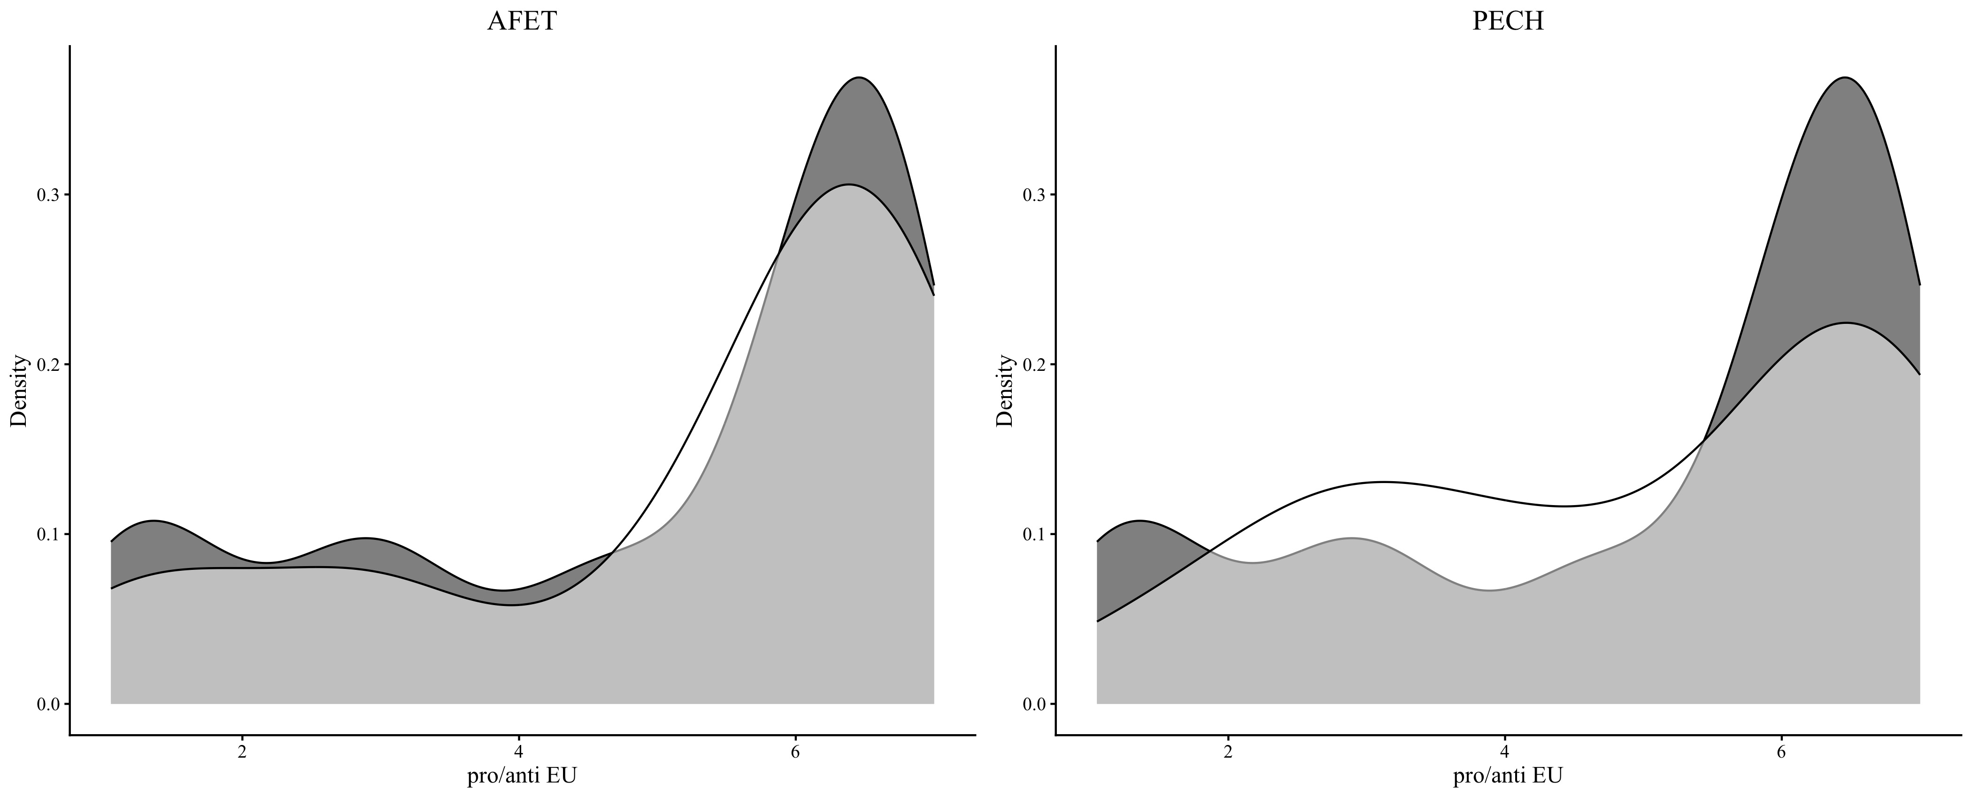
Replication of Analysis (1/3)
Compare distribution of preferences on the pro/anti EU dimension in two committees (Foreign Affairs (AFET) and Fisheries (PECH)) with plenary-level distributions
Light grey = committee distribution; Dark grey = plenary distribution
Shows: pro-EU bias of the EP plenary, not reflected in all committees to the same extent.
Overlap in AFET ca. 86%, overlap in PECH is only 70%: MEPs from less Europhile national parties are overrepresented in PECH.

Slide 7
Representativeness of powerful committees (2/3)
High scores/overlap with the plenary-level distribution = representativeness of the committees.
Left-right dimension: “non-powerful” committees occupy ca. the same range as the more powerful committees
Pro/anti EU dimension: powerful committees tend to be more representative than less powerful committees, with the exceptions of Legal Affairs (JURI, powerful) and Foreign Affairs (AFET, not powerful).

Slide 8
Representativeness of popular committees (3/3)
Key finding: increased representativeness of more popular committees can be observed.
Left-right dimension: popular and less popular occupy same range
Pro/anti EU: Less popular seem to be less representative (Legal Affairs (JURI), Petitions (PETI), and Budgetary Control (CONT)).

Slide 9
Replication of Regression Models
Model I
Left/right: Regresses committee representativeness on the left–right dimension on committee popularity (percentage measure).
Model II
Left/right: Regresses committee representativeness on the left–right dimension on committee popularity using an ordinal rank measure.
Model III
Left/right: Regresses committee representativeness on the left–right dimension on committee power.
Model IV
Pro/anti EU: Regresses committee representativeness on the pro/anti EU dimension on committee popularity (percentage measure).
Model V
Pro/anti EU: Regresses committee representativeness on the pro/anti EU dimension on committee popularity using an ordinal rank measure.
Model VI
Pro/anti EU: Regresses committee representativeness on the pro/anti EU dimension on committee power.

Slide 10
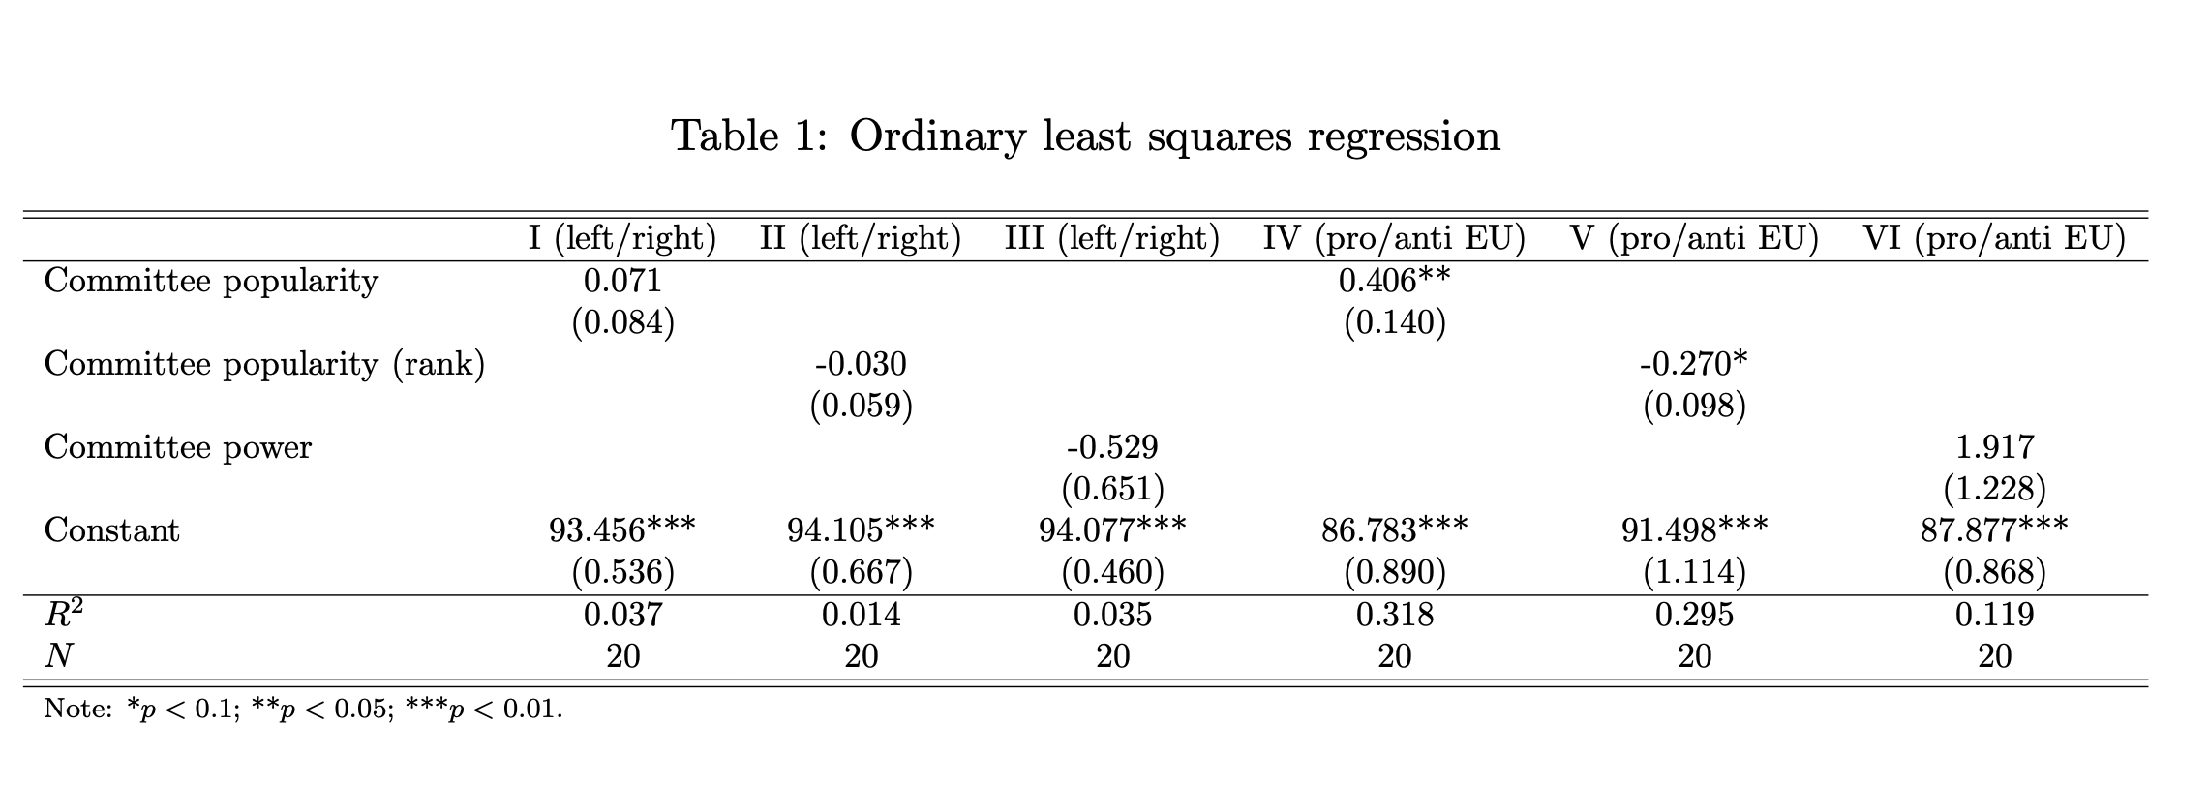
Replication of Regression Models

Slide 11
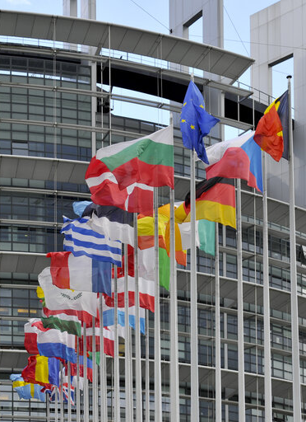
Result findings interpretation
Hypothesis: More popular and more powerful committees are more representative of the plenary on key dimensions of political conflict than less popular and less powerful committees.
Neither committee popularity nor power helps explain deviations in committee representativeness on the left/right dimension (Models I–III).
Positive relationship between committee popularity and committee representativeness on the pro/anti-EU dimension (Model IV):
Every percentage point increase in popularity is associated with an increase in overlap on the pro/anti-EU dimension of .4 points.
Also holds if use an ordinal ranking of committee popularity resulting from Whitaker’s survey (Model V)

Slide 12
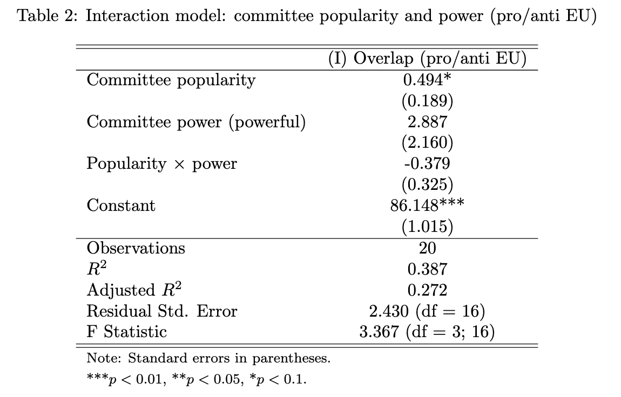
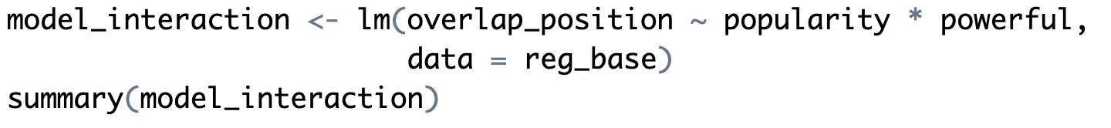
Extension: Interaction term
>> Test whether the effect of committee popularity on representativeness (pro/anti EU dimension) depends on whether a committee is powerful.

Slide 13
Popularity: more popular committees have stronger overlap, are more representative.
Power: more powerful committees may be expected to have stronger overlap, but not systematically more representative.
Interaction: positive effect of popularity may be weaker for powerful committees (decrease in overlap), but not statistically significant.
KEY FINDING: Committee popularity is an important determinant of representativeness on the pro/anti EU dimension, while committee power and its interaction with popularity play a limited role.

Slide 14
Thank you!

