Slide 1

“Because You Listened to …” Podcast Recommender
Kacie Webster
Retrieved from Vox

Slide 2
Title
Room of Requirement
Description
“Room of Requirement is a podcast dedicated to reason and resilience in the Time of Trump. Hosted by Miracle Jones and Kamalesh Rao and based in Jackson Heights, Queens, the podcast aims to be a voice of advocacy for democracy and human rights.”
Category
“News & Politics”
Language
English
The Data
listennotes.com
19,126 podcasts

Slide 3
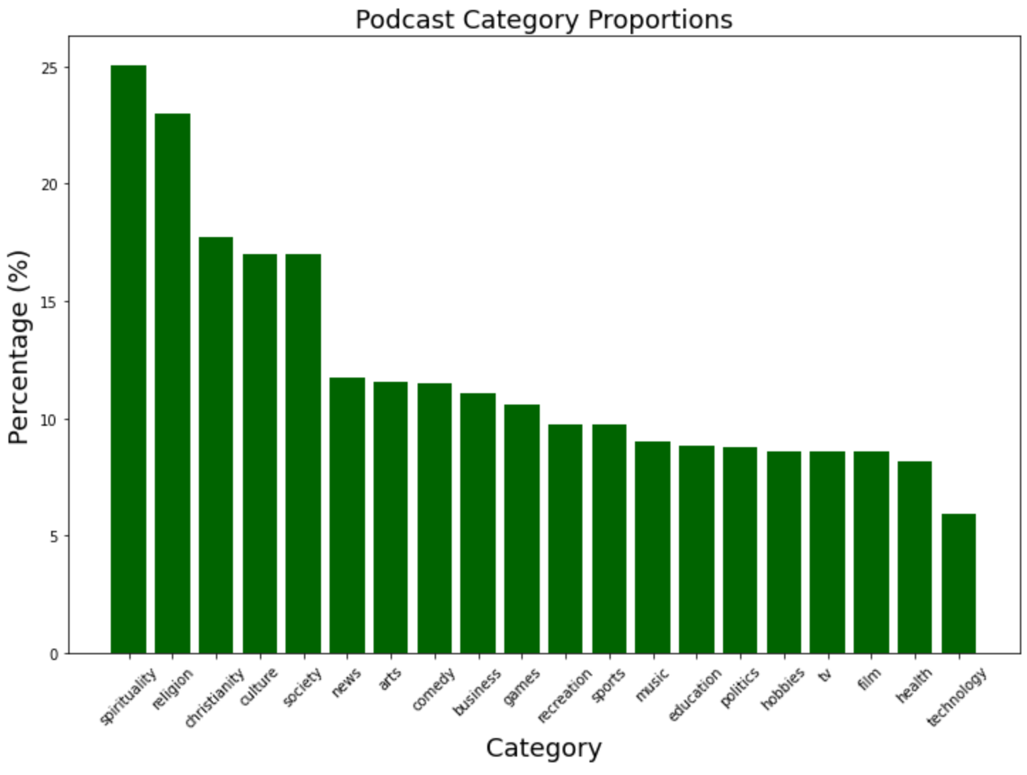
The Categories
Top 5 Categories
Spirituality
Religion
Christianity
Culture
Society

Slide 4
Language | Percentage
English | 81.75%
German | 3.61%
French | 3.28%
Spanish | 3.01%
Portuguese | 1.55%
Swedish | 1.43%
Chinese | 1.10%
Japanese | 0.89%
Italian | 0.67%
Russian | 0.51%
The Languages

Slide 5
The Recommender
 | business | sports | basketball | manage | trade | english | spanish
podcast 1 | 0 | 1 | 1 | 1 | 1 | 1 | 0
podcast 2 | 0 | 1 | 1 | 1 | 0 | 1 | 0
podcast 3 | 1 | 0 | 0 | 1 | 1 | 0 | 1
What podcast would we recommend for podcast 1?
Cosine similarity of podcast 1 and podcast 2 ≈ 90%
Cosine similarity of podcast 1 and podcast 3 ≈ 45%
Since 90% > 45%, we would recommend podcast 2.

Slide 6

Thank you!
Email: kacieweb98@gmail.com
LinkedIn: /in/kacie-webster/
Github: /kaciewebster
Tech Used:
numpy, pandas, google_trans_new, nltk, matplotlib, sklearn, flask, aws
Retrieved from NBC News

