Slide 1
Arkansas Park Inspections Web Application
GEOG576 - Final Project
Dan Goodrich, Vlad Sliusar, Robert Kacir, Andrew Wiseman
System implementation

Slide 2
DATA
Database design & implementation
Four shapefiles (ParkFootprints, InspectionNotes, Project Boundary, and Structures)

Slide 3
Database Design
Database design & implementation
Entity Relationship Diagram via ERDPlus tool: entity types (strong/weak), attributes, primary/foreign keys added/identified, relationships (type, degree, and cardinality)
ER-Diagram converted into Relational Schema: data types specified including geometry types and associated SRID, names of entity types and fields updated to match the shapefiles
Relational Schema exported as SQL: not null constraints updated to ensure seamless data upload due to empty fields in shapefiles

Slide 4
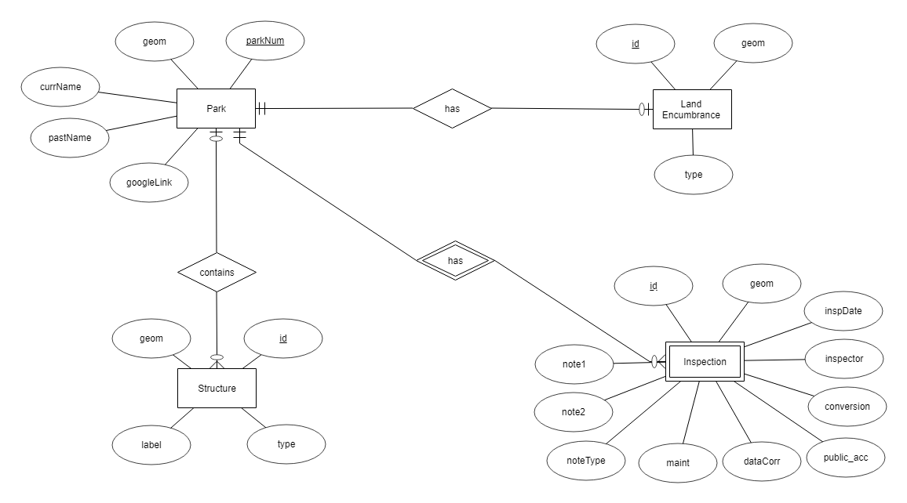
Database Design (ER diagram)
Database design & implementation

Slide 5
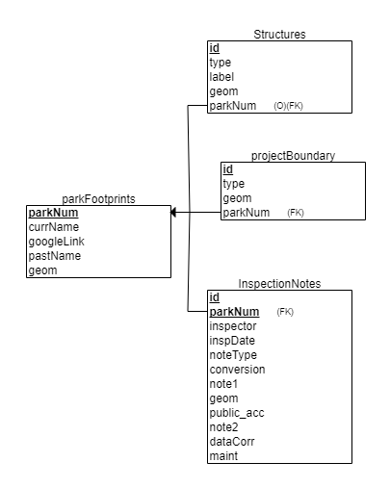
Database Design (Relational schema)
Database design & implementation

Slide 6
Database Implementation
Database design & implementation
New spatial database created in Postgres (PostGIS extension) via PgAdmin
Relational Schema SQL ran to create tables
Shapefiles uploaded into the database

Slide 7
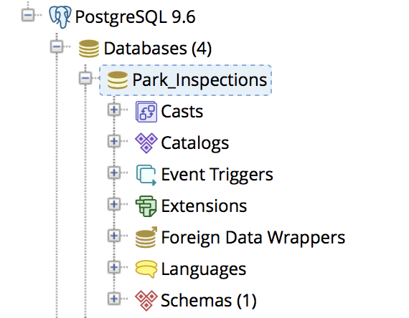
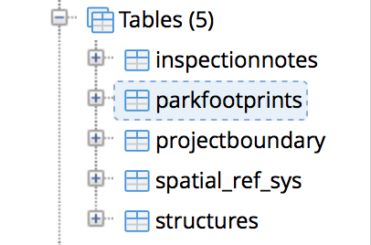
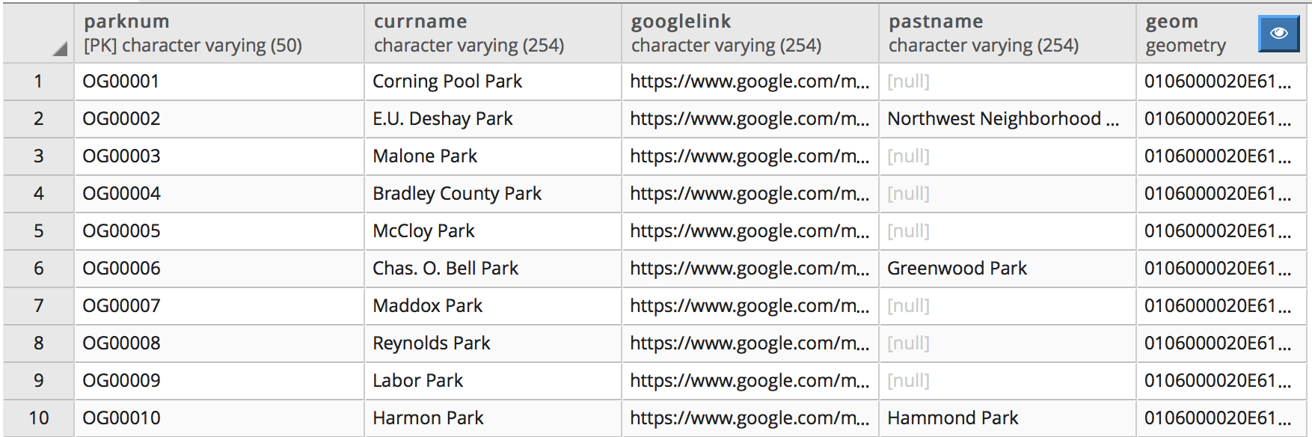
Database Implementation
Database design & implementation

Slide 8
Technologies & implementation
Front-end development
HTML, CSS, Javascript, jQuery, D3, Leaflet, AJAX, JSON
Four HTML pages created (index - landing navigate page, inspect, createReport, and viewPast)
Four JS files created to support user interactivity and interaction with the database (navigate, inspect, createReport, and viewPast)
navigate.js - implements Leaflet map (MapBox streets layer), fetches data from the database to show parks as markers (green color icon - current inspection, red color icon - past due inspection)
inspect.js - implements ESRI World Imagery layer that supports park inspections when combined with park/encumbrance boundaries and available structures fetched via AJAX calls; links to createReport.js and viewPast.js
createReport.js - allows to create new inspection reports and submit them to the database - form data is sent to the database via AJAX calls
viewPast.js - supports viewing of available park inspection reports in accordion format implemented using D3; reports are fetched from the database via AJAX calls

Slide 9
Technologies & implementation
Back-end development
Java, Java Servlet, JDBC
Implemented six Java classes: one JDBC connectivity class (DBUtility), five servlet classes (Navigate, Inspect, CreateReport, ViewPast, and ParkName)
Navigate.java - supports AJAX calls from navigate.js requesting inspection reports data; queries data from the database with support of the DBUtility class; sends data back in JSON format
Inspect.java - supports AJAX calls from inspect.js requesting available park and encumbrance boundaries, and structures; queries data from the database with support of the DBUtility class; sends data back in JSON format
CreateReport.java - supports AJAX calls from createReport.js sending new park inspection reports data; the data is inserted into the database utilizing DBUtility
ViewPast.java - supports AJAX calls from viewPast.js requesting past inspection reports data; the data is queried from the database via DBUtility and is send back in JSON format
ParkName.java - supports AJAX calls from all four JS files requesting the selected park name

