Slide 1
Object Oriented Analysis and Design
Neil Urquhart

Slide 2
Analysis and design
Most software is written to solve a problem
Some start to code when faced with a new problem (aka hacking)
Hacking can lead to
Software bugs
Software that does not meet requirements
Lack of documentation
Financial overruns

Slide 3
Analysis and design
Analysis involves examining the problem and finding out more about it
We need to understand the nature of the problem
We need to understand the size/scope of the problem
Having understood our problem we may design our solution
We could use class diagrams (& other UML components)
Having completed as design we can now implement our solution

Slide 4
Analysis
We commence by undertaking a requirements analysis
This is out width the scope of this module
The requirements analysis leads to a specification
In this module we will commence with a problem statement as our specification

Slide 5
Problem Statement
“Sunk Shipping operates a fleet of ships each ship has a name. The ships are of type tanker or cargo ship. A tanker may only carry oil.
Ships may be booked by a client for a voyage, each client has a name and an address. Each voyage has a start date, duration, departure port and a destination, and a cargo description. Each vessel is allocated a captain for each voyage, the captain is identified by their name and payroll number. The cost of a voyage is calculated once the ship has docked. The costs for a tanker will be greater as the tanks must be cleaned out.”

Slide 6
Analysis
A good starting point in transforming a problem statement into an OO design is to identify nouns and verbs
Nouns indicate some form of entity, some of which may be classes
Verbs indicate actions, some of which may be methods

Slide 7
Nouns
“Sunk Shipping operates a fleet of ships each ship has a name. The ships are of type tanker or cargo ship. A tanker may only carry oil.
Ships may be booked by a client for a voyage, each client has a name and an address. Each voyage has a start date, duration, departure port and a destination, and a cargo description. Each vessel is allocated a captain for each voyage, the captain is identified by their name and payroll number. The cost of a voyage is calculated once the ship has docked. The costs for a tanker will be greater as the tanks must be cleaned out.”

Slide 8
Verbs
“Sunk Shipping operates a fleet of ships, each ship has a name. The ships are of type tanker or cargo ship. A tanker may only carry oil.
Ships may be booked by a client for a voyage, each client has a name and an address. Each voyage has a start and a destination, and a cargo description. Each vessel is allocated a captain for each voyage, the captain is identified by their name and payroll number. The cost of a voyage is calculated once the ship has docked. The costs for a tanker will be greater as the tanks must be cleaned out.”

Slide 9
Scope
Are any of the nouns/verbs outside the scope of the system?
Sunk Shipping? Is the name of an organisation we are working for, it’s not part of the system
Cleaned, docked, these are physical operations carried out on the actual ships
Oil refers to a specific physical cargo
There may be others...

Slide 10
Synonyms
Synonyms are two words which have the same meaning
Ship | Vessel
Note that name appears 3 times, but it is not a synonym as it refers to
Ship name
Client name
Captain’s name
Failure to identify synonyms could result in duplicated classes

Slide 11
Classes/Attributes
We need to identify which nouns are classes and which are attributes of a class:
fleet
ship
ship name
tanker
ship name
cargo ship.
ship name
client
client name
voyage
start date
duration
departure port
destination
cargo description.
cost
captain
captain name
payroll number

Slide 12
Classes/Methods
We can use our verb list to allocate methods to classes (attributes not listed for clarity)
fleet
operates()
ship
tanker
cargo ship
client
books()
voyage
calculate()
Captain
allocate()

Slide 13
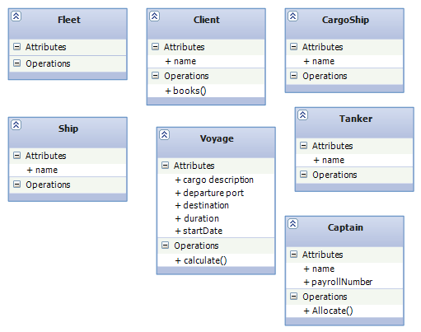
A first cut at the class diagram

Slide 14
Further thoughts
The cost of a voyage is dependant on the ship used.
We should add a calculateCost attribute to each type of ship.

Slide 15
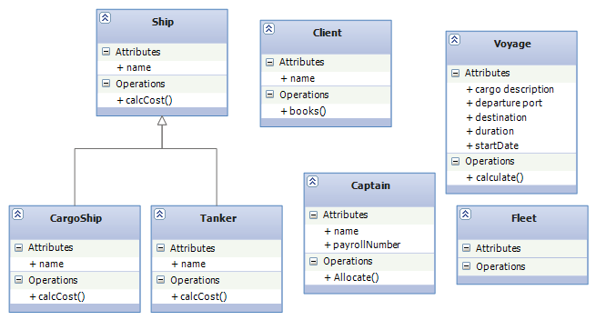
Relations
Some further though suggests that Ship, CargoShip and Tanker are related.
CargoShip and Tanker are specialisations of ship.

Slide 16
Relations
The verbs and use of plurals give us some idea of the 1:M type relations between our classes
“operates” 1 fleet -> M ships
“booked for voyages” 1 ship –> M voyages

Slide 17
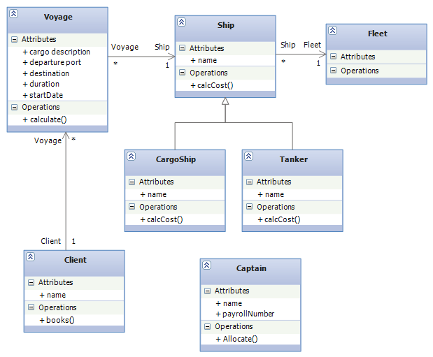
Relations

Slide 18
Relations
Captain?
Is the captain allocated to the ship?
Is the captain allocated to the voyage?
Go back and ask the client
In this case the Captain is allocated to the ship
The ship must have a captain

Slide 19
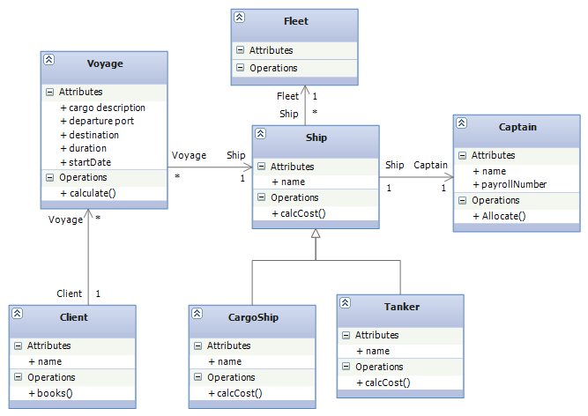
Relations

Slide 20
Relations
Looking at our diagram we notice a couple of things
The system should have more than one client

Slide 21
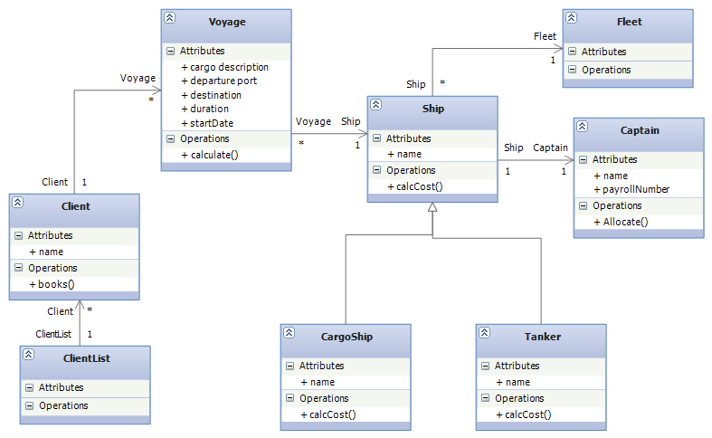
A Possible Design

Slide 22
Not finished yet
This design captures the “business logic”
No user-interface
No persistence (data storage)
This design needs to be further refined during implementation

