Slide 1
Student Data Evaluation
with Python 3.6

Slide 2
Python stack for the analysis
• Python vs. 3.6
• Docker application container vs. 18.09.02
• Anaconda vs. 5.2.0 and Spider | Eric6 IDE
• Python libraries:
Pandas
Seaborn
Matplotlib
ScikitLearn

Slide 3

The Dataset
Success rate of education in two Portuguese high schools from Portuguese language (649) and maths (395)
33 attributes include marks of students, social and demographic conditions and study results (binary, nominal and numeric)
Target column is G3 – final grade (0-20)

Slide 4
Prediction of G3 (final grade) from the whole dataset
Accuracy of prediction for all data features:
Accuracy (Random Forest): 0.35
Accuracy (Decision Tree): 0.28
Accuracy (Extra Tree):
0.27
ACCURACY? TOO LOW!
3 main algorithms for predicting the target grade:
Random Forest
Decision tree
Extra Tree
Results are really bad: 33 features are too many to have good predictions = a lot of noise in the data!

Slide 5
Extraction of the main components
We have used different methods to compare the results:
RandomForestClassifier
DecisionTree
ExtraTreesClassifier
PCA-Principal Component Analysis
We needed to select a sub-set of the data attributes to achieve a better prediction rate

Slide 6
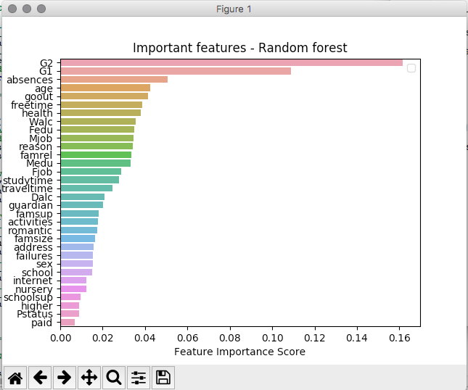
1) Random Forest (whole dataset)

Slide 7
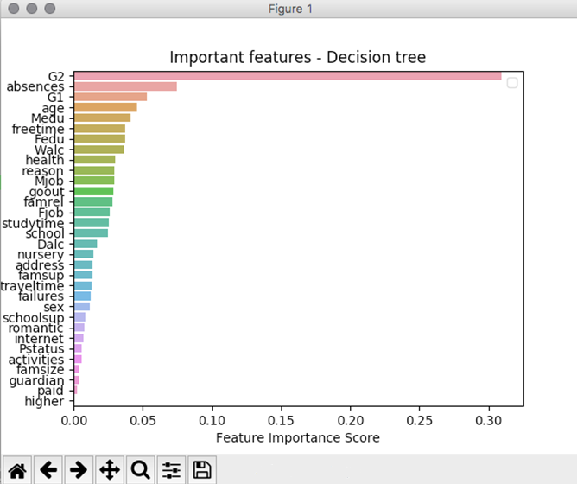
2) Decision Tree (whole dataset)

Slide 8
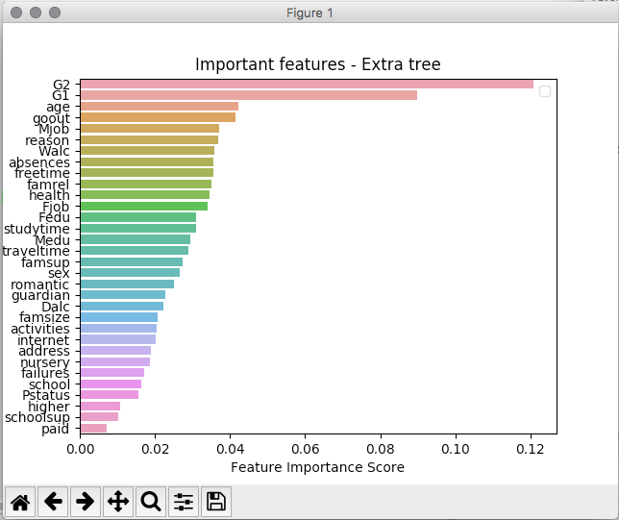
3) Extra Tree (whole dataset)

Slide 9
Analysis Result from Feature Extraction
There is evidence that the most relevant aspects are:
G3 is strongly dependent from G2 and G1, because G3 is the final grade, while G1 and G2 are the grades from the previous semesters
The number of absences is a sensible parameter
Less important parameters:
the school which the students are visiting
if they want to pursue a higher education path

Slide 10
Prediction of G3 (final grade) from the most important features (3 main components)
Results and comparison with the previous accuracy:
Algorithm | Whole data accuracy | 3 Main Components accuracy
Random Forest | 0.35 | 0.42
Decision Tree | 0.28 | 0.45
Extra Tree | 0.27 | 0.42

Slide 11
4) PCA (Principal Component Analysis)
Another approach: looking for the best number of components and then transforming the data --> the best option is to use the 2 main components
N.of Components | Explained Variance
1 | [0.39045982]
2 | [0.39045982 0.25078734]
3 | [0.39045982 0.25078734 0.04637921]
4 | [0.39045982 0.25078734 0.04637919 0.0388406]
5 | [0.39045982 0.25078734 0.04637921 0.03884068 0.03454581]

Slide 12
PCA - Results of predictions on transformed data
Accuracy of the previous 3 algorithms (RF, DT, ET) to the transformed data: the best option is to have only from 2 to 4 components
ACCURACY | 1 component | 2 components | 3 components | 4 components | 5 components | 6 components
Random Forest | 0.18 | 0.42 | 0.34 | 0.32 | 0.33 | 0.42
Decision Tree | 0.18 | 0.33 | 0.30 | 0.35 | 0.35 | 0.24
Extra Tree | 0.18 | 0.32 | 0.36 | 0.41 | 0.32 | 0.22

Slide 13
Improving our predictions
We had better results than the first iteration, but still not so good:
we are predicting from 20 categories at once
low accuracy
n.20 target grades are too many
Instead of predicting target grade (0-20) let´s predict only passed (grade >=10) or fail
We will use the same algorithms

Slide 14
Prediction for Pass/Fail Results
Algorithm | Whole dataset accuracy | 3 Main Components accuracy | after PCA (3 components) accuracy
Random Forest | 0.85 | 0.92 | 0.93
Decision Tree | 0.92 | 0.89 | 0.90
Extra Tree | 0.89 | 0.96 | 0.92

Slide 15
Prediction without G1 and G2
We achieved the following:
performed the extraction of the main components
used different methods to compare the results:
RandomForestClassifier
Decision Trees
ExtraTreesClassifier
Principal Component Analysis
here follow the plots for the classification results

Slide 16
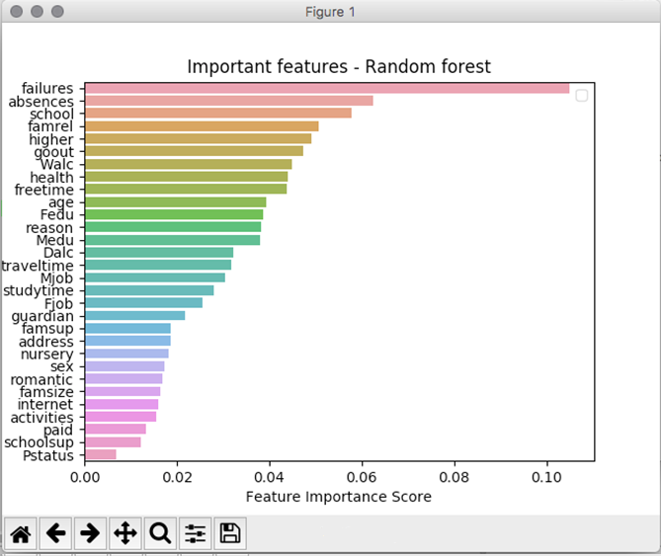
Random Forest (without G1 and G2)

Slide 17
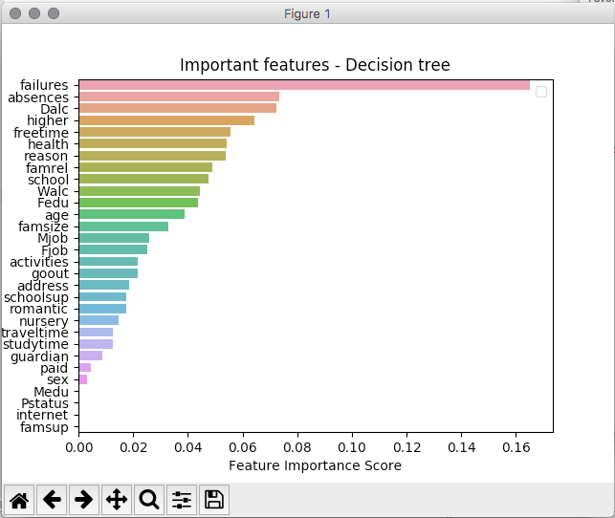
Decision Tree (without G1 and G2)

Slide 18
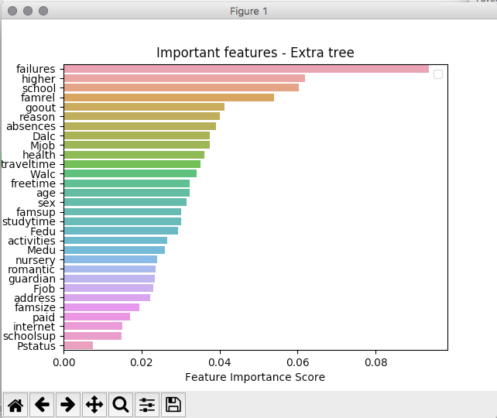
Extra Tree (without G1 and G2)

Slide 19
Main Components per algorithm
Random Forest
Failures, absences, higher, school, famrel
Decision Tree
Failures, absences, health, higher, freetime
Extra Tree
Failures, higher, school, famrel, freetime
The main features are similar, but not exactly the same

Slide 20
Results of predicting without grades
Algorithm | Prediction for all grades: whole dataset accuracy | Prediction for pass/fail: whole dataset accuracy
Random Forest | 0.83 | 0.81
Decision Tree | 0.80 | 1.0
Extra Tree | 0.85 | 1.0

Slide 21
PCA (Principal Component Analysis)
Prediction of all grades with previous 3 algorithms (RF, DT, ET) to the transformed data - accuracy comparison by number of components :
prediction for pass/fail: always 1.0?! (really weird)
Best number of components: from 4 to 5, better results than including G1 and G2
Reason: either the G1/G2 grades bring some noise in the dataset, or there is an error
Algorithm | 1 component | 2 components | 3 components | 4 components | 5 components
Random Forest | 0.75 | 0.76 | 0.84 | 0.82 | 0.85
Decision Tree | 0.77 | 0.73 | 0.71 | 0.76 | 0.72
Extra Tree | 0.75 | 0.75 | 0.82 | 0.83 | 0.78

Slide 22
Final Considerations
We used 3 main algorithms for predicting the target grade
Random Forest
Decision Tree
Extra Tree
We also used PCA to convert the data and find the principal components, as we had 33 different features, which are too many to be managed at once
The first iteration gave bad results, so we decided to predict only the pass/fail component instead of the overall grade
Successively we tried to predict the final grade and pass/fail without the other grades (only according to the social and demographic conditions). We got these final results:
Predicting pass/fail gives much better results than predicting the final grade
Predicting without the other grades gives more accurate results (maybe noise in the data, or an error)
All the 3 methods gave similar results

Slide 23
Dataset source
https://archive.ics.uci.edu/ml/datasets/Student+Performance

