Slide 1
Wi-Fi:
Starspace 46 guest
Password:
Techlahoma

Slide 2
Thanks for joining us today!
We're here thanks to volunteers, speakers, and Techlahoma.

Slide 3
Techlahoma.org
non-profit volunteer-run organization
hosts 33 groups and 2 conferences
sponsors free local events
supports the grassroots tech community of Oklahoma

Slide 4
donate.techlahoma.org/membership
If you like this meetup and what we do here, please consider becoming a Techlahoma member.
Funding allows Techlahoma to help user groups like this around the state and host 2 great conferences.
Thank you!

Slide 5
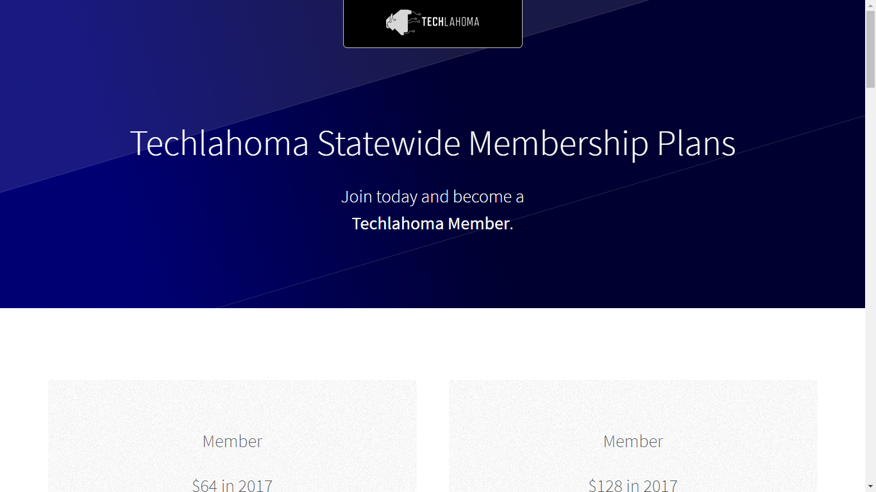
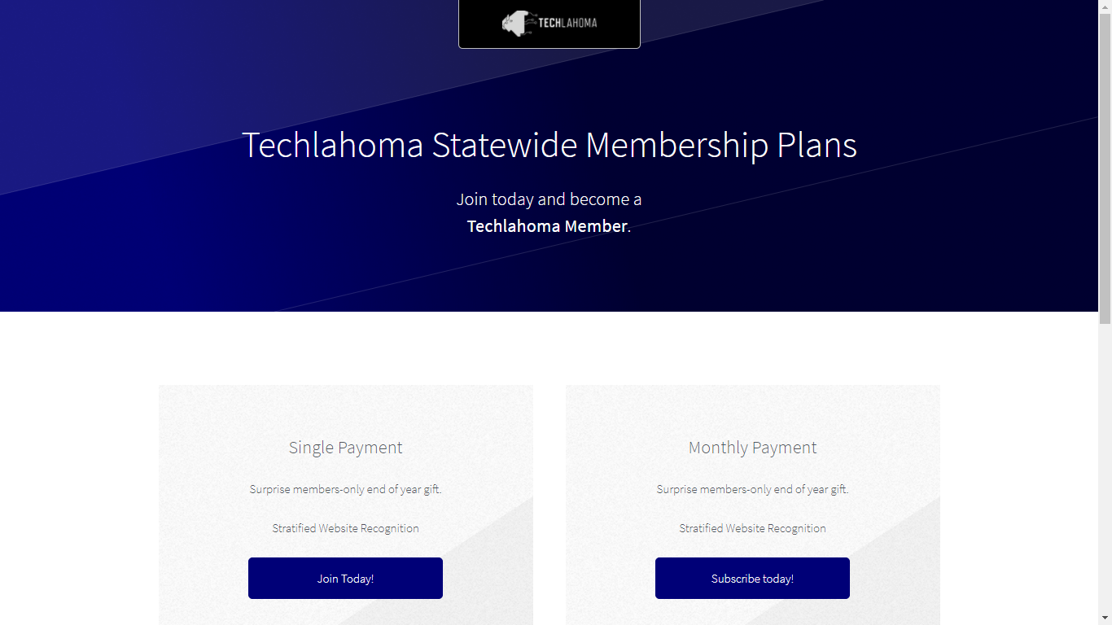

Slide 6
200OK.us
The annual 200OK conference is on May 18th.
Call for sponsors AND call for papers are open.
If your company wants to advertise at 200OK and support Techlahoma, go to 200ok.us and click Sponsors to get more information.

Slide 7
StarSpace46.com
Event Center is donated by StarSpace46.
If you like them and want them to stick around, get a $40 community membership.
www.starspace46.com/calendar-1

Slide 8
Twitch.tv/Techlahoma
Live streaming at StarSpace46
Subscribe with Amazon Prime
Techlahoma gets a small donation from Amazon

Slide 9
Slack
Channels for #design, #javascript, #jobs, and over 150 other topics!
www.techlahoma.org/spaces

Slide 10
Free Code Camp OKC
Sunday 2/4
2:00 - 3:00 pm
Intro to Angular with Maegan Womble
www.meetup.com/freecodecampokc

Slide 11
OKC#
Monday 2/5
11:30 - 12:30
Alexa SDK using Amazon and Azure with Gary Carr
www.meetup.com/OKC-Sharp

Slide 12
Techlahoma Hack Night
Tuesday 2/6
6:00 - 8:00 pm
Bring Your Own Project
meetup.com/techlahoma-foundation

Slide 13
OKC Ruby
Thursday 2/8
11:30 - 12:30
Topic to be Announced
www.meetup.com/okc-ruby

Slide 14
OKC LUGnuts
Friday 2/9
7:00 - 9:00 pm
Topic to be Announced
www.meetup.com/okc-lugnuts

Slide 15
OKC Open Source Hardware
Saturday 2/10
2:00 - 4:00 pm
Lightning Talks
www.meetup.com/okc-osh

Slide 16
Free Code Camp OKC
Sunday 2/11
2:00 - 3:00 pm
Intro to Angular Routing with Patrick Hartley
www.meetup.com/freecodecampokc

Slide 17
OKC Java
Tuesday 2/13
11:30 - 12:45
Topic to be Announced
www.meetup.com/okc-jug

Slide 18
OKC Python
Wednesday 2/14
11:30 - 12:30
Machine Learning with Scikit-Learn
www.meetup.com/okcpython

Slide 19
CocoaHeads OKC
Thursday 2/15
11:30 - 12:30
SiriKit with Tyler Jones
www.meetup.com/cocoaheads-okc

Slide 20
DevOps OKC
Friday 2/16
11:30 - 12:30
SaltStack with Floyd May
www.meetup.com/devopsokc

Slide 21
Free Code Camp OKC
Sunday 2/18
2:00 - 3:00 pm
Angular with Jeff Maxwell
www.meetup.com/freecodecampokc

Slide 22
OKC SQL
Monday 2/19
6:00 - 8:00 pm
Becoming a Public Speaker
www.meetup.com/okcsql

Slide 23
OKC JavaScript
Tuesday 2/20
11:30 - 12:30
Pong in Native JS with Aaron Krauss
and Babylon.js with Jesse Harlin
www.meetup.com/okc-js

Slide 24
OKC WordPress
Thursday 2/22
11:30 - 1:00
Website Tracking with Stephen Bell
www.meetup.com/okc-wordpress-users-group

Slide 25
Free Code Camp OKC
Sunday 2/25
1:00 - 2:00 pm
Lightning Talks
www.meetup.com/freecodecampokc

Slide 26
SheCodes OKC
Sunday 2/25
2:30 - 4:30 pm
Intro to SQL
www.meetup.com/shecodesokc

Slide 27
OKC Functional Programming
Tuesday 2/27
11:30 - 12:30
Topic to be Announced
www.meetup.com/okc-fp

Slide 28
Refresh OKC
Wednesday 2/28
11:30 - 12:30
A Study in User Experience with Luke Crouch
www.meetup.com/refresh-okc

Slide 29
Big Data and Data Science in OKC
Thursday 3/1
11:30 - 1:00
Apache NiFi
www.meetup.com/big-data-in-oklahoma-city

Slide 30
OK Game Developers
Thursday 3/1
7:00 - 8:00 pm
Topic to be Announced
www.meetup.com/oklahoma-game-developers

Slide 31
Free Code Camp OKC
Sunday 3/4
2:00 - 3:00 pm
Resume 101: Tips & Tricks with Tara Hadji
www.meetup.com/freecodecampokc

Slide 32
OKC#
Monday 3/5
11:30 - 12:30
Topic to be Announced
www.meetup.com/OKC-Sharp

Slide 33
OKC Analytics
Monday 3/5
6:30 - 8:00 pm
First Meeting
www.meetup.com/okc-analytics

