Slide 1
Wi-Fi:
Starspace 46 guest
Password:
Techlahoma

Slide 2
Thanks for joining us today!
We're here thanks to volunteers, speakers, and Techlahoma.

Slide 3
What is Techlahoma?
non-profit volunteer-run organization
hosts 33 groups and 2 conferences
sponsors free local events
supports the grassroots tech community of Oklahoma

Slide 4
Techlahoma.org
meetup.com/pro/Techlahoma
twitter.com/Techlahoma
donate.techlahoma.org/membership

Slide 5
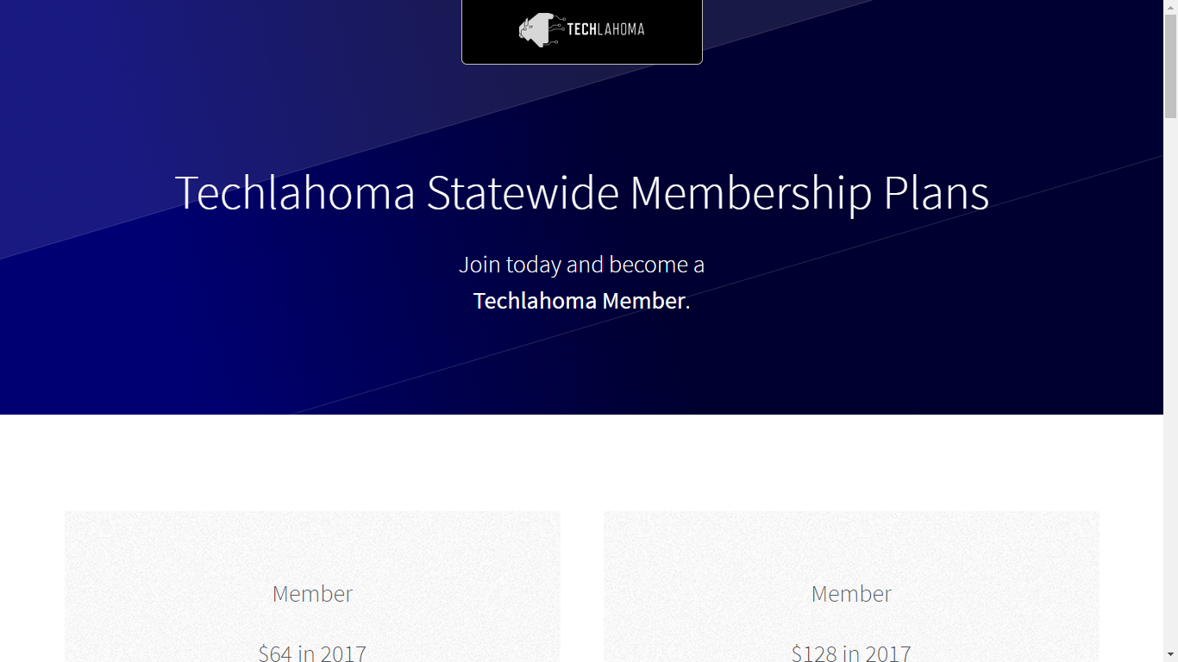
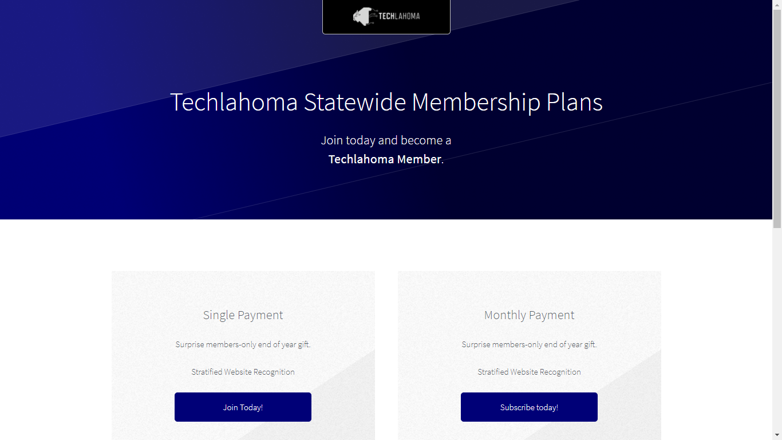

Slide 6
StarSpace46.com
starspace46.com/calendar-1
twitter.com/StarSpace46
Community membership $40/month

Slide 7
Twitch.tv/Techlahoma
Live streaming at StarSpace46
Subscribe with Amazon Prime
Techlahoma gets a small donation from Amazon

Slide 8
Slack
techlahoma.org/spaces
Channels for #devops, #jobs, and over 150 other topics!

Slide 9
Free Code Camp OKC
Sunday 1/21
2:00 - 3:00 pm
Intro to Single-Page Applications
www.meetup.com/freecodecampokc

Slide 10
WordPress OKC
Thursday 1/25
11:30 - 1:00
BackupBuddy Demo
www.meetup.com/OKC-WordPress-Users-Group

Slide 11
Free Code Camp OKC
Sunday 1/28
1:00 - 2:00 pm
Getting Started on a Project
www.meetup.com/freecodecampokc

Slide 12
SheCodes OKC
Sunday 1/28
2:30 - 4:30 pm
Lightning Talks
www.meetup.com/shecodesokc

Slide 13
OKC Functional Programming
Tuesday 1/30
11:30 - 12:30
Servant: A Type-level DSL for Web API Specification
www.meetup.com/OKC-FP

Slide 14
Refresh OKC
Wednesday 1/31
11:30 - 12:30
Tommy’s Talks
www.meetup.com/Refresh-OKC

Slide 15
Big Data in OKC
Thursday 2/1
11:30 - 1:00
Data Pipelines
meetup.com/big-data-in-oklahoma-city

Slide 16
OK Game Developers
Thursday 2/1
7:00 - 8:00 pm
Lightning Talks
meetup.com/oklahoma-game-developers

Slide 17
OKC#
Monday 2/5
11:30 - 12:30
Alexa SDK using Amazon and Azure
www.meetup.com/OKC-Sharp

Slide 18
Techlahoma Hack Night
Tuesday 2/6
6:00 - 8:00 pm
meetup.com/techlahoma-foundation

