Slide 1

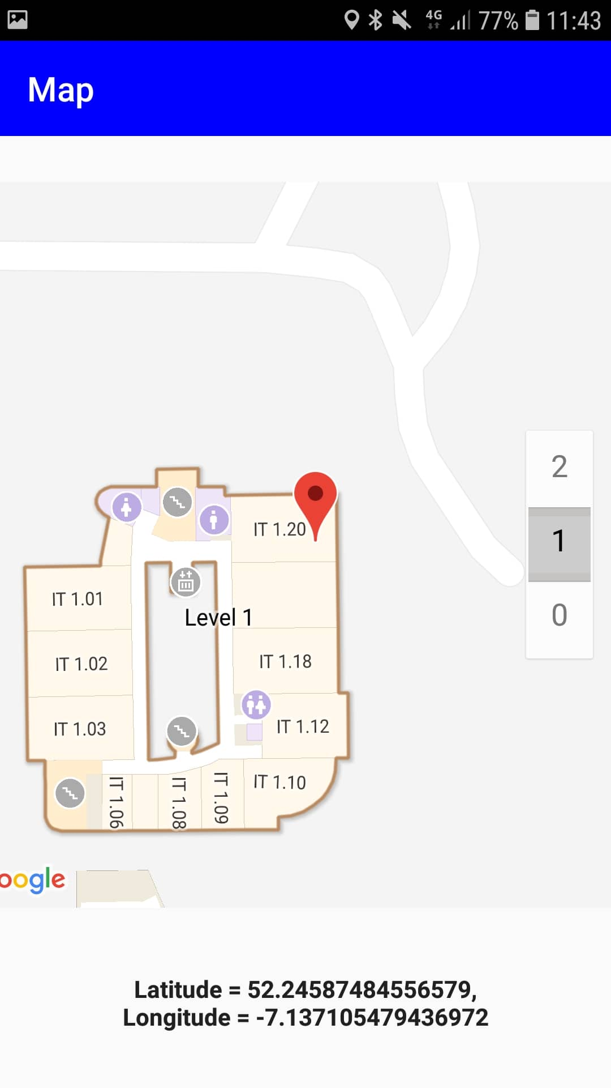
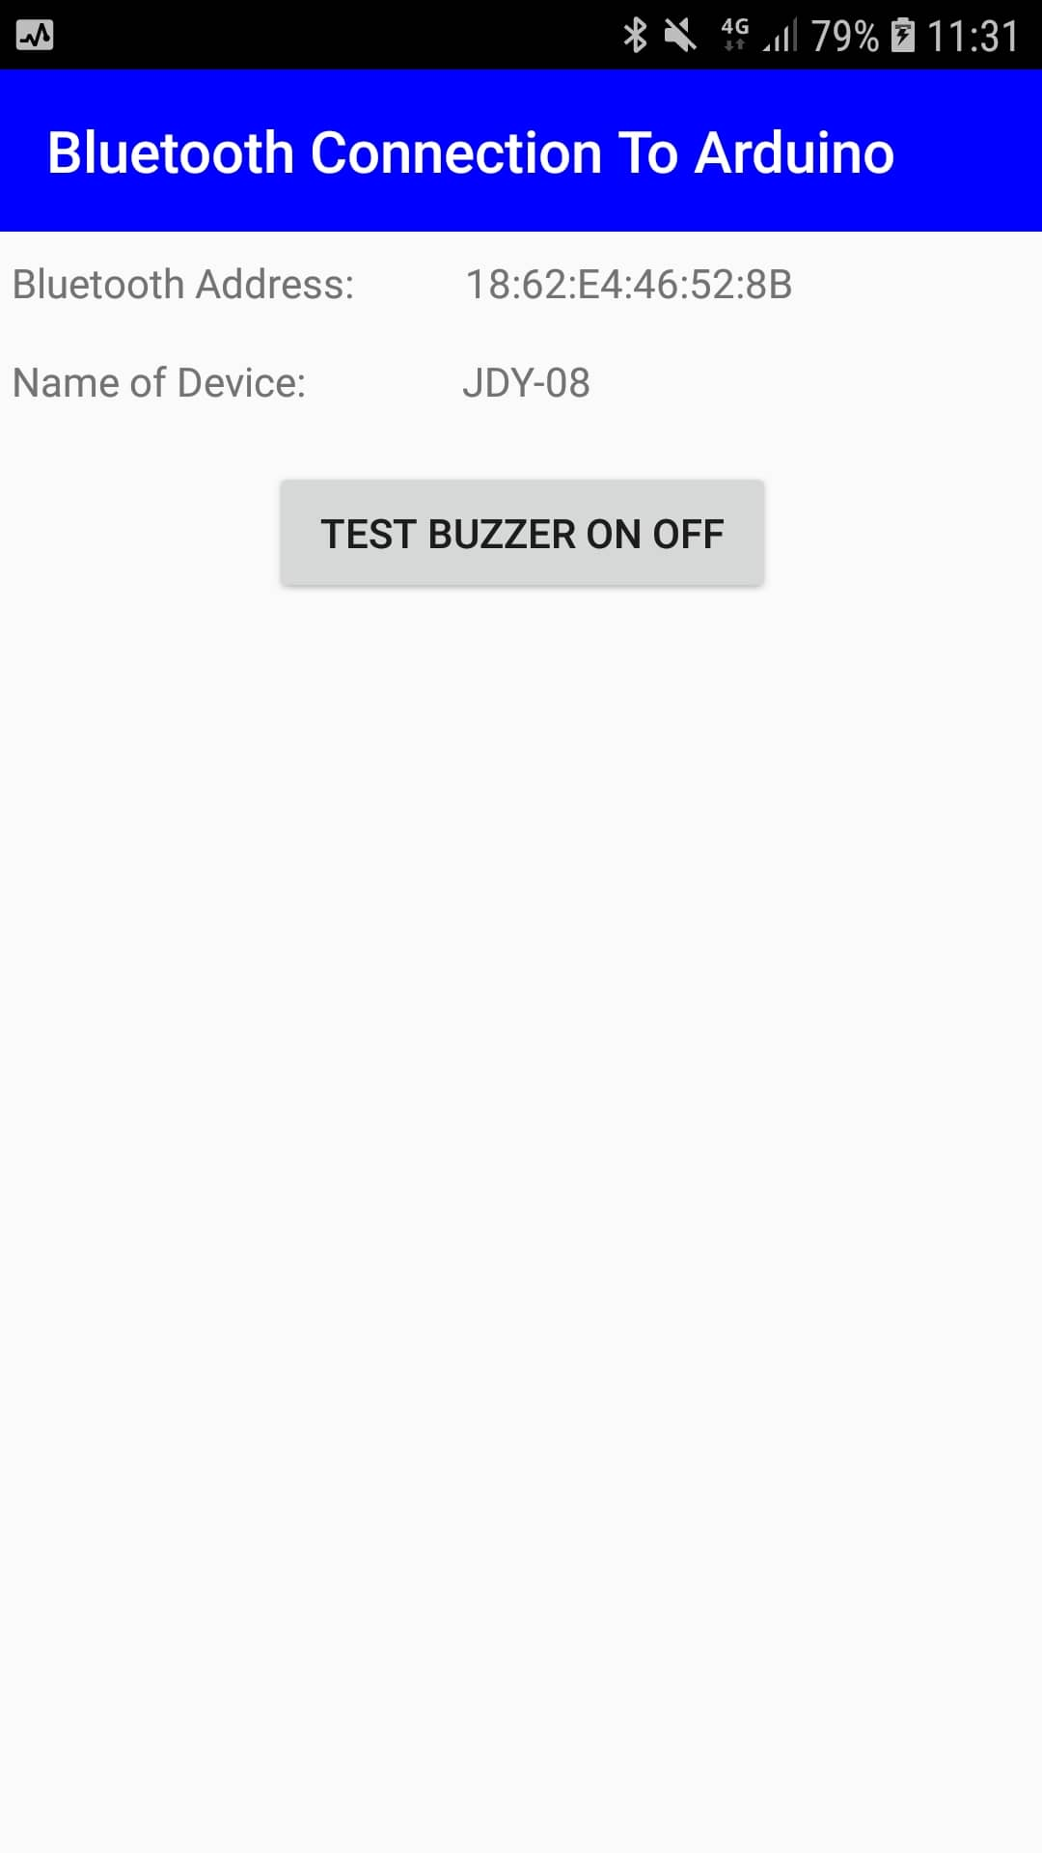
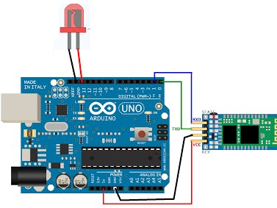
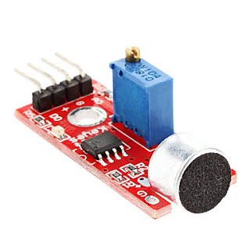
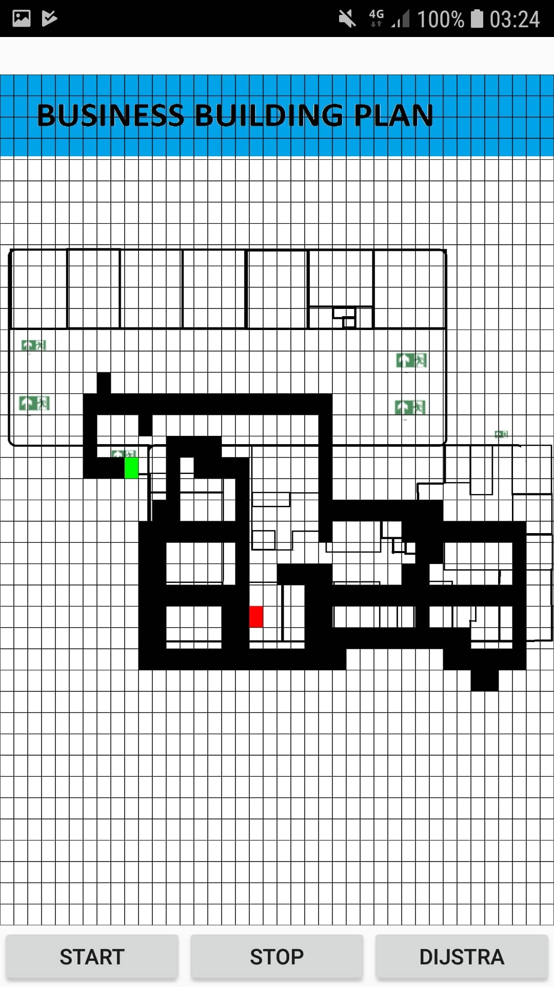
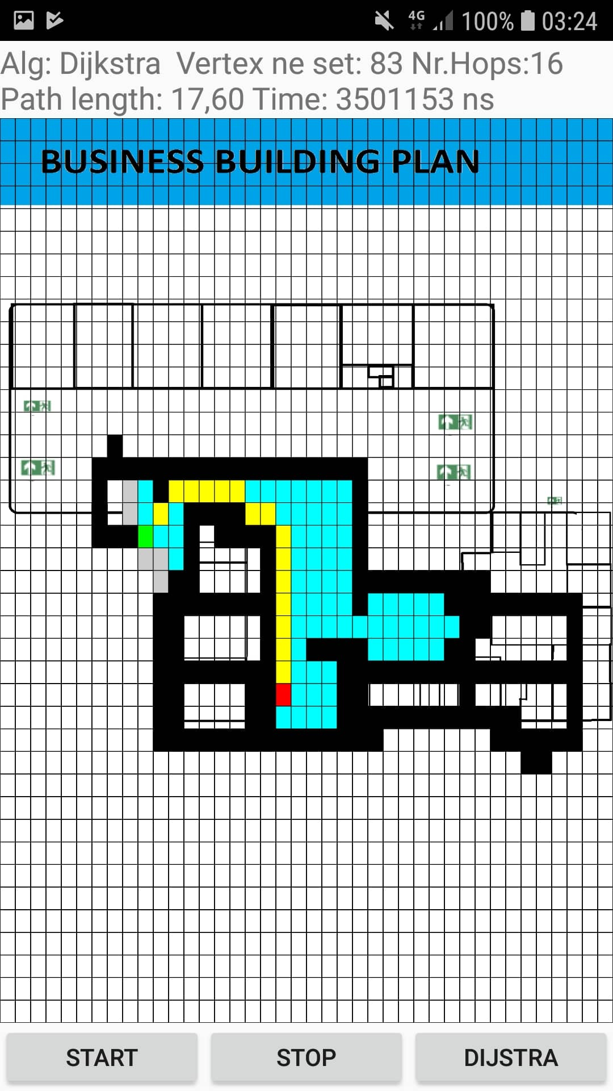







Emergency Escaper Application with Arduino
Kacper Woloszyn, BSc(Hons) in Applied Computing, Department of Computing and Mathematics, School of Science and Computing, WIT.
Introduction
In the project I use an Arduino, the Arduino is connected to my mobile application and I programmed a buzzer and sound sensor in Arduino.
The buzzer will sound, and an emergency exit route is displayed on the screen.
The application is for android, it has a database of users, stored in Firebase, and an algorithm is used to find the quickest route out of the building.
Dijstras algorithm is in the background.
Google API is used to display a map.
Overview
Things I learned
Dijstra’s Algorithm
Java Coding
XML Layouts
Firebase
Arduino -> Sound / Bluetooth
Google Maps API
No Route
Route Drawn
Use Cases
Getting Routes in Colleges, app for new people around
Routing Applications
Arduino Mobile Applications
Quickest way to a parking spot in a big Car Park
Alarm Is Received Through a Bluetooth Module and a Sound Sensor
Technologies Used

