Slide 1
Emergency exit application
Kacper Woloszyn semester 2 presentation

Slide 2

Intro
..

Slide 3
Algorithm for quickest route finding
Dijkstra’s algorithm
This algorithm begins with a start node and an "open set" of candidate nodes.
At each step, the node in the open set with the lowest distance from the start is examined.
The node is marked "closed", and all nodes adjacent to it are added to the open set if they have not already been examined.

Slide 4
Technology That I Have used
An Arduino board is connected to a mobile application through a Bluetooth module.
A buzzer and a sound sensor are connected to the application through Bluetooth.
A buzzer will be connected to the board, positive leg to positive pin, negative leg to ground. A tone command would be used to play the sound.
The application is for android, it has a firebase database of users.
Google Maps API is used to display the map with the current location of the user.
Used GIMP To develop my own graphics for the application

Slide 5
Problems and solutions
Bluetooth module has a very weak signal sometimes, as this is only a project, done only by me, if this was to be scalled up, a better connector would be obtained to maintain stability.
I had problems with google api keys, as I’ve created a number of projects previously and had to contact google to get more keys sent out to me.
Canvas and the way it uses bitmaps is not the way I want it. I.e. The user has a building plan, he has to draw over it as the bitmap is only a background image, and can’t be loaded back into canvas (as of 11/04). Limitations due to a small amount i.e. 0 libr aries to dispaly nodes in android.

Slide 6
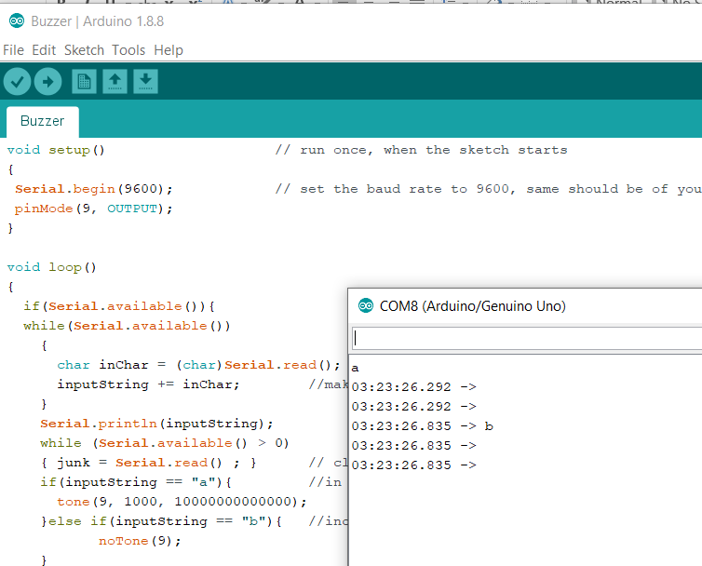
Future
..

Slide 7
Conclusions
..

