Slide 1

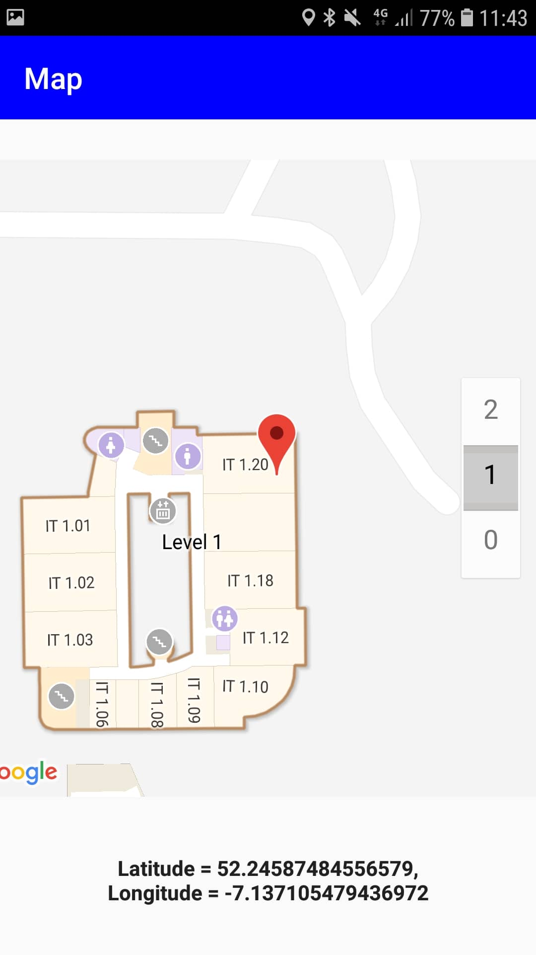
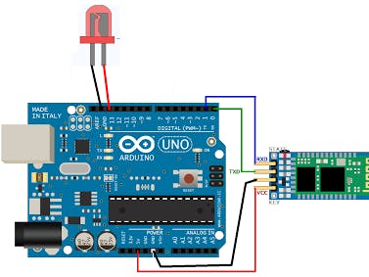
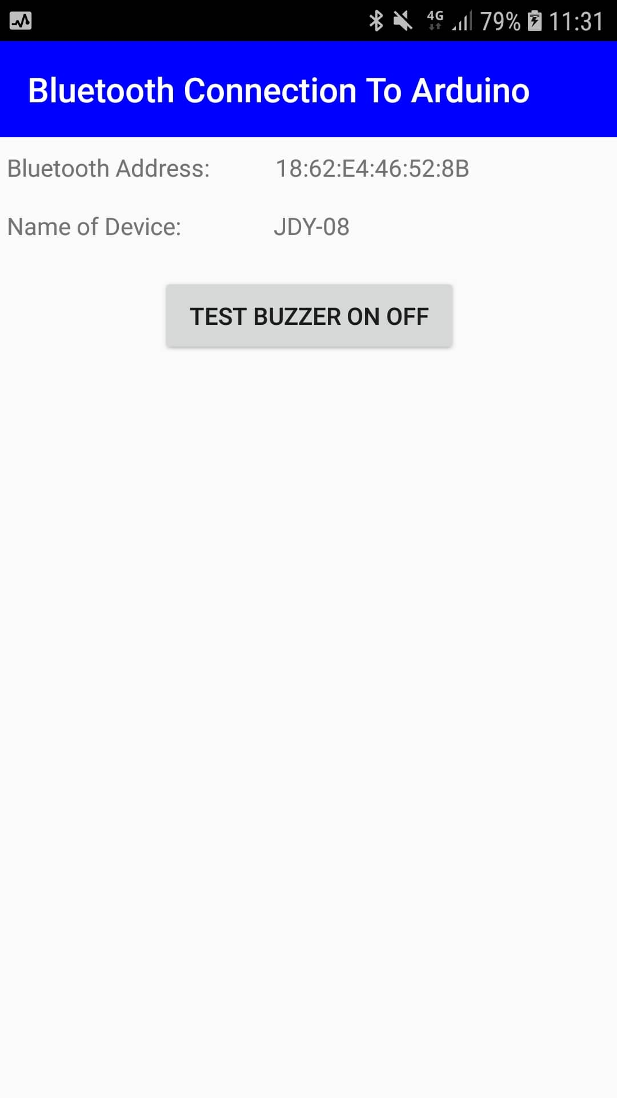
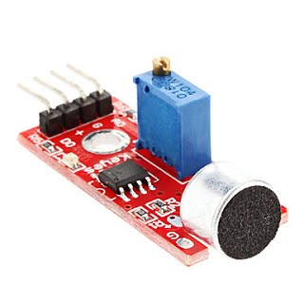

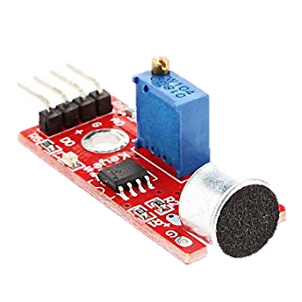
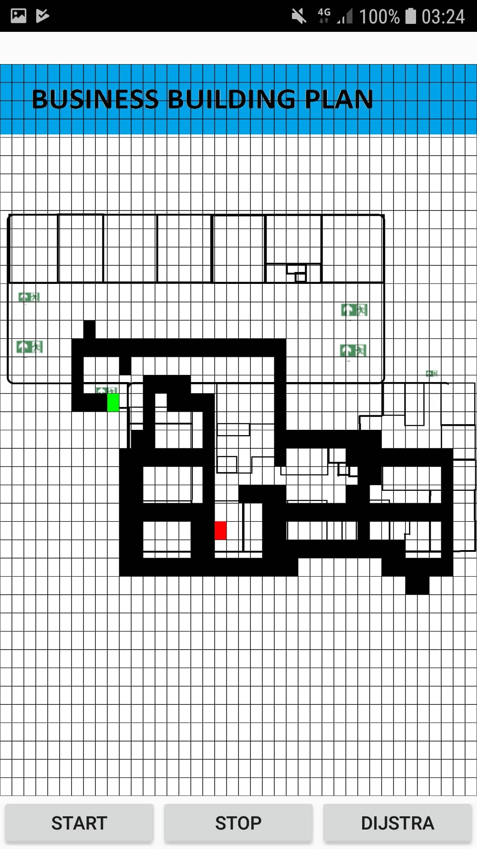
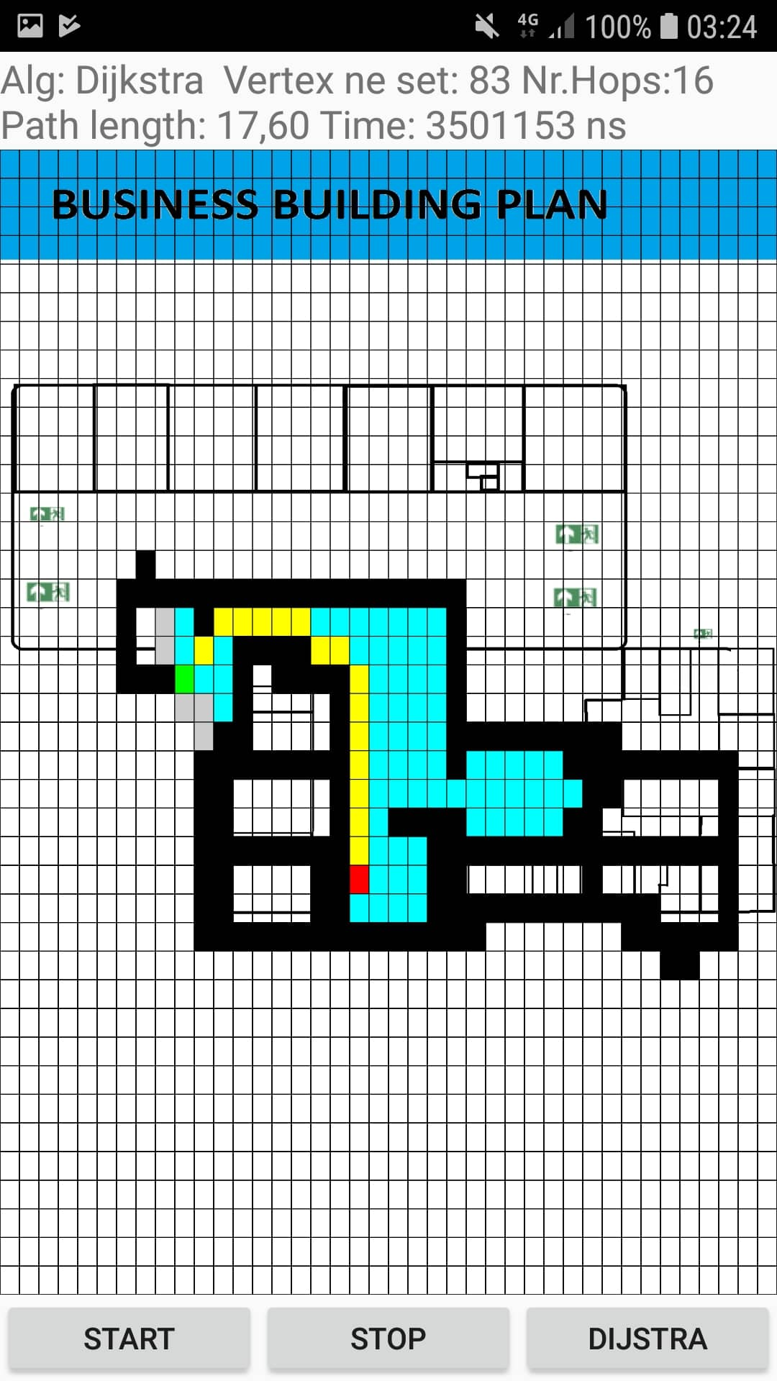







Emergency Escape Application with Arduino
Kacper Woloszyn, BSc(Hons) in Applied Computing, Department of Computing and Mathematics, School of Science and Computing, WIT.
Introduction
An Arduino board is connected to a mobile application, a buzzer and a sound sensor in Arduino.
The buzzer will sound, and an emergency exit route is displayed on the screen.
I use a custom view in Arduino called GridView to display the graphs of the escape route.
The application is for android, it has a firebase database of users. Dijstras algorithm is used to find the quickest route out of the building.
Google Maps API is used to display the map with current location.
Overview
Arduino Board
Bluetooth Arduino
Things I learned
Dijstra’s Algorithm
Java
XML
Firebase
Google Maps API
Using Arduino - Sound and Bluetooth module in C++
Location
Bluetooth
Google Maps Api gets the users live current location
Bluetooth Arduino Connection and buzzer test activity
No Route
Alarm from buzzer is received through a sound sensor and Bluetooth module.
Route Drawn
Possible Uses
Getting routes in college campus buildings, could be used for induction days
Routing Applications
Arduino Mobile Applications
Quickest way to a parking spot in a big Car Park
Emergency escapes at large events
No Route
The start node and
end node is chosen based on google maps location on the building plan
Dijstras Algorihm is used to calculate the quickest route between the start node and the end node with information displayed on the graph
Technologies Used

