Slide 1
The Training Plan
Developers: Oskar Grzenda & Kacper Grzenda
Supervisor: Martin Hynes

Slide 2

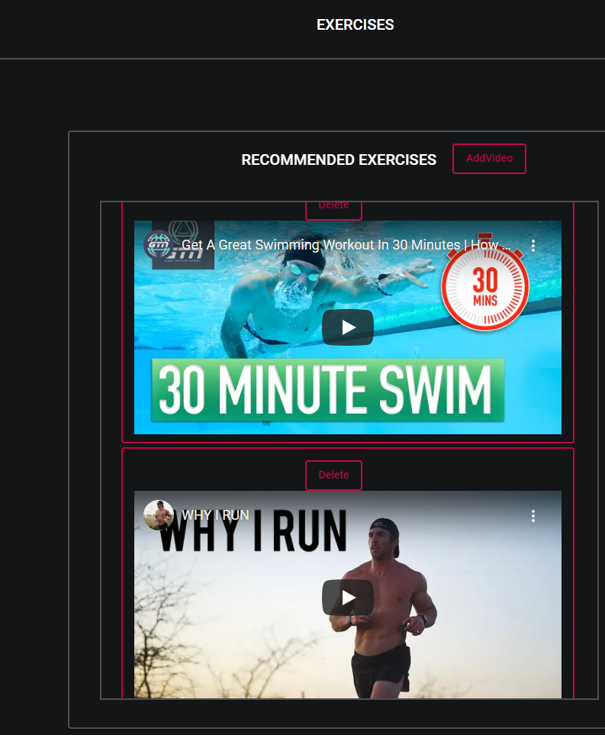
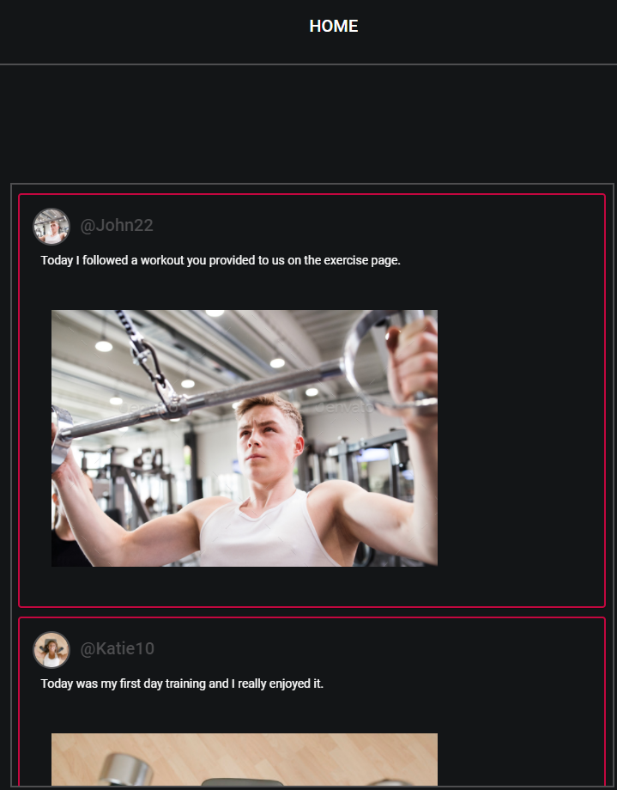
Aims & Objectives
To design a fitness website where an instructor can keep track of their clients progress and post assisting training videos.

Slide 3
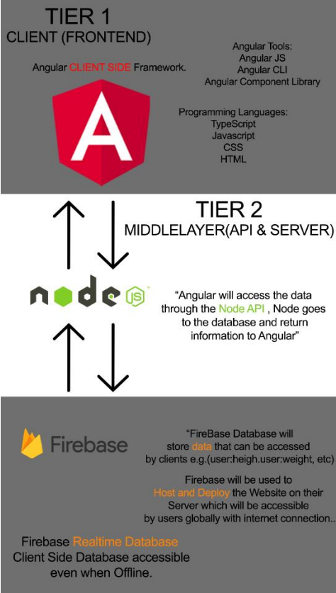
Architecture Of The Website
Project-Map
Front End: Angular
Middle Layer: Nodejs
Backend: Firebase Database

Slide 4
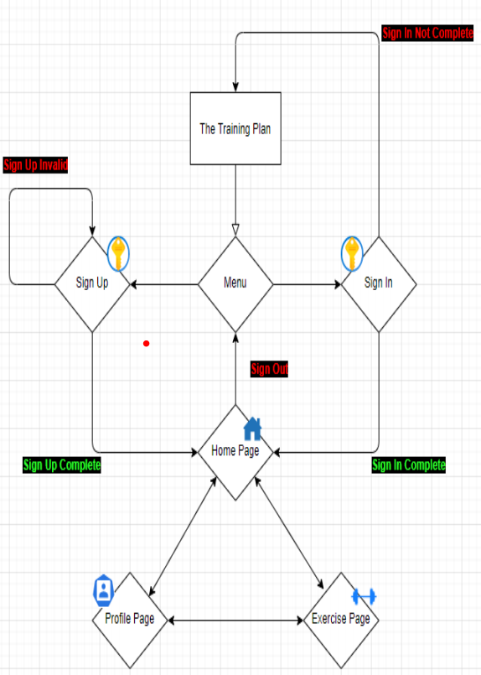
Architecture Of The Website
Web Layout of our website

Slide 5

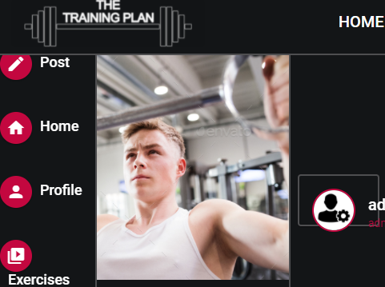
Problems Encountered
Planning and timing our work
Styling with CSS
Displaying Multiple videos on one page

Slide 6

Conclusions
We learned how important communication is when working as a team.
Also to do proper research of what tools you will be using for development.
We also learned it’s very important to stay consistent with the project.

