Slide 1
NYC Taxi Company
Summer 2022

Slide 2
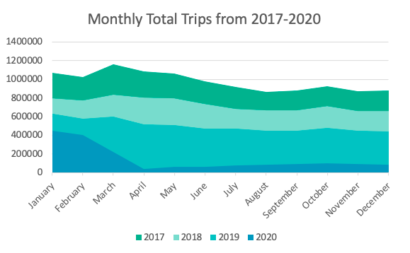
Highest number of trips in March every year
2020 declined in trip numbers due to COVID

Slide 3
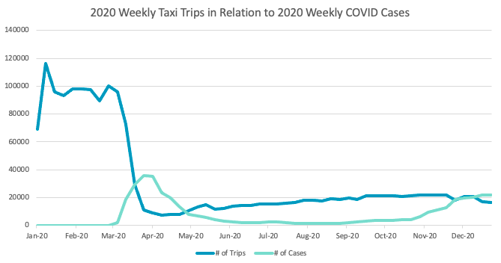
The Effects of COVID on Taxi Trips
Inverse relationship between COVID cases and Taxi Trips
Ridership declined 91% during initial COVID spike
Trips increased 58% as cases decreased

Slide 4
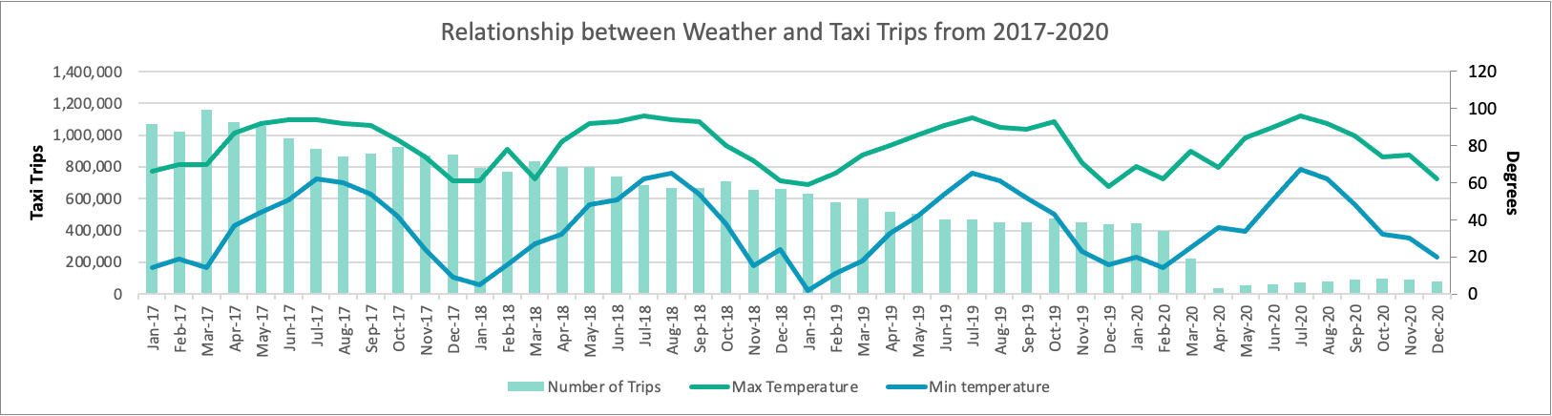
Factors influencing Taxi Companies

Slide 5
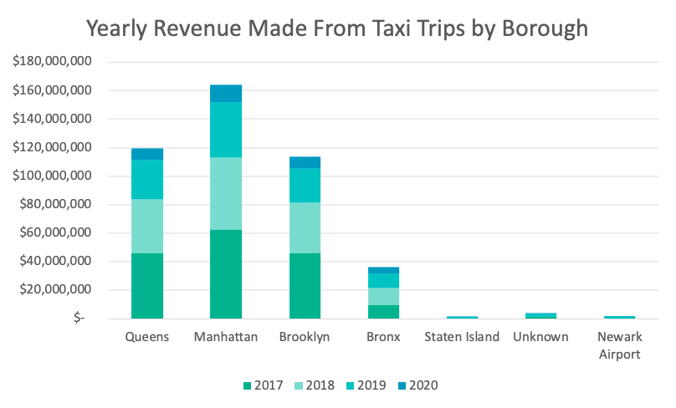
Popular Location: Manhattan and Queens
2020: Revenue decreased

Slide 6
Sources
https://www.weather.gov/
https://www.statista.com/statistics/1109711/coronavirus-cases-by-date-new-york-city/

