Slide 1
Self-introduction
Fu Ge CST1909133

Slide 2
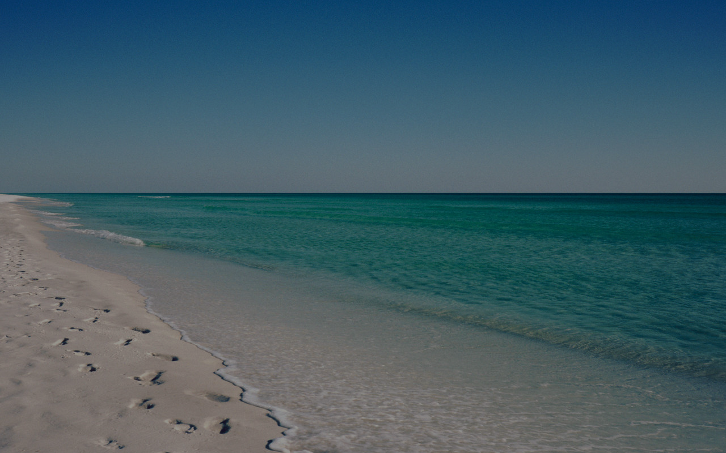
Hi everyone, This is Fu Ge. You can also call me by my English name, Kacy.
Nanyang, a vibrant and hospitable city in the center of China, is where I come from.
Now I come here with my great passion to pursue academic achievements as well as expand the boundary of life.
This Photo by Unknown Author is licensed under CC BY-NC-ND
This Photo by Unknown Author is licensed under CC BY-SA
Notes:
Brief introduction

Slide 3
I always enjoy reading and exercise a lot.
Besides, snorkeling and traveling are also fascinating for me. I don’t do them quite often but I try to make them a plan during every vacation.
I enjoy chatting with friends, particularly those friends between generations. Because they have various personal experience and can pass their wisdom through talking, which changelessly inspire me in my own life.
Notes:
Personal hobbies

Slide 4
Thanks for Watching☺

