Slide 1
Earthquake Prediction Model using Python
phase2 Project

Slide 2

Prepared by:
S.RAJALAKSHMI,
510521205031,
BHARATHIDASAN ENGINEERING COLLEGE,
PHASE2 PROJECT SUBMISSION.

Slide 3
INTRODUCTION

Slide 4
Earthquakes, among the most devastating natural disasters, strike with little warning, leaving communities vulnerable and in need of proactive measures. In the age of data science and machine learning, we embark on a journey to harness the power of technology for early earthquake prediction. This endeavor is not just about predicting tremors; it's about saving lives, protecting infrastructure, and fostering resilience. Welcome to the world of earthquake prediction, where data meets innovation, and where Python, with its formidable libraries and tools, serves as our guiding light. earthquake prediction is a highly specialized and challenging field, and more advanced techniques and domain-specific knowledge may be required for meaningful results. Additionally, ethical considerations and expert consultation are crucial when working on such critical and potentially life-saving applications.

Slide 5
ADVANCED TECHNIQUES

Slide 6
1. Understand the Earthquake Phenomenon: Dive into the science behind earthquakes, exploring their causes, patterns, and the seismic data that holds valuable clues. 2. Model Development: Construct a machine learning model using Python that has the potential to forecast earthquake events. But we won't stop at the basics; we will consider advanced techniques that set this project apart.

Slide 7
3. Advanced Techniques for Model Enhancement: Delve into the realms of “hyperparameter tuning” to fine-tune our model's parameters, optimizing its predictive accuracy. Then, we'll explore the art of “feature engineering”, shaping our data into informative representations that empower the model to make more precise predictions.

Slide 8
DEFINITION

Slide 9
hyperparameter tuning: When you’re training machine learning models, each dataset and model needs a different set of hyperparameters, which are a kind of variable. The only way to determine these is through multiple experiments, where you pick a set of hyperparameters and run them through your model. This is called hyperparameter tuning. In essence, you're training your model sequentially with different sets of hyperparameters. This process can be manual, or you can pick one of several automated hyperparameter tuning methods. Whichever method you use, you need to track the results of your experiments. You’ll have to apply some form of statistical analysis, such as the loss function, to determine which set of hyperparameters gives the best result. Hyperparameter tuning is an important and computationally intensive process.

Slide 10
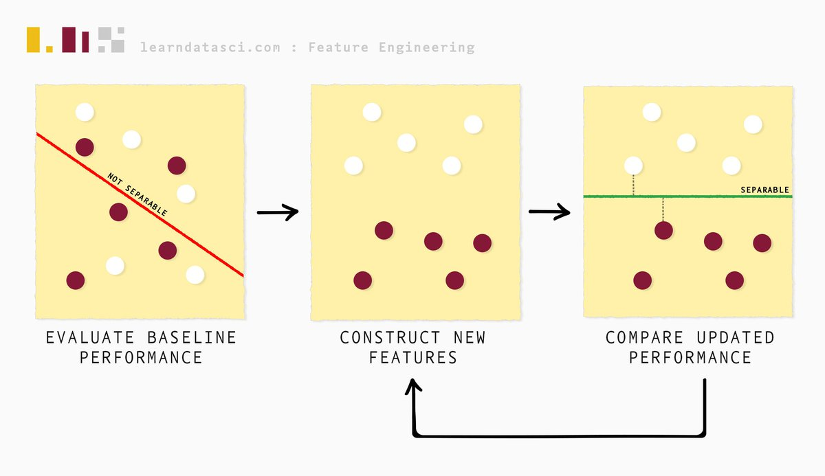
feature engineering: Feature Engineering is the process of transforming data to increase the predictive performance of machine learning models.

Slide 11
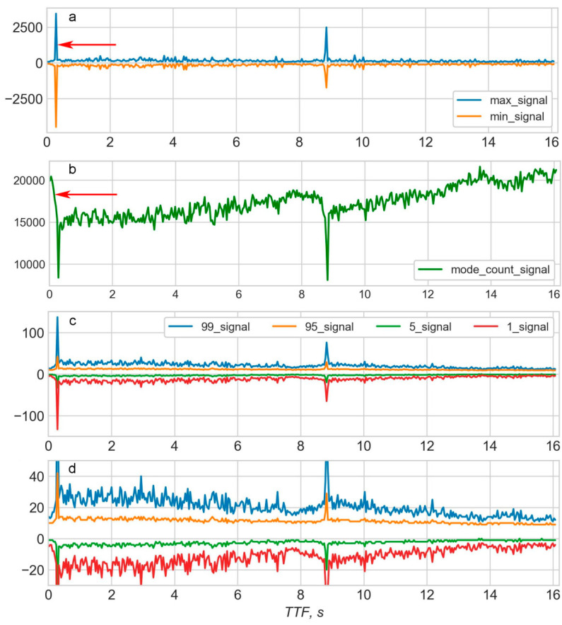
FEATURE ENGINEERING STEPS

Slide 12
1. Data Collection: Obtain historical earthquake data from reliable sources, such as the United States Geological Survey (USGS) or other relevant organizations. This data should include earthquake magnitudes, locations, depths, and timestamps. 2. Data Preprocessing: Clean and preprocess the data to remove any missing values or outliers. You may also need to convert timestamp data into a format suitable for analysis. 3. Feature Engineering: Spatial Features: Calculate distance or proximity to known fault lines, tectonic plate boundaries, or other geological features that may be correlated with earthquake occurrence. Temporal Features: Extract temporal information, such as the time of day, day of the week, or month, which may reveal patterns in earthquake occurrence. Historical Features: Create lag features, such as earthquake occurrences in the past, to capture temporal dependencies. Statistical Features: Compute statistics (mean, standard deviation, etc.) for earthquake magnitudes and depths within specific time windows or regions. - **External Dat or satellite imagery, if they may have an impact on earthquake prediction

Slide 13
Geospatial Features: Utilize geographic information system (GIS) data to include features like elevation, soil type, or land use, which can affect seismic activity. External Data: Incorporate external data sources, such as weather data or satellite imagery, if they may have an impact on earthquake prediction. 4. Data Splitting: Split the dataset into training, validation, and test sets. Typically, you'll use a larger portion for training and smaller portions for validation and testing. 5. Model Selection: Choose an appropriate machine learning or statistical model for earthquake prediction. Common choices include decision trees, random forests, support vector machines, or deep learning models like neural networks. 6. Model Training: Train your selected model on the training data using the engineered features 7. Hyperparameter Tuning: Optimize the hyperparameters of your model using techniques like grid search or random search to improve its performance

Slide 14
8. Model Evaluation: Evaluate your model's performance on the validation set using appropriate evaluation metrics, such as mean squared error (MSE), mean absolute error (MAE), or area under the ROC curve (AUC), depending on the nature of the prediction problem (regression or classification). 9. Testing: Assess the model's performance on the test set to get an unbiased estimate of its predictive power. 10. Deployment: If your model performs satisfactorily, you can deploy it for real-time or near-real-time earthquake prediction. However, note that earthquake prediction is a challenging problem, and even the best models may have limited accuracy. 11. Monitoring and Maintenance: Continuously monitor and update your model as new earthquake data becomes available to ensure its accuracy and reliability.

Slide 15
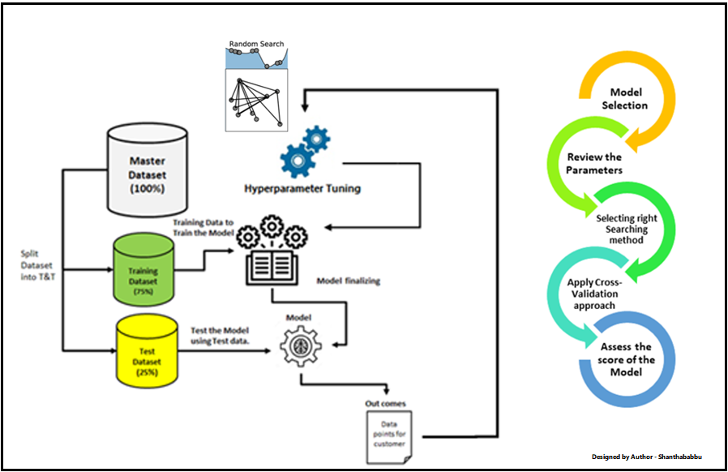
HYPERPARAMETER TUNING STEPS

Slide 16
1. Import Libraries and Prepare Data: *Import the necessary libraries, such as scikit-learn and any other libraries required for your specific model. *Preprocess your earthquake dataset, including feature engineering, data cleaning, and splitting the data into training and validation sets. 2. Choose a Model: *Select the machine learning model you want to use for earthquake prediction. Common choices include Decision Trees, Random Forest, Support Vector Machines (SVM), Gradient Boosting, or Neural Networks. 3. Define the Hyperparameter Grid: *Create a dictionary or a parameter grid that specifies the hyperparameters you want to tune and their respective ranges. For example, you can define values for 'max_depth', 'learning_rate', 'n_estimators', etc. Include a reasonable range of values to explore.

Slide 17
4. Split the Data for Cross-Validation: * Implement k-fold cross-validation. Split your training data into multiple subsets (folds), typically using a value like k=5 or k=10. This allows you to assess your model's performance more robustly. 5. Hyperparameter Search: * Use a hyperparameter tuning technique like Grid Search or Random Search to explore different combinations of hyperparameters. Here's how to do it using scikit-learn's GridSearchCV: ```python from sklearn.model_selection import GridSearchCV # Create your model (e.g., DecisionTreeRegressor) model = DecisionTreeRegressor()

Slide 18
# Define the hyperparameter grid param_grid = { 'max_depth': [None, 10, 20, 30], 'min_samples_split': [2, 5, 10], 'min_samples_leaf': [1, 2, 4] } # Create GridSearchCV instance grid_search = GridSearchCV(estimator=model, param_grid=param_grid, scoring='neg_mean_squared_error', cv=5) # Fit the model with different hyperparameter combinations grid_search.fit(X_train, y_train) # Get the best hyperparameters best_params = grid_search.best_params_ ```

Slide 19
6. Evaluate Performance: *After hyperparameter tuning, evaluate the model's performance on the validation set using appropriate evaluation metrics (e.g., Mean Absolute Error, Mean Squared Error). 7. Retrain the Model: *Once you've found the best hyperparameters, retrain your model using the entire training dataset (including the validation data if desired) with these optimal hyperparameters. 8. Final Evaluation: * Assess the model's performance on a separate test dataset to ensure it generalizes well to new, unseen data. 9. Deploy and Monitor: *If the model meets your performance criteria, deploy it in a production or research environment. Continuously monitor its performance and retrain as necessary with new data.

Slide 20
SAMPLE PROGRAM: import numpy as np import pandas as pd import matplotlib.pyplot as plt import os print(os.listdir("../input")) data = pd.read_csv("../input/database.csv") data.head() data = data[['Date', 'Time', 'Latitude', 'Longitude', 'Depth', 'Magnitude']] data.head()

Slide 21
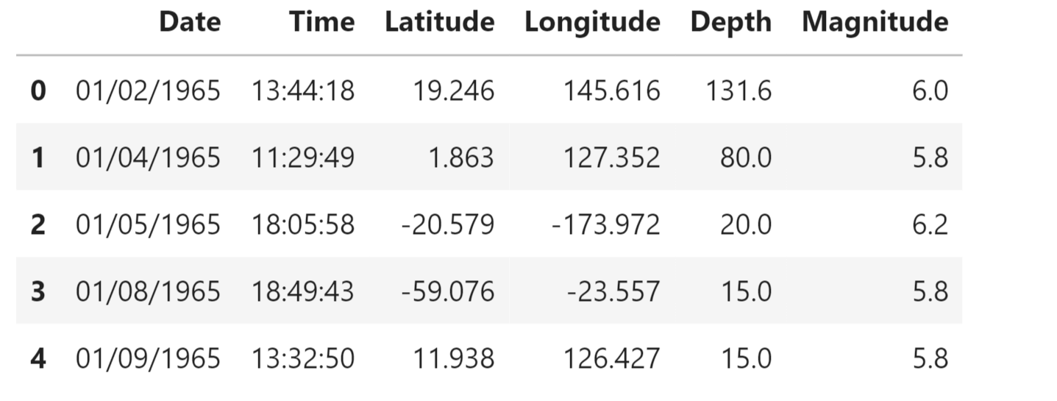
Output:
Output:

Slide 22

CONCLUSION

Slide 23
This project is not just about code and algorithms; it's about a commitment to understanding, mitigating, and ultimately preparing for one of nature's most formidable forces. Together, we will unlock the potential of data science to save lives and build a more resilient world. Join us as we embark on this journey at the intersection of science, technology, and humanity, where innovation and compassion converge to protect our communities from the unpredictable power of earthquakes

Slide 24
Thanks!

