Slide 1

EARTHQUAKE PREDICTION MODEL USING PYTHON
PHASE4 PROJECT

Slide 2
PREPARED BY
S.RAJALAKSHMI,
510521205031,
BHARATHIDASAN ENGINEERING COLLEGE,
PHASE4 PROJECT SUBMISSION.

Slide 3

INTRODUCTION

Slide 4
Earthquake prediction using advanced techniques is a vital area of research aimed at mitigating the devastating impact of seismic events on human lives and infrastructure. Traditional earthquake prediction methods have often been limited in their accuracy and reliability. However, recent advancements in seismology, geodesy, and data analytics have opened up new avenues for more precise earthquake forecasting. In this discussion, we will explore the cutting-edge technologies and methodologies that are revolutionizing earthquake prediction, offering hope for better preparedness and risk reduction in earthquake-prone regions.

Slide 5
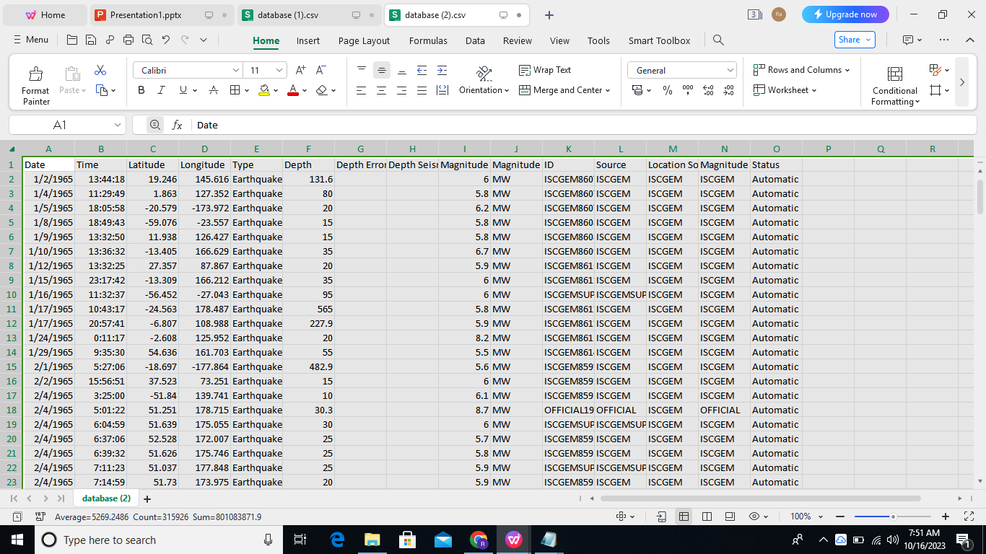
DATASET

Slide 6
OVERVIEW

Slide 7
FEATURE
ENGINEERING
MODEL
TRAINING
EVALUATION

Slide 8
FEATURE ENGINEERING:
Feature engineering in earthquake prediction involves selecting, creating, or transforming relevant attributes or characteristics (features) from raw data that can improve the accuracy of earthquake prediction models. These features might include seismic data, geological information, historical earthquake records, and various other parameters. The goal is to extract meaningful patterns and relationships that enable machine learning models to better predict when and where earthquakes might occur.

Slide 9
MODEL TRAINING:
Model training in earthquake prediction refers to the process of using historical earthquake data, as well as relevant features and attributes, to teach a machine learning or statistical model how to make predictions about future seismic events. During training, the model learns the patterns and relationships within the data, adjusting its internal parameters to minimize prediction errors. Once the model is trained, it can be used to make forecasts and predictions about the likelihood, location, and magnitude of future earthquakes based on new, unseen data. This training process is a crucial step in developing accurate earthquake prediction models.

Slide 10
EVALUATION:
Evaluation in earthquake prediction involves assessing the performance and accuracy of a prediction model to determine how well it can forecast seismic events. This typically includes measuring the model's ability to correctly predict earthquakes in terms of their timing, location, and magnitude. Common evaluation metrics in earthquake prediction might include precision, recall, F1 score, and mean squared error. The goal of evaluation is to gauge the model's reliability and effectiveness, helping researchers and authorities understand its strengths and limitations in providing early warnings or forecasts of earthquakes.

Slide 11
STEPS FOR FEATURE ENGINEERING
1.Data Collection 8.Model Building andTraining
2.Data Preprocessing 9.Model Evaluation
3.Feature Selection 10.Iterative Refinement
4.Feature Extraction 11.Validation and Cross-Validation
5.Feature Engineering 12.Hyperparameter Tuning
6.Dimensionality Reduction 13.Final Model Selection
7.Data Splitting

Slide 12
STEPS FOR MODEL TRAINING
1.Data Preprocessing 8.Model Evaluation
2.Select a Model 9.Hyperparameter Tuning
3.Hyperparameter Selection 10.Final Model Selection
4.Feature Scaling and Normalization 11.Testing
5.Model Training 12.Deployment
6.Cross-Validation 13.Monitoring and Maintenance
7.Performance Metrics

Slide 13
STEPS FOR EVALUATION
1.Test Data Selection 8.Cross-Validation
2.Model Prediction 9.Threshold Tuning
3.Performance Metrics 10.Compare to Baselines
4.Evaluate Location and Magnitude 11.Report Results
5.Evalute Timing 12.Decision-Making
6.Visual Inspection 13.Iterative Refinement
7.Analyze False Positives and False 14.Deployment Decision
Negatives

Slide 14
PROGRAM

Slide 15
Importing Libraries:
import numpy as np
import pandas as pd
import matplotlib.pyplot as plt
import os
print(os.listdir("../input"))
OUTPUT:

Slide 16
Read the Dataset:
import datetime
import time
timestamp = []
for d, t in zip(data['Date'], data['Time']):
try:
ts = datetime.datetime.strptime(d+' '+t, '%m/%d/%Y %H:%M:%S')
timestamp.append(time.mktime(ts.timetuple()))
except ValueError:
# print('ValueError')
timestamp.append('ValueError')
timeStamp = pd.Series(timestamp)
data['Timestamp'] = timeStamp.values
final_data = data.drop(['Date', 'Time'], axis=1)
final_data = final_data[final_data.Timestamp != 'ValueError']
final_data.head()

Slide 17
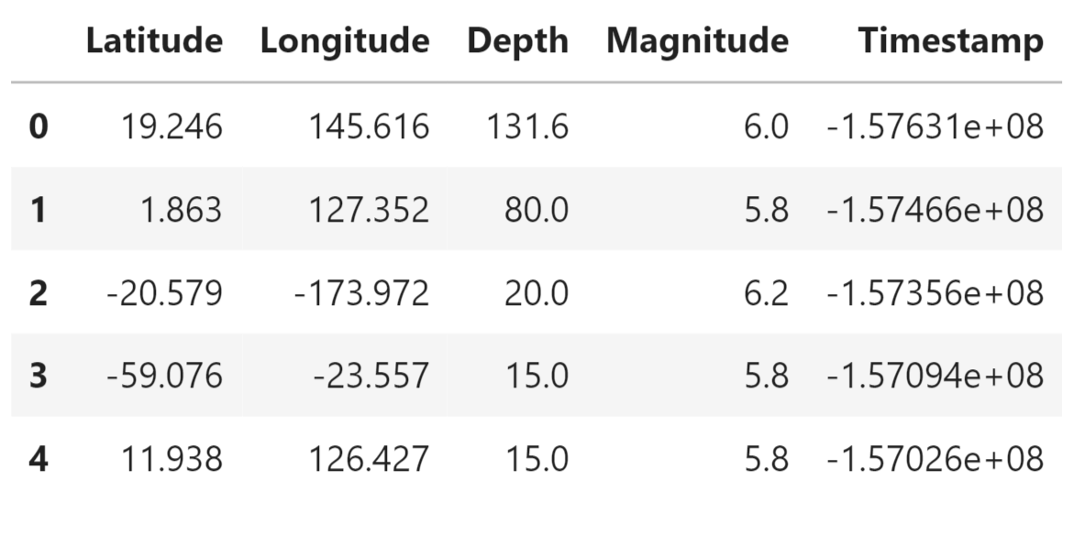

Slide 18
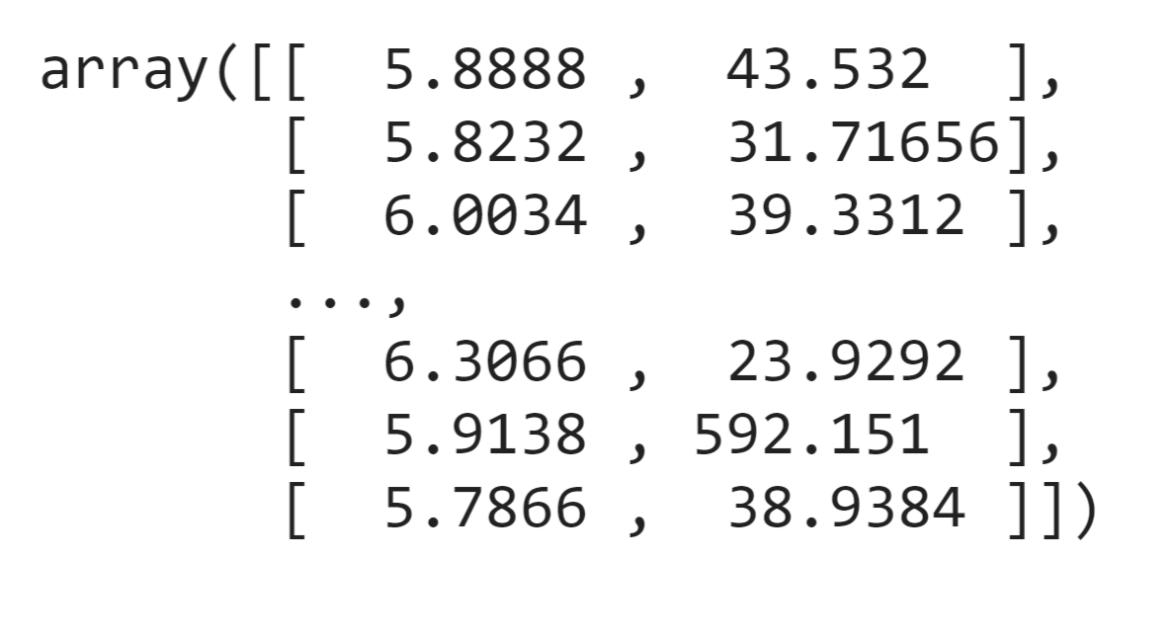
Splitting The Dataset:
from sklearn.model_selection import GridSearchCV
parameters = {'n_estimators':[10, 20, 50, 100, 200, 500]}
grid_obj = GridSearchCV(reg, parameters)
grid_fit = grid_obj.fit(X_train, y_train)
best_fit = grid_fit.best_estimator_
best_fit.predict(X_test)
OUTPUT:

Slide 19
Neural Network Model:
from keras.models import Sequential
from keras.layers import Dense
def create_model(neurons, activation, optimizer, loss):
model = Sequential()
model.add(Dense(neurons, activation=activation, input_shape=(3,)))
model.add(Dense(neurons, activation=activation))
model.add(Dense(2, activation='softmax'))
model.compile(optimizer=optimizer, loss=loss, metrics=['accuracy'])
return model
from keras.wrappers.scikit_learn import KerasClassifier
model = KerasClassifier(build_fn=create_model, verbose=0)
# neurons = [16, 64, 128, 256]
neurons = [16]
# batch_size = [10, 20, 50, 100]
batch_size = [10]
epochs = [10]
# activation = ['relu', 'tanh', 'sigmoid', 'hard_sigmoid', 'linear', 'exponential']
activation = ['sigmoid', 'relu']

Slide 20
# optimizer = ['SGD', 'RMSprop', 'Adagrad', 'Adadelta', 'Adam', 'Adamax', 'Nadam']
optimizer = ['SGD', 'Adadelta']
loss = ['squared_hinge']
param_grid = dict(neurons=neurons, batch_size=batch_size, epochs=epochs, activation=activation, optimizer=optimizer, loss=loss)
grid = GridSearchCV(estimator=model, param_grid=param_grid, n_jobs=-1)
grid_result = grid.fit(X_train, y_train)
print("Best: %f using %s" % (grid_result.best_score_, grid_result.best_params_))
means = grid_result.cv_results_['mean_test_score']
stds = grid_result.cv_results_['std_test_score']
params = grid_result.cv_results_['params']
for mean, stdev, param in zip(means, stds, params):
print("%f (%f) with: %r" % (mean, stdev, param))

Slide 21
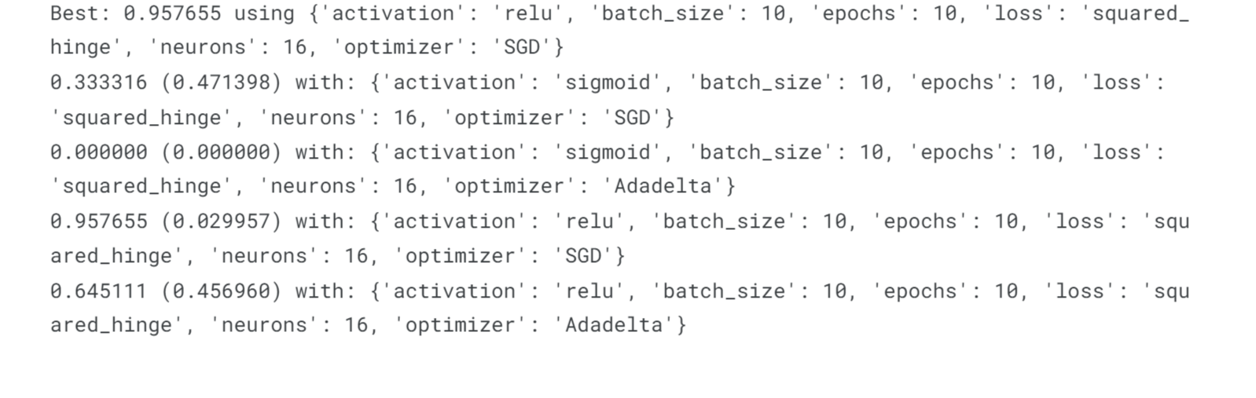
OUTPUT:

Slide 22
Visualization:
from mpl_toolkits.basemap import Basemap
m = Basemap(projection='mill',llcrnrlat=-80,urcrnrlat=80, llcrnrlon=-180,urcrnrlon=180,lat_ts=20,resolution='c')
longitudes = data["Longitude"].tolist()
latitudes = data["Latitude"].tolist()
#m = Basemap(width=12000000,height=9000000,projection='lcc',
#resolution=None,lat_1=80.,lat_2=55,lat_0=80,lon_0=-107.)
x,y = m(longitudes,latitudes)
fig = plt.figure(figsize=(12,10))
plt.title("All affected areas")
m.plot(x, y, "o", markersize = 2, color = 'blue')
m.drawcoastlines()
m.fillcontinents(color='coral',lake_color='aqua')
m.drawmapboundary()
m.drawcountries()
plt.show()

Slide 23
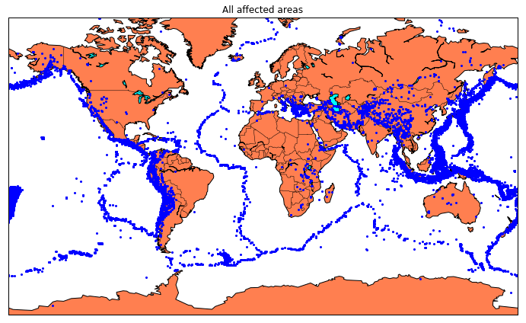

Slide 24
CONCLUSION

Slide 25
Understanding earthquakes and effectively responding to them remains a complex and challenging task, even with the latest technological advancements. However, leveraging the capabilities of machine learning can greatly enhance our comprehension of seismic events. By employing machine learning techniques to analyze seismic data, we can uncover valuable insights and patterns that contribute to a deeper understanding of earthquakes. These insights can subsequently inform more effective strategies for mitigating risks and responding to seismic events.
In summary, an earthquake prediction project is a critical undertaking that holds the potential to mitigate the devastating effects of earthquakes. While the pursuit of precise prediction remains challenging, the project's efforts contribute to a growing body of knowledge and technology aimed at enhancing our understanding and preparedness for these natural disasters. The project's conclusion marks not the end but a milestone in a continuous journey toward more effective earthquake prediction and risk reduction.

Slide 26
Thank you so much for your watching

