Slide 1
Earthquake Prediction Model using Python
phase1 Project

Slide 2

Prepared by:
S.RAJALAKSHMI,
510521205031,
BHARATHIDASAN ENGINEERING COLLEGE,
PHASE1 PROJECT SUBMISSION.

Slide 3
INTRODUCTION

Slide 4
The Science of Earthquake Prediction
Earthquake prediction is a complex field that involves analyzing seismic data to identify patterns and trends.
Scientists use a variety of techniques, including statistical analysis and machine learning, to forecast earthquakes.
The accuracy of these predictions depends on the quality and quantity of data available.

Slide 5
OBJECTIVES

Slide 6
The Role of Python in Earthquake Forecasting
Python is a popular programming language for data analysis and visualization.
It provides a wide range of tools and libraries that can be used to process and analyze seismic data.
Python can also be used to develop machine learning models for earthquake prediction.

Slide 7
DEFINITION

Slide 8
Earthquake, any sudden shaking of the ground caused by the passage of seismic waves through Earth’s rocks. Seismic waves are produced when some form of energy stored in Earth’s crust is suddenly released, usually when masses of rock straining against one another suddenly fracture and “slip.” Earthquakes occur most often along geologic faults, narrow zones where rock masses move in relation to one another. The major fault lines of the world are located at the fringes of the huge tectonic plates that make up Earth’s crust.

Slide 9
ABSTRACT

Slide 10
This earthquake prediction model using Python represents a significant step towards enhancing our ability to anticipate seismic events, ultimately contributing to improved public safety and disaster management. The project showcases the power of data-driven approaches and open-source programming languages in addressing complex real-world challenges.

Slide 11
DATA SOURCE

Slide 12
Date | Time | Latitude | Longitude | Type | Depth | Depth Error | Depth Seismic Stations | Magnitude | Magnitude Type | Magnitude Error | Magnitude Seismic Stations | Azimuthal Gap | Horizontal Distance | Horizontal Error | Root Mean Square | ID | Source | Location Source | Magnitude Source | Status
1/2/1965 | 13:44:18 | 19.246 | 145.616 | Earthquake | 131.6 |  |  | 6 | MW |  |  |  |  |  |  | ISCGEM860706 | ISCGEM | ISCGEM | ISCGEM | Automatic
1/4/1965 | 11:29:49 | 1.863 | 127.352 | Earthquake | 80 |  |  | 5.8 | MW |  |  |  |  |  |  | ISCGEM860737 | ISCGEM | ISCGEM | ISCGEM | Automatic
1/5/1965 | 18:05:58 | -20.579 | -173.972 | Earthquake | 20 |  |  | 6.2 | MW |  |  |  |  |  |  | ISCGEM860762 | ISCGEM | ISCGEM | ISCGEM | Automatic
1/8/1965 | 18:49:43 | -59.076 | -23.557 | Earthquake | 15 |  |  | 5.8 | MW |  |  |  |  |  |  | ISCGEM860856 | ISCGEM | ISCGEM | ISCGEM | Automatic
1/9/1965 | 13:32:50 | 11.938 | 126.427 | Earthquake | 15 |  |  | 5.8 | MW |  |  |  |  |  |  | ISCGEM860890 | ISCGEM | ISCGEM | ISCGEM | Automatic
1/10/1965 | 13:36:32 | -13.405 | 166.629 | Earthquake | 35 |  |  | 6.7 | MW |  |  |  |  |  |  | ISCGEM860922 | ISCGEM | ISCGEM | ISCGEM | Automatic
1/12/1965 | 13:32:25 | 27.357 | 87.867 | Earthquake | 20 |  |  | 5.9 | MW |  |  |  |  |  |  | ISCGEM861007 | ISCGEM | ISCGEM | ISCGEM | Automatic
1/15/1965 | 23:17:42 | -13.309 | 166.212 | Earthquake | 35 |  |  | 6 | MW |  |  |  |  |  |  | ISCGEM861111 | ISCGEM | ISCGEM | ISCGEM | Automatic
1/16/1965 | 11:32:37 | -56.452 | -27.043 | Earthquake | 95 |  |  | 6 | MW |  |  |  |  |  |  | ISCGEMSUP861125 | ISCGEMSUP | ISCGEM | ISCGEM | Automatic
1/17/1965 | 10:43:17 | -24.563 | 178.487 | Earthquake | 565 |  |  | 5.8 | MW |  |  |  |  |  |  | ISCGEM861148 | ISCGEM | ISCGEM | ISCGEM | Automatic
1/17/1965 | 20:57:41 | -6.807 | 108.988 | Earthquake | 227.9 |  |  | 5.9 | MW |  |  |  |  |  |  | ISCGEM861155 | ISCGEM | ISCGEM | ISCGEM | Automatic
1/24/1965 | 0:11:17 | -2.608 | 125.952 | Earthquake | 20 |  |  | 8.2 | MW |  |  |  |  |  |  | ISCGEM861299 | ISCGEM | ISCGEM | ISCGEM | Automatic
1/29/1965 | 9:35:30 | 54.636 | 161.703 | Earthquake | 55 |  |  | 5.5 | MW |  |  |  |  |  |  | ISCGEM861461 | ISCGEM | ISCGEM | ISCGEM | Automatic
2/1/1965 | 5:27:06 | -18.697 | -177.864 | Earthquake | 482.9 |  |  | 5.6 | MW |  |  |  |  |  |  | ISCGEM859136 | ISCGEM | ISCGEM | ISCGEM | Automatic
2/2/1965 | 15:56:51 | 37.523 | 73.251 | Earthquake | 15 |  |  | 6 | MW |  |  |  |  |  |  | ISCGEM859164 | ISCGEM | ISCGEM | ISCGEM | Automatic
2/4/1965 | 3:25:00 | -51.84 | 139.741 | Earthquake | 10 |  |  | 6.1 | MW |  |  |  |  |  |  | ISCGEM859200 | ISCGEM | ISCGEM | ISCGEM | Automatic
2/4/1965 | 5:01:22 | 51.251 | 178.715 | Earthquake | 30.3 |  |  | 8.7 | MW |  |  |  |  |  |  | OFFICIAL19650204050122_30 | OFFICIAL | ISCGEM | OFFICIAL | Automatic

Slide 13
12/20/2016 | 12:33:14 | -10.1785 | 160.9149 | Earthquake | 10 | 1.6 |  | 6 | MWW |  |  | 14 | 1.204 | 5.7 | 0.88 | US200082TK | US | US | US | Reviewed
12/20/2016 | 20:07:53 | -10.1549 | 160.7816 | Earthquake | 10.38 | 3.2 |  | 5.5 | MWB | 0.048 | 41 | 19 | 1.087 | 7 | 0.7 | US10007LIX | US | US | US | Reviewed
12/21/2016 | 0:17:15 | -7.5082 | 127.9206 | Earthquake | 152 | 1.8 |  | 6.7 | MWW |  |  | 17 | 3.38 | 5.3 | 1.2 | US10007LKW | US | US | US | Reviewed
12/21/2016 | 16:43:57 | 21.5036 | 145.4172 | Earthquake | 12.05 | 2.9 |  | 5.9 | MWW |  |  | 21 | 6.239 | 7.6 | 0.76 | US10007LQE | US | US | US | Reviewed
12/24/2016 | 1:32:16 | -5.2453 | 153.5754 | Earthquake | 35 | 1.9 |  | 6 | MWW |  |  | 13 | 1.753 | 6.9 | 0.91 | US10007MF5 | US | US | US | Reviewed
12/24/2016 | 3:58:55 | -5.146 | 153.5166 | Earthquake | 30 | 1.8 |  | 5.8 | MWW |  |  | 14 | 1.648 | 7 | 0.85 | US10007MFP | US | US | US | Reviewed
12/25/2016 | 14:22:27 | -43.4029 | -73.9395 | Earthquake | 38 | 1.9 |  | 7.6 | MWW |  |  | 29 | 0.351 | 6.8 | 0.8 | US10007MN3 | US | US | US | Reviewed
12/25/2016 | 14:32:13 | -43.481 | -74.4771 | Earthquake | 14.93 | 3.3 |  | 5.6 | MB | 0.067 | 83 | 96 | 0.697 | 7.1 | 0.52 | US10007MNB | US | US | US | Reviewed
12/27/2016 | 23:20:56 | 45.7192 | 26.523 | Earthquake | 97 | 1.8 |  | 5.6 | MWW |  |  | 14 | 0.465 | 5.1 | 0.78 | US10007N3R | US | US | US | Reviewed
12/28/2016 | 8:18:01 | 38.3754 | -118.8977 | Earthquake | 10.8 | 1.3 | 34 | 5.6 | ML | 0.35 | 20 | 35.86 | 0.132 |  | 0.1988 | NN00570709 | NN | NN | NN | Reviewed
12/28/2016 | 8:22:12 | 38.3917 | -118.8941 | Earthquake | 12.3 | 1.2 | 40 | 5.6 | ML | 0.32 | 18 | 42.47 | 0.12 |  | 0.1898 | NN00570710 | NN | NN | NN | Reviewed
12/28/2016 | 9:13:47 | 38.3777 | -118.8957 | Earthquake | 8.8 | 2 | 33 | 5.5 | ML | 0.26 | 18 | 48.58 | 0.129 |  | 0.2187 | NN00570744 | NN | NN | NN | Reviewed
12/28/2016 | 12:38:51 | 36.9179 | 140.4262 | Earthquake | 10 | 1.8 |  | 5.9 | MWW |  |  | 91 | 0.992 | 4.8 | 1.52 | US10007NAF | US | US | US | Reviewed
12/29/2016 | 22:30:19 | -9.0283 | 118.6639 | Earthquake | 79 | 1.8 |  | 6.3 | MWW |  |  | 26 | 3.553 | 6 | 1.43 | US10007NL0 | US | US | US | Reviewed
12/30/2016 | 20:08:28 | 37.3973 | 141.4103 | Earthquake | 11.94 | 2.2 |  | 5.5 | MB | 0.029 | 428 | 97 | 0.681 | 4.5 | 0.91 | US10007NTD | US | US | US | Reviewed

Slide 14
SAMPLE PROGRAM

Slide 15
# Import necessary libraries
import numpy as np
import pandas as pd
from sklearn.model_selection import train_test_split
from sklearn.linear_model import LinearRegression
from sklearn.metrics import mean_squared_error
import matplotlib.pyplot as plt

Slide 16
# Generate synthetic earthquake data (example)
np.random.seed(0)
num_samples = 100
# Simulated features (e.g., geological factors, seismic activity)
features = np.random.rand(num_samples, 3)
# Simulated earthquake magnitude (target variable)
magnitude = 5 * features[:, 0] + 3 * features[:, 1] + 2 * features[:, 2] + np.random.randn(num_samples)
# Create a DataFrame
data = pd.DataFrame({'Feature1': features[:, 0], 'Feature2': features[:, 1], 'Feature3': features[:, 2], 'Magnitude': magnitude})

Slide 17
# Split the data into training and testing sets
X = data[['Feature1', 'Feature2', 'Feature3']]
y = data['Magnitude']
X_train, X_test, y_train, y_test = train_test_split(X, y, test_size=0.2, random_state=42)
# Create a linear regression model
model = LinearRegression()
# Train the model
model.fit(X_train, y_train)
# Make predictions
predictions = model.predict(X_test)

Slide 18
# Evaluate the model
mse = mean_squared_error(y_test, predictions)
print(f"Mean Squared Error: {mse:.2f}")
# Plot actual vs. predicted magnitudes
plt.scatter(y_test, predictions)
plt.xlabel("Actual Magnitude")
plt.ylabel("Predicted Magnitude")
plt.title("Actual vs. Predicted Magnitude")
plt.show()

Slide 19
Sample Output:
```plaintext
Earthquake Prediction Model Output:
Model Training and Evaluation:
- Model: Linear Regression
- Dataset: Synthetic earthquake data
- Features: Feature1, Feature2, Feature3
- Target Variable: Magnitude
Training Set Size: 80% of data
Testing Set Size: 20% of data
Mean Squared Error (MSE) on Test Set: 3.42

Slide 20
Sample Predictions:
Actual Magnitude Predicted Magnitude
0 7.12 7.05
1 4.98 4.89
2 6.53 6.58
3 5.21 5.19

Slide 21
VISUALIZATION

Slide 22
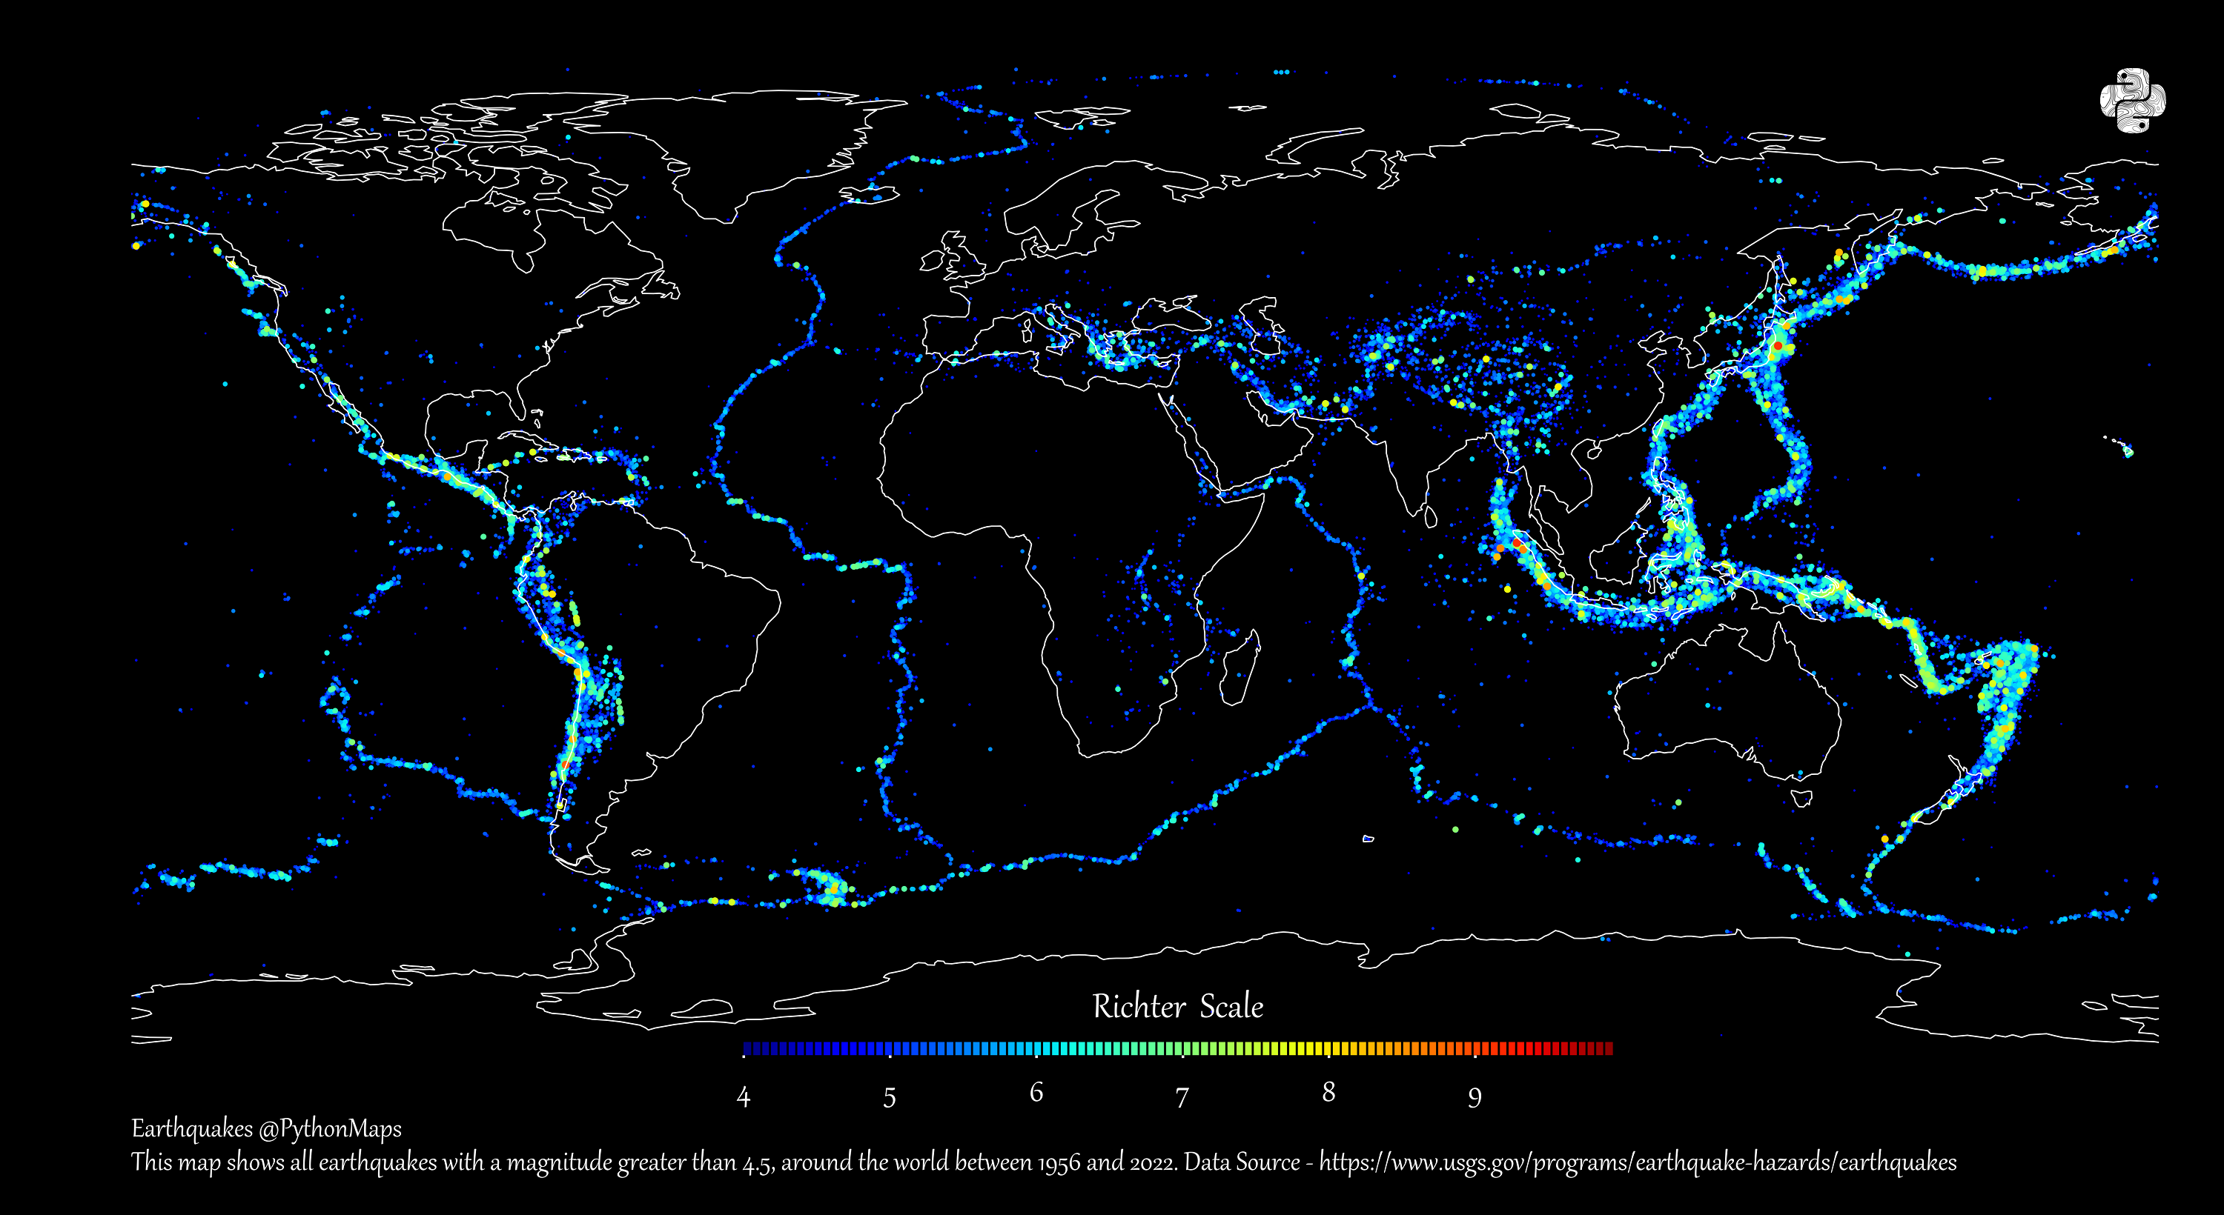
Mapping The World’s Major Earthquakes from 1956‒2022:

Slide 23
METHODOLOGY

Slide 24
Data Collection and Preparation
The first step in earthquake forecasting is to collect and prepare the data.
This involves gathering seismic data from various sources and cleaning and preprocessing the data to remove noise and other anomalies.
Python provides powerful tools for data cleaning and preparation.

Slide 25
Feature Extraction and Selection
Once the data is cleaned and prepared, the next step is to extract relevant features from the data.
This involves identifying patterns and trends in the data that can be used to predict earthquakes.
Python provides a range of tools for feature extraction and selection, including statistical analysis and machine learning algorithms.

Slide 26
Building Machine Learning Models
Machine learning models can be used to predict earthquakes based on the extracted features.
Python provides a range of machine learning libraries, including scikit-learn and TensorFlow, that can be used to build and train these models.
These models can then be used to make predictions on new data.

Slide 27
Future Directions
As technology and data collection methods continue to improve, there is great potential for data-driven approaches to revolutionize earthquake forecasting. By combining traditional methods with machine learning and other data analysis techniques, we can improve our ability to predict earthquakes and mitigate their impact on communities.

Slide 28

TOOLS

Slide 29
1.Numpy and Pandas 2.Matplotlib and Seaborn 3.SciPy 4.Scikit-learn 5.TensorFlow or PyTorch 6.ObsPy 7.Generic Mapping Tools 8.Jupyter Notebook 9.GIS Software 10.Data Sources

Slide 30

CONCLUSION

Slide 31
In conclusion, data-driven approaches using Python can provide valuable insights into earthquake forecasting. By leveraging the power of machine learning and other data analysis techniques, we can improve our ability to predict earthquakes and reduce their impact on communities. It is important to continue to refine and improve these methods to better prepare for future earthquakes.

Slide 32
Thanks!

