Slide 1
Project Inception Mavs abroad Japan
CSE 3311 – 001
Prof. Csallner
Prof. Aiken
By
Dylan Dinh
Amay Kadakia
Shubhayu Shrestha

Slide 2
Vision
Our goal is to build a progressive web app for Dr. Aiken’s study abroad trip to Japan. The app should provide daily itineraries, maps with directions, hotel/location information, emergency contacts, and image sharing. It should also be able to seamlessly integrate as an Android, iOS, and desktop web application.

Slide 3
Project Proposition
MavsAbroad
Create a convenient and easy to navigate application for Professor Aiken’s UTA Japan Study Abroad students in order to have an organized and safe experience.
This application is also planned to be made open source in order to be used by future Study Abroad students for different locations.
Problem Statement
Students do not have a central source to gain information about the trip and do not have easy access to an itinerary as well as stable internet connection throughout the day.

Slide 4
Features
Access the application without internet connection
Students can view:
A map with directions
An itinerary with details about the different locations
Emergency Information / Contacts
Upload and host images
Administrators can:
Update itinerary and other features

Slide 5



Technical Specifications
Frontend – Wordpress
Database – Firebase
No backend required
Version Control – GitHub
https://github.com/shubshres/CSE-3311-Team-4
Maps – Google Maps
UI Design – Figma
Use Case Design – LucidChart
[1] Wordpress Logo
[2] Google Maps Logo
[3] Google Firebase Logo

Slide 6
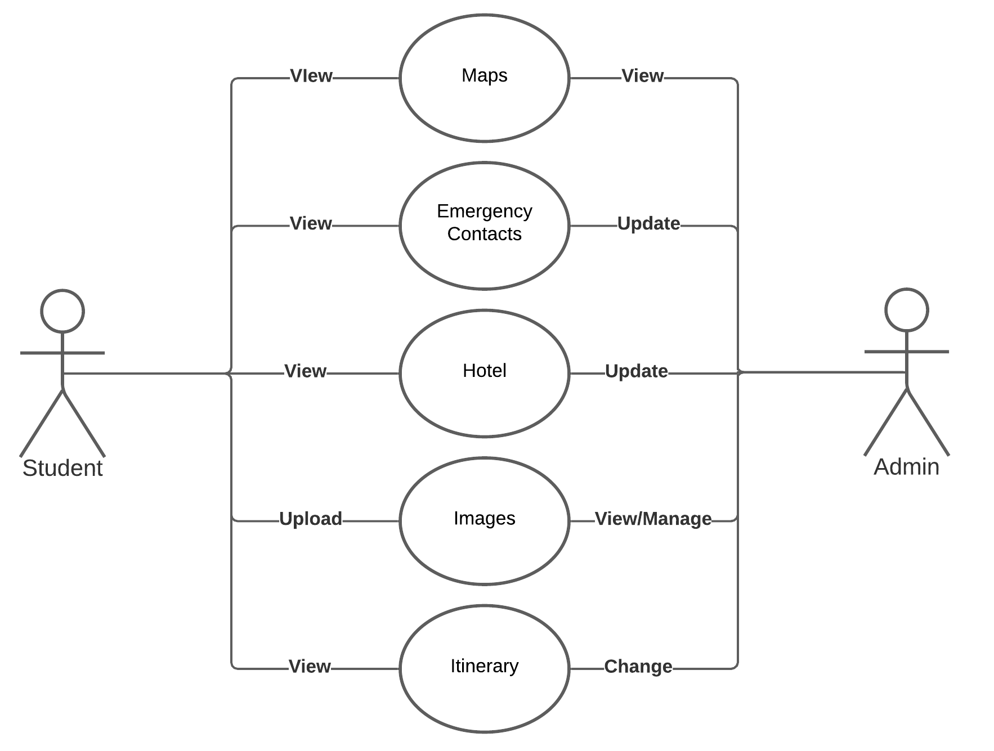
Use Case

Slide 7
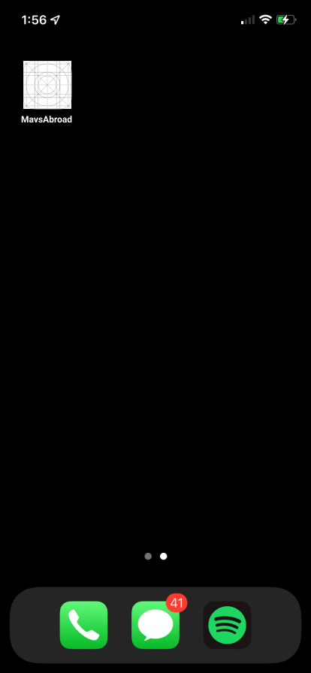
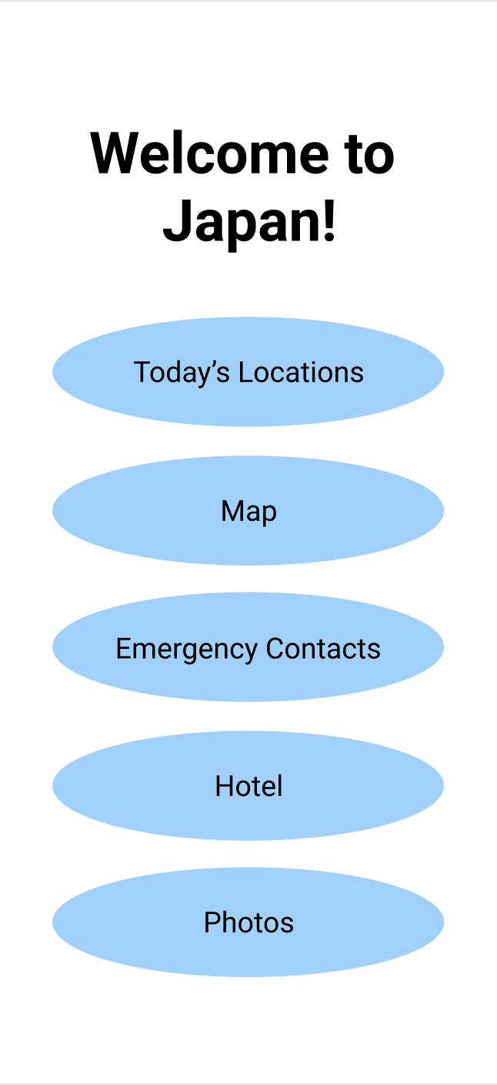
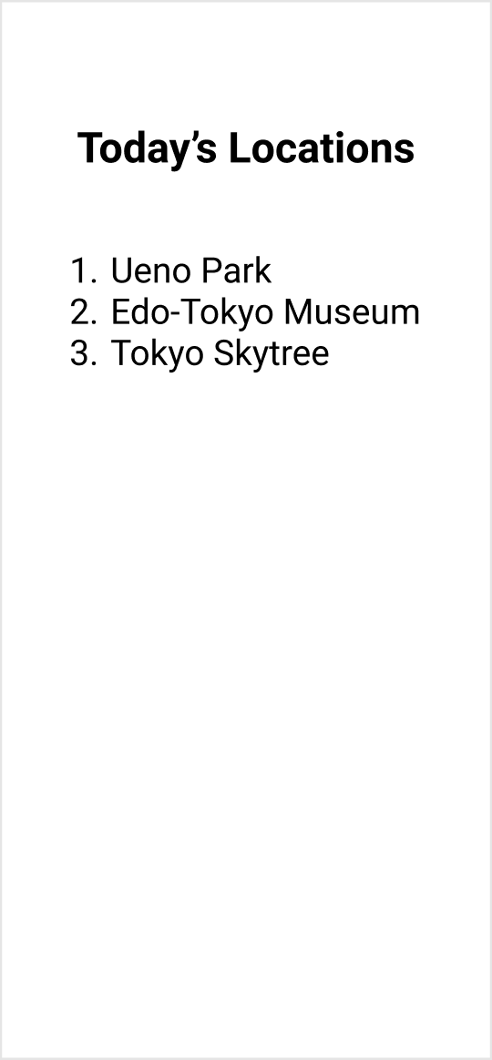
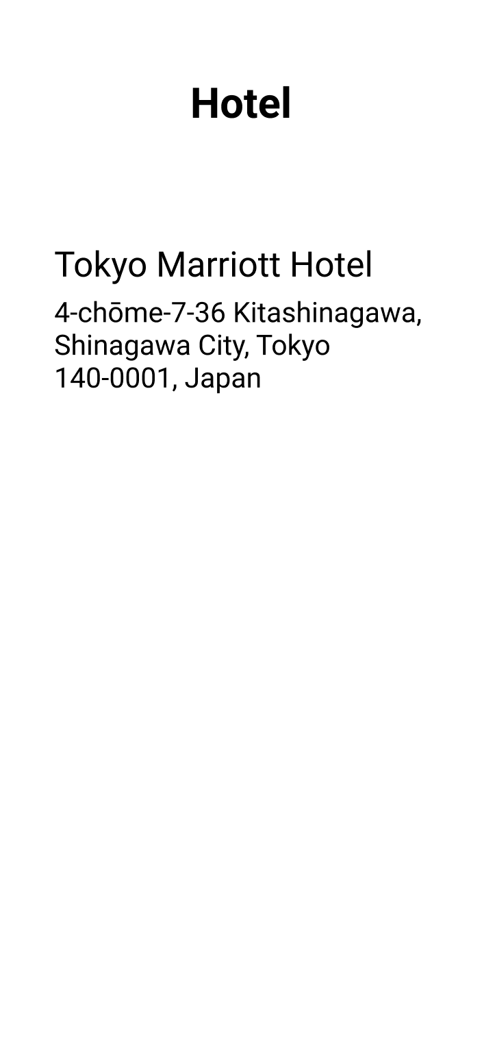
UI Interface

Slide 8
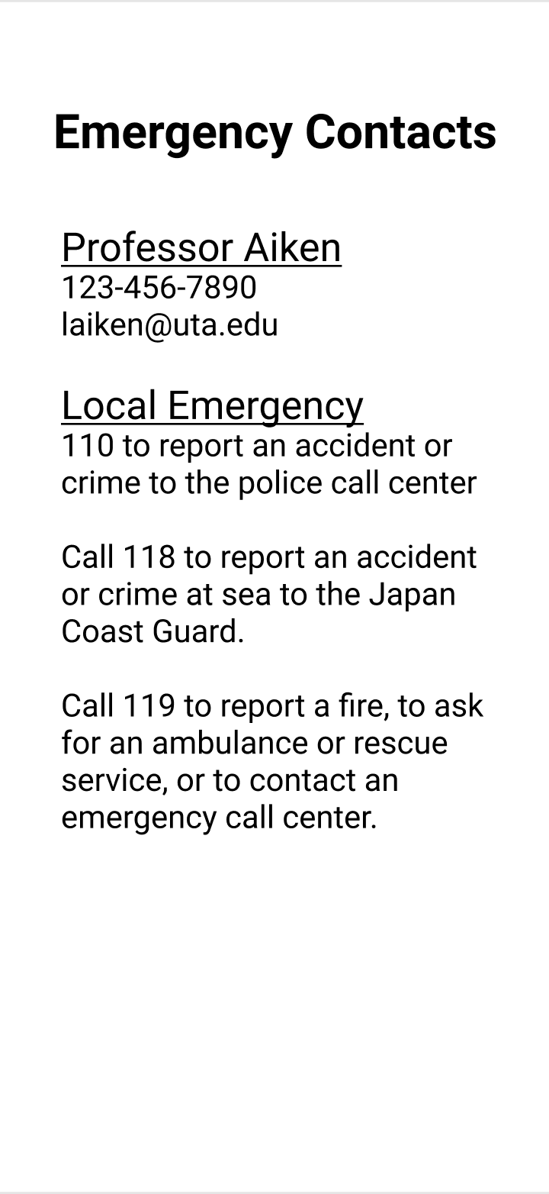
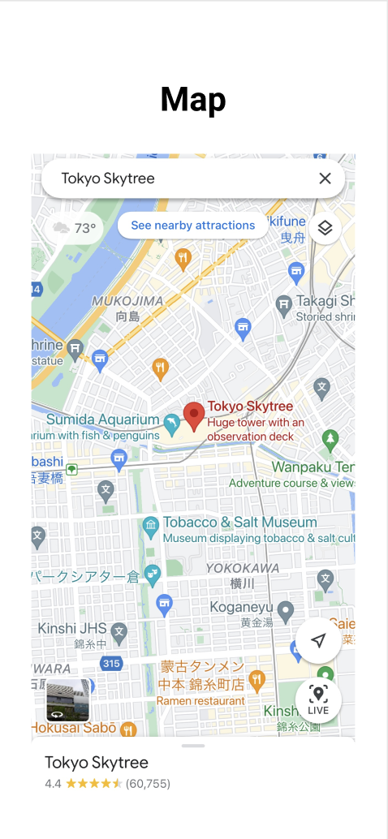

UI Interface
[4] Emergency Contact Information
[5] Screenshot of Google Maps

Slide 9
Risks
Risk: Inability to meet in person causes inefficiency as it is harder to coordinate times and meetings.
Management: We created a Microsoft Teams chat as well as a GroupMe to stay connected and post updates about our projects progress. We also have committed to making weekly goals for this projects and meeting every week to showcase our progress.

Slide 10
Risks
Risk: A team member could drop the course, which would cause the workload to be much more demanding as our group consists of three members.
Management: As a team, we have discussed our workload and have demonstrated a commitment to this class and project and are planning to work ahead of schedule in order to mitigate the stress if we were to fall behind.

Slide 11
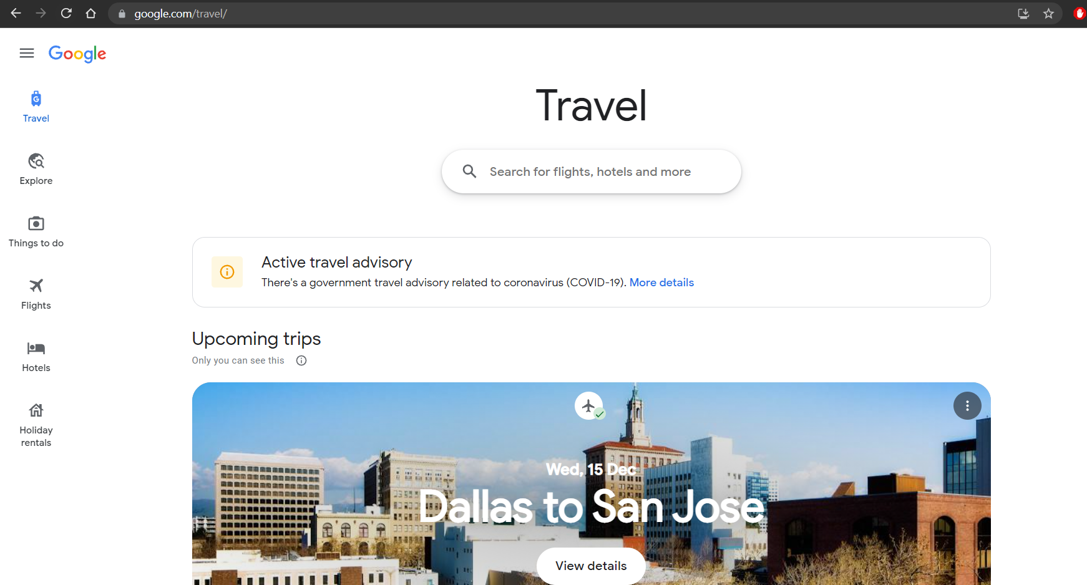
Competition
Google Travel
Does not allow for group itineraries
No central location to post important details or announcements for a group trip.
Designed for making individual trips.
Only a website – Lacks an application
Unable to access offline
Wanderlog
Lacks a collaborative itinerary
No interaction between other students
[6] Screenshot of the Google Trips website.

Slide 12
Citations
[1] https://en.wikiversity.org/wiki/Wordpressk as of September 11, 2021
[2] https://en.wikipedia.org/wiki/File:Google_Maps_Logo_2020.svg, as of September 11, 2021
[3] http://arduino.vn/bai-viet/77-bai-2-cach-lam-den-led-nhap-nhay-theo-yeu-cau, as of September 11, 2021
[4] https://tabunka.tokyo-tsunagari.or.jp/guide_eng/kinkyu/01.html, as of September 12, 2021
[5] https://apps.apple.com/us/app/google-maps/id585027354, as of September 12, 2021
[6] https://www.google.com/travel/, as of September 11, 2021

